Slide 1
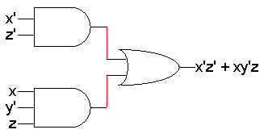
Karnaugh maps
Last time we saw applications of Boolean logic to circuit design.
  The basic Boolean operations are AND, OR and NOT.
  These operations can be combined to form complex expressions, which can also be directly translated into a hardware circuit.
  Boolean algebra helps us simplify expressions and circuits.
Today we’ll look at a graphical technique for simplifying an expression into a minimal sum of products (MSP) form:
  There are a minimal number of product terms in the expression.
  Each term has a minimal number of literals.
Circuit-wise, this leads to a minimal two-level implementation.
February 2, 2004
CS 231

Slide 2
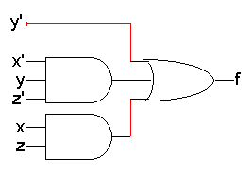
Review: Standard forms of expressions
We can write expressions in many ways, but some ways are more useful than others
A sum of products (SOP) expression contains:
  Only OR (sum) operations at the “outermost” level
  Each term that is summed must be a product of literals
The advantage is that any sum of products expression can be implemented using a two-level circuit
  literals and their complements at the “0th” level
  AND gates at the first level
  a single OR gate at the second level
This diagram uses some shorthands…
  NOT gates are implicit
  literals are reused
  this is not okay in LogicWorks!
f(x,y,z) = y’ + x’yz’ + xz
February 2, 2004
CS 231

Slide 3
Terminology: Minterms
A minterm is a special product of literals, in which each input variable appears exactly once.
A function with n variables has 2^{n} minterms (since each variable can appear complemented or not)
A three-variable function, such as f(x,y,z), has 2³ = 8 minterms:
Each minterm is true for exactly one combination of inputs:
x’y’z’ x’y’z x’yz’ x’yz
xy’z’ xy’z xyz’ xyz
Minterm Is true when… Shorthand
x’y’z’ x=0, y=0, z=0 m₀
x’y’z x=0, y=0, z=1 m₁
x’yz’ x=0, y=1, z=0 m₂
x’yz x=0, y=1, z=1 m₃
xy’z’ x=1, y=0, z=0 m₄
xy’z x=1, y=0, z=1 m₅
xyz’ x=1, y=1, z=0 m₆
xyz x=1, y=1, z=1 m₇
February 2, 2004
CS 231

Slide 4
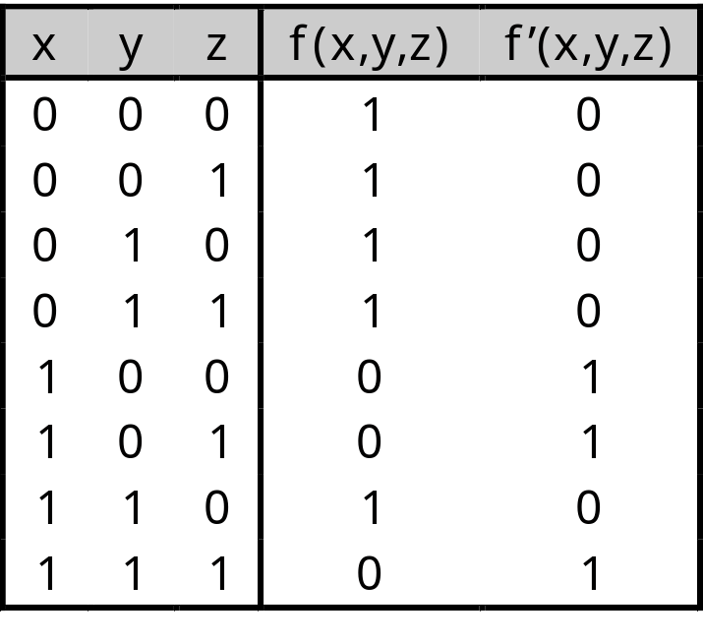
Terminology: Sum of minterms form
Every function can be written as a sum of minterms, which is a special kind of sum of products form
The sum of minterms form for any function is unique
If you have a truth table for a function, you can write a sum of minterms expression just by picking out the rows of the table where the function output is 1.
f = x’y’z’ + x’y’z + x’yz’ + x’yz + xyz’
= m₀ + m₁ + m₂ + m₃ + m₆
= Σm(0,1,2,3,6)
f’ = xy’z’ + xy’z + xyz
= m₄ + m₅ + m₇
= Σm(4,5,7)
f’ contains all the minterms not in f
February 2, 2004
CS 231

Slide 5
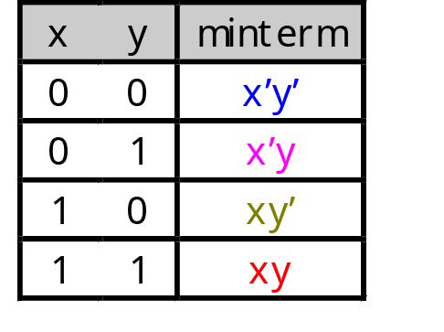
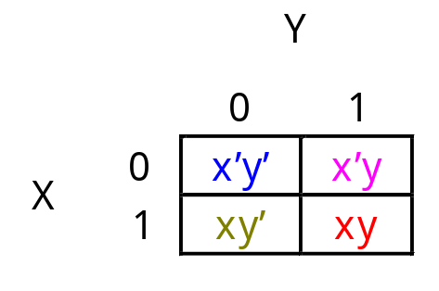
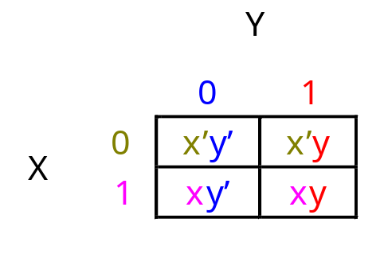
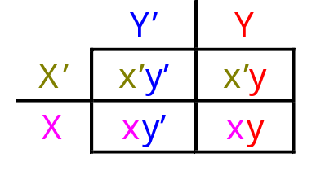
Re-arranging the truth table
A two-variable function has four possible minterms. We can re-arrange these minterms into a Karnaugh map.
Now we can easily see which minterms contain common literals.
  Minterms on the left and right sides contain y’ and y respectively.
  Minterms in the top and bottom rows contain x’ and x respectively.
February 2, 2004
CS 231

Slide 6
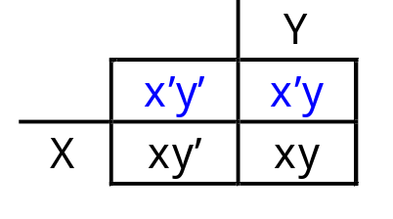
Karnaugh map simplifications
Imagine a two-variable sum of minterms:
x’y’ + x’y
Both of these minterms appear in the top row of a Karnaugh map, which means that they both contain the literal x’.
What happens if you simplify this expression using Boolean algebra?
x’y’ + x’y = x’(y’ + y) [ Distributive ]
= x’ • 1 [ y + y’ = 1 ]
= x’ [ x • 1 = x ]
February 2, 2004
CS 231

Slide 7
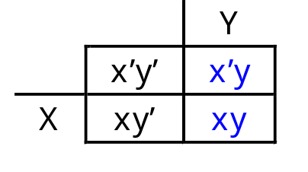
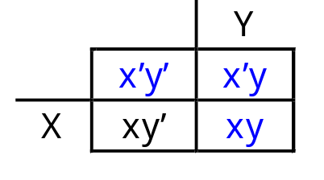
More two-variable examples
Another example expression is x’y + xy.
  Both minterms appear in the right side, where y is uncomplemented.
  Thus, we can reduce x’y + xy to just y.
How about x’y’ + x’y + xy?
  We have x’y’ + x’y in the top row, corresponding to x’.
  There’s also x’y + xy in the right side, corresponding to y.
  This whole expression can be reduced to x’ + y.
February 2, 2004
CS 231

Slide 8
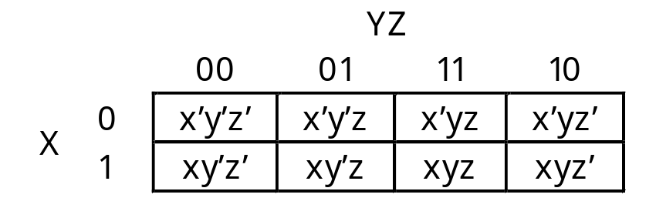
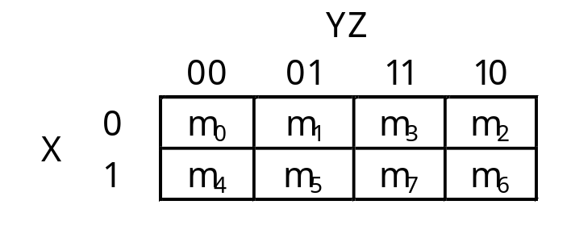
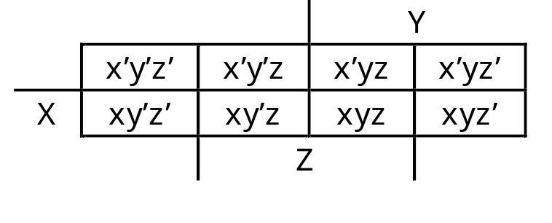
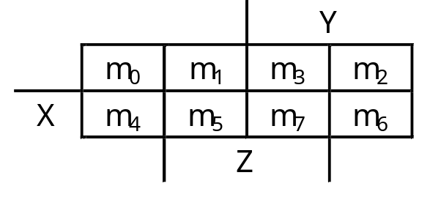
A three-variable Karnaugh map
For a three-variable expression with inputs x, y, z, the arrangement of minterms is more tricky:
Another way to label the K-map (use whichever you like):
February 2, 2004
CS 231

Slide 9
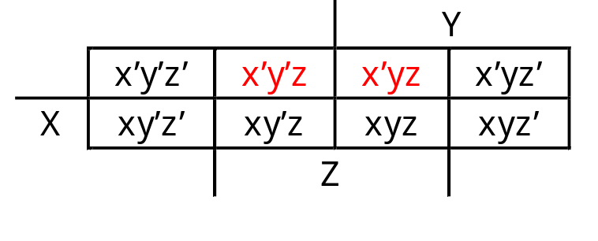
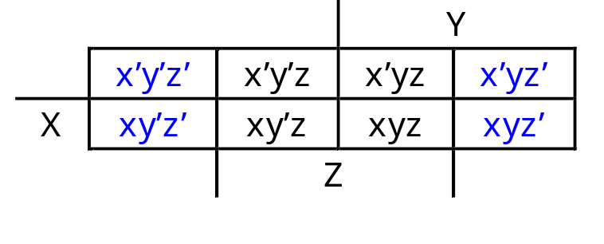
Why the funny ordering?
With this ordering, any group of 2, 4 or 8 adjacent squares on the map contains common literals that can be factored out.
“Adjacency” includes wrapping around the left and right sides:
We’ll use this property of adjacent squares to do our simplifications.
x’y’z + x’yz
= x’z(y’ + y)
= x’z • 1
= x’z
  x’y’z’ + xy’z’ + x’yz’ + xyz’
  = z’(x’y’ + xy’ + x’y + xy)
  = z’(y’(x’ + x) + y(x’ + x))
  = z’(y’+y)
  = z’
February 2, 2004
CS 231

Slide 10
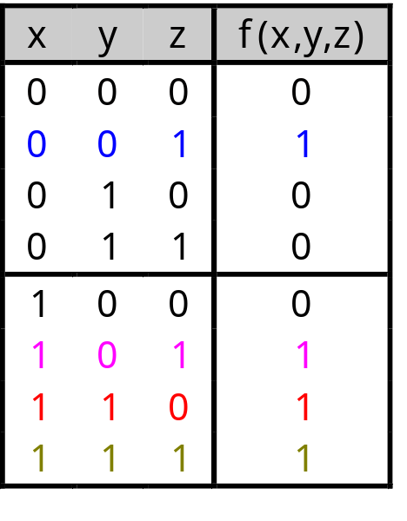
Example K-map simplification
Let’s consider simplifying f(x,y,z) = xy + y’z + xz.
First, you should convert the expression into a sum of minterms form, if it’s not already.
  The easiest way to do this is to make a truth table for the function, and then read off the minterms.
  You can either write out the literals or use the minterm shorthand.
Here is the truth table and sum of minterms for our example:
f(x,y,z) = x’y’z + xy’z + xyz’ + xyz
= m₁ + m₅ + m₆ + m₇
February 2, 2004
CS 231

Slide 11
Unsimplifying expressions
You can also convert the expression to a sum of minterms with Boolean algebra.
  Apply the distributive law in reverse to add in missing variables.
  Very few people actually do this, but it’s occasionally useful.
In both cases, we’re actually “unsimplifying” our example expression.
  The resulting expression is larger than the original one!
  But having all the individual minterms makes it easy to combine them together with the K-map.
xy + y’z + xz = (xy • 1) + (y’z • 1) + (xz • 1)
= (xy • (z’ + z)) + (y’z • (x’ + x)) + (xz • (y’ + y))
= (xyz’ + xyz) + (x’y’z + xy’z) + (xy’z + xyz)
= xyz’ + xyz + x’y’z + xy’z
February 2, 2004
CS 231

Slide 12
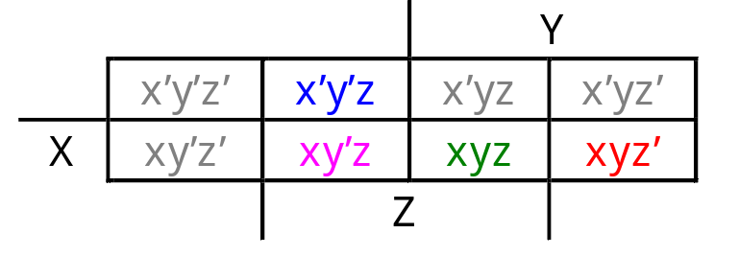
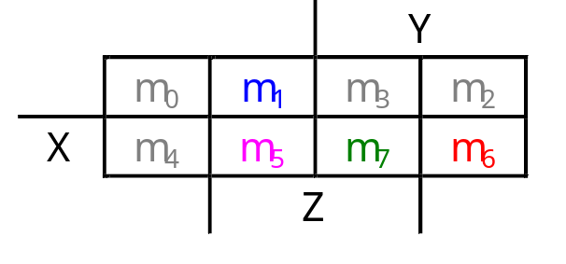
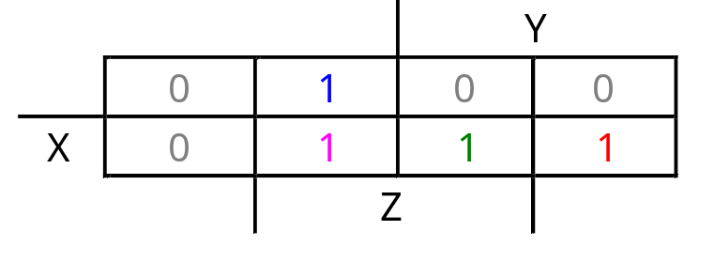
Making the example K-map
Next up is drawing and filling in the K-map.
  Put 1s in the map for each minterm, and 0s in the other squares.
  You can use either the minterm products or the shorthand to show you where the 1s and 0s belong.
In our example, we can write f(x,y,z) in two equivalent ways.
In either case, the resulting K-map is shown below.
f(x,y,z) = x’y’z + xy’z + xyz’ + xyz
f(x,y,z) = m₁ + m₅ + m₆ + m₇
February 2, 2004
CS 231

Slide 13
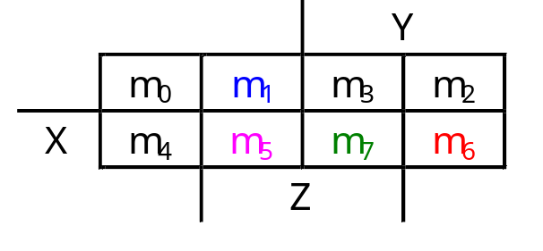
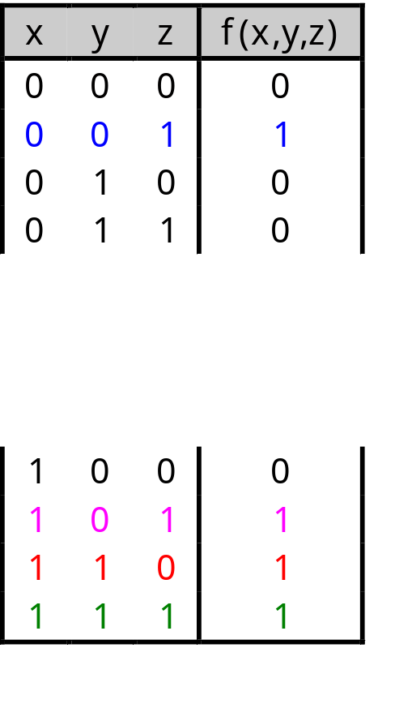
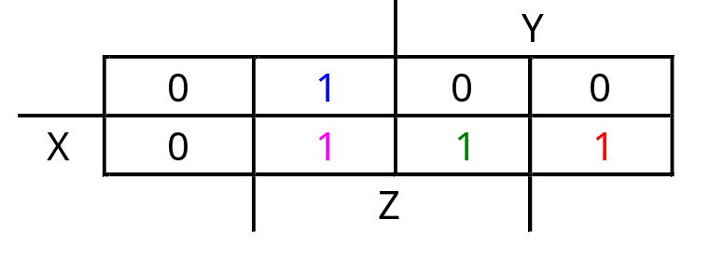
K-maps from truth tables
You can also fill in the K-map directly from a truth table.
  The output in row i of the table goes into square m_{i} of the K-map.
  Remember that the rightmost columns of the K-map are “switched.”
February 2, 2004
CS 231

Slide 14
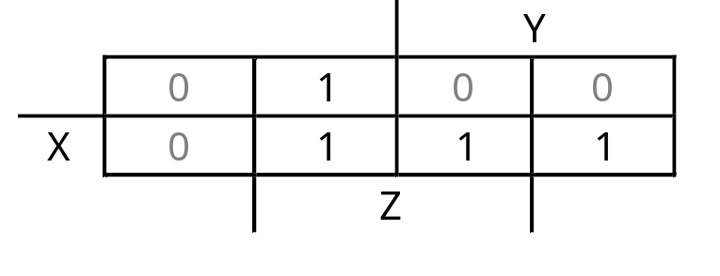
Grouping the minterms together
The most difficult step is grouping together all the 1s in the K-map.
  Make rectangles around groups of one, two, four or eight 1s.
  All of the 1s in the map should be included in at least one rectangle.
  Do not include any of the 0s.
Each group corresponds to one product term. For the simplest result:
  Make as few rectangles as possible, to minimize the number of products in the final expression.
  Make each rectangle as large as possible, to minimize the number of literals in each term.
  It’s all right for rectangles to overlap, if that makes them larger.
February 2, 2004
CS 231

Slide 15
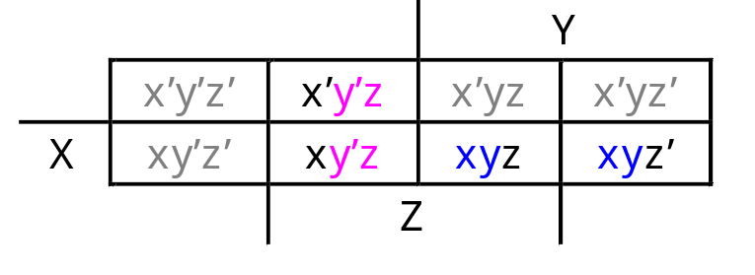
Reading the MSP from the K-map
Finally, you can find the MSP.
  Each rectangle corresponds to one product term.
  The product is determined by finding the common literals in that rectangle.
For our example, we find that xy + y’z + xz = y’z + xy. (This is one of the additional algebraic laws from last time.)
February 2, 2004
CS 231

Slide 16
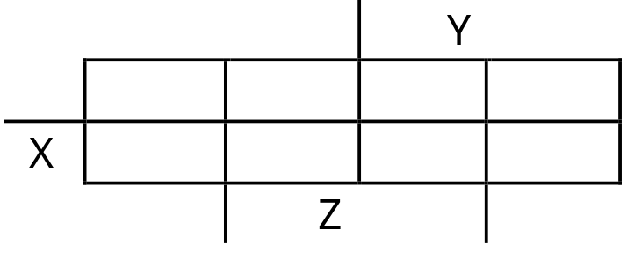
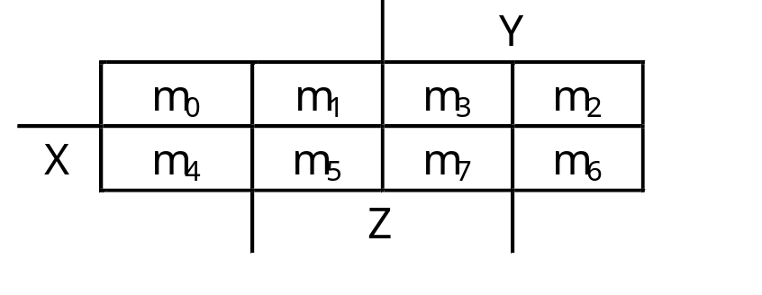
Practice K-map 1
Simplify the sum of minterms m₁ + m₃ + m₅ + m₆.
February 2, 2004
CS 231

Slide 17
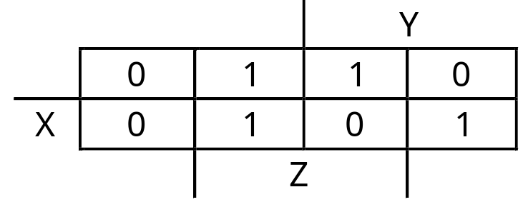
Solutions for practice K-map 1
Here is the filled in K-map, with all groups shown.
  The magenta and green groups overlap, which makes each of them as large as possible.
  Minterm m₆ is in a group all by its lonesome.
The final MSP here is x’z + y’z + xyz’.
February 2, 2004
CS 231

Slide 18
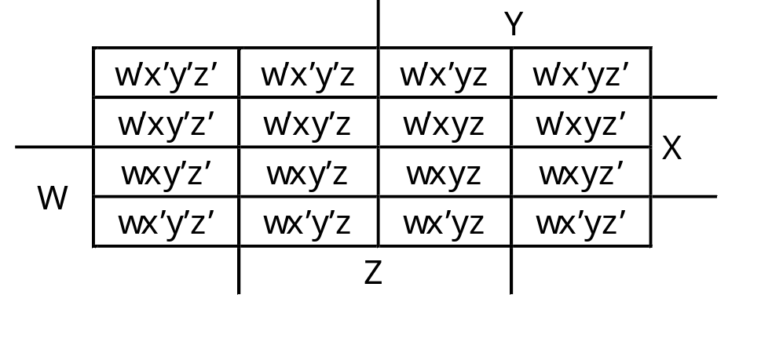
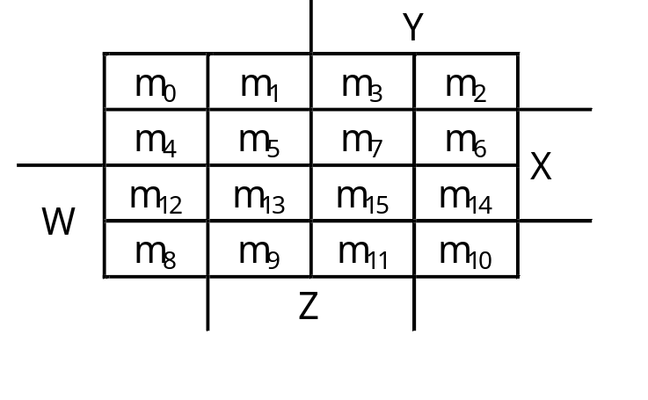
Four-variable K-maps
We can do four-variable expressions too!
  The minterms in the third and fourth columns, and in the third and fourth rows, are switched around.
  Again, this ensures that adjacent squares have common literals.
Grouping minterms is similar to the three-variable case, but:
  You can have rectangular groups of 1, 2, 4, 8 or 16 minterms.
  You can wrap around all four sides.
February 2, 2004
CS 231

Slide 19
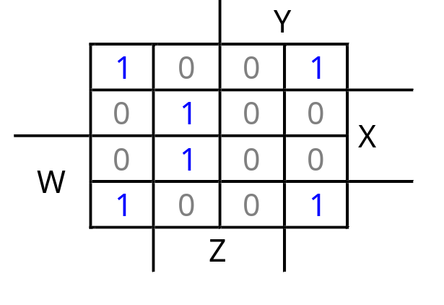
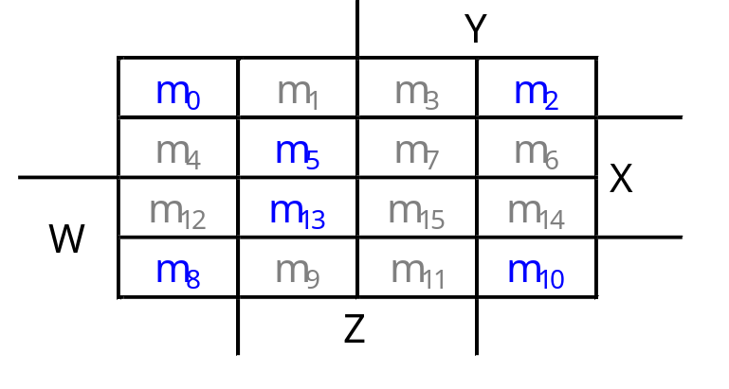
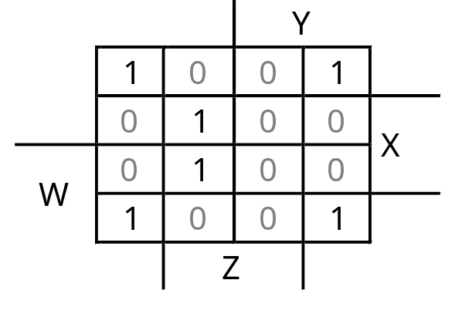
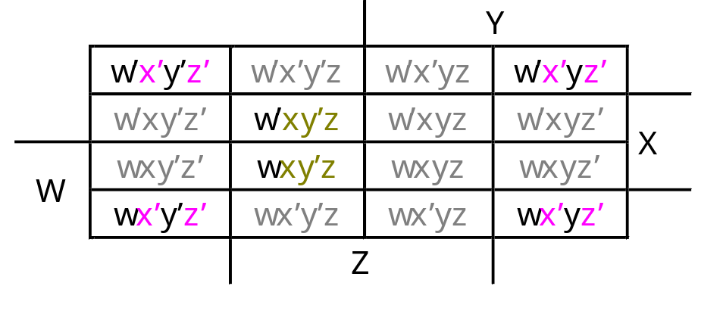
Example: Simplify m₀+m₂+m₅+m₈+m₁₀+m₁₃
The expression is already a sum of minterms, so here’s the K-map:
We can make the following groups, resulting in the MSP x’z’ + xy’z.
February 2, 2004
CS 231

Slide 20
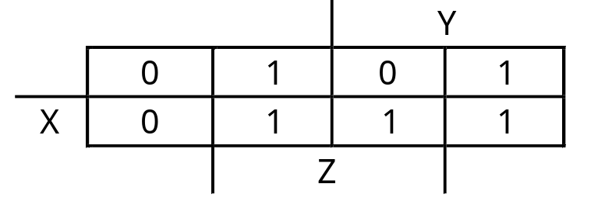
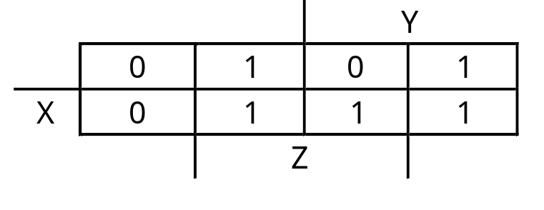

K-maps can be tricky!
There may not necessarily be a unique MSP. The K-map below yields two valid and equivalent MSPs, because there are two possible ways to include minterm m₇.
Remember that overlapping groups is possible, as shown above.
y’z + yz’ + xy
y’z + yz’ + xz
February 2, 2004
CS 231

