Slide 1
INTRODUCTION TO Engineering Ethics
NAZIA HOSSAIN
LECTURER, DEPT OF CSE

Slide 2
Definitions
Etiquette
Laws
Morals
Ethics
Moral Reasoning
Character

Slide 3
Definitions
Etiquette
rules of acceptable personal behavior and courtesy
e.g. proper dress, answering the phone, language, talking about others
Laws
a system of rules and punishments clearly defined
e.g. legal driving age or driving license

Slide 4
Definitions
Morals
– personal rules of right and wrong behavior
– e.g. derived from a person’s upbringing, religious
beliefs
Ethics
– a code or system of rules defining moral behavior
for a particular society

Slide 5
Differences
Morals | Ethics
Social in Nature Based on Customs Accepted by religious/cultural institutions General principles (Friends & Family) Narrow Scope | Personal in Nature Based on Personal Aspects Personally accepted Personal principles(own) Wider scope

Slide 6
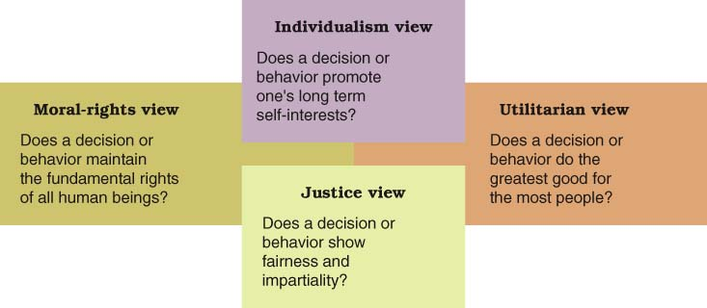
Moral Reasoning
Moral Reasoning
Reasons for various ethical practices
Notes:
Here are four different ways of determining whether something is right or wrong.

Slide 7
Character
“Character is like a tree and reputation like its shadow. The shadow is what we think of it, the tree is real thing.”
Character is the inherent complex of attributes that determine a persons moral and ethical actions and reactions.
Abraham Linclon

Slide 8
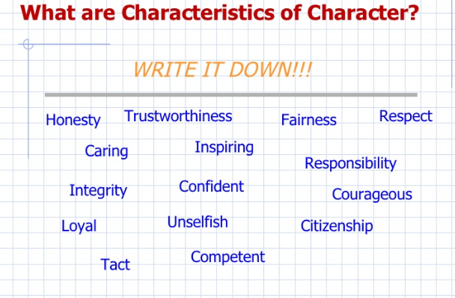
Characteristics of Character

Slide 9
Ethics
“ethika” in Greek means “character”.
What do we mean by Ethics?
“a body of moral principles”
A set of rules and behaviors
Standards, rules and guidelines
Socially approved conduct
Respect for people and rights
Distinguished from matters of legality

Slide 10
Ethics
In the literal context, ethics can be defined as “ a body of
moral principles”. Ethical rules are very much like laws or standards that govern social and professional interactions. Ethical behavior may broadly be equated with the respect for one’s colleagues, and for their rights.
Of course, ethical rules do not have the force of law. The sanctions against unethical behavior are much less formal. Unethical behavior may lead to the loss of an individual’s reputation for professional conduct or the loss of a professional engineering license.

Slide 11
An Ethic Based on Individuals
Individuals:
Have equal political rights
Deserve to be treated fairly
Have the right to live as they want, as long as they do not harm the rights of others
This includes the right to live badly
A good society is one that treats individuals fairly and protects their rights. This requires:
Efficient, non-corrupt government and business
A clean, non-toxic environment

Slide 12
An Ethic Based on Relationships, Family and Community
Relationships, Families, and Communities require
Loyalty
Honor
Friendship
Humility
Self-sacrifice
A clean, non-toxic environment
A good individual has the qualities that promote stable, long-lasting relationships, families, and communities.

Slide 13
Why should I study Ethics?
Logically whenever we’re thinking about professionalism, we link it to high standards, technically & ethically.
Professional without standards is not professional
Mostly ethical people are professional. So, professionalism & ethics comes together (integrated).
Ethics
Professionalism
Ethics
professionalism

Slide 14
Why should I study Ethics?
Moral awareness: Proficiency in recognizing moral problems and issues in engineering
Moral coherence: Forming consistent and comprehensive viewpoints based on consideration of relevant facts
Moral imagination: Discerning alternative responses to moral issues and finding creative solutions for practical difficulties
Moral communication: Precision in the use of a common ethical language, a skill needed to express and support one’s moral views adequately to others .

Slide 15
Why should I study Ethics?
Moral reasonableness: The willingness and ability to be morally reasonable
Respect for persons: Genuine concern for the well-being of others as well as oneself
Tolerance of diversity: Within a broad range, respect for ethnic and religious differences and acceptance of reasonable differences in moral perspectives
Moral hope: Enriched appreciation of the possibilities of using rational dialogue in resolving moral conflicts
Integrity: Maintaining moral integrity and integrating one’s professional life and personal convictions

Slide 16
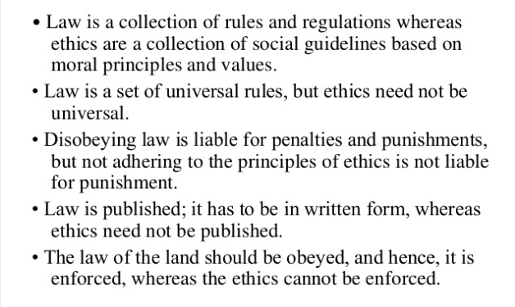
Difference between Law and ethics

Slide 17
Relationship between Ethics and Law
The relationship between ethics and law leads to four possible states
Legal Not Legal
Ethical
I
I I
Not Ethical
III
IV

Slide 18
Some Examples of the Four Categories
Ethical and Legal
Firing an individual who does not perform according to expectations or who fails to follow certain contractual obligations
Increasing the price of goods when the demand for those goods increases
Ethical but not Legal
Copying copyrighted software to use only as a backup, even when the copyright agreement specifically prohibits copying for that purpose

Slide 19
Examples Continued
III. Not Ethical but Legal
Revealing data that was expected to remain confidential – for example, gossiping by data entry operators, about the salary data they are processing
Using a pirated version of a software product in a foreign country that has no software copyright laws
IV. Not Ethical and Not Legal
Pirating copyrighted software
Planting viruses in someone else’s computer system

Slide 20
Four Categories Conclusion
We’ll cover these useful ideas next
When law does not provide an answer, as in categories II and IV, it becomes necessary to consider the ethical situation by using informal or formal guidelines.

Slide 21
What Is Profession?
Engineering practice can be defined as a “profession” , as opposed to an “occupation” or “job” ,A profession has the following attributes:
Work requires sophisticated skills, judgment, and exercise of discretion(work is not routine)
Membership in the profession requires formal
education

Slide 22
What Is Profession?
Special societies (controlled by members of the profession) establish standards for admission into the profession and conduct of its members
Significant positive public service results from the practice of the profession

Slide 23
Is Engineering a profession?
Engineering is a profession, but differs from law and medicine in the following ways:
Most engineers are not self-employed, but work for large companies (the exceptions include civil engineers and consulting engineers)
Education is different: only a BS degree is required to practice engineering
Engineering societies are not as powerful as the AMA or ABA, since BS degree holders can practice engineering without a Professional License

Slide 24
Professional Ethics
Professional Ethics is the set of standards adopted by professionals
insofar as they see themselves acting as professionals.
Personal Ethics is the set of one’s own ethical commitments , usually given in early home or religious training and often modified by later reflection.
Common Morality is the set of moral ideals shared by most
members of a culture or society.
Who decides
Standards adopted by professional community and established companies
NSPE, ASME, ASCE,IEEE etc
May conflict with personal ethics
Case studies used to set examples, standards
10

Slide 25
First Topic on Professionalism, Professional Ethics
• Think of this as being “on the job”
– You like your job, you want to be promoted, you want a raise
– You are concerned about how your colleagues view you
• View this as a meeting that you have to be at each week
– Be on time, listen, do not do other things
– Get involved !
• DO NOT BE LATE. It is quite unprofessional… do not
sneak in!!! How would your colleagues view this? Your
boss?
• DO NOT CHEAT
– Don’t cheat on attendance sheets

Slide 26
Academic Integrity, Undergraduate Students, Graduate Students
Cheating: Intentionally violating the rules of fair play in any academic exercise, for example, by using crib notes, copying from another student during a test.

Slide 27
Cheating vs. Teamwork
Working on a team for an assigned project is not cheating.
However, failing do due your assigned task on an a team project is a form of cheating. It is called free-riding, which is benefiting from the work of others without doing any work of your own.
Teamwork is important in engineering, but free-riding is wrong, since if everyone did it nothing would get done.

Slide 28
Copying
One obvious type of cheating that we all recognize is copying someone’s work on a homework assignment, exam, or paper.
May discuss, but must turn in all your own work
Submitting someone’s work as your own is a kind of cheating.

Slide 29
Multiple Submissions
Submitting your own work from one class to another class or submitting one piece of work to two distinct classes is a kind of cheating.
A paper for one class is not a paper for another class.

Slide 30
Unauthorized Sources
Using sources that one is not allowed to use as deemed by the instructor or the university as a whole is a kind of cheating, such as solution manuals.
Also a text message from your friend with the answer to a question on the exam is a form of cheating.

Slide 31
Surrogate
Surrogate cheating occurs when someone else either does your homework, takes an exam for you, or writes your paper.
Doing someone’s work for them is a kind of cheating.

Slide 32
Cheating is Wrong?
Cheating also undermines the work of fellow students who are honest.
When you cheat, all the other students who didn’t cheat are penalized. They end up getting lower grades. As a consequence of lower grades they lose out on scholarships and recommendations.

Slide 33
Academic Integrity, Undergraduate Students, Graduate Students
Plagiarism: Intentionally/negligently submitting others’ work as one’s own, for example, by quoting the words of others without using quotation marks and citing the source.
Misrepresentation: Intentionally giving false information to an instructor, for example, by lying about why one missed a test.
Failure to contribute to a collaborative project: failing to do one’s fair share on a joint project.
Theft: Stealing, for example, stealing library books or other students’ property.
Don’t cheat on attendance sheets

Slide 34
What students Say
70% of American high school seniors admit to cheating on at least one test
95% of the students who said they cheated were never caught.
An average of 75% of college students report cheating sometime during their college career
Notes:
Cheating in Online Student Assessment: Beyond Plagiarism, Neil C. Rowe 2004

Slide 35
Academic Integrity: Faculty, Implications for Future
Faculty unethical behavior:
Failure to show up for class; condescending
Failure to monitor exams?/report unethical behavior, re-use of old exams?

Slide 36
Important Notes about the Code of Ethics
It is not a legally binding document.
It is not something that we want (or need) engineers to memorize.
It is something we want engineers to understand and be able to live by as engineers.
However, in the beginning knowing the code is a guide to understanding how to apply it.

Slide 37
What we Will Discuss
The code of ethics for engineers.
Practicing ethics as an engineering student.
How to identify and analyze ethical dilemmas through case analysis.
Specific examples of ethical situations you may encounter.

Slide 38


