Slide 1
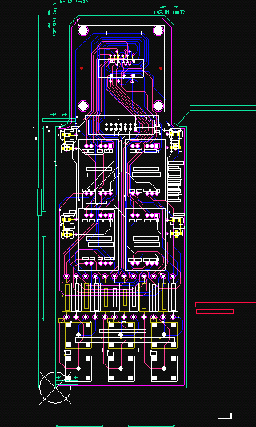
MEASUREMENT SYSTEM ANALYSIS DEMO
-L15 INTEGRATED LOADBOARD PROJECT
28 FEB, 2007
FAISAL

Slide 2
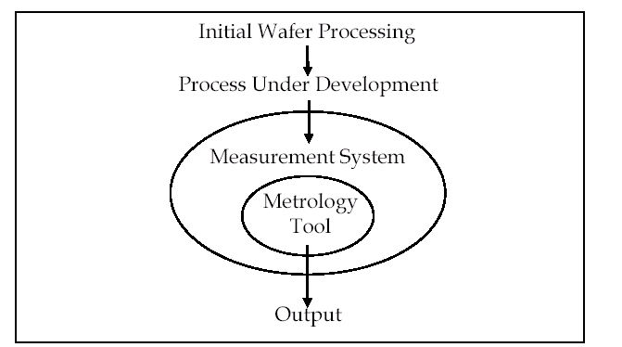
OVERALL OBJECTIVE OF MSA STUDY
D
M
A
D
V
-The objective of this study to perform MSA on automated dc fet tester metrology
tool to quantify the source of variation since a new component(Loadboard) from
supplier BIM technologies has been added to metrology tool which might affect
the performance.
-No intentional hardware or software changes were performed during
the evaluation.
- Also ventured into other data collection areas:
The MSA was done based on the following steps:
Stability
Accuracy (Bias)
Linearity
Precision(Repeatabiity and Reproducibility)

Slide 3
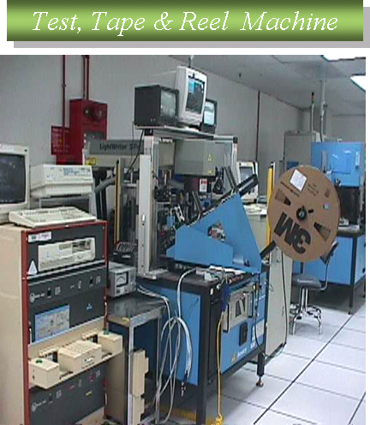
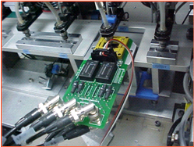
GENERAL N PROCESS SPECIFIC INFORMATION
D
M
A
D
V
The Metrology tool used under study
consist of :-
Measurement Equipment :
a) FET tester to measure the dc parametric
b) ISMECA test handler to load parts into
loadboard ,laser marking and sorting into
tubes or tape n reel.
c) LOADBOARD as an interface between
FET test and device under test.
HIDDEN
Measurement : VDSP,BVGSS,VGS
Process Spec : 1) VDSP = 0 – 800mV
: 2) BVGSS = 4 - 7V
: 3) VGS = 3 – 5 V

Slide 4
1)STABILITY-MSA
D
M
A
D
V
1. Stability
1) STABILITY THEORY
2. Accuracy (Bias)
3. Linearity
4. Precision
Gage stability examines how stable the measurements made from
metrology tools ie is measurement varies a lot time to time, between
part to part or within part when the same part is measured over
time with repeated measurements for each time.
2) SAMPLING PLAN/PROCEDURE-STABILITY
- Manufacturing technician will load the same part for three times in auto
handler per day for total of 6 days (Day 1 to Day 6).
-The three repeated measurements were made per day with current
loadboard(BIM) will be recorded.
- DC parametric data(Vds on) will be recorded.

Slide 5
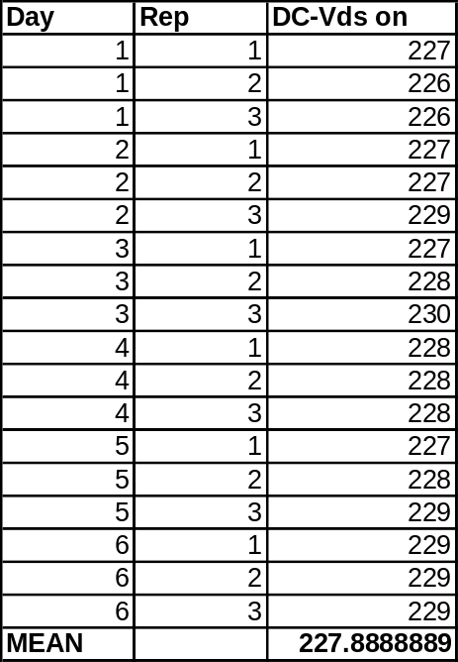
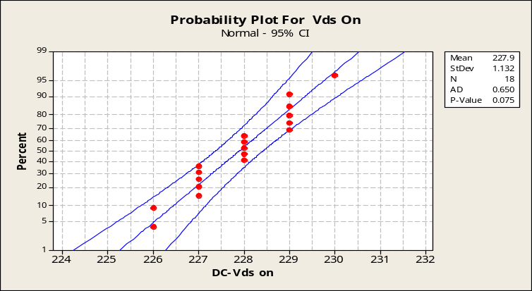
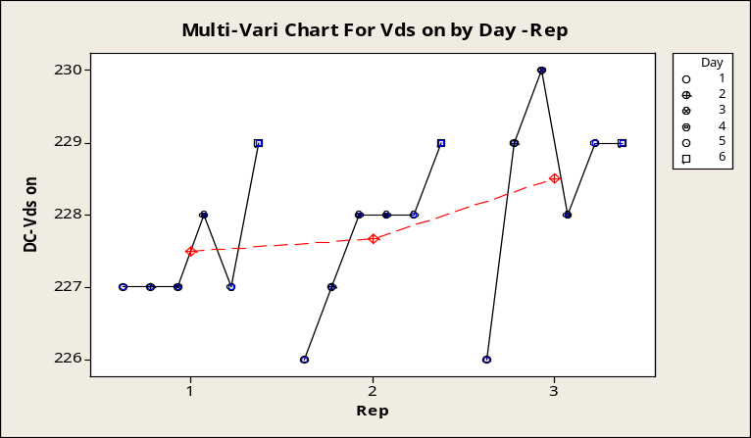
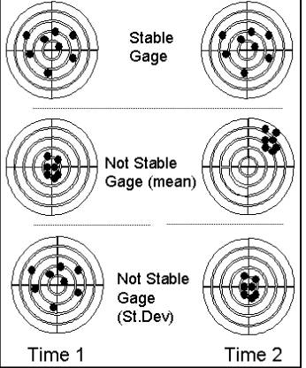
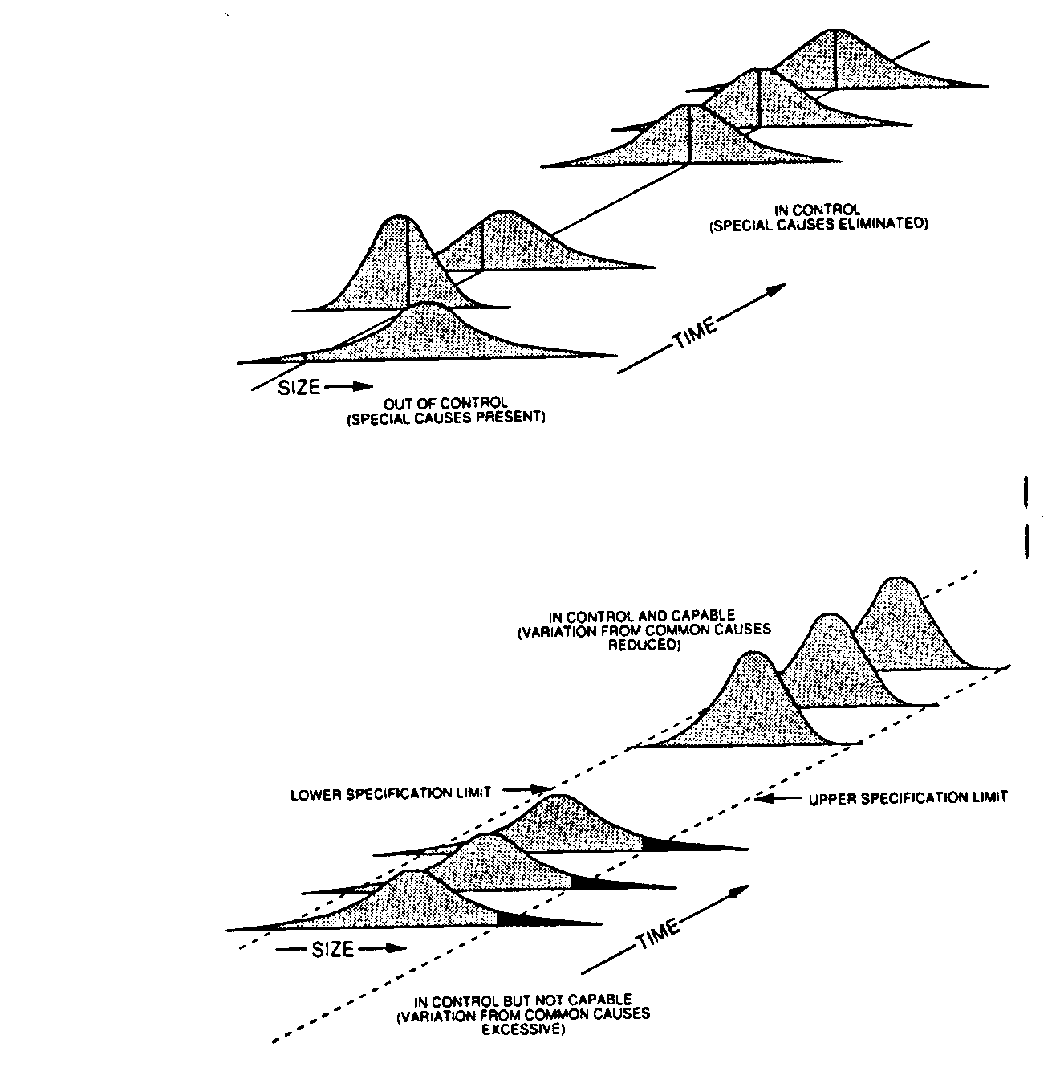
1)STABILITY-MSA
D
M
A
D
V
1. Stability
3) ANALYSIS METHOD/ASSUMPTIONS-MULTIVARI CHART
DC test data on the same part was collected
for day 1 to day 6 and repeated 3 times.
2. Accuracy (Bias)
3. Linearity
4. Precision
P-value > 0.05
The Vds on data is normally distributed
Multi-Vari chart shows there is no variation for Time to Time, between part to part and within part.
Thus , the Vds on data is STABLE

Slide 6
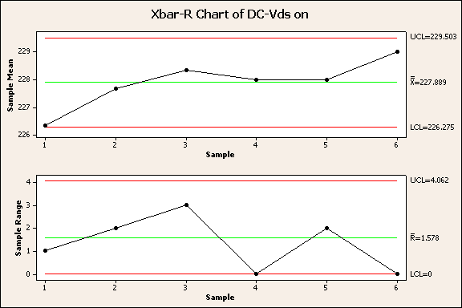
2) STABILITY-MSA
1. Stability
2. Accuracy (Bias)
3) ANALYSIS METHOD/ASSUMPTIONS XBAR –R CHART
3. Linearity
4. Precision
No abnormally shown on Xbar-R chart which indicates that the measurement system is stable.

Slide 7
2) ACCURACY(BIAS) -MSA
D
M
A
D
V
1. Stability
1) BIAS THEORY
2. Accuracy (Bias)
3. Linearity
Gage bias examines the difference between the observed average
measurement and a reference or master value. It answers the question,
"How biased is my gage when compared to a master value?"
4. Precision
2) LINEARITY THEORY
Gage linearity tells you how accurate your measurements are through the expected
range of the measurements. It answers the question, "Does my gage have the same
accuracy for all sizes of objects being measured?"
3) SAMPLING PLAN /PROCEDURE-BIAS AND LINEARITY
-Firstly three golden parts were selected.
-Manufacturing tech. will load each of this golden part in automated dc test
system and repeats for 5 times to make the 5 measurements for each golden
parts.
-Measured data will be recorded and compared against actual
data.

Slide 8
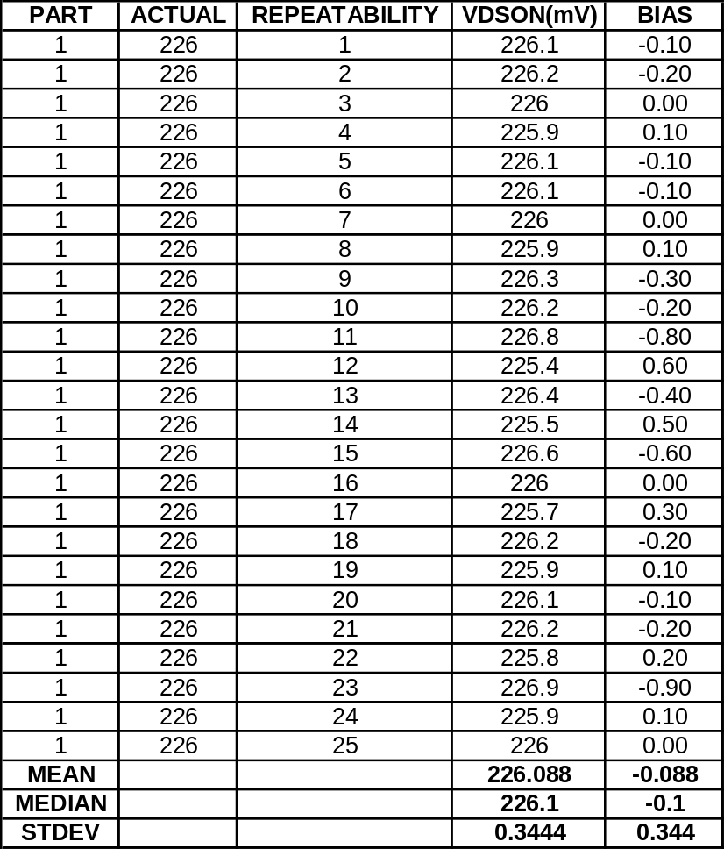
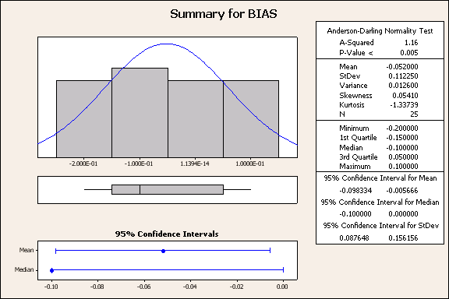
2) ACCURACY(BIAS) -MSA
D
M
A
D
V
1. Stability
In order to test either the measurement system is “Bias” or not, one-sample T-test (two sided) is used.
2. Accuracy (Bias)
1. Test for Independence
H_{O}: Data is order independent
H_{A}: Data is not order independent
3. Linearity
4. Precision
Graphical summary
Median=-0.1
Runs Test: BIAS
Runs test for BIAS
Runs above and below K = -0.1
The observed number of runs = 13
The expected number of runs = 10.12
19 observations above K, 6 below
P-value = 0.101
Conclusion:The observed number of runs, 13, is smaller than the expected number of runs, 10.12. The P-value for the test is 0.101, which is higher than α = 0.05. This result indicates that the data is independent in time order.

Slide 9
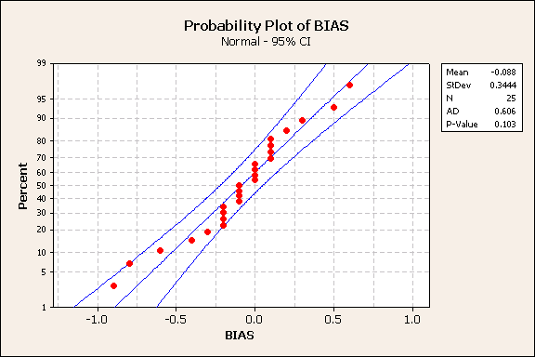
2) ACCURACY(BIAS) -MSA
D
M
A
D
V
1. Stability
2. Test for Normality
H_{O}: Sample data are normally distributed
H_{A}: Sample data are not normally distributed
2. Accuracy (Bias)
3. Linearity
4. Precision
The P-value for the normal probability test is 0.103,
which is higher than α = 0.05. This result indicates
that we fail to reject the null hypothesis (Ho) and
accept the distribution as from a normal distribution.
3. Comparison statement
H_{O}: No Bias i.e. Mean (observed data) = 0
H_{A}: Bias i.e. Mean (observed data) ≠ 0
One-Sample T: BIAS
Test of mu = 0 vs not = 0
Variable N Mean StDev SE Mean 95% CI T P
BIAS 25 -0.088000 0.344384 0.068877 (-0.230155, 0.054155) -1.28 0.214
The hypothesis result shows P value > 0.05, so fail to reject H_{O}. It can be interpreted as at the 95% confidence level, estimated that the gage has no significant bias from zero.

Slide 10
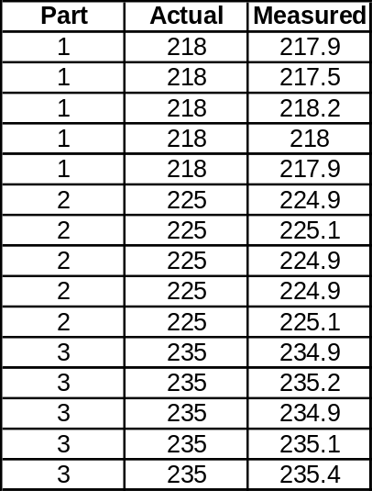
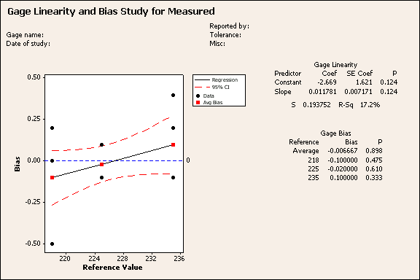
3)LINEARITY-MSA
D
M
A
D
V
1. Stability
4) ANALYSIS METHOD/ASSUMPTIONS
2. Accuracy (Bias)
3. Linearity
4. Precision
** The actual value computed based on industry standard curve traced parts
The hypothesis result shown that all p>0.05. It can be interpreted as at the 95% confidence level, estimated that the gage is performing well in the operating range of 217mV to 235mV.

Slide 11
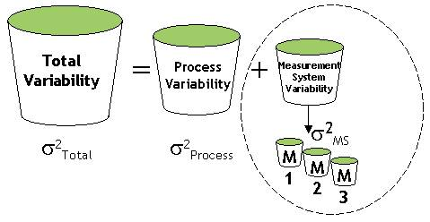
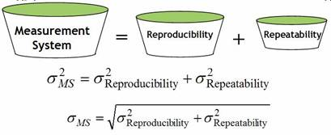
4) PRECISION-MSA
D
M
A
D
V
1. Stability
2. Accuracy (Bias)
3. Linearity
4. Precision

Slide 12
4) PRECISION-MSA
D
M
A
D
V
1. Stability
2. Accuracy (Bias)
STEP 1: OVERVIEW OF PROCEDURE/SAMPLING PLAN
3. Linearity
-For GRnR study, firstly manufacturing tech. will load 9 parts into dc test
handler in serialized form to do the measurements using the new load board
from vendor BIM. Repeat loading 2X and data will be recorded for the
total of 27 measurements per time period.
4. Precision
Due to automation,operator is not a factor here.Instead the data were collected
over three time periods (three different days).
Factors Type Levels
1) TIME Qualitative 3 levels
2) PART Qualitative 9 levels per time
3) READINGS Qualitative 3 levels per part

Slide 13
4) PRECISION-MSA
D
M
A
D
V
1. Stability
STEP 1: OVERVIEW OF PROCEDURE/SAMPLING PLAN
2. Accuracy (Bias)
-The corresponding tree diagram for this study is as shown in BELOW
3. Linearity
4. Precision
TIME
1
2
3
PART
1,2,3,4,5,6,7,8,9
1,2,3,4,5,6,7,8,9
1,2,3,4,5,6,7,8,9
READINGS
1,2,3,4,5,6,7…27
28,29,30,31,32,33,34…54
55,56,57,58,59,60,61…81

Slide 14
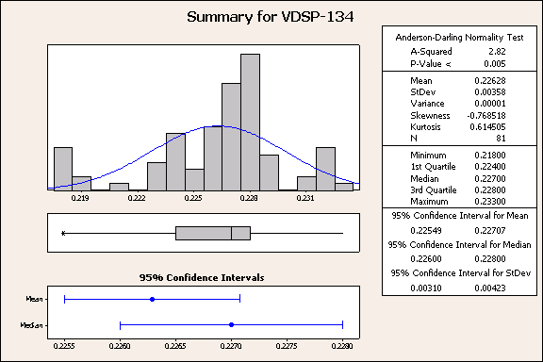
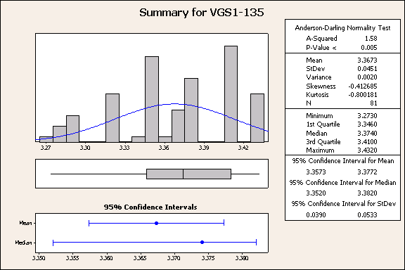
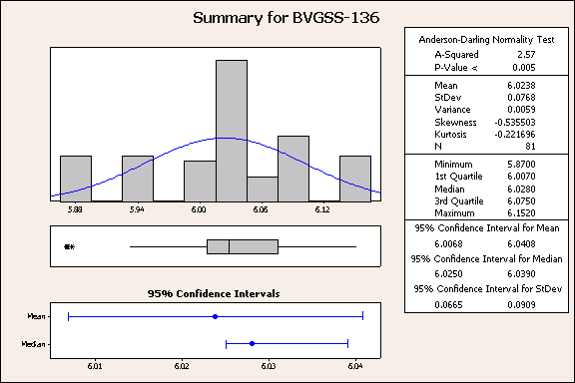
4) PRECISION-MSA
D
M
A
D
V
1. Stability
STEP2: OUTLIERS / ODD DATA POINTS
2. Accuracy (Bias)
3. Linearity
-There were no unusual measurements observed in the data.The tool
continued to perform over the period of the evaluation with no unexpected
hardware or software changes being required.An overall summary of the data
in terms of its distributional properties is shown below.
4. Precision
VDSP
VGS1
BVGSS

Slide 15
4) PRECISION-MSA
D
M
A
D
V
1. Stability
STEP 3 : ANALYSIS METHOD/ASSUMPTIONS
2. Accuracy (Bias)
3. Linearity
Analysis Method
4. Precision
Analysis of variance method were used to analyze the data and estimate the
sources of variability using MINITAB 14.
- Since we are interested in time variability and part variability, time
and parts are random factors while the lowest level which Readings is nested
within all above factors(Error term).
-The model used to fit the data was a two factor cross model as shown below:-
Observed Y = Time + Parts + Time*Parts + Error
-The repeatability of the measurement system is observed from the error
term in the model.
-The reproducibility of the measurement system is obtained from both
the Time and Time to Part interactions variance components.
-The resulting multivariate chart and accompanying variance component estimates text
report are shown in next slides.This is a two factor crossed model.

Slide 16
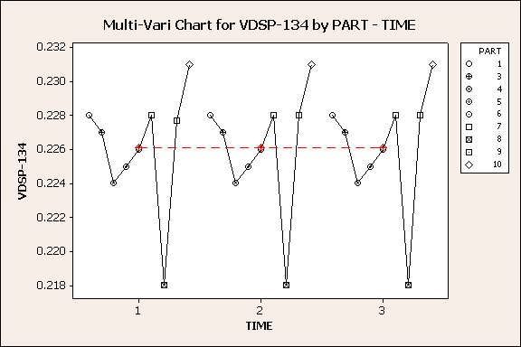
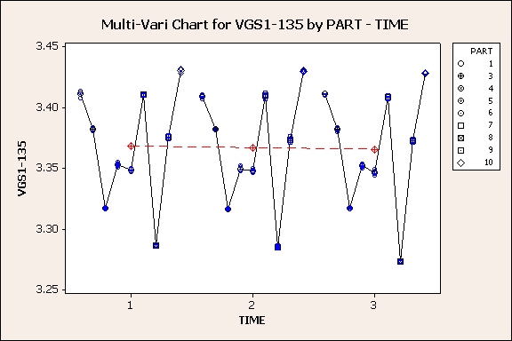
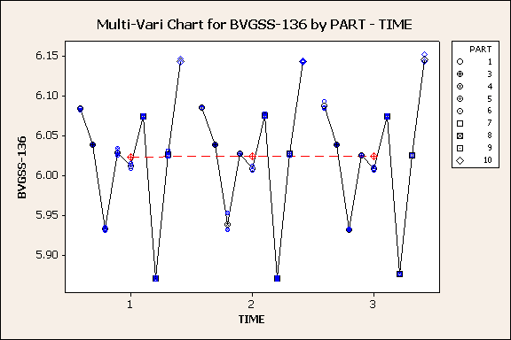
4) PRECISION-MSA
D
M
A
D
V
1. Stability
STEP 3 : ANALYSIS METHOD/ASSUMPTIONS
2. Accuracy (Bias)
The above analysis assumes the following:
1.The repeatability estimate is the same for all parts measured.
2.The reproducibility estimate is the same for all parts measured.
3. Linearity
4. Precision
STEP 4 : ANALYSIS RESULTS AND ASSOCIATED GRAPHICS-MULTIVARI CHART
BVGSS
VDSP
VGS1

Slide 17
4) PRECISION-MSA
D
M
A
D
V
STEP 5 : ANOVA ANALYSIS AND VARIANCE COMPONENTS ESTIMATES-
VDSP,VGS1 AND BVGSS
1. Stability
VARIANCE
COMPONENT
WERE
ZERO
2. Accuracy (Bias)
3. Linearity
ANOVA: VDSP-134 versus TIME, PART
Factor Type Levels Values
TIME random 3 1, 2, 3
PART random 9 1, 3, 4, 5, 6, 7, 8,
9, 10
Analysis of Variance for VDSP-134
Source DF SS MS F P
TIME 2 0.000000025 0.000000012 **
PART 8 0.000958321 0.000119790 **
TIME*PART 16 0.000000198 0.000000012 **
Error 54 0.000000667 0.000000012
Total 80 0.000959210
** Denominator of F-test is zero.
S = 0.000111111 R-Sq = 99.93% R-Sq(adj) = 99.90%
Expected Mean Square
Variance Error for Each Term (using
Source component term unrestricted model)
1 TIME 0.00000 3 (4) + 3 (3) + 27 (1)
2 PART 0.00001 3 (4) + 3 (3) + 9 (2)
3 TIME*PART -0.00000 4 (4) + 3 (3)
4 Error 0.00000 (4)
4. Precision
ANOVA: VGS1-135 versus TIME, PART
Factor Type Levels Values
TIME random 3 1, 2, 3
PART random 9 1, 3, 4, 5, 6, 7, 8,
9, 10
Analysis of Variance for VGS1-135
Source DF SS MS F P
TIME 2 0.0000542 0.0000271 4.47 0.029
PART 8 0.1620987 0.0202623 3339.27 0.000
TIME*PART 16 0.0000971 0.0000061 1.52 0.128
Error 54 0.0002160 0.0000040
Total 80 0.1624660
S = 0.002 R-Sq = 99.87% R-Sq(adj) = 99.80%
Expected Mean Square
Variance Error for Each Term (using
Source component term unrestricted model)
1 TIME 0.00000 3 (4) + 3 (3) + 27 (1)
2 PART 0.00225 3 (4) + 3 (3) + 9 (2)
3 TIME*PART 0.00000 4 (4) + 3 (3)
4 Error 0.00000 (4)
ANOVA: BVGSS-136 versus TIME, PART
Factor Type Levels Values
TIME random 3 1, 2, 3
PART random 9 1, 3, 4, 5, 6, 7, 8,
9, 10
Analysis of Variance for BVGSS-136
Source DF SS MS F P
TIME 2 0.000004 0.000002 0.18 0.839
PART 8 0.471453 0.058932 5187.85 0.000
TIME*PART 16 0.000182 0.000011 1.04 0.428
Error 54 0.000587 0.000011
Total 80 0.472227
S = 0.00329796 R-Sq = 99.88% R-Sq(adj) = 99.82%
Expected Mean Square
Variance Error for Each Term (using
Source component term unrestricted model)
1 TIME -0.00000 3 (4) + 3 (3) + 27 (1)
2 PART 0.00655 3 (4) + 3 (3) + 9 (2)
3 TIME*PART 0.00000 4 (4) + 3 (3)
4 Error 0.00001 (4)
VDSP
VGS1
BVGSS

Slide 18
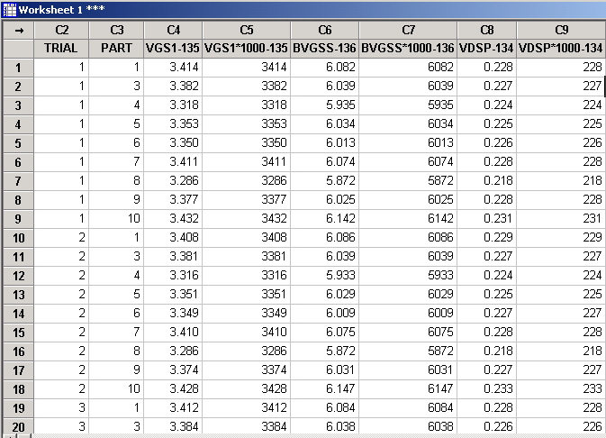
4) PRECISION-MSA
D
M
A
D
V
1. Stability
STEP 5 : ANOVA ANALYSIS-RESPONSES MULTIPLIED BY 1000
2. Accuracy (Bias)
3. Linearity
4. Precision

Slide 19
4) PRECISION-MSA
D
M
A
D
V
STPE 5 : RECOMPUTE ANOVA ANALYSIS N VARIANCE COMPONENTS
-BVGSS*1000,
1. Stability
STAT-ANOVA-BALANCED ANOVA
2. Accuracy (Bias)
3. Linearity
ANOVA: VDSP*1000-134_1 versus TIME, PART
Factor Type Levels Values
TIME random 3 1, 2, 3
PART random 9 1, 3, 4, 5, 6, 7, 8, 9, 10
Analysis of Variance for VDSP*1000-134_1
Source DF SS MS F P
TIME 2 0.025 0.012 1.00 0.390
PART 8 958.321 119.790 9703.00 0.000
TIME*PART 16 0.198 0.012 1.00 0.471
Error 54 0.667 0.012
Total 80 959.210
S = 0.111111 R-Sq = 99.93% R-Sq(adj) = 99.90%
Expected Mean Square
Variance Error for Each Term (using
Source component term unrestricted model)
1 TIME 0.0000 3 (4) + 3 (3) + 27 (1)
2 PART 13.3086 3 (4) + 3 (3) + 9 (2)
3 TIME*PART -0.0000 4 (4) + 3 (3)
4 Error 0.0123 (4)
4. Precision
ANOVA: VGS1*1000-135 versus TIME, PART
Factor Type Levels Values
TIME random 3 1, 2, 3
PART random 9 1, 3, 4, 5, 6, 7, 8,
9, 10
Analysis of Variance for VGS1*1000-135
Source DF SS MS F P
TIME 2 54.2 27.1 4.47 0.029
PART 8 162098.7 20262.3 3339.27 0.000
TIME*PART 16 97.1 6.1 1.52 0.128
Error 54 216.0 4.0
Total 80 162466.0
S = 2 R-Sq = 99.87% R-Sq(adj) = 99.80%
Expected Mean Square
Variance Error for Each Term (using
Source component term unrestricted model)
1 TIME 0.78 3 (4) + 3 (3) + 27 (1)
2 PART 2250.70 3 (4) + 3 (3) + 9 (2)
3 TIME*PART 0.69 4 (4) + 3 (3)
4 Error 4.00 (4)
ANOVA: BVGSS*1000-136 versus TIME, PART
Factor Type Levels Values
TIME random 3 1, 2, 3
PART random 9 1, 3, 4, 5, 6, 7, 8,
9, 10
Analysis of Variance for BVGSS*1000-136
Source DF SS MS F P
TIME 2 4 2 0.18 0.839
PART 8 471453 58932 5187.85 0.000
TIME*PART 16 182 11 1.04 0.428
Error 54 587 11
Total 80 472227
S = 3.29796 R-Sq = 99.88% R-Sq(adj) = 99.82%
Expected Mean Square
Variance Error for Each Term (using
Source component term unrestricted model)
1 TIME -0.35 3 (4) + 3 (3) + 27 (1)
2 PART 6546.70 3 (4) + 3 (3) + 9 (2)
3 TIME*PART 0.16 4 (4) + 3 (3)
4 Error 10.88 (4)
VDS ON*1000
VGS1*1000
BVGSS*1000

Slide 20
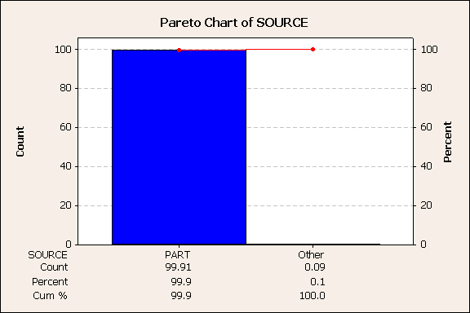
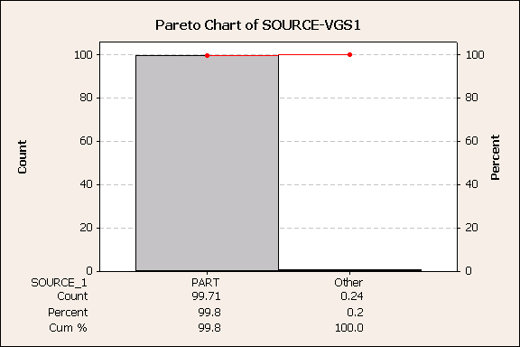
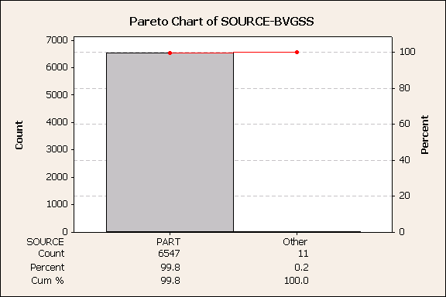
4) PRECISION-MSA
D
M
A
D
V
STEP 6: PARETO CHART FOR SOURCE-BVGSS,VGS1 AND VDS ON
1. Stability
2. Accuracy (Bias)
3. Linearity
4. Precision
VDS ON*1000
BVGSS*1000
VGS1*1000
Conclusion : Majority of variation in measurement system coming from part itself which is part of the
process which is accountable for >99% of total variation.

Slide 21
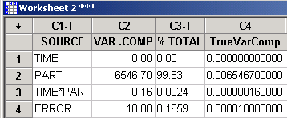
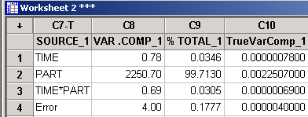
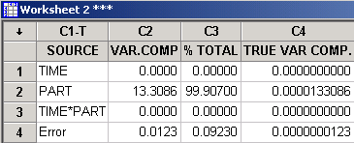
4) PRECISION-MSA
D
M
A
D
V
VDSP
STEP 7 : DERIVED METRICES-BVGSS*1000,VGS1*1000 AND VDSP*1000
1. Stability
BVGSS
VGS1*1000
2. Accuracy (Bias)
3. Linearity
4. Precision
Repeatability, σ²_{RPT} = Error term = 0.000010880000
Repeatability, σ²_{RPT} = Error term = 0.000004
Repeatability, σ²_{RPT} = Error term = 0.0000000123
Repeatability, σ_{RPT} = 0.002
Repeatability, σ_{RPT} = 0.0032984
Repeatability, σ_{RPT} = 0.000111
Reproducibility, σ²_{RPD} = Time + Time* Part = 0.00000078 +
0.00000069
Reproducibility, σ²_{RPD} = Time + Time* Part =0+0
Reproducibility, σ²_{RPD} = Time + Time* Part = 0 + 0.00000016
Reproducibility, σ_{RPD} = 0.0000
Measurement,
σ²_{MS}
σ²_{RPT} + σ²_{RPD} = 0.0000000123+0
Reproducibility, σ_{RPD} = 0.0012124
Measurement,
=
Reproducibility, σ_{RPD} = 0.0004
Measurement,
Measurement, σ_{MS} = 0.000111(Precision)
σ²_{MS}
σ²_{RPT} + σ²_{RPD} = 0.000010880000+0.00000016
= σ²_{RPT} + σ²_{RPD} = 0.000004+0.00000147
=
σ²_{MS}
Part Variability, σ²_{PART} = 0.0000133086
Measurement, σ_{MS} = 0.002338 (Precision)
Part Variability, σ²_{PART} = 0.00225070
Measurement, σ_{MS} = 0.003322 (Precision)
Total Variability, σ²_{TOTAL} = σ²_{PART} + σ²_{MS}
Part Variability, σ²_{PART} = 0.0065467
Total Variability, σ_{TOTAL} = 0.003649
Total Variability, σ²_{TOTAL} = σ²_{PART} + σ²_{MS}=0.00655774
Total Variability, σ²_{TOTAL} = σ²_{PART} + σ²_{MS}= 0.00225070 +
0.00000547
= (σ_{MS} /σ_{TOTAL})*100=(0.00011/0.003649)*100=3%
Total Variability, σ_{TOTAL} = 0.0474991
% R & R
Total Variability, σ_{TOTAL} = 0.081
% P/T
= (6*σ_{MS}/ USL-LSL)*100= 6*0.00011/(0.8)*100
= (σ_{MS} /σ_{TOTAL})*100=(0.002338/0.0474991)*100= 4.92%
% R & R
% R & R
= (σ_{MS} /σ_{TOTAL})*100=(0.003322/0.081)*100= 4 %
= 0.08%
= (6*σ_{MS}/ USL-LSL)*100=
= 0.47%
% P/T
% P/T
(6*0.002338/3)*100
(6*σ_{MS}/ USL-LSL)=(6*0.003322/3)*100
=
= 0.66%
Conclusion
The percentage variation for both %RR and %P/T is less than 10%.In this experiment we do not have process variation, σ process however the spec. limits are specified. This measurement process is deemed acceptable.From the GRR study total six sigma spread for Bvgss is 0.019V while
for Vgs1 is 0.014 V while for Vdson is 0.0006V which is rather low.

Slide 22
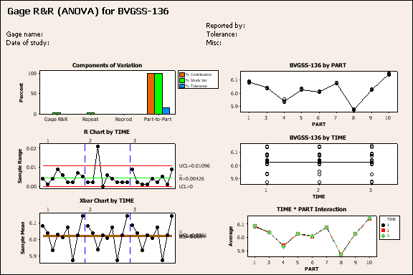
Two-Way ANOVA Table Without Interaction
Source DF SS MS F P
PART 8 0.471453 0.0589317 5363.79 0.000
TIME 2 0.000004 0.0000020 0.18 0.833
Repeatability 70 0.000769 0.0000110
Total 80 0.472227
Gage R&R
%Contribution
Source VarComp (of VarComp)
Total Gage R&R 0.0000110 0.17
Repeatability 0.0000110 0.17
Reproducibility 0.0000000 0.00
TIME 0.0000000 0.00
Part-To-Part 0.0065467 99.83
Total Variation 0.0065577 100.00
Study Var %Study Var %Tolerance
Source StdDev (SD) (6 * SD) (%SV) (SV/Toler)
Total Gage R&R 0.0033147 0.019888 4.09 0.66
Repeatability 0.0033147 0.019888 4.09 0.66
Reproducibility 0.0000000 0.000000 0.00 0.00
TIME 0.0000000 0.000000 0.00 0.00
Part-To-Part 0.0809119 0.485472 99.92 16.18
Total Variation 0.0809798 0.485879 100.00 16.20
BVGSS
Conclusion: The gauge is suitable for maintaining Bvgss within specification limits
since %PT <<< 10% which is 0.66%.The gauge also suitable for process improvement since
% R+R is < 10% which is 4.09%.

Slide 23
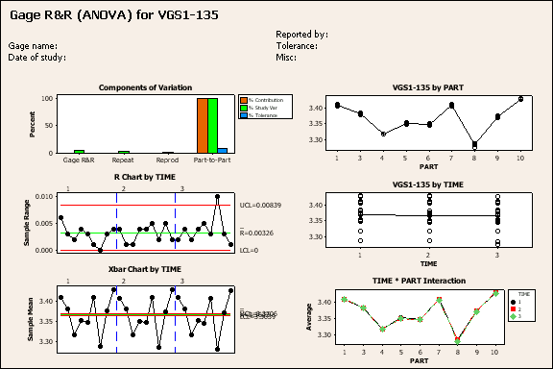
Gage R&R Study - ANOVA Method
Two-Way ANOVA Table With Interaction
Source DF SS MS F P
PART 8 0.162099 0.0202623 3339.27 0.000
TIME 2 0.000054 0.0000271 4.47 0.029
PART * TIME 16 0.000097 0.0000061 1.52 0.128
Repeatability 54 0.000216 0.0000040
Total 80 0.162466
Gage R&R
%Contribution
Source VarComp (of VarComp)
Total Gage R&R 0.0000055 0.24
Repeatability 0.0000040 0.18
Reproducibility 0.0000015 0.07
TIME 0.0000008 0.03
TIME*PART 0.0000007 0.03
Part-To-Part 0.0022507 99.76
Total Variation 0.0022562 100.00
Study Var %Study Var %Tolerance
Source StdDev (SD) (6 * SD) (%SV) ( SV/Toler)
Total Gage R&R 0.0023386 0.014032 4.92 0.47
Repeatability 0.0020000 0.012000 4.21 0.40
Reproducibility 0.0012121 0.007272 2.55 0.24
TIME 0.0008831 0.005298 1.86 0.18
TIME*PART 0.0008302 0.004981 1.75 0.17
Part-To-Part 0.0474415 0.284649 99.88 9.49
Total Variation 0.0474991 0.284995 100.00 9.50
Number of Distinct Categories = 28
VGS1
Conclusion: The gauge is suitable for maintaining Vgs1 within specification limits
since %PT <<< 10% which is 0.47%.The gauge also suitable for process improvement since
% R+R is < 10% which is 4.92%.

Slide 24
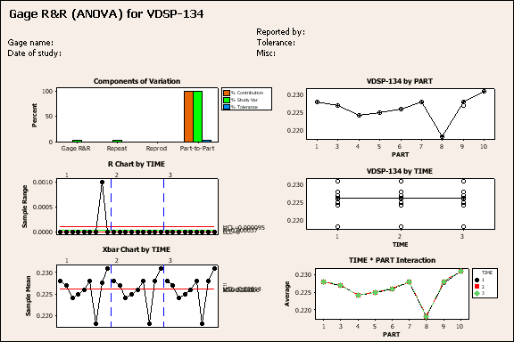
Two-Way ANOVA Table Without Interaction
Source DF SS MS F P
PART 8 0.0009583 0.0001198 9703 0.000
TIME 2 0.0000000 0.0000000 1 0.373
Repeatability 70 0.0000009 0.0000000
Total 80 0.0009592
Gage R&R
%Contribution
Source VarComp (of VarComp)
Total Gage R&R 0.0000000 0.09
Repeatability 0.0000000 0.09
Reproducibility 0.0000000 0.00
TIME 0.0000000 0.00
Part-To-Part 0.0000133 99.91
Total Variation 0.0000133 100.00
Study Var %Study Var %Tolerance
Source StdDev (SD) (6 * SD) (%SV) (SV/Toler)
Total Gage R&R 0.0001111 0.0006667 3.04 0.08
Repeatability 0.0001111 0.0006667 3.04 0.08
Reproducibility 0.0000000 0.0000000 0.00 0.00
TIME 0.0000000 0.0000000 0.00 0.00
Part-To-Part 0.0036481 0.0218886 99.95 2.74
Total Variation 0.0036498 0.0218988 100.00 2.74
Number of Distinct Categories = 46
VDSP
Conclusion: The gauge is suitable for maintaining Vdsp within specification limits
since %PT <<< 10% which is 0.08%.The gauge also suitable for process improvement since
% R+R is < 10% which is 3.04%.

