Slide 1
WELCOME

Slide 2
Content
1) Group Member 11) GUI
2)E-commerce website 12) Admin Panel
3)What is E-Commerce 13)Insert Product Page
4)Faisal Store 14)Show All Product Page
5)Process of E-Commerce 15)Orders Page
6)Features 16)User Panel
7)Languages and Tools 17) Home Page
8) Data Flow Diagram 18)Single Product Page
9)Business Process Model 19)Cart Page
10)Advantages 20)Checkout Page
10) Disadvantages

Slide 3
Group Member
Faisal Ahmad(1901930100038)
Shivam Tiwari(1901930100101)

Slide 4

Presentation on E-Commerce(Shopping Website)

Slide 5
What is E-Commerce
Comm0nly known as Electronic Marketing
“It consist of buying and selling goods and services over an electronic systems Such as Internet and other computer network.”

Slide 6
Faisal Store
Faisal Store is an e-commerce website from where peoples can buy product online.
Admin monitor the activity of the user and checks the orders.

Slide 7
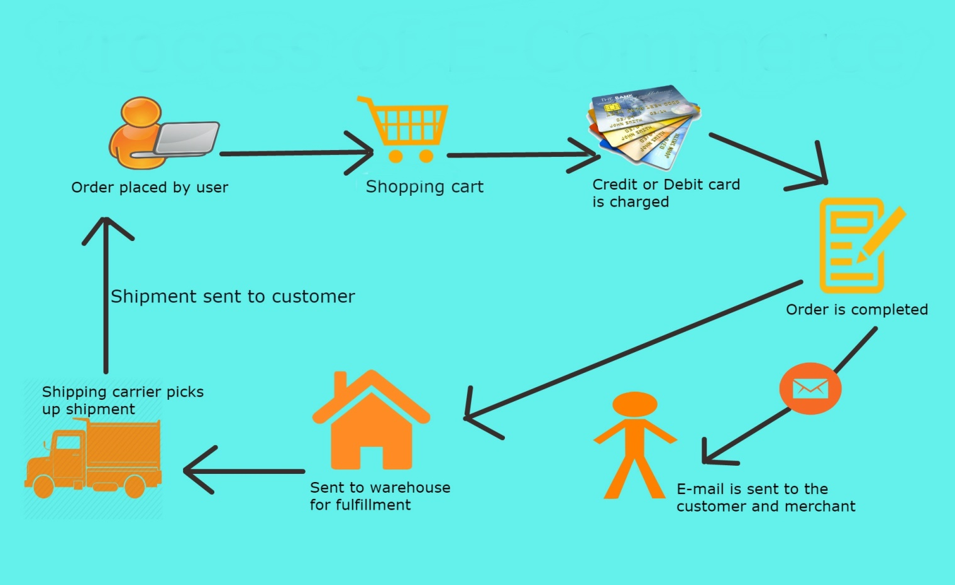
The Process of E-Commerce

Slide 8
Features
Search
Product List
Cart
LogIn/LogOut
SignUp
Checkout
View Product Details

Slide 9
Languages: Tools
Angular Vs Code
HTML Springboot
CSS
Bootstrap
MySql
Springboot

Slide 10
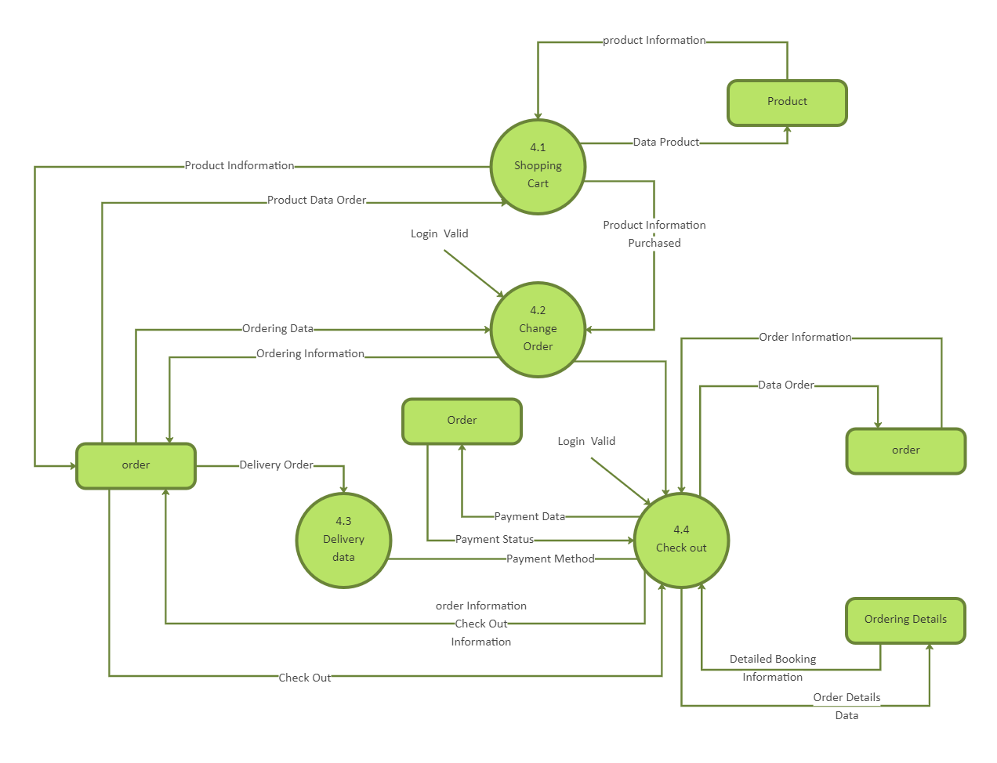
Data Flow Diagram

Slide 11
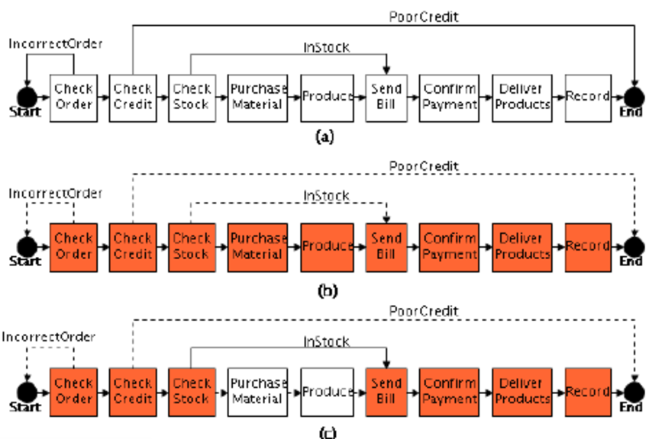
Business Process Model

Slide 12
Advantages of E-commerce
Store and product listing creation
Flexibility for customers
Faster response to buyer/market demands
No reach limitations
Enables easy exports
Several payment modes

Slide 13
Disadvantages of E-commerce
Potential security threats
Competition
Limited connection with customers
IT issues
Shipping logistics

Slide 14
Graphical User Interface (GUI)

Slide 15
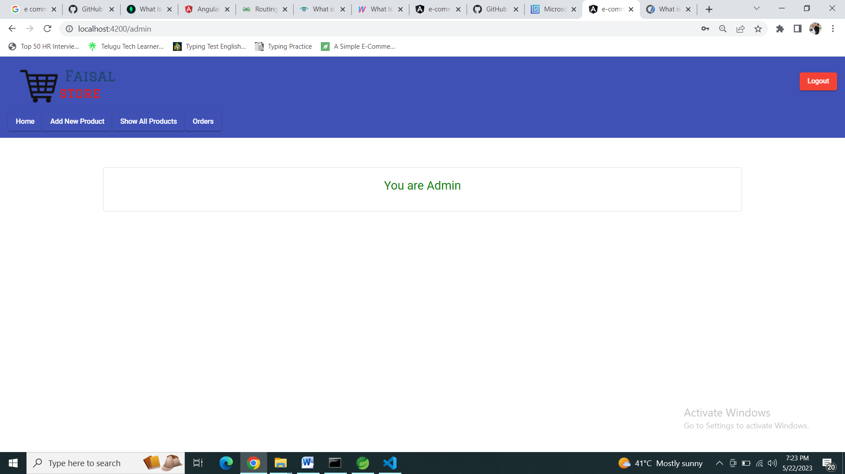
Admin Panel

Slide 16
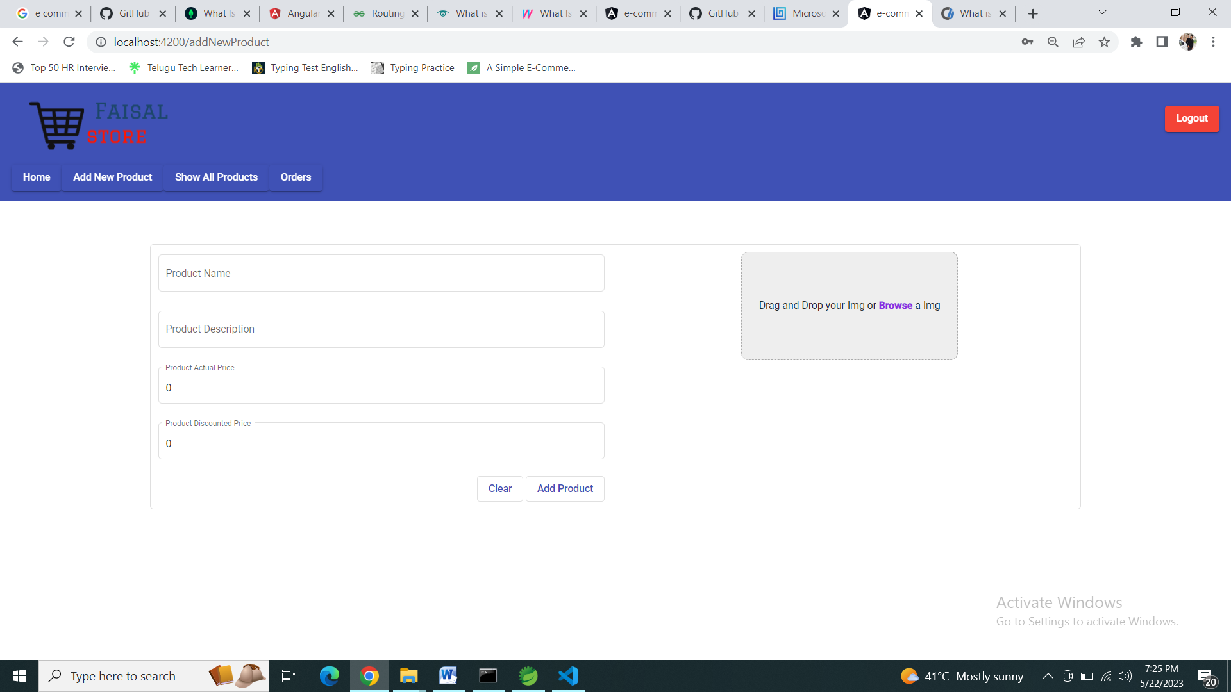
Insert Product Page

Slide 17
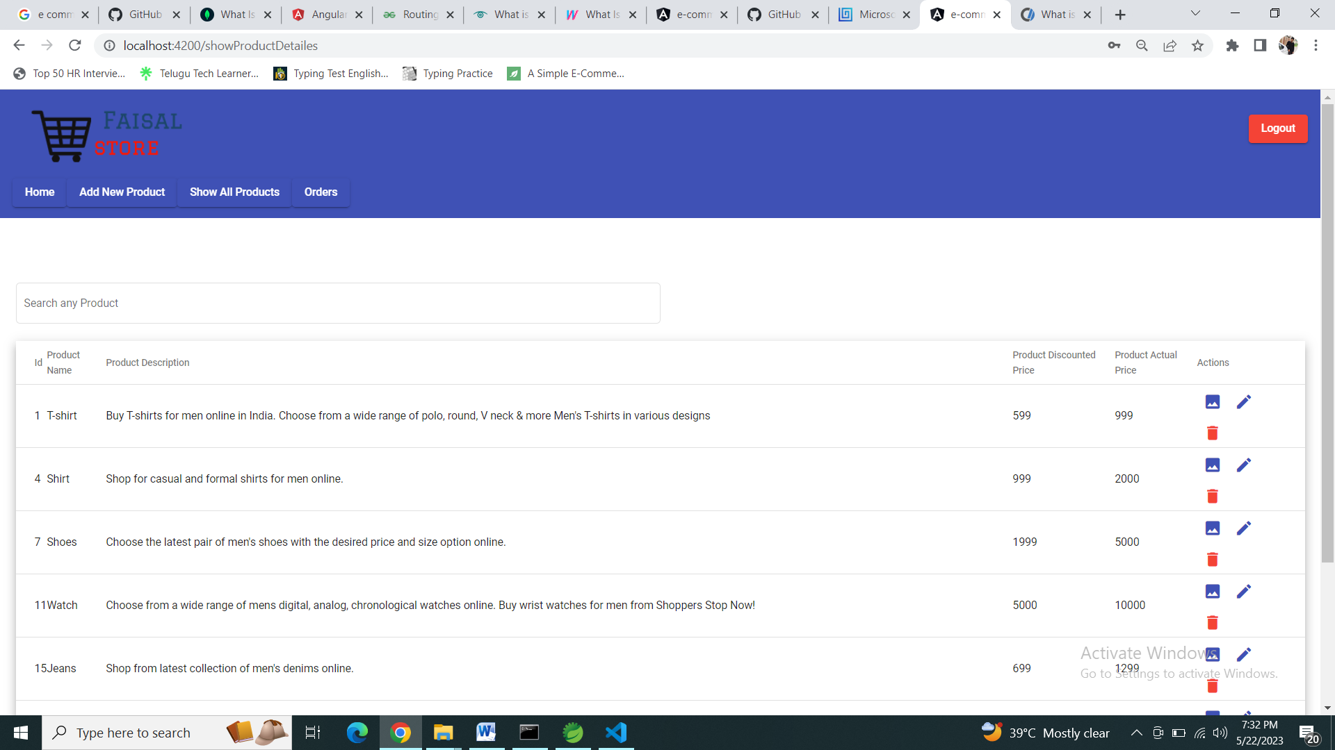
Show All Product Page

Slide 18
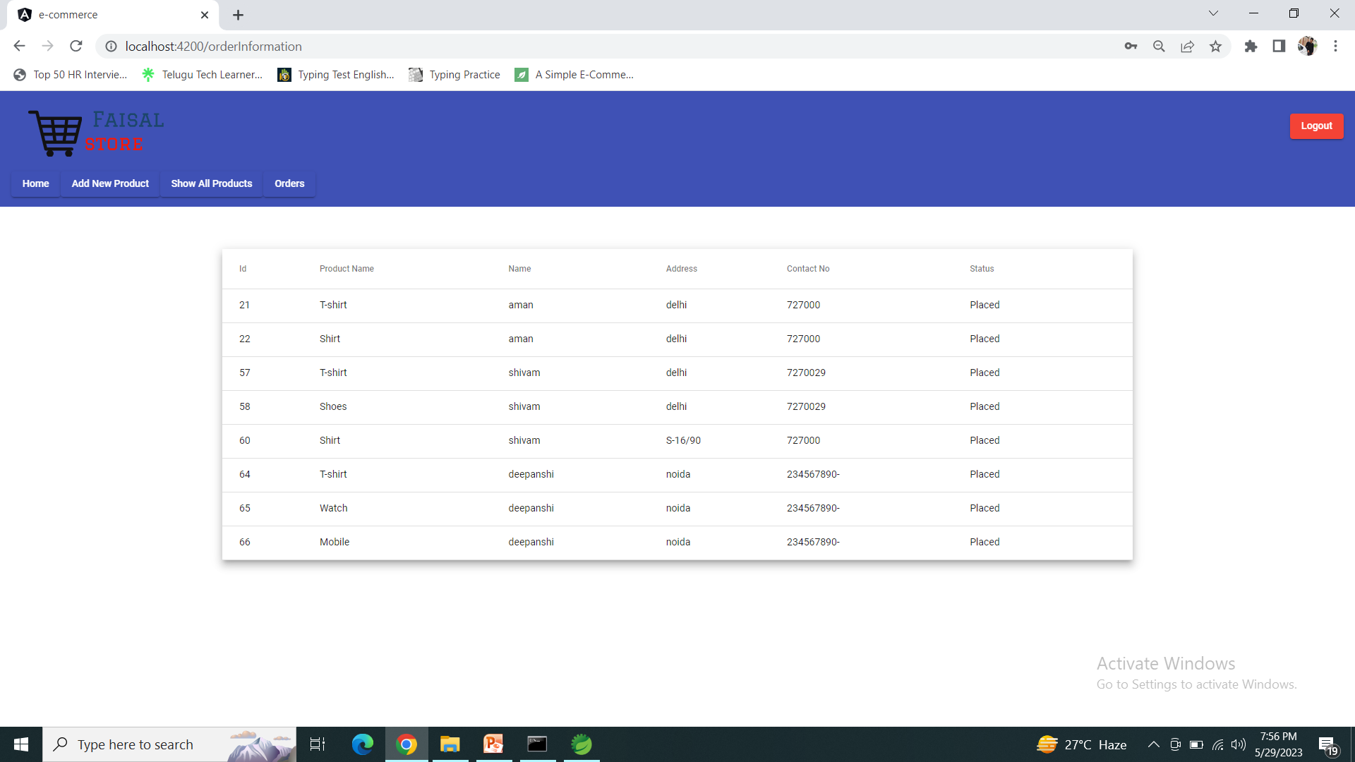
Orders Page

Slide 19
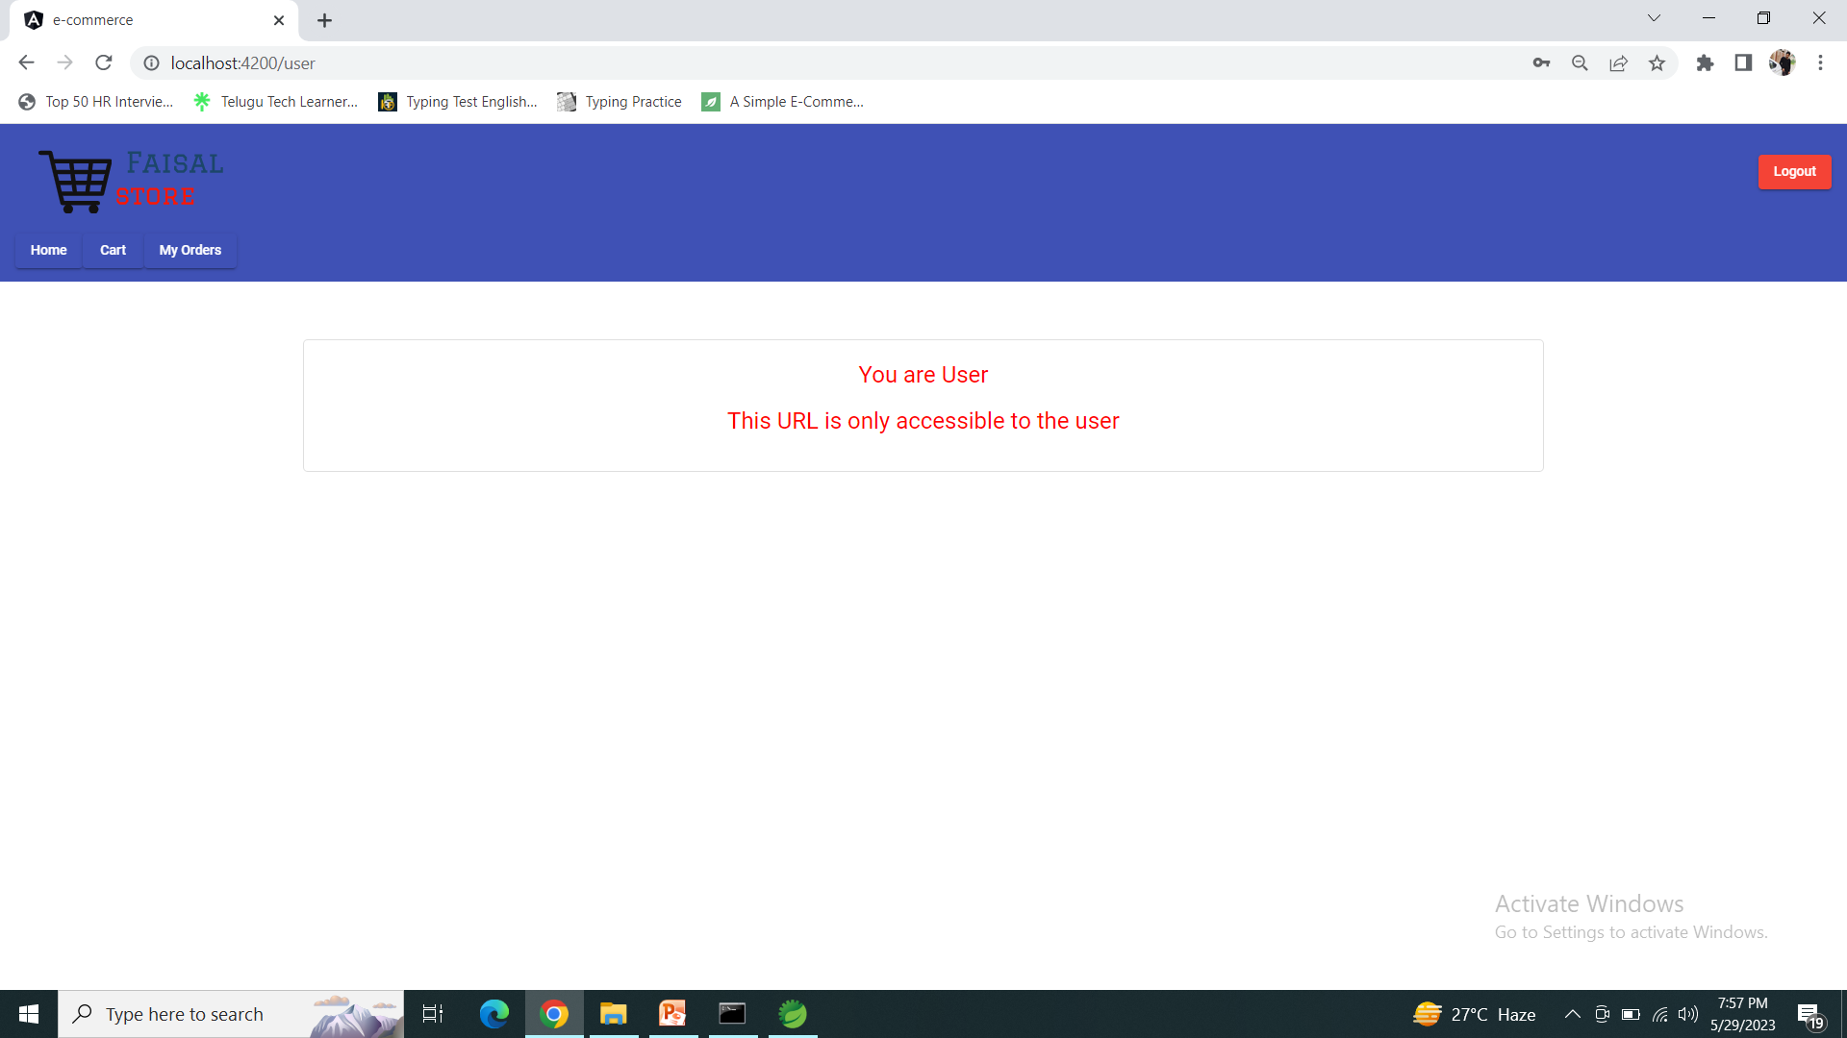
User Panel

Slide 20
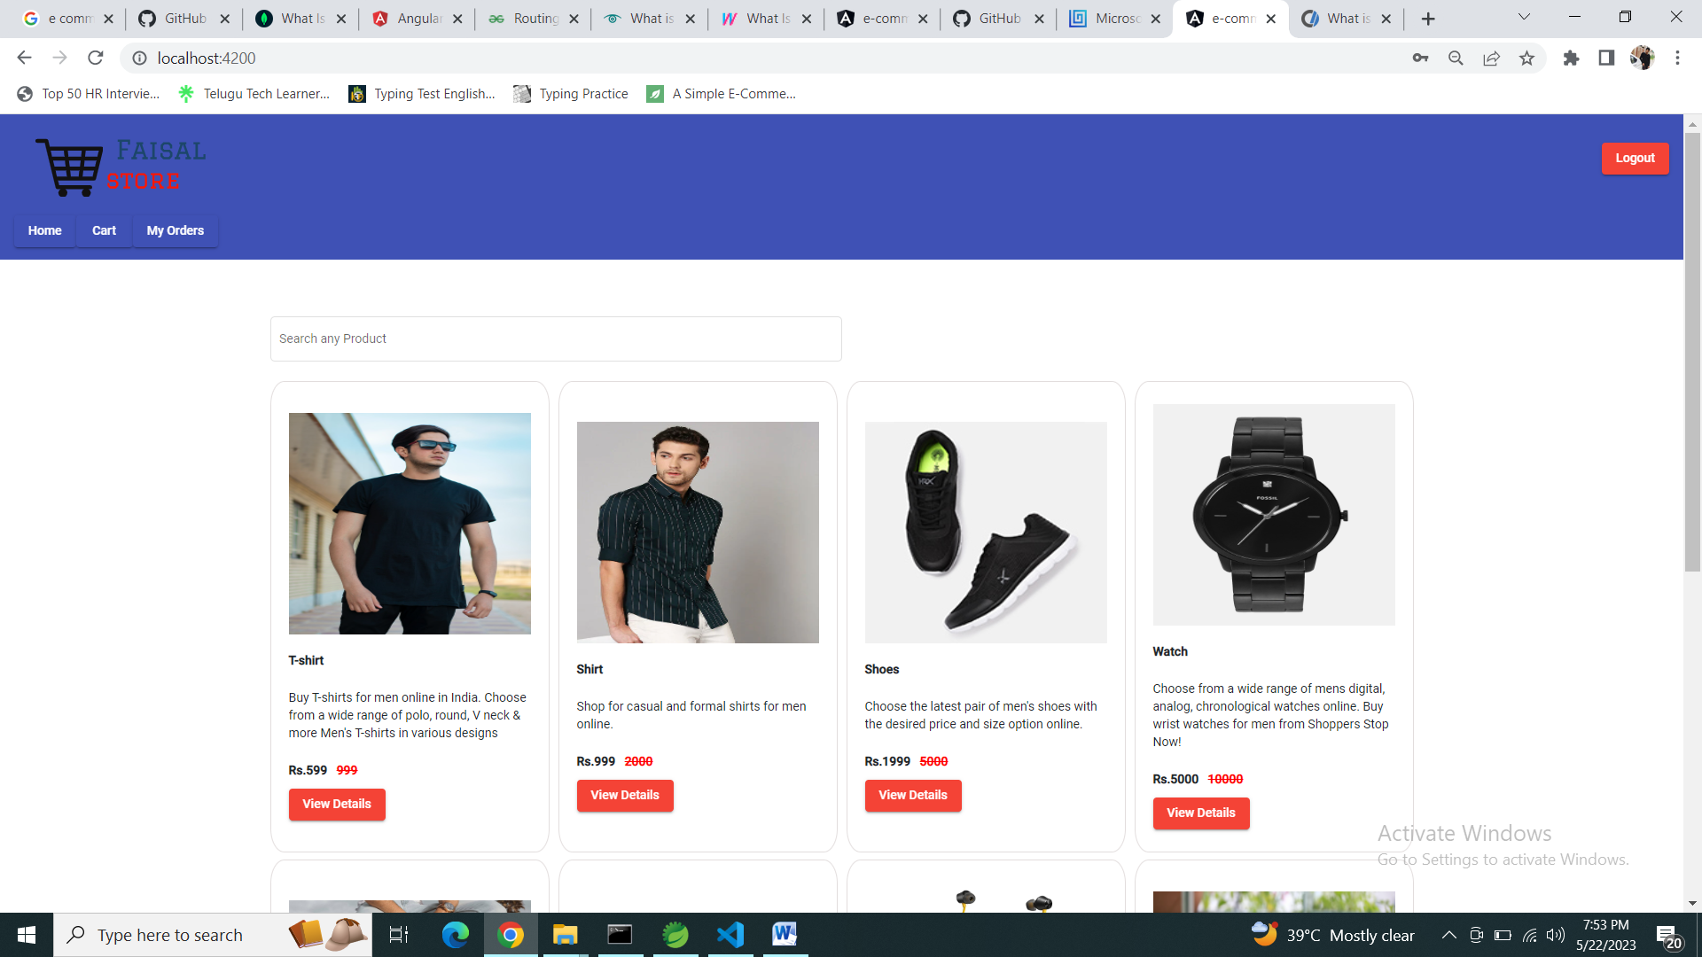
Home Page

Slide 21
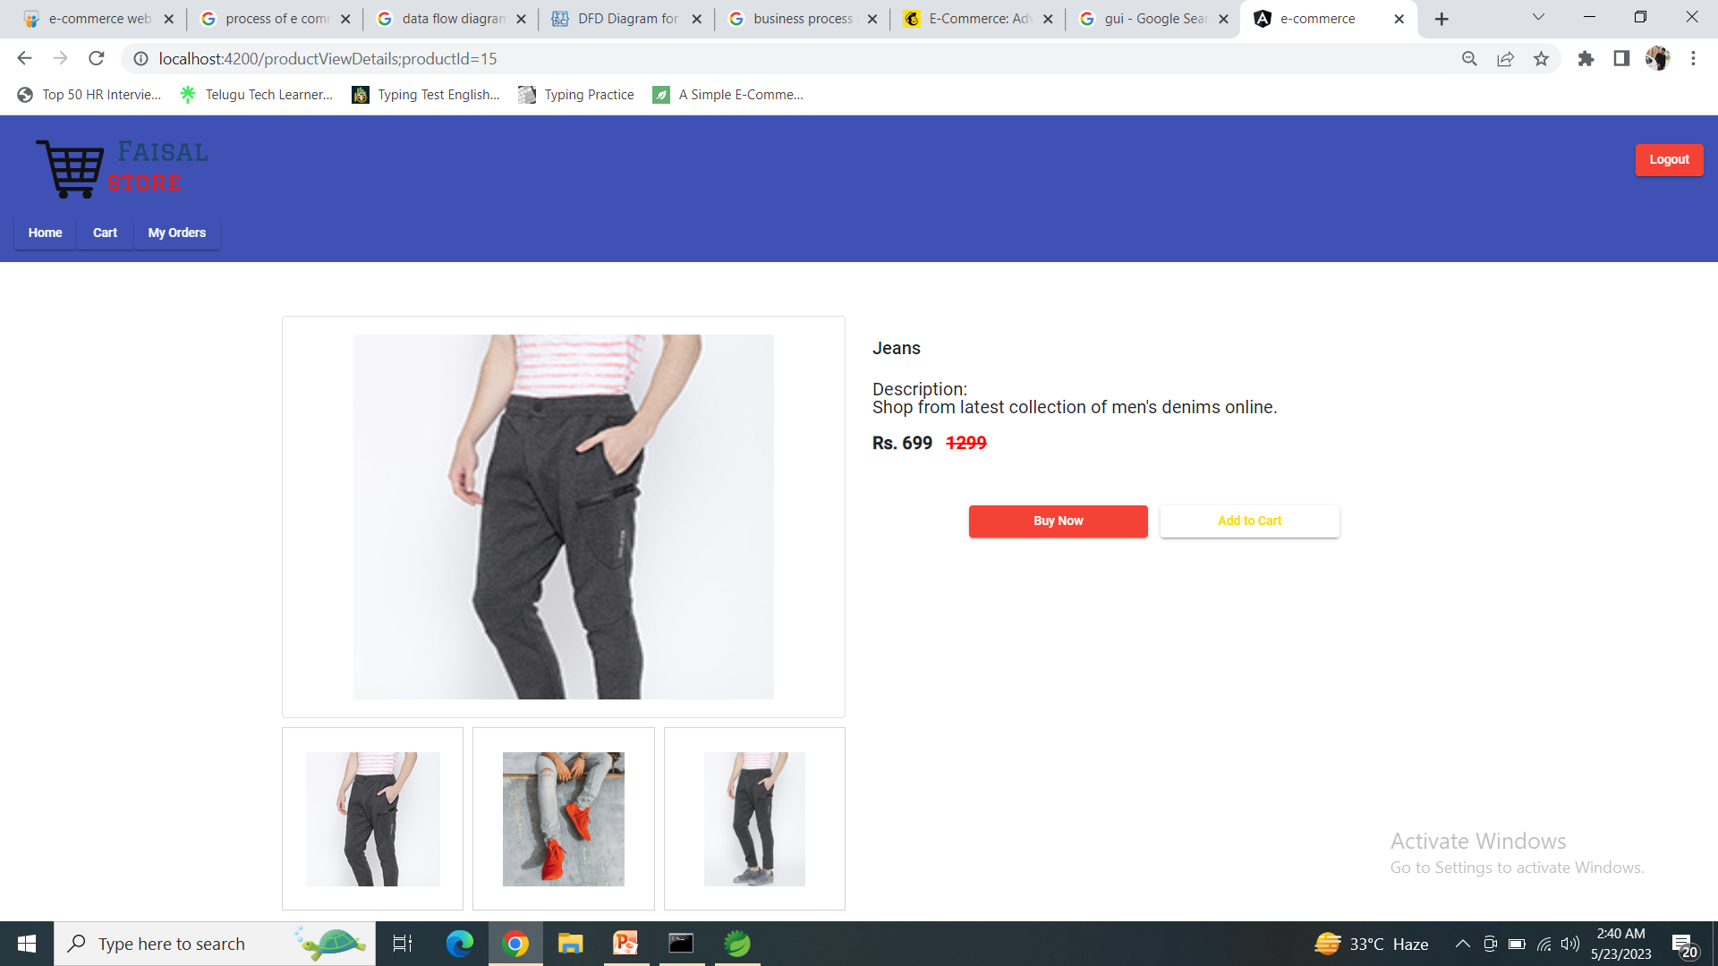
Single Product Page

Slide 22
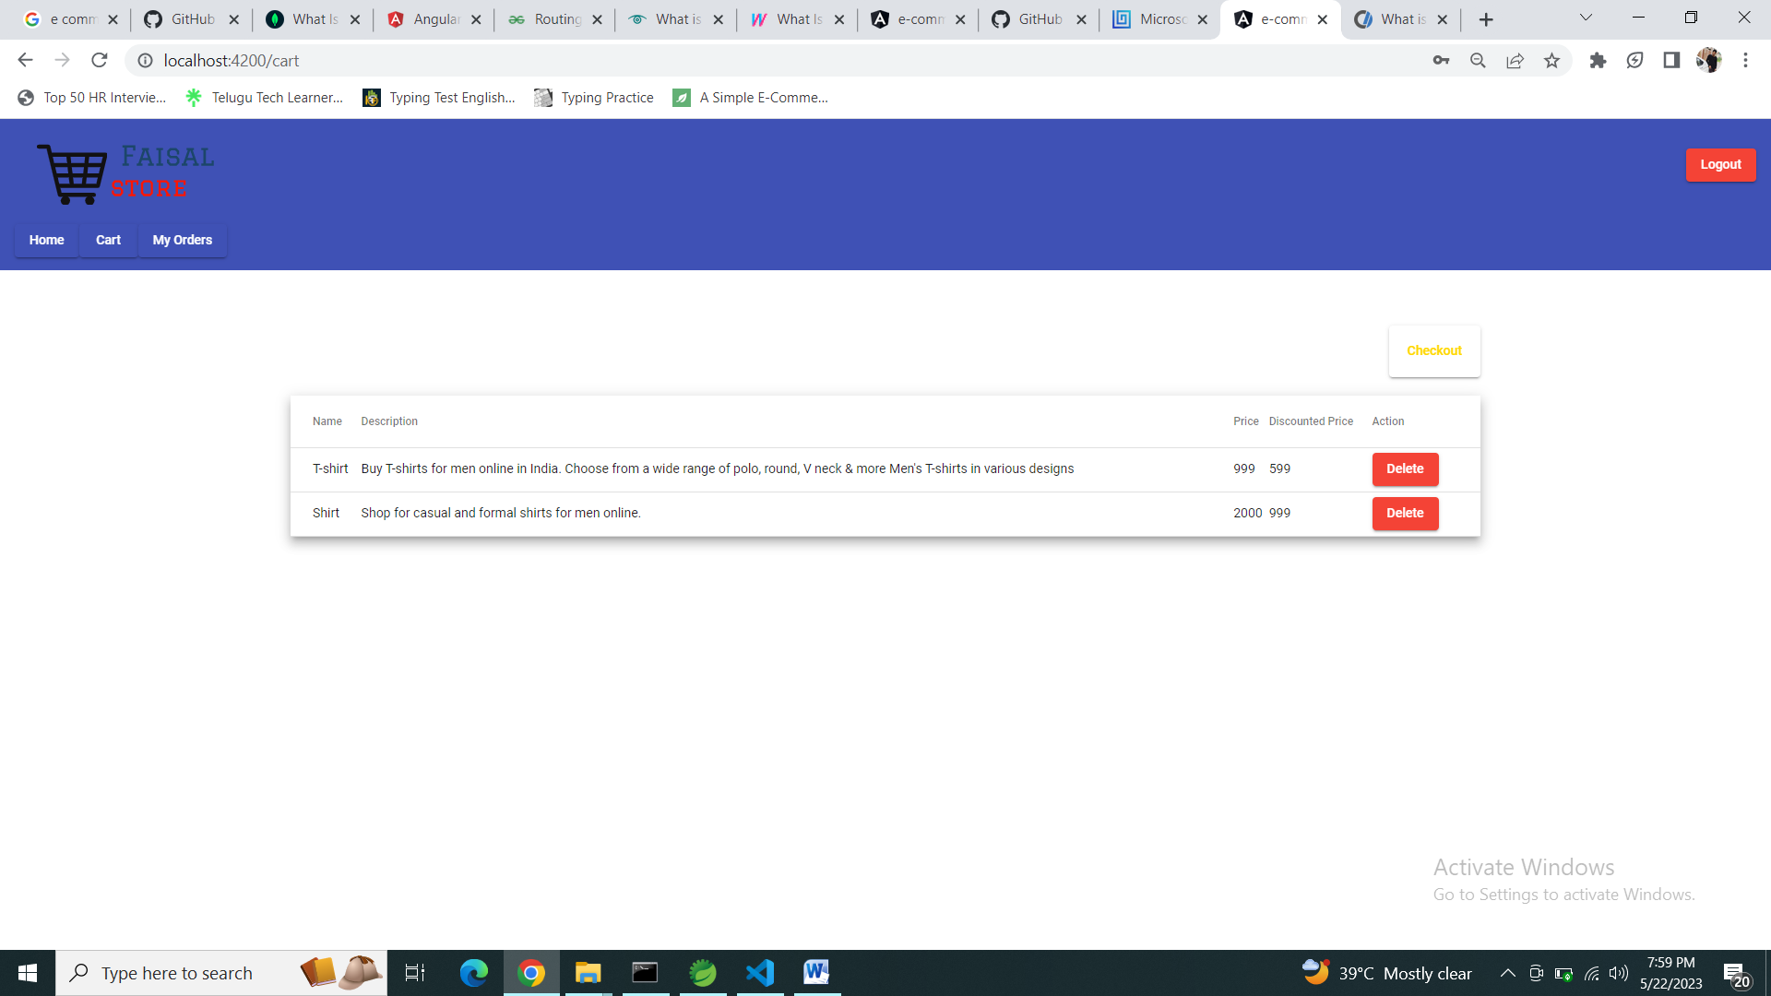
Cart Page

Slide 23
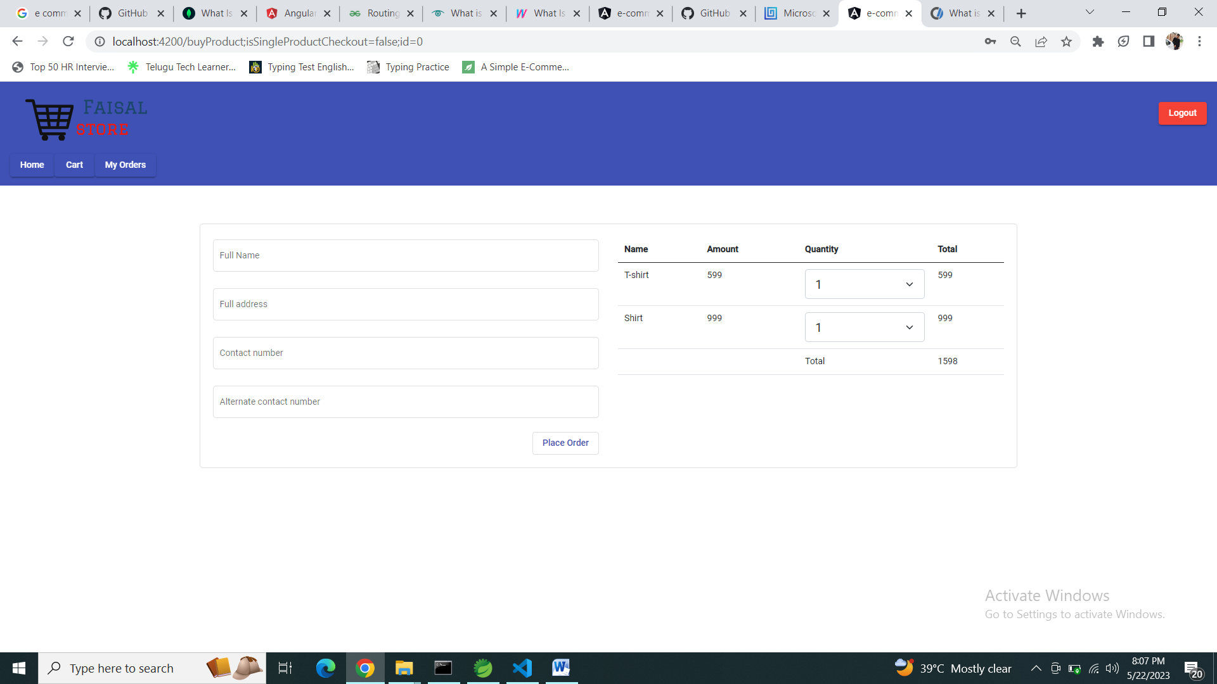
Checkout Page

Slide 24
Thank You

