Slide 1
SMART INDIA HACKATHON 2026
Honey Chain
CORE INNOVATION
• Hardware IoT Edge (Arduino + DHT22) monitors brood nest temperature & humidity.
• Rule-Based & Predictive AI Colony Health & Yield Diagnostics.
• Cryptographic SHA-256 Immutable Blockchain Ledger.
• 5 Role-Scoped Portals: Beekeeper, Lab QA, Processor, Logistics, Consumer.
• 1-Click Consumer QR Honey Passport with Purity Verification.
Problem Statement ID – SIH26021
Problem Statement Title – Honey Chain: A blockchain-based system for honey traceability and smart beekeeping management
Theme – Agriculture, FoodTech & Rural Development
PS Category – Software (IoT + Blockchain + AI)
Team ID – SIH2026-TEAM-894
Team Name – NovaForge

Slide 2
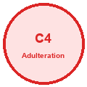
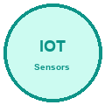
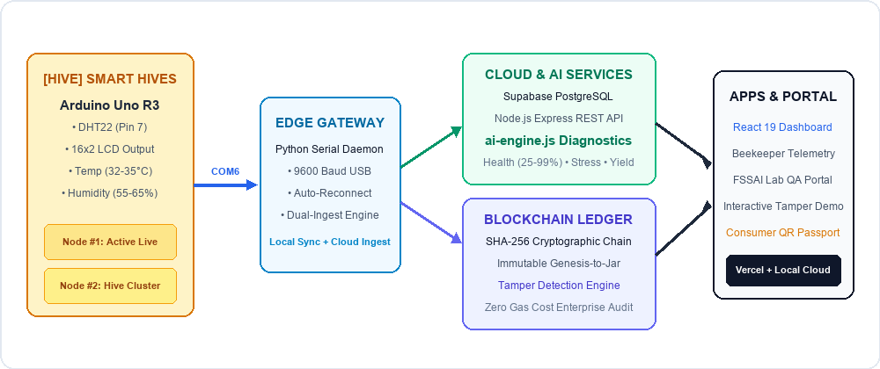

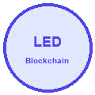
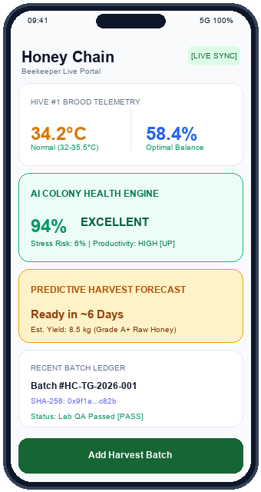
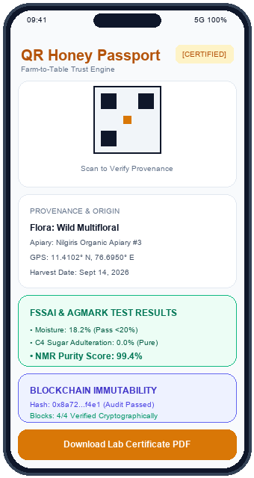
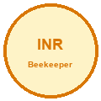

NovaForge
PROBLEM STATEMENT & PROPOSED SYSTEM SOLUTION
SMART INDIA
HACKATHON 2026
SIH26021
NATIONAL PROBLEM
PROPOSED SOLUTION
SYSTEM ARCHITECTURE
C4 Syrup Adulteration:
Widespread market practice of mixing cheap inverted sugar, rice, and corn syrups. Destroys consumer trust and fails FSSAI NMR purity norms.
Arduino IoT Hive Monitoring:
Real-time edge tracking of brood temperature (32-35.5°C) & humidity on Pin 7 with local 16x2 LCD + dual-sync Python bridge to Supabase Cloud.
Zero Supply Chain Visibility:
Opaque traditional process from hive to consumer. No tamper-proof origin tracking, leaving consumers blind to synthetic adulterants.
SHA-256 Blockchain Ledgering:
Immutable, transparent cryptographic block chaining for every honey batch linking Harvest -> Lab QA -> Processing with instant tamper alerts.
Beekeeper Price Exploitation:
Middlemen dictate rock-bottom prices (<₹120/kg) to tribal and marginal beekeepers, capturing huge margins while beekeepers suffer losses.
Consumer QR Honey Passport:
End-to-end trace capability via scannable QR labels revealing NMR purity score (99.4%), apiary GPS coordinates, and FSSAI lab certificates.
Beekeeper Dashboard
QR Verification Passport
@SIH Idea submission- Template | Honey Chain | Team NovaForge 2

Slide 3
NovaForge
TECHNICAL APPROACH & SYSTEM ARCHITECTURE
SMART INDIA
HACKATHON 2026
SIH26021
HARDWARE & IOT EDGE
• Microcontroller:
Arduino Uno R3 (ATmega328P) processing sensor reads.
• DHT22 Sensor:
Digital Pin 7, 0.1 C resolution, 2s query sampling cycle.
• 16x2 LCD Display:
Pins 12, 11, 5, 4, 3, 2 for live beekeeper on-site readouts.
• Serial Bridge:
Python daemon on COM6, baud 9600 with auto-reconnect logic.
• Dual Ingest:
Synchronous write to local SQLite and HTTPS PATCH to Supabase Cloud.
AI ENGINE (ai-engine.js)
• Colony Health Index:
Base 92% scored with penalties for thermal stress (<31 C or >36 C), pest risks, weak queen.
• Stress Risk Metric:
Calculated as 100 - Health with amplifications for high pest and extreme temp (>37 C).
• Productivity Classifier:
Categorized into HIGH, MODERATE, LOW based on health score and honey reserves.
• Harvest Readiness:
Predicts days to harvest (0-28 days) and yield volume (kg) with confidence scoring.
• Automated Alerts:
Triggers Critical (Temp >36.5 C) & Warning (Hum >75%) alerts directly to dashboard & header.
BLOCKCHAIN & FULL-STACK
• SHA-256 Ledger:
Cryptographic block hashing linking Harvest -> Quality -> Processing -> Distribution.
• Tamper Detection:
Instant verification detects altered blocks and highlights compromised chain in red.
• Frontend Stack:
React 19, TypeScript, Tailwind CSS, Leaflet Maps, Recharts, SVG QR codes.
• Backend Stack:
Node.js Express REST API, SQLite (better-sqlite3), Supabase PostgreSQL Cloud.
• Zero Gas Fees:
Permissible enterprise-grade cryptographic audit ledger without costly token gas.
@SIH Idea submission- Template | Honey Chain | Team NovaForge 3

Slide 4
NovaForge
FEASIBILITY AND VIABILITY ANALYSIS
SMART INDIA
HACKATHON 2026
SIH26021
FEASIBILITY ANALYSIS
Can we build, operate and deploy it?
✔ Technical Feasibility
Built entirely on proven, off-the-shelf components (Arduino, DHT22, React, Node.js, Supabase).
✔ Operational Feasibility
Plug-and-play field setup. Clear local LCD status ensures non-tech beekeepers can use it effortlessly.
✔ Network Feasibility
Dual-sync architecture operates offline in rural apiaries via SQLite, syncing when connectivity resumes.
✔ Regulatory Feasibility
Fully compliant with FSSAI Honey Regulations (2020), AGMARK Grade A+, and ISO 22000 standards.
VIABILITY & MARKET
Will it work and create sustainable value?
★ Economic Viability
Eliminates adulterated honey dumping, boosting beekeeper income by 30-40% via direct certification.
★ Market Demand
India exports 74,000+ MT honey annually. Global markets demand 100% NMR-traceable raw honey.
★ Social Impact
Empowers smallholder & tribal beekeepers under KVIC Honey Mission and TRIFED cooperatives.
★ Environmental Viability
Reduces hive thermal stress mortality, protecting pollinator biodiversity and agricultural yields.
BUSINESS & SCALE
Can it scale and monetize?
▲ Massive Market Size
India apiculture market reaches ₹3,500+ Cr, driven by organic health trends and exports.
▲ B2B Revenue Model
SaaS subscription for honey aggregators, FPOs, quality labs, and export packaging units.
▲ API Monetization
Traceability API licensing for e-commerce platforms (Amazon, BigBasket) to verify honey jars.
▲ Government Integration
Ready to integrate into National Bee Board Madhukranti portal and State Beekeeping missions.
@SIH Idea submission- Template | Honey Chain | Team NovaForge 4

Slide 5
NovaForge
IMPACT, BENEFITS & FUTURE SCOPE
SMART INDIA
HACKATHON 2026
SIH26021
STAKEHOLDER BENEFITS
• Beekeepers (Marginal/Tribal): Early heat/humidity warnings, harvest readiness prediction, 30-40% higher price realization.
• FPOs & Cooperatives: Centralized apiary health monitoring, aggregate batch tracking, verified organic origin.
• Processors & Exporters: Automated FSSAI compliance, cold-chain temp logs, tamper-free cryptographic export passports.
• Consumers: 100% confidence against syrup adulteration via instant smartphone QR scan.
ESTIMATED IMPACT IN NUMBERS
30 – 40% Increase in beekeeper net revenue by selling certified Grade A+ batches.
35% Reduction in bee colony mortality via real-time temperature stress alerts.
100% Tamper detection against fake/counterfeit sugar syrup honey.
< 3 sec End-to-end hardware IoT telemetry propagation to cloud dashboard.
FUTURE ROADMAP & SCALABILITY
▲ Solar-Powered LoRaWAN Nodes – Deploying long-range wireless nodes for deep forest & hilly apiary clusters.
▲ Acoustic AI Bio-Sensing – Microphone frequency analysis to predict swarming events and queen-less conditions.
▲ Smart Contract Escrow – Automated payments to beekeepers triggered immediately upon lab quality approval.
▲ National Integration – Seamless API bridge to Government of India Madhukranti portal for nationwide adoption.
@SIH Idea submission- Template | Honey Chain | Team NovaForge 5

Slide 6
NovaForge
RESEARCH AND REFERENCES
SMART INDIA
HACKATHON 2026
SIH26021
1. FSSAI – Manual of Methods of Analysis of Foods: Honey & Bee Products
Category: Regulatory & Food Safety Standard
Standards on moisture limits (<20%), C4 sugar detection, sucrose, and NMR testing.
2. ISO 22000:2018 – Food Safety Management Systems Requirements
Category: Quality Control & Traceability Compliance
Framework for hazard analysis, critical control points, and supply chain accountability.
3. IEEE 2413-2019 – Standard for Architectural Framework for IoT
Category: Edge Sensing & Hardware Communication
Architectural guidelines for edge sensor nodes, data ingestion, and cloud telemetry.
4. NIST SP 800-162 – Attribute-Based Access Control & Data Integrity
Category: Security & Access Governance
Role-scoped authentication protocols for Beekeepers, Lab QA, and Logistics operators.
5. OpenStreetMap – Overpass API for Geolocation & Apiary Mapping
Category: GIS & Location Tracking
Precision mapping of apiary boundaries, floral reserves, and transport cold corridors.
6. Solidity & SHA-256 Hashing & Cryptographic Ledger Audit
Category: Blockchain & Smart Contracts
Cryptographic hash verification (FIPS PUB 180-4) ensuring immutable batch logging.
🏛 STANDARDS & REGULATORY COMPLIANCE AUDIT
Honey Chain framework strictly aligns with official FSSAI honey purity norms, ISO 22000 food safety protocols, IEEE 2413 IoT standards, and NBB/KVIC guidelines for GoI Honey Mission deployment.
@SIH Idea submission- Template | Honey Chain | Team NovaForge 6

