Slide 1
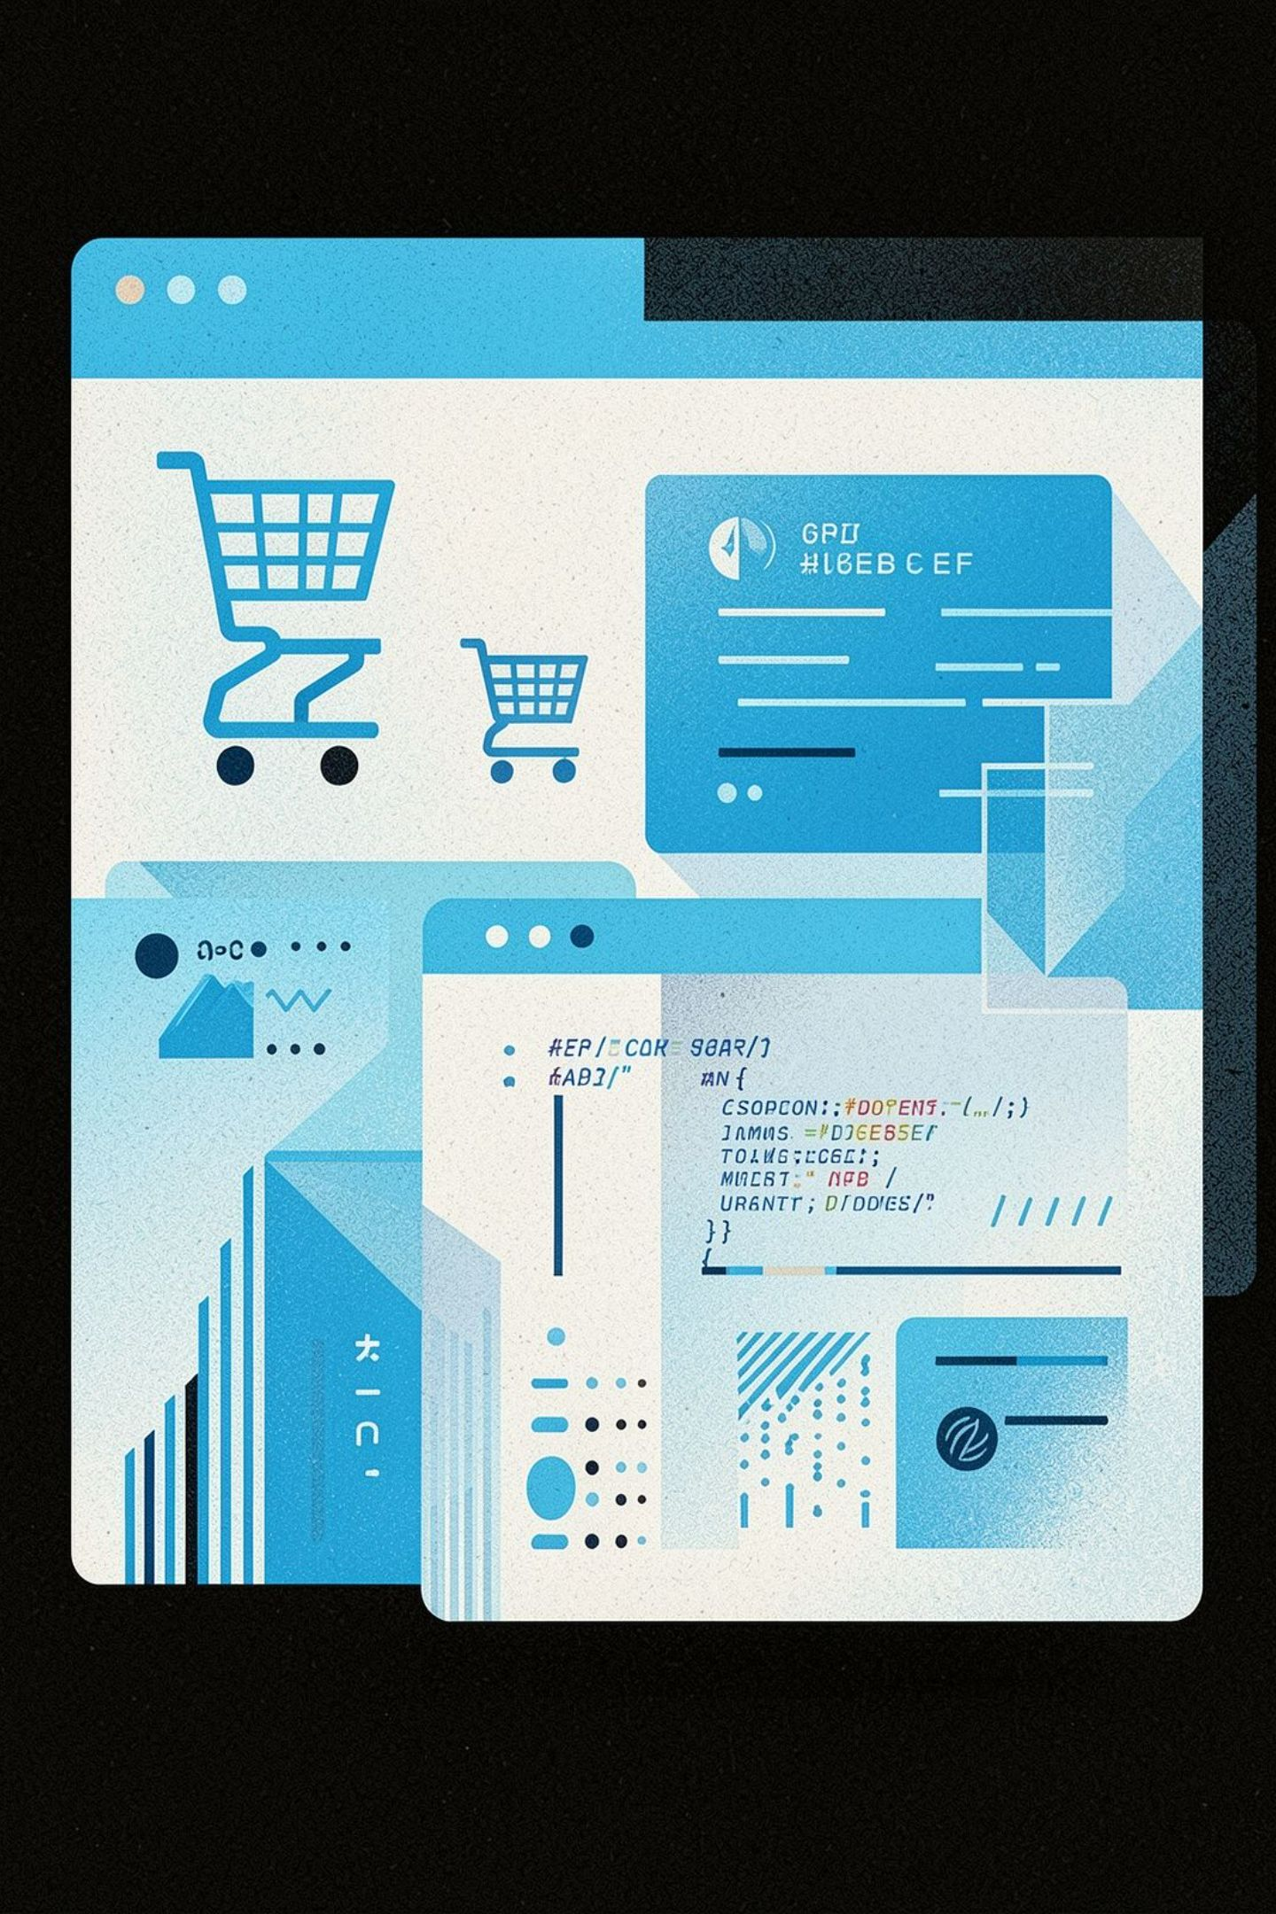
E-Commerce System -Additional Endpoints
Faisal Bageis

Slide 2
Buy Gift 🎁
Purpose: Allows a user to purchase a product as a gift for another user.
Inputs: User ID (Buyer), Product ID, Other User ID (Recipient)
How It Works:
1
Validate buyer, product, and recipient
Response Codes:
2
Check product availability
Code | Meaning
0 | User not found
1 | Product not found
2 | Recipient not found
3 | Product out of stock
4 | Insufficient balance
5 | Gift purchased successfully
3
Reduce product stock by one
4
Check the buyer's balance
5
Deduct the product price from the buyer's balance
6
Complete the gift purchase

Slide 3


Refund 💰
Purpose: Allows a user to receive a refund for a purchased product.
Inputs: User ID, Product ID, Merchant ID
Example: A customer returns a product worth 150 SAR and receives 150 SAR back.
Response Codes:
Code | Meaning
0 | User not found
1 | Product not found
2 | Merchant not found
3 | Refund processed
4 | Refund completed
Validate
Retrieve Price
Credit Balance
Return Stock

Slide 4

Compensation 💵
Purpose: Allows an administrator to compensate a user by adding money to their balance.
Inputs: Admin ID, Amount, User ID
How It Works:
01
02
Verify that the requester is an Admin
Find the target user
Example: An Admin gives a customer 100 SAR compensation due to a service issue.
03
04
Add the compensation amount to the user's balance
Complete the operation
Response Codes:
Code | Meaning
0 | Unauthorized / Not an Admin
1 | Compensation successful
2 | User not found

Slide 5

Repricing & Discount
Repricing 🔄
Discount 🏷️
Purpose: Allows the system to change the price of an existing product.
Inputs: Product ID, New Price
Example: Current Price: 100 SAR → New Price: 120 SAR
Response Codes: 0 (Price updated successfully), 1 (New price is the same as the current price), 2 (Product not found)
Purpose: Applies a percentage discount to a product.
Inputs: Product ID, Discount Percentage
Formula:
Example: Original Price: 200 SAR → Discount: 20% → Final Price: 160 SAR
Response Codes: True (Discount applied successfully), False (Product not found)
Find the product
Compare new vs. current price
Update if different
Return result
Find the product
Calculate the discounted price
Update the product price

Slide 6
Endpoint Overview
🎁 Buy Gift
💰 Refund
💵 Compensation
🔄 Repricing
Purchase a product for another user
Return money and product
Add compensation to a user's balance
Change the product price
🏷️ Discount
Reduce the product price by a percentage
Key Benefits: Improves customer experience, supports flexible product management, provides administrative control, handles common e-commerce operations, adds more functionality beyond basic CRUD.

Slide 7
Response Code Reference
A consolidated reference of all response codes across the five endpoints.
Endpoint | Code | Meaning
Buy Gift | 0–4 | Not found / Out of stock / Insufficient balance
Buy Gift | 5 | Gift purchased successfully
Refund | 0–2 | User / Product / Merchant not found
Refund | 3–4 | Refund processed / Refund completed
Compensation | 0 | Unauthorized / Not an Admin
Compensation | 1 | Compensation successful
Compensation | 2 | User not found
Repricing | 0 | Price updated successfully
Repricing | 1 | New price is the same as the current price
Repricing | 2 | Product not found
Discount | True | Discount applied successfully
Discount | False | Product not found

Slide 8
Thank You!
Questions?

