Slide 1

JUSTICE
Legal Consultation Platform
Connecting clients with suitable lawyers through a simple digital consultation process
CAPSTONE 2
JAVA
SPRING BOOT
REST API

Slide 2

The Problem
Finding the right lawyer can be difficult, especially when the client does not know which legal specialty matches their problem.
Unknown Specialty
Not knowing which legal specialty applies to their situation
Finding a Lawyer
Locating a suitable lawyer by specialty, city, and consultation price
Starting Communication
Initiating contact and managing the consultation process in one place
Legal Problem → Confusion → Searching → Calls / Visits → Finding a Lawyer

Slide 3


Real-World Example
The Scenario
A client has a problem related to a rental agreement. They know they need legal help, but face multiple barriers:
Don't know which legal specialty applies
Don't know which lawyers specialize in this area
Want a lawyer in their city
Want to compare consultation prices
Need a simple way to contact the lawyer
Traditional process: Search → Calls → Compare → Visit → Consultation
JUSTICE simplifies this entire journey.

Slide 4
Solution: JUSTICE
JUSTICE provides one platform where clients can search, connect, and manage their legal consultation from start to finish.
Search & Filter
Request & Respond
Find lawyers by specialty, city, and consultation price
Send consultation requests and receive accept/reject responses
Case Management
Review
Manage the consultation case and communicate with the lawyer
Submit feedback after case completion
🤖 AI Assistance: Describe the problem → Gemini AI → Possible Legal Specialty → Search for Lawyers
The AI provides a possible specialty suggestion and does not replace professional legal advice.

Slide 5

Main System Flow
Admin oversight
User discovery
Manage users, lawyers, system
Search or use AI assistant
Closure & review
Selection & request
Consultation Lifecycle
Close case and leave review
Pick lawyer and send request
Case management
Lawyer response
Open case for communication
Accept or reject request
The complete consultation lifecycle — from discovery to case closure — managed in one platform.

Slide 6


Key REST API Endpoints
Five essential endpoints supporting the main business flow:
1
GET /lawyer/search
Find lawyers by specialty, city, and price
2
POST /request
User sends a consultation request to a selected lawyer
3
PUT /request/{id}/accept
Lawyer accepts the user's consultation request
4
POST /case
Legal case created after request is accepted
Business Flow:
Search → Request → Accept → Case → Close
5
PUT /case/{id}/close
Closes the consultation case after completion

Slide 7


External API Integrations
📧 Gmail API
🤖 Gemini API
Handles email communication and notifications throughout the consultation process.
AI-assisted specialty identification for users unsure of their legal needs.
User Describes Problem
JUSTICE Calls Gemini
Returns Legal Specialty
JUSTICE Backend
Gmail Notification

Slide 8
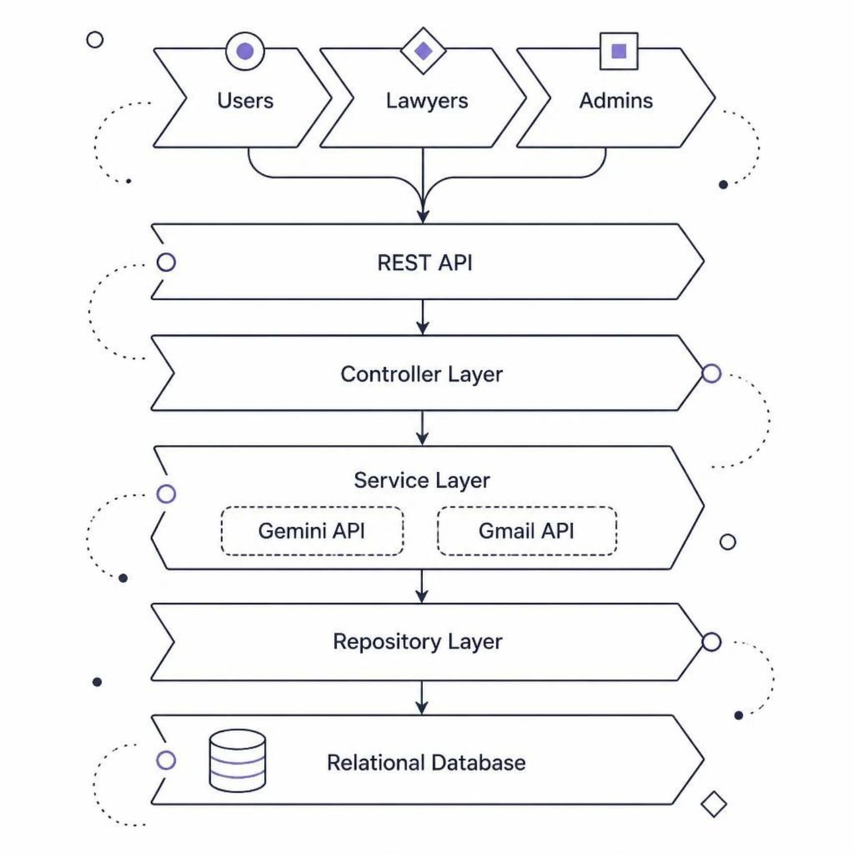
System Architecture
Technology Stack
Backend
API Layer
Java • Spring Boot • Spring Data JPA • Hibernate
REST APIs • Bean Validation
Data
Integrations
Relational Database
Gemini API • Gmail API

Slide 9
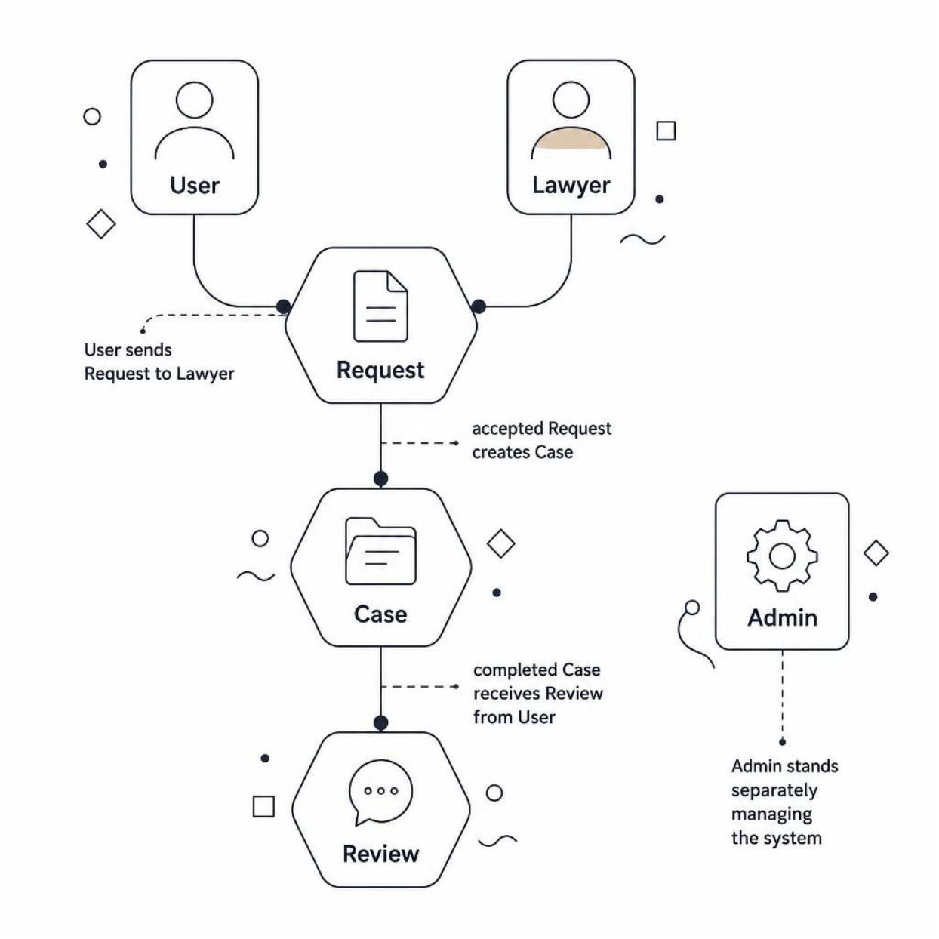

Database & Main Entities
Core Entities
User
Client seeking legal assistance
Lawyer
Legal professional offering consultation
Request
Consultation request from user to lawyer
Case
Active consultation case
Review
Client feedback after case completion
User → Request → Case → Review
Lawyer → Request → Case

Slide 10

JUSTICE: Making Legal Assistance Simpler
The Journey
Key Features
Problem
Lawyer search by specialty, city, and price
Consultation requests and case management
Secure communication
Client reviews
AI-assisted specialty identification
Finding the right lawyer can be difficult
Solution
A digital platform connecting clients with suitable lawyers
SPRING BOOT
REST API
GEMINI API
GMAIL API
Thank You

