Slide 1
Flow Graph of Software Keyboard Interfacing
Presented by : Mohammad Faisal Chowdhury
ID: 1111031
Presented to: Syed Shakil Mahmud
Lecturer, Dept. of CSE

Slide 2
Introduction and Overview
What is Software Keyboard Interfacing?
- The process of connecting a keyboard with software to process inputs like key presses and releases.
- Converts physical actions into digital signals that software can use.
Why It Matters:
- Enables interaction with devices like computers, gaming systems, and embedded interfaces.
Flow Overview:
- Initialization of hardware and software.
- Continuous real-time response.

Slide 3
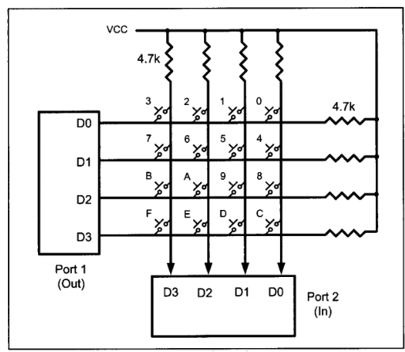
00
01
10
11
11 10 01 00
Fig: Keyboard Interfacing with 80551

Slide 4
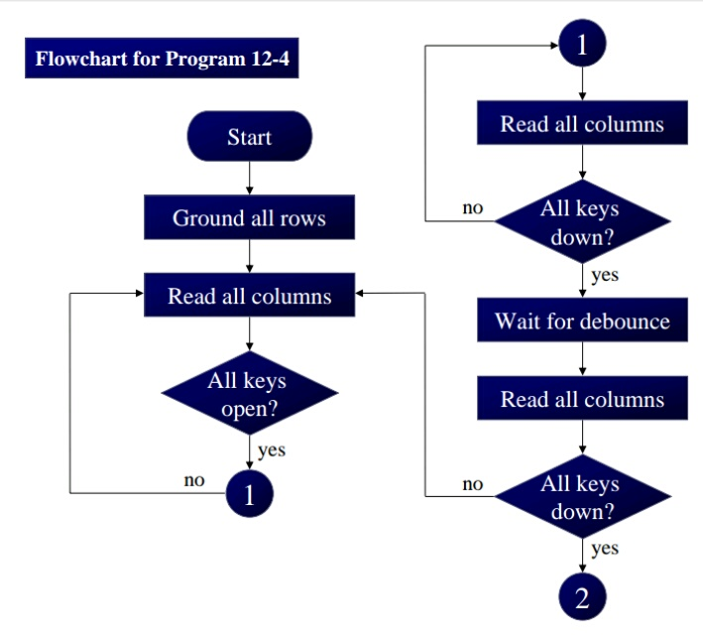
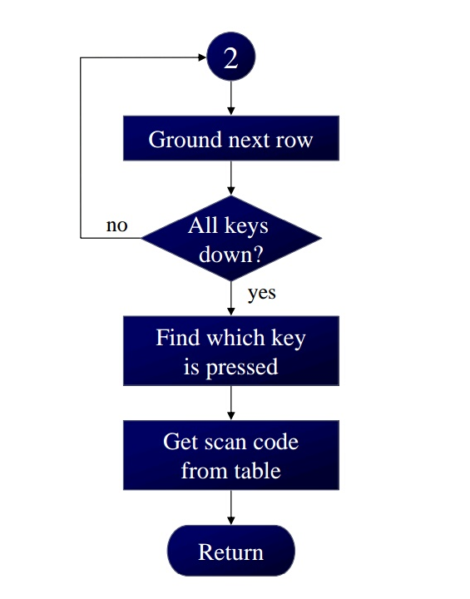
Flow Graph
Fig: Flowgraph of keyboard interfacing

Slide 5
Conclusion
Key Takeaways:
- Keyboard interfacing bridges physical inputs and digital systems.
- The flow graph simplifies understanding of this process.

Slide 6
Thank You

