Slide 1
Mediator Design Pattern
Programming Palli

Slide 2
What is Mediator
The mediator pattern defines an object that encapsulates how a set of objects interact.
It is considered to be a “behavioral pattern”.
The pattern restricts direct communications between objects.
Objects communicate with each other indirectly through the mediator.

Slide 3
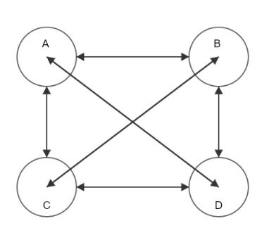
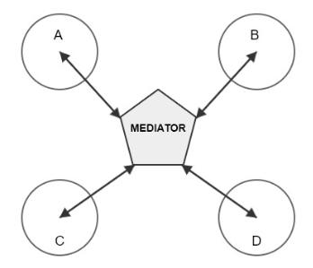
Conceptual Example

Slide 4

Real World Example

Slide 5
Question?

Slide 6
Thank You
Please subscribe

