Slide 1
CQRS Design Pattern
Programming Palli

Slide 2
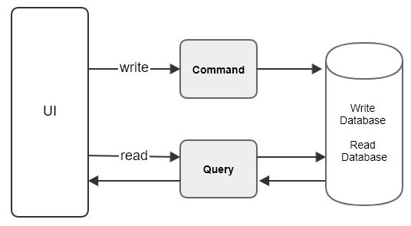
What is CQRS
CQRS stand for “Command Query Responsibility Segregation”.
Basically this pattern separates read and update operations for a database.
CQRS separates reads and writes into different models, uses “command” to update the data and “query” to read the data.

Slide 3
Why use CQRS
Large projects where high performance is required and independent scalability is required.
In the applications where business logic is complex. In such a case, you can separate your reads from write to make it more simple.

Slide 4
Pros
Independent optimization of read and write paths for better performance.
Handling complex queries and reporting without affecting write operations.
Distinct separation of command (write) and query (read) concerns for clarity.
Enhanced user experience due to faster and more responsive queries.
Avoid query bottlenecks affecting writes.

Slide 5
Challenges
Increase complexity to architecture and codebase.
Developers need to understand and manage complexities.
Synchronizing data between read and write sides can be challenging.
Synchronization mechanisms requires more effort.
Debugging and troubleshooting complex.

Slide 6
Question?

Slide 7
Thank You
Please subscribe

