Slide 1
Domain Driven Design
Programming Palli

Slide 2
Agenda
What is DDD?
Why use DDD?
Types of DDD.
Ubiquitous Language.
Bounded Context.
Context Maps.
Entity.
Value Object.
Aggregate.

Slide 3
Domain Driven Design
Not a technology.
Domain-driven design is the idea of solving problems of the organization through code.
Domain-driven design solves complex domain models, connecting to the core business concepts.
Collection of principles

Slide 4
Why DDD
Complex domain.
Clear Communication.
Team Collaboration.

Slide 5
Domain Driven Design
Strategic Design
Tactical Design
Ubiquitous Language
Bounded Context
Context Maps

Slide 6
Ubiquitous Language
It is a shared vocabulary used by both development teams and domain experts.
Naming is important.
The code should use the same terms used in documents and discussion.
Use it consistently in speech, documentation, diagrams and code.
A change in ubiquitous language then change in Model and Code.

Slide 7
Bounded Context
Bounded context is a specific “Business Process / Concern”.
Components/ Modules inside the bounded context are context specific.
Each bounded context will have it’s own “Source Code Repository”.
Within a bounded context the team must have same language called “Uniwuitous language” for spoken and for design / code implementation.

Slide 8
Customer Model in Different Bounded Context
Customer
CustomerId
Discount
Bonus Programm
Customer
CustomerId
Address
DeliveryMethod
Packaging
Delivery Contact
Customer
CustomerId
BillingAddress
PaymentType
Tax
Order
Delivery
Billing

Slide 9
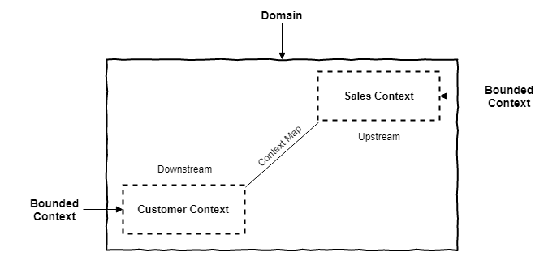
Context Map
Context Maps help in understanding the whole project, being able to show the relationships between the different Bounded Contexts.

Slide 10
Domain Driven Design
Strategic Design
Tactical Design
Entity
Value Object
Aggregate

Slide 11
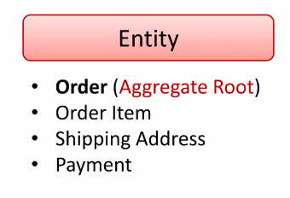
Entity
Entity are domain concepts with have an identity and can be stored in a database.
Identity may be determined by assigned key.
Mutable - can be changed.

Slide 12
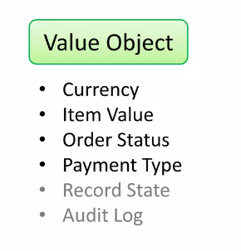
Value Objects
Value object represent a specific business concept related that bounded context in that sub-domain.
Immutable - value object can not change, they must be replaced.
Value object does not have any specific identity.
It exists as part of an Entity.

Slide 13
Aggregate
An aggregate is cluster of Entities and value objects. Each aggregate is treated as one single unit.
An aggregate includes a root entity, entities, and value objects.
The root identity is global, the identities of entities inside are local.
External objects may have references only to root.
Internal objects cannot be changed outside the aggregate.

Slide 14
Question?

Slide 15
Thank You
Please subscribe

