Slide 1
Prerequisites
Programming Palli

Slide 2
Prerequisites
Basic knowledge of C#.
Have knowledge of Asp.Net MVC and REST API.
OOP Concenpt.
IIS.

Slide 3
Source Code
Source code on Github
Link: https://github.com/faisalcse1/microservicedemo
Fork the repository.
Find you solution.
Send pull request.

Slide 4
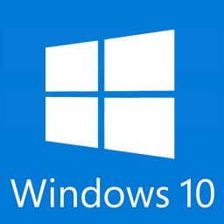
Tools that we will use
.NET7 or above SDK.
Visual Studio 2022 version17.x or above.
Internet Information Service(IIS).
Postman.

Slide 5
Thank You
Please subscribe

