Slide 1
Redis
Programming Palli

Slide 2
Redis
Redis stands for REmote DIctionary Server.
Redis is an open source, in-memory, NoSQL key/value database.
It is primarily used as an application cache or quick-response database.
Redis supports a lot of languages such as C#, C++,Java etc.

Slide 3
Pros
Fast Performance.
Simplicity.
Open Source.
A wide range of Data Structures.
Capable of withstanding failures.

Slide 4
Cons
In-memory storage.
No query language.
Limited access rights.
Unique instances are not scalable.

Slide 5
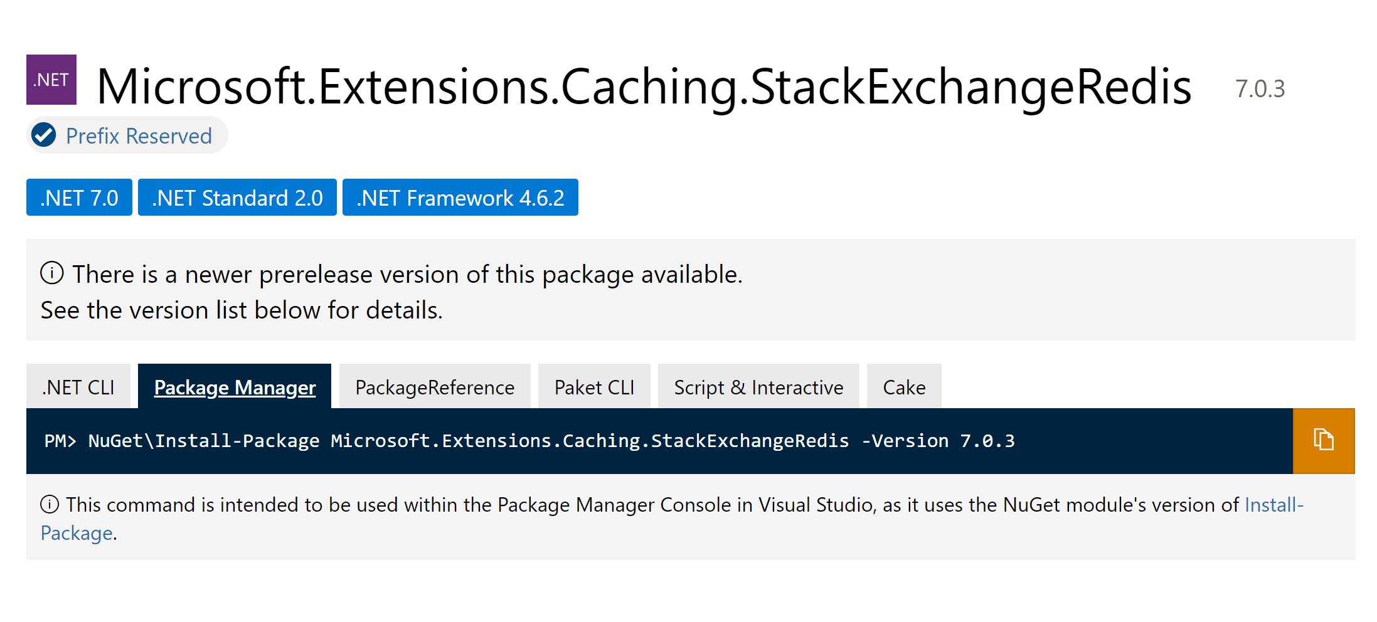
Tools that we will use
Microsoft.Extensions.Caching.StackExchangeRedis
Link:https://www.nuget.org/packages/Microsoft.Extensions.Caching.StackExchangeRedis.

Slide 6
Thank You
Please subscribe

