Slide 1
RabbitMQ
Programming Palli

Slide 2
Introduction to RabbitMQ
RabbitMQ is an open-source message broker software written in Erlang.
It is commonly called message-oriented middleware that implements the AMQP (Advanced Message Queuing Protocol).
RabbitMQ supports multiple messageing protocols like MQ Telemetry Transport (MQTT), Streaming Text Oriented Messaging Protocol (STOMP).
RabbitMQ follows FIFO methods.

Slide 3
Basic concepts of RabbitMQ
Producer: A producer is the one who sends messages to a queue based on the queue name.
Queue: A Queue is a sequential data structure that is a medium through which messages are transferred and stored.
Consumer: A consumer is the one who subscribes to and receives messages from the broker.
Exchange: An exchange is an entry point for the broker because it takes messages from a publisher and routes those messages to the appropriate queue.
Channel: Channels offer a lightweight connection to a broker via a shared TCP connection.

Slide 4
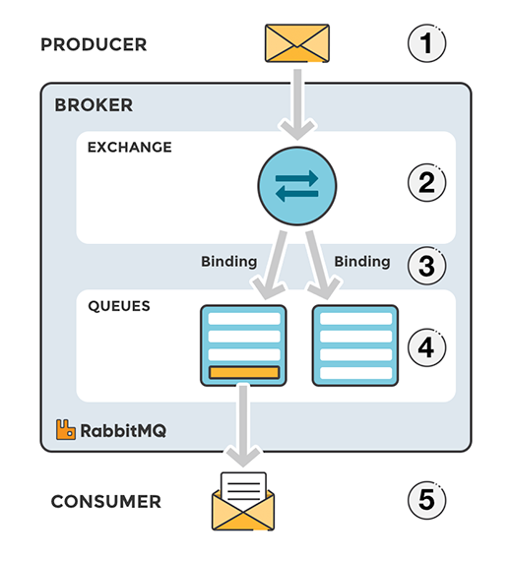
RabbitMQ Message Flow
The producer publishes a message to the exchange.
The exchange receives the message and responsible for the routing of the message.
A binding has to be set up between the queue and the exchange. It defines the rules for how messages should be routed from the exchange to the queue.
The messages stay in the queue until they are handled by a consumer.
The consumer handles the message.

Slide 5
Question?

Slide 6
Thank You
Please subscribe

