Slide 1
SOLID Principles
Programming Palli

Slide 2
What is SOLID
The SOLID principles are a set of design principles for object-oriented programming (OOP) that aim to make software systems more maintainable, flexible, and robust.

Slide 3
SOLID Stands
Single Responsibility Principle (SRP)
Open-closed Principle (OCP)
Liskov substitution Principle (LSP)
Interface Segregation Principle (ISP)
Dependency Inversion Principle (DIP)

Slide 4
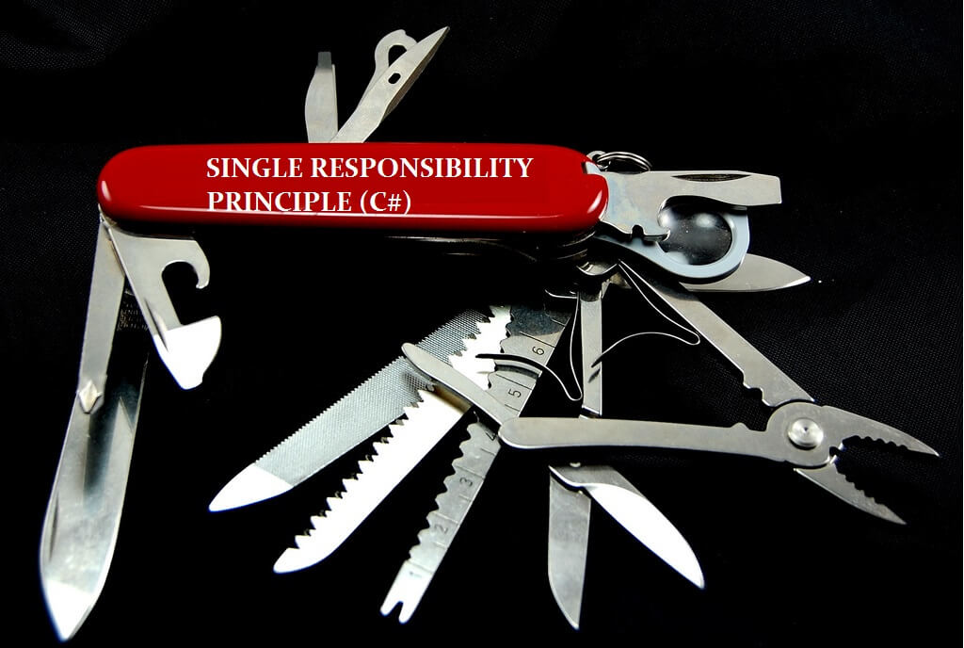
Single Responsibility Principle (SRP)
A class should have only one reason to change.
A class should have only one responsibility.

Slide 5



Open-closed Principle (OCP)
Software entities (classes, modules, functions, etc.) should be open for extension but closed for modification.

Slide 6
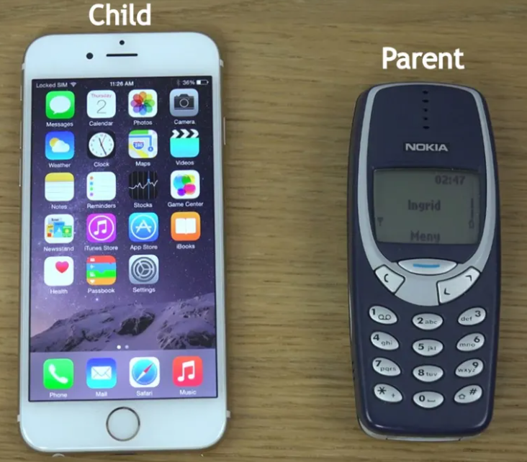
Liskov substitution Principle (LSP)
A derived class must be substitutable for its base class.
You should be able to use any derived class instead of a parent class and have it behave in the same manner without modification.

Slide 7
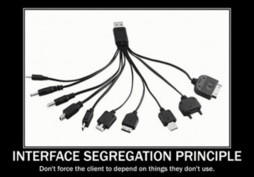
Interface Segregation Principle (ISP)
That clients should not be forced to implement interfaces they don't use.

Slide 8

Dependency Inversion Principle (DIP)
High-level class should not depend on low-level class.
Both should depend upon abstractions.

Slide 9
Question?

Slide 10
Thank You
Please subscribe

