Slide 1
Prediction of Diabetes Disease using Data mining
WEB APP LINK: https://p2diabetes.herokuapp.com/

Slide 2
Supervisor Ataullah Bhuiyan
Senior Lecturer & Coordinator
Dept. of CSE
City University
Group Members
Faisal Ahmed
ID-161412316
Dept. of CSE
City University
Md. Manwar
ID-161412323
Dept. of CSE
City University

Slide 3
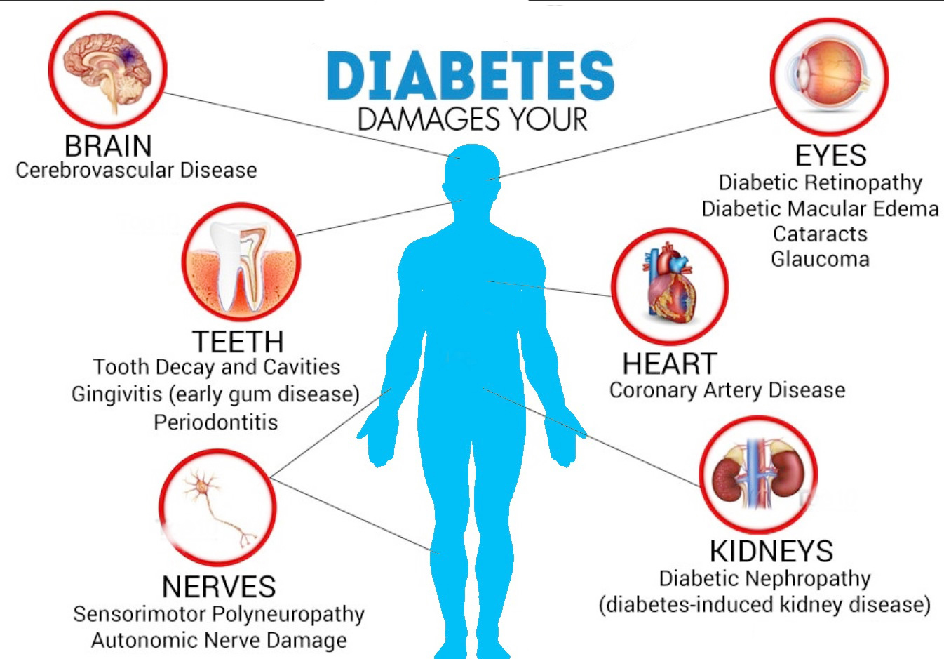
Problem statement

Slide 4
Contents
Problem Statement
Existing work
Compare with existing work
Comparative Analysis
Algorithm & Technique
Comparison of the Training & Testing performance
Proposed system
Objective of the Proposed system
Architecture of the Proposed system
Work Procedure
Resources
Gantt chart
Budget
Scope
Benefits
Methodology
Prediction
Future Work
Conclusion
References

Slide 5
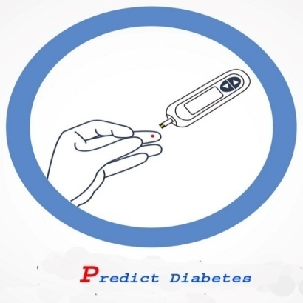
Problem Statement
The aim of this project is to develop a system which can perform early prediction of diabetes for a patient with a higher accuracy by combining the results of different supervised machine learning algorithm.

Slide 6
Existing work
Existing project 1:
Name: Prediction of Diabetes using Classiﬁcation Algorithms
This paper has explained to design a model which can prognosticate the likelihood of diabetes in patients with maximum accuracy. Therefore three machine learning classification algorithms namely Decision Tree, SVM and Naive Bayes are used in this experiment to detect diabetes at an early stage. Experiments are performed on Pima Indians Diabetes Database (PIDD) which is sourced from UCI machine learning repository.
Accuracy: 76.36% on-Pima Indians Diabetes Dataset (as they claimed). [1]
Existing project 2:
Name: Predicting Diabetes Mellitus With Machine Learning Techniques
This article focused on there own dataset to predict diabetes mellitus. The dataset is the hospital physical examination data in Luzhou, China. It contains 14 attributes. They randomly selected 68994 healthy people and diabetic patients’ data, respectively as training set. They used principal component analysis (PCA) and minimum redundancy maximum relevance (mRMR) to reduce the dimensionality.
Accuracy: 77.21% on -Pima Indians Diabetes Dataset (as they claimed).
80.84% on –Luzhou Dataset (as they claimed). [2]
Existing project 3:
Name: Prediction of Diabetes by Employing a New Data Mining Approach Which Balances Fitting and Generalization
This paper has described a new approach, called the Homogeneity- Based Algorithm (or HBA) as developed by Pham and Triantaphyllou to optimally control the overfitting and overgeneralization behaviors of classification on the pima indian dataset. The HBA is used in conjunction with traditional classification approaches (such as Support Vector Machines (SVMs), Artificial Neural Networks (ANNs), or Decision Trees (DTs)) to enhance their classification accuracy.
Accuracy: 77.6% on-Pima Indians Diabetes Dataset (as they claimed). [3]

Slide 7
Compare with existing work
 | Existing System | Proposed System
Algorithms | [1]Decision Tree, SVM and Naive Bayes [2]Principal component analysis (PCA) [3]HBA,SVM,ANN,DT | Naïve Bayes
Technology | [1]WEKA tool,[2] WEKA, Matlab, | Python,Scikit-learn, NumPy, Pandas, Matplotlib etc.
Dataset | [1][3]Pima Indians Diabetes[2] LuzhouDataset, Pima Indians Diabetes | Pima Indians Diabetes Dataset
Accuracy | [1]76.36%, [2] 77.21% , 80.84% [3]77.6% | 75.65%
Deployment | NO | Web App

Slide 8

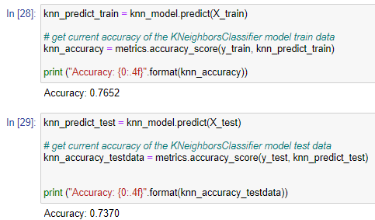
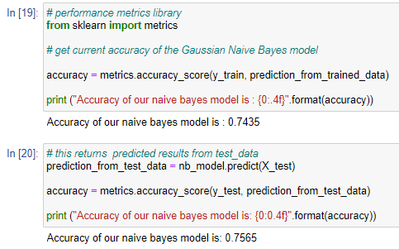
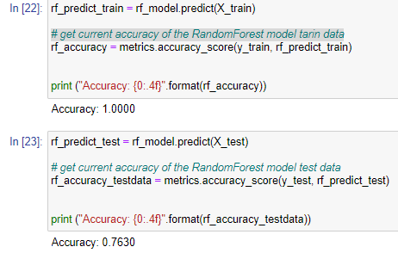
Comparative Analysis ( Using Different Algorithms)

Slide 9
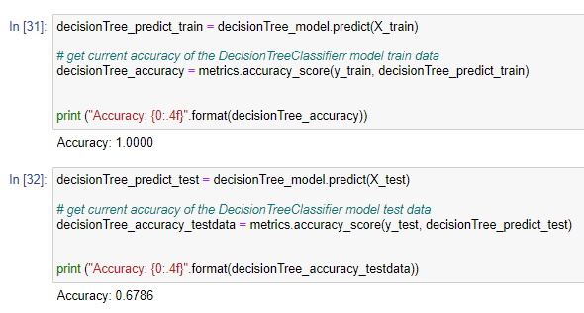
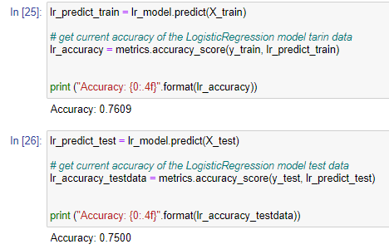

Slide 10
How to choose right algorithm
Size of the training data
Speed or training time
Number of features

Slide 11
Algorithm & Technique
Machine Learning
Supervised learning
Unsupervised learning
Reinforcement learning
Regression
Naïve Bayes
Random Forest
Logistic Regression
Classification
K nearest neighbor
Decision Tree
SVM

Slide 12
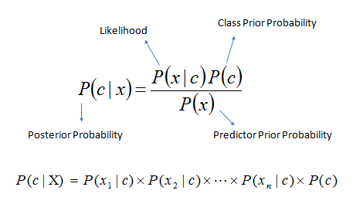
Naive Bayes

Slide 13
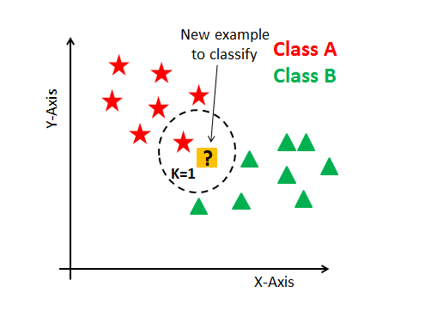
KNN( K- nearest neighbor):

Slide 14
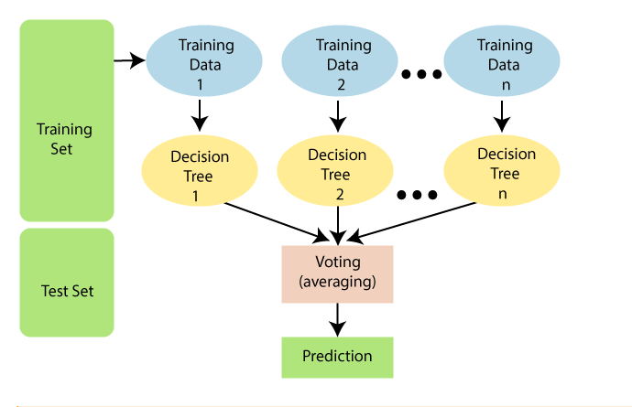
Random Forest:

Slide 15
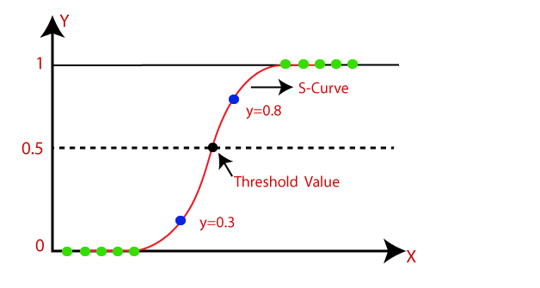
Logistic regression:

Slide 16
Comparison of the Training & Testing performance
Training
74.35%
Training
100%
Training
76.09%
Training
76.52%
Training
100%
Testing
75.65%
Testing
76.30%
Testing
75.00%
Testing
73.70%
Testing
67.86%
Naïve Bayes
Random Forest
Logistic Regression
K nearest Neighbor
Decision Tree

Slide 17
Cont….

Slide 18

Proposed system

Slide 19
Objective of our project
The objective of this project is to predict the diabetic cases analyzing which factors responsible for diabetics using data mining methods with maximum accuracy.

Slide 20
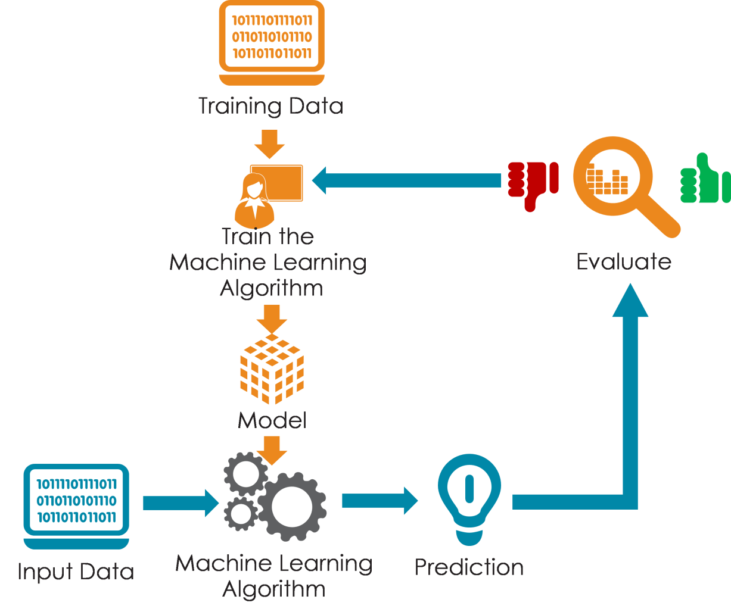
Architecture of our project

Slide 21
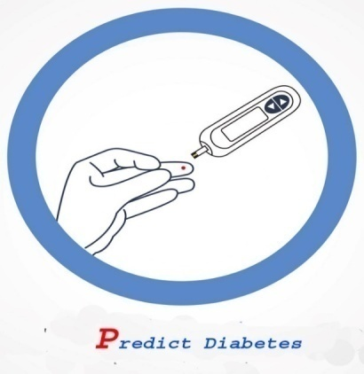
Work Procedure
Data Collection
Data Pre-processing
Select the right machine learning algorithm
Build the model
Testing the model
Model Deployment

Slide 22
Resources
Software Dependencies:
Spyder IDE
Google Colab
Python
Flask
Heroku As a PaaS
Scikit-learn
NumPy
Pandas
Matplotlib
Seaborn etc.
Hardware:
We will deploy our trained model in core i5 2.40 GHz processor computer with 8 GB RAM.

Slide 23

Gantt Chart
 | Jan | Feb | Mar | Apr | May | June | July | Aug | S E p | OC T | NO V | D E C
Data Collection |  |  |  | =86 days
Data Pre-processing |  |  |  |  | =60days
Model Analysis |  |  |  |  | =19 days
Building Model |  |  |  |  |  | =24 days
Testing Model |  |  |  |  |  |  | =34days
Model Deployment |  |  |  |  |  |  |  | =48days
-31 Mar
5 Jan
15 Feb-15 Apr
16Apr-5May
6May-30May
1Jun-5July
6July-23Aug
Incomplete
complete
Not started

Slide 24
Budget
1 | Create dataset (Gathering Data, Data preparation, Data Wrangling, Analyses data) | 10000/= tk
2 | Train the model | 50000/= tk
3 | Test the model | 40000/= tk
4 | Computer for development | 100000/=tk
Total= |  | 200000/=tk

Slide 25
Scope
The system will present at doctor assistant.
The user can check his/her diagnose at home.
It also helps in medical health research.

Slide 26
Benefits
The number of test should be reduced.
The reduced test plays an important role in time and cost.
In early the ability to diagnose diabetes plays a vital role for the patients treatment process.

Slide 27
Methodology
Dataset and Attributes
Dataset: “Pima Indian Diabetes”
No. | Name of Attributes | Type
1 | Glucose concentration a 2 hours in an oral glucose tolerance | Numeric
2 | Diastolic blood pressure | Numeric
3 | Skin Thickness (Triceps skin fold thickness (mm)) | Numeric
4 | BMI | Numeric
5 | Age | Numeric
6 | Diabetes | Numeric

Slide 28
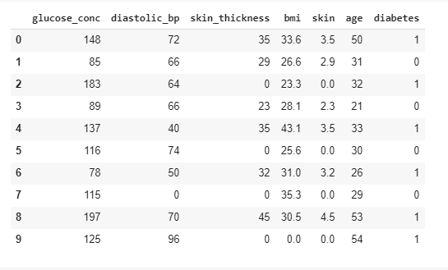
Sample Dataset

Slide 29

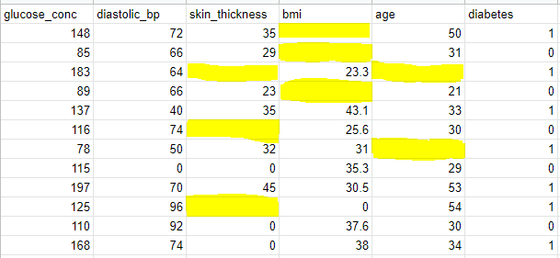
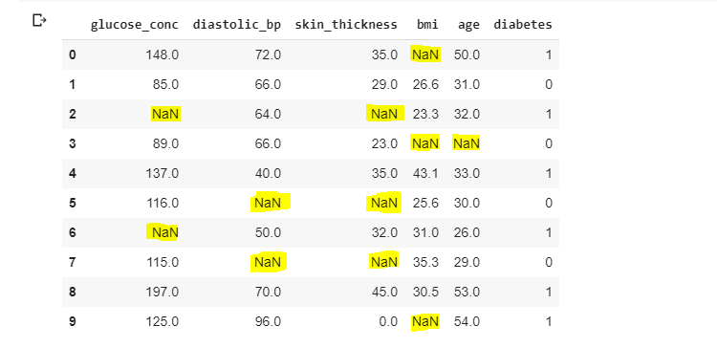
Data Cleaning

Slide 30

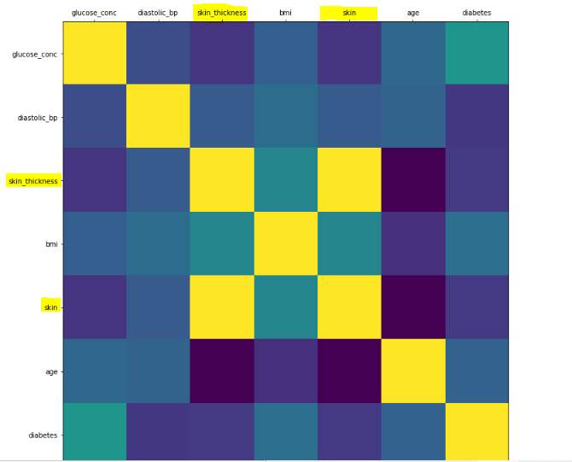
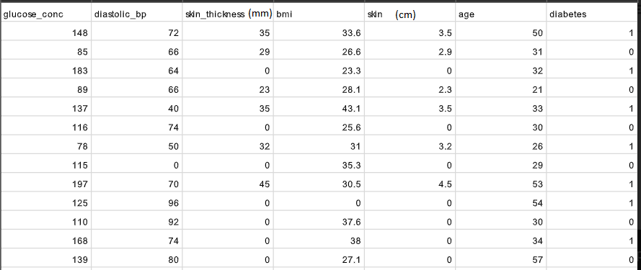
Data Integration

Slide 31
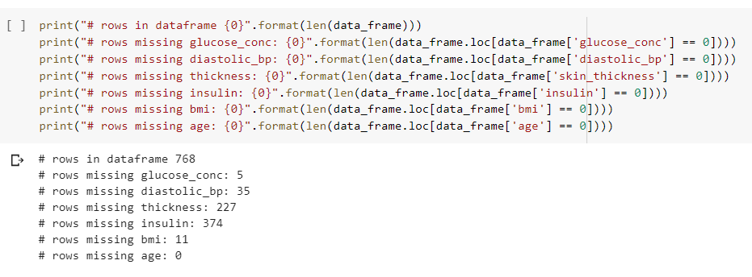
Missing Data Checking:

Slide 32

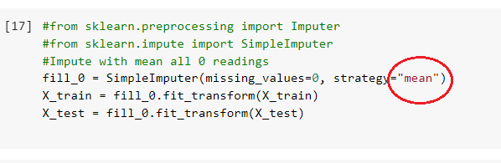
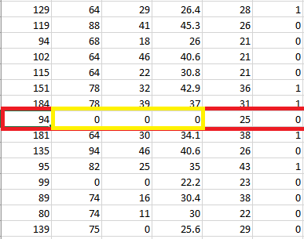
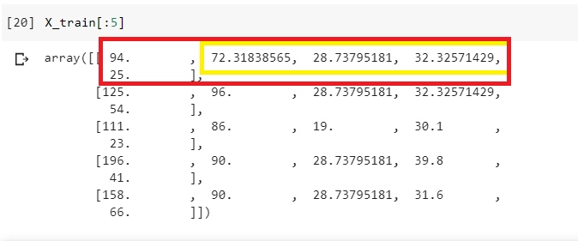
Missing Data Filled up

Slide 33
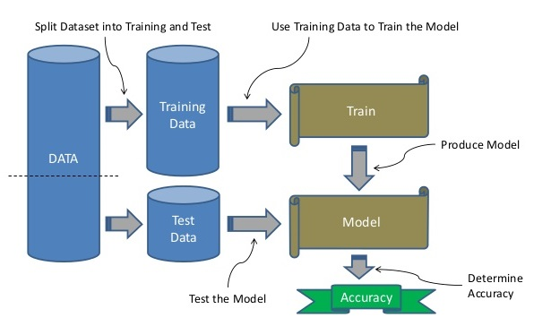
Data Splitting

Slide 34
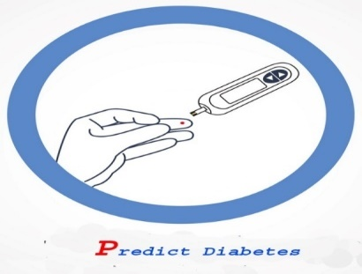
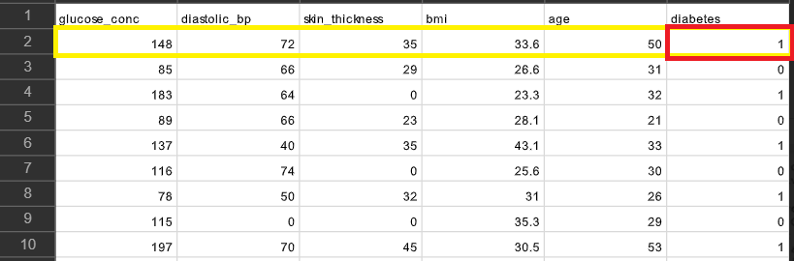
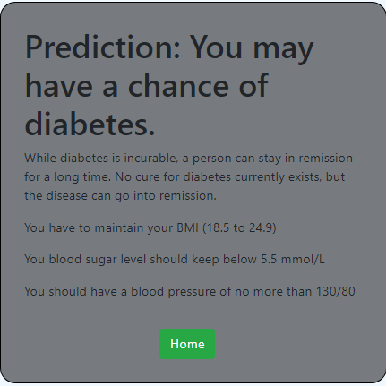
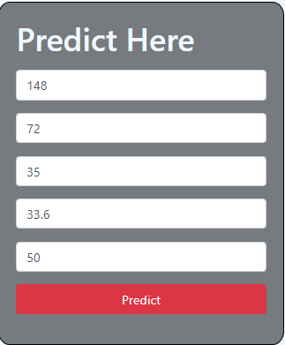
Results
Test Case 1:

Slide 35

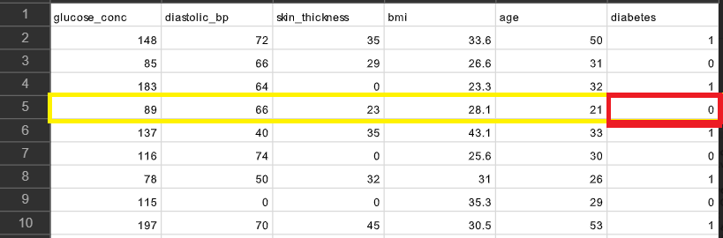
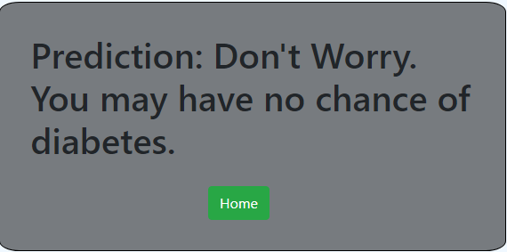
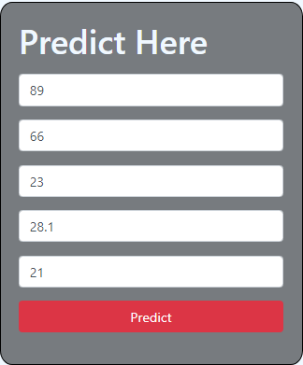
Test Case 2:

Slide 36

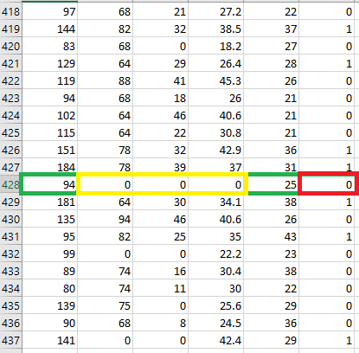
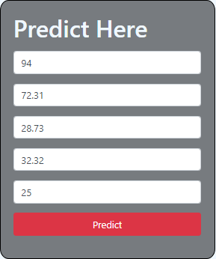
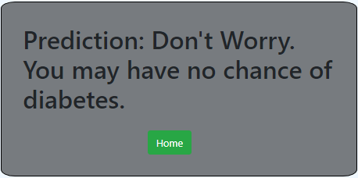
Test Case 3:

Slide 37
FUTURE WORK
Improving Performance
Mobile base Application
User Account System
Automatic Treatment or Recommendation

Slide 38
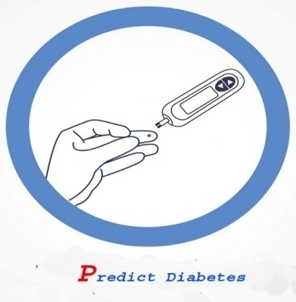
Conclusion
The result of the project shows the predictions system that is capable of predicting diabetes effectively, efficiently and most importantly, timely. That means the project capable of making decisions towards patient health risks. It generates results that make it closer to the real life situations. Much more than huge savings in costs in terms of medical expenses, loss of duty time and usage of critical medical facilities.

Slide 39

References
[1] D. Sisodia and D. S. Sisodia, “Prediction of Diabetes using Classification Algorithms,” Procedia Computer Science, vol. 132, pp. 1578–1585, 2018.
[2] Q. Zou, K. Qu, Y. Luo, D. Yin, Y. Ju, and H. Tang, “Predicting Diabetes Mellitus With Machine Learning Techniques,” Frontiers in Genetics, vol. 9, Nov. 2018.
[3]H. N. A. Pham and E. Triantaphyllou, “Prediction of Diabetes by Employing a New Data Mining Approach Which Balances Fitting and Generalization,” Studies in Computational Intelligence, pp. 11–26.
[4] About diabetes information
https://www.thediabetescentre.com/diabetes-complications-n/uncontrolled-diabetes-new_l2/
[5] http://tiny.cc/1o8ziz
For citation
[6] https://scinapse.io/
For video editing
[7] https://www.plotagon.com/
[8] https://www.thedailystar.net/supplements/world-diabetes-day-2018/news/worrying-picture-diabetes-bangladesh-1659979
[9] Introduction-to-machine-learning
https://www.ssdntech.com/blog/introduction-to-machine-learning/
[10] Uncontrolled-diabetes
https://healthyself.rocks/diabetes/short-and-long-term-consequences-of-uncontrolled-diabetes/
[11] Predict-my-age
https://www.crazyengineers.com/threads/computer-predict-my-age-study-shows-improvement-in-age-prediction.98651
[12] machine-learning-splitting-datasets https://image.slidesharecdn.com/mlregression-splittingdatasets-170914113926/95/machine-learning-splitting-datasets-3-638.jpg?cb=1505389251

Slide 41
Any Question

