Slide 1

Tour Assistant, An Android Application
Software Engineering Lab, CSE 416
Course Teacher: Sabbir Muhammad Saleh

Slide 2
Project Group Members
Md Sakibul Alam 161412315
Faisal Ahmed 161412316
Hossain Mohammad Farhad 161412350
Akash Saha 161412341
Mahadi Hasan 161412334
Md Ripan Miah 161412306

Slide 3
Agenda / Topics
Project Description
Project Methodology
Results (Application Demo)
Survey
Conclusion
Appendix

Slide 4
Project Description
Objective
Results
Tour Assistant App helps to organize the people for a schedule to make travel easy ,comfort and keep away any kind of hassle.
People can be able to easy his tour by using this apps feature like event budget,expenditure,destination, weather update etc.

Slide 5
Project Methodology
View of the Developer and User
Causes that may fail our project
Feasibility
Requirement
Cost Benefit

Slide 6
Methodology

Slide 7
View of developer and user
Developer View
User View
A simple application for mobile user.
Couples of pages for user to interact with the application
Simple and light application.
Don’t need to put any extra data to use.
Saves storage space

Slide 8
Causes that may fail our project
Not user-friendly
High cost
Difficult to deliver on time
Low quality

Slide 9
Feasibility
Technical
Operational
Economic
Schedule

Slide 10
Requirement & Cost Benefit
Requirement
Cost Benefit
A computer with required softwares to develop the application.
An android device to test the application.
Cost for this project is only time.
User will get benefited as well as the developer as a user.

Slide 11
Results

Slide 12
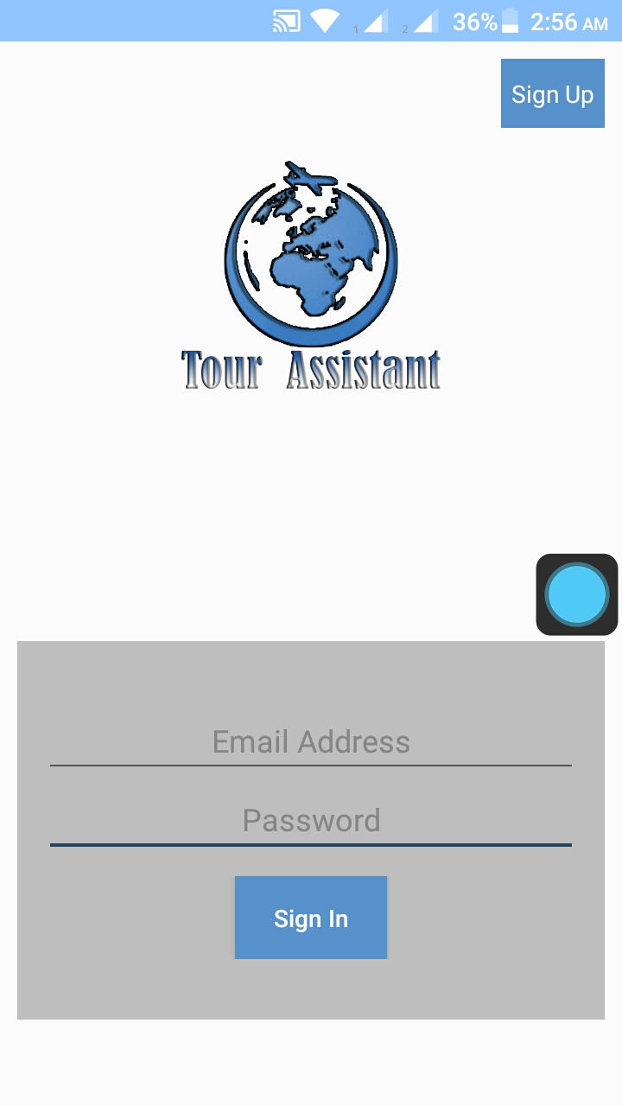
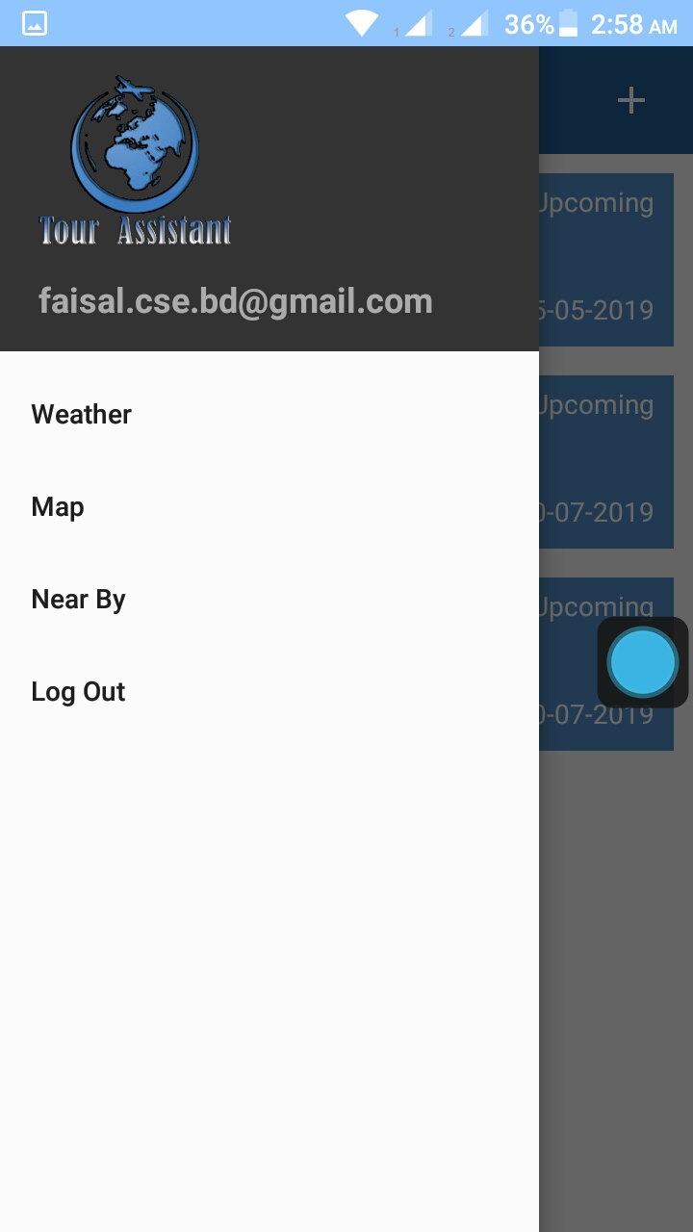
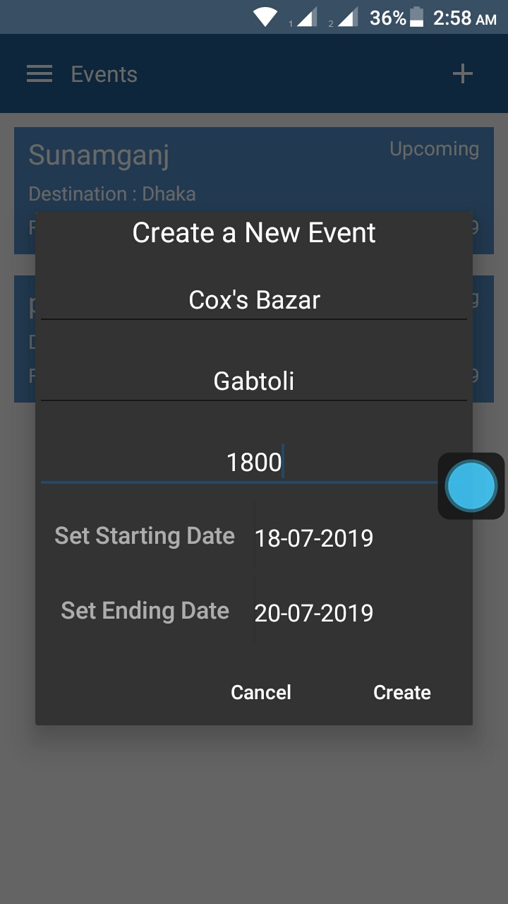
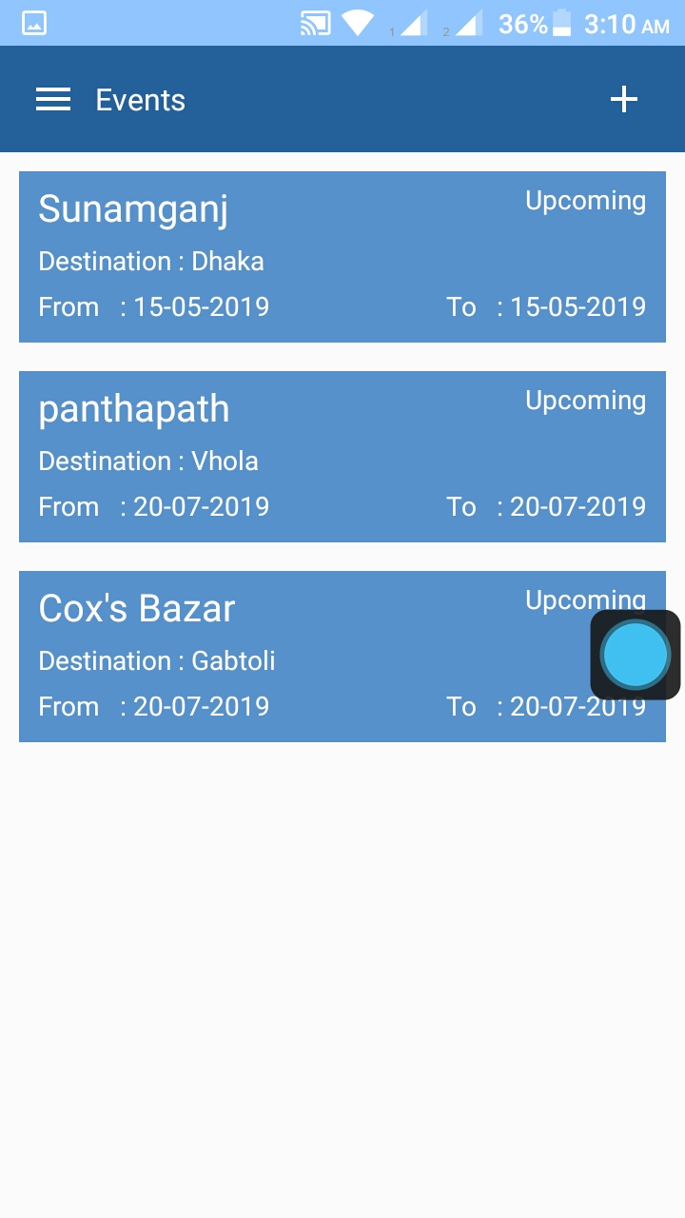
Sign Up/Sign In/Create Event

Slide 13
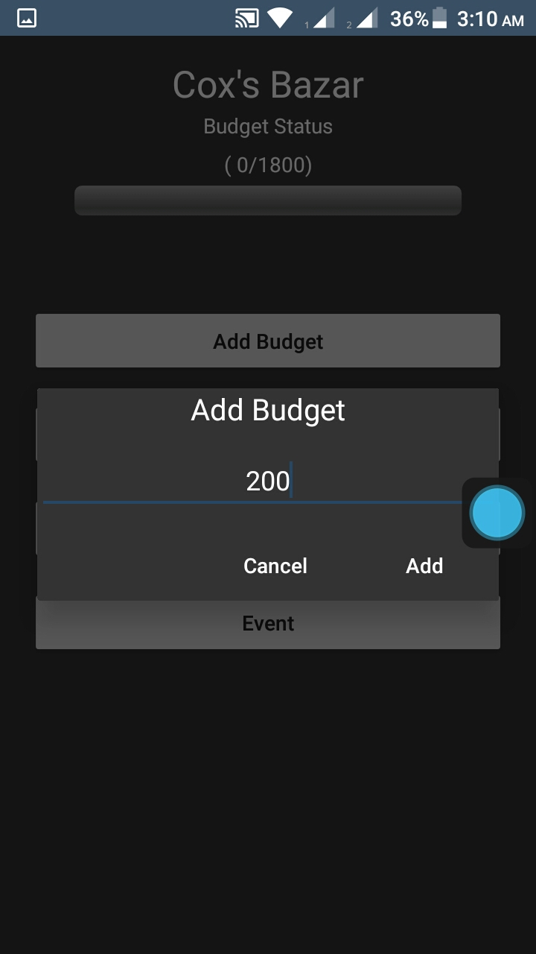
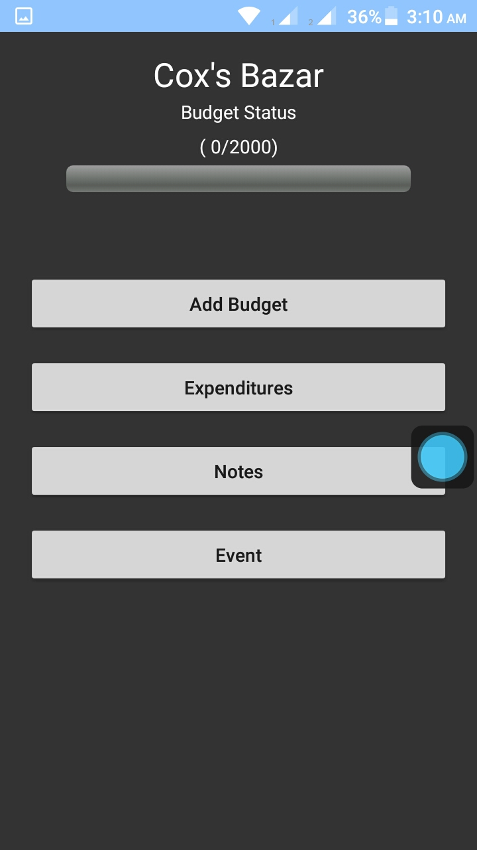
Add Budget

Slide 14
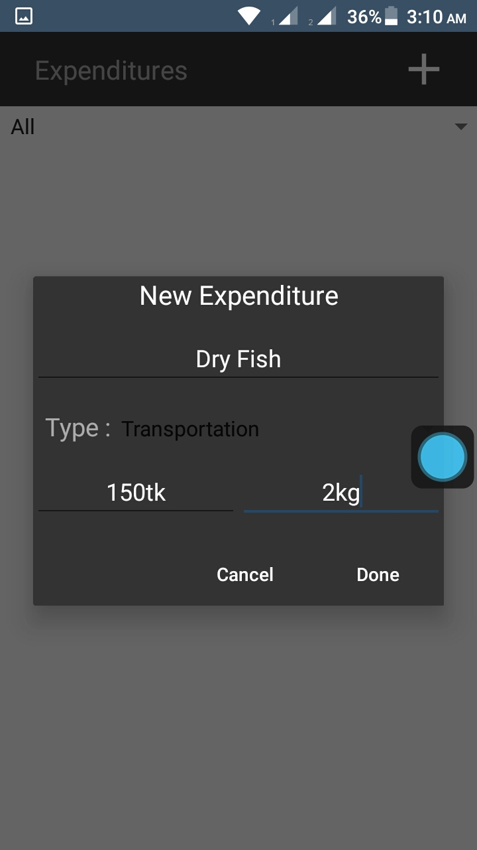
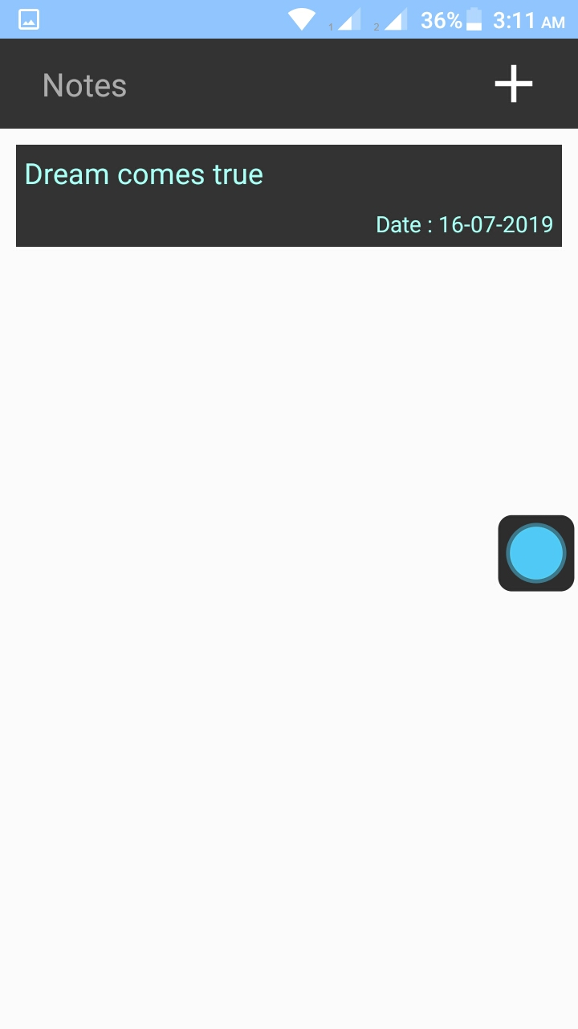
Expenditure/Notes

Slide 15
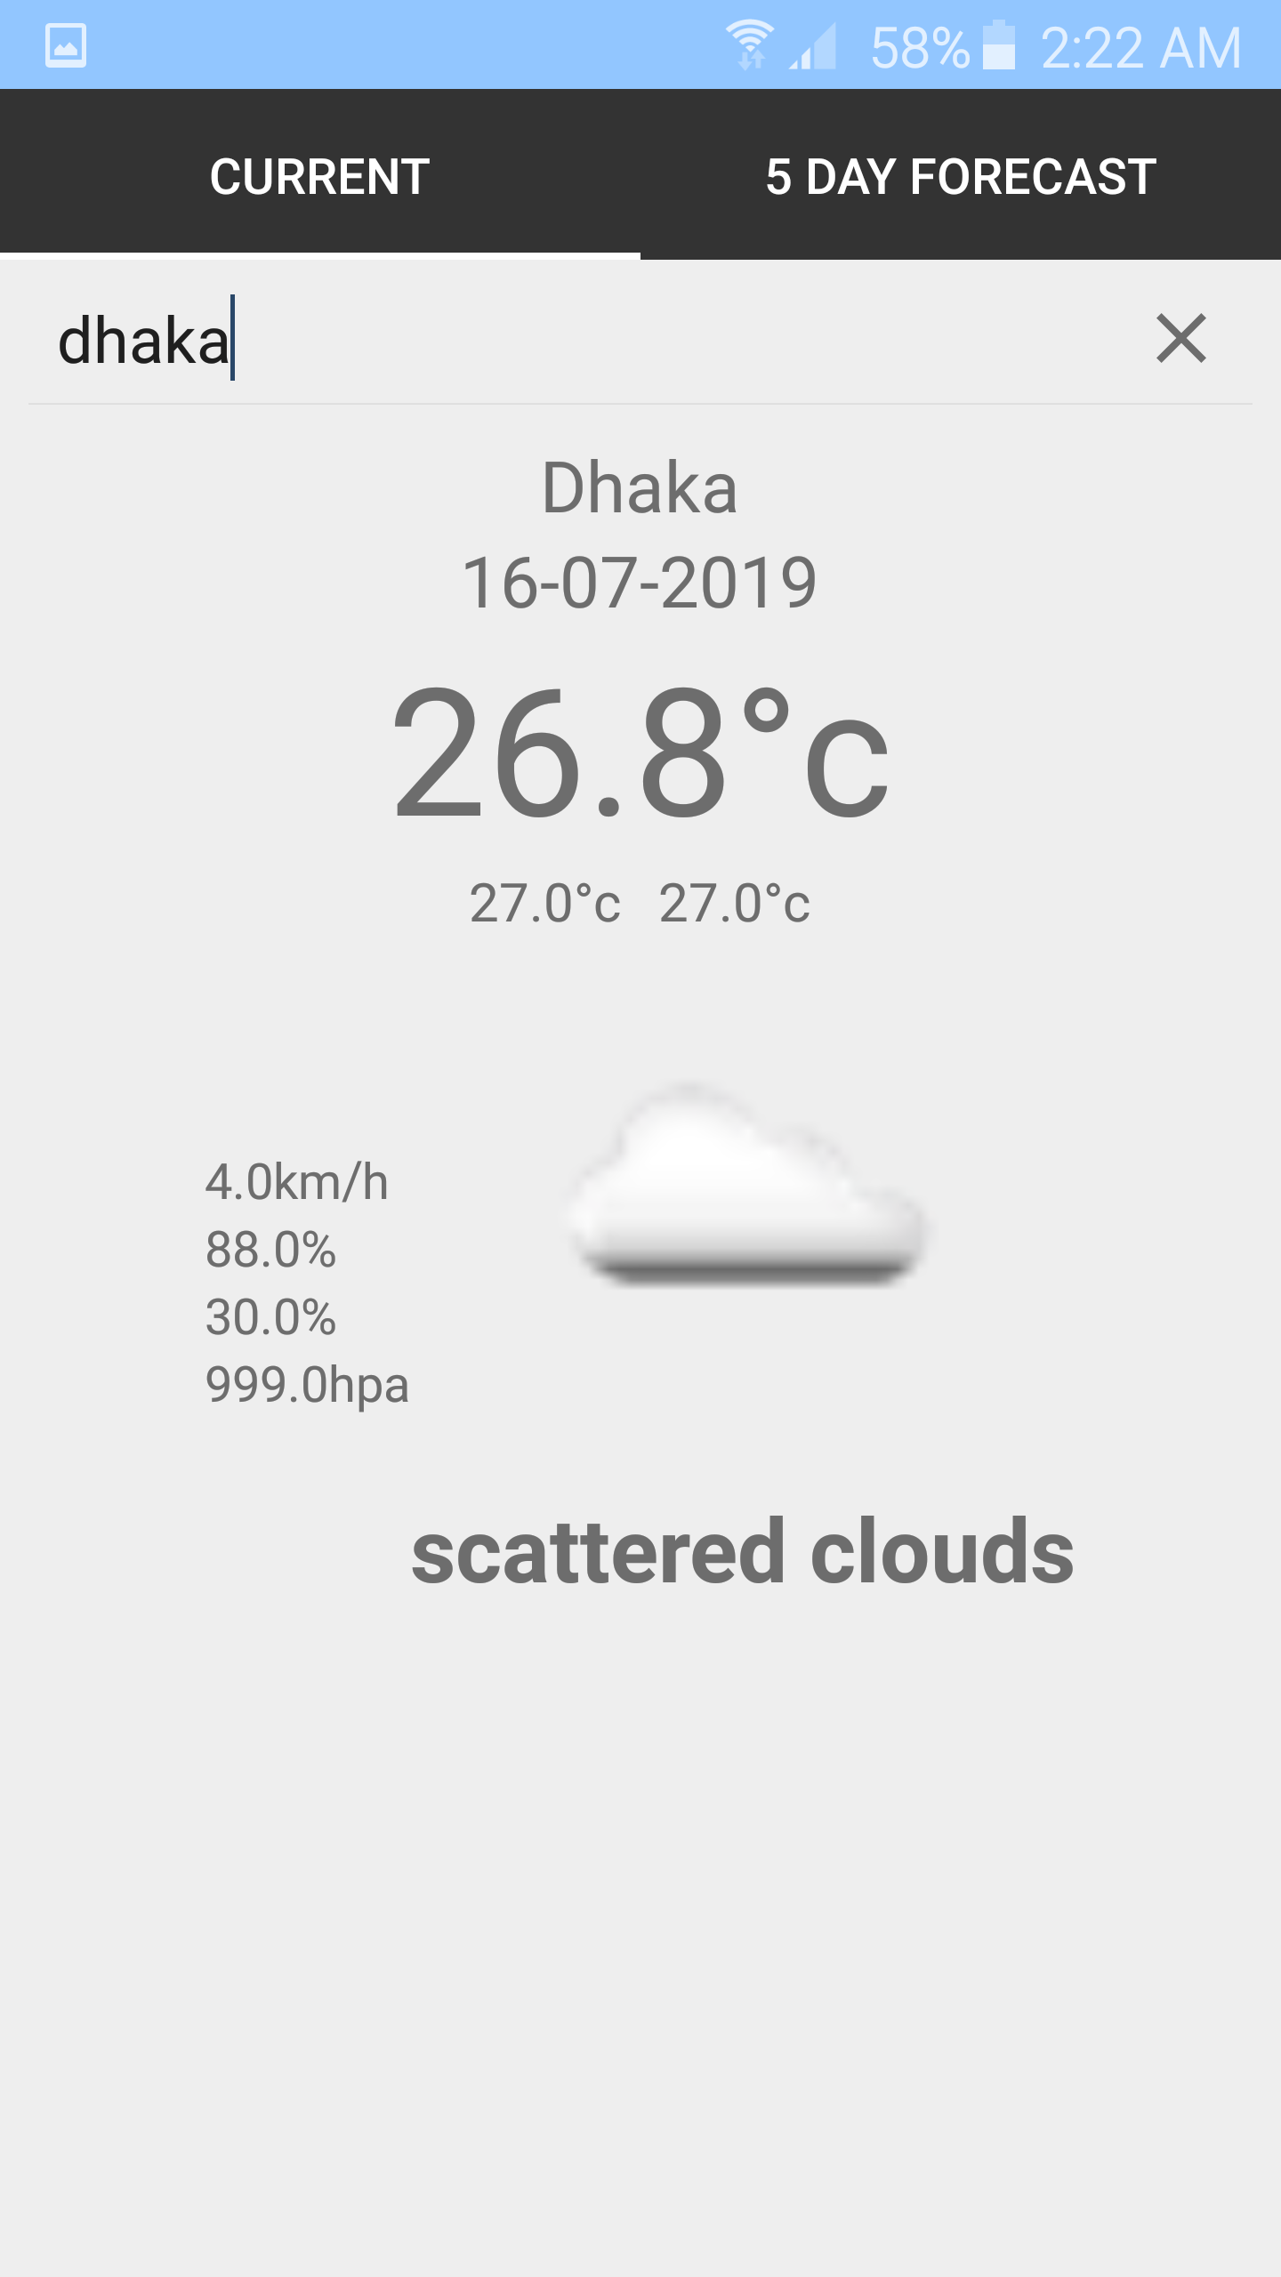
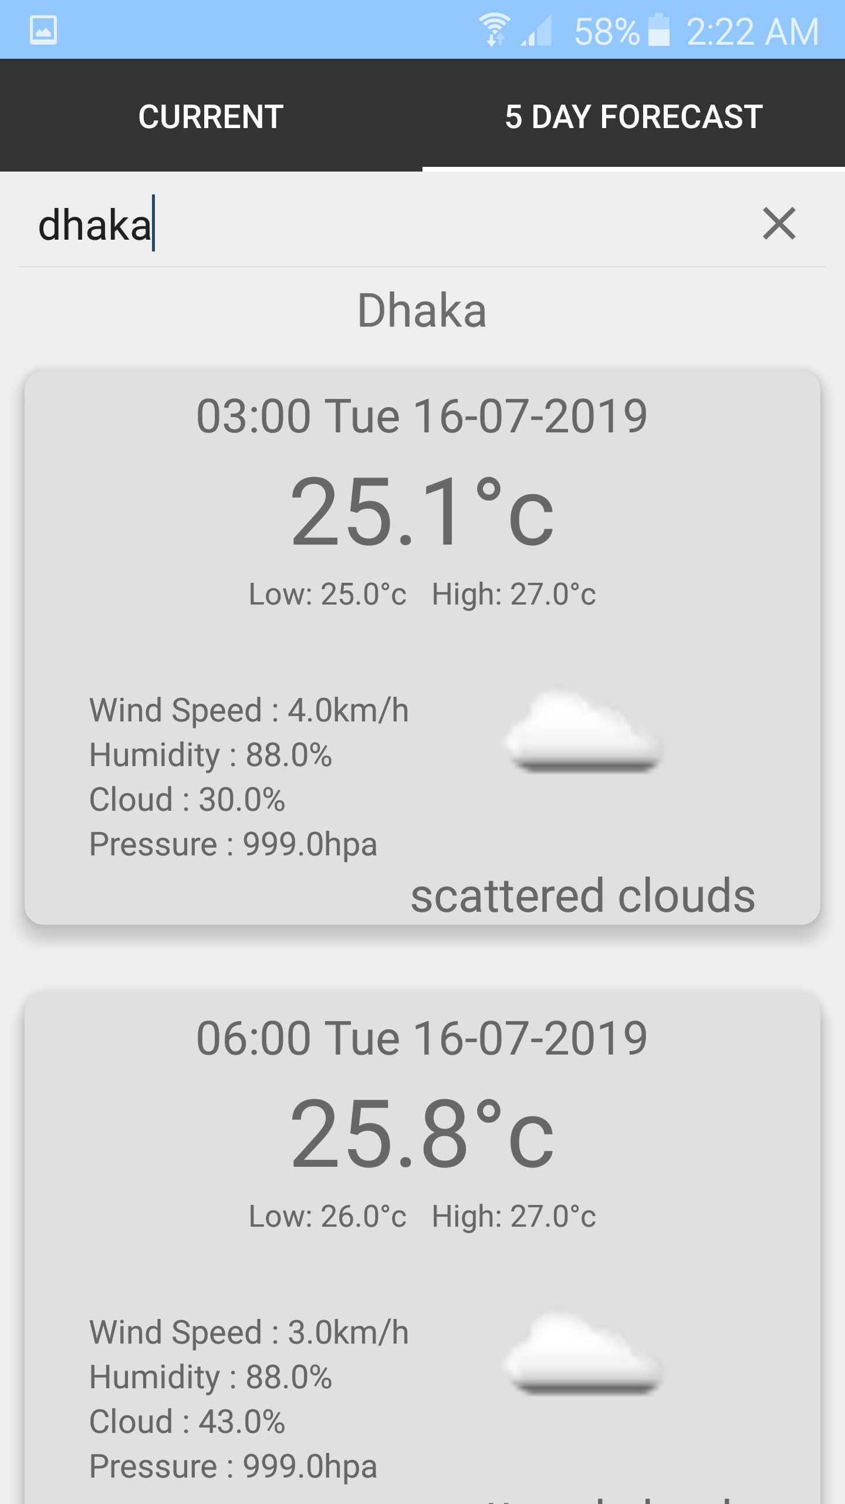
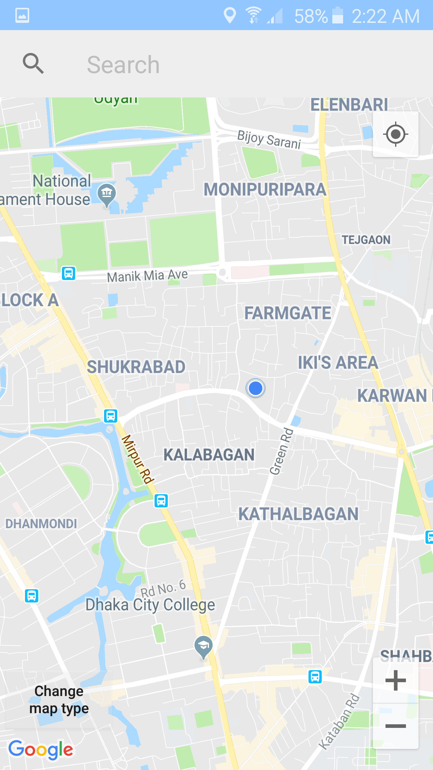
Current/5 day ForeCasT Weather/Location

Slide 16
User Survey

Slide 17
Survey & Result
Suggestions (Some Selected)
Add Hotel information
Add local guide
need to increase accuracy level
Helpful app for tourists.
Not Bad Go Ahead Brothers.
no idea

Slide 18
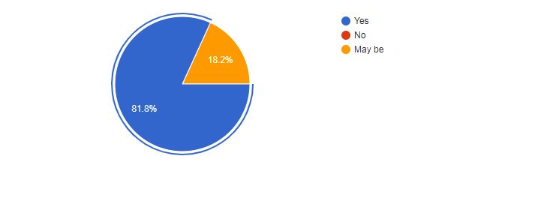
Survey & Result
Will you use our application ?

Slide 19
Project Summary

Slide 20
Conclusion
At last we managed to build the application. Some feature still needs to be modified to run it efficiently. The application is running successfully. In Future we will definitely try to implement all the user suggestion that fits with the application.
Hopefully user will like the application.

Slide 21
Appendix
https://docs.google.com/forms/d/e/1FAIpQLSfQrqFvQ1qxtPExdzkjQ5LR6vW9jyksu2L8BwAyDvU7_Tv75g/viewform
https://docs.google.com/spreadsheets/d/1X5kHtEuYI4NHCznab2OYOyk1Lwtr9CN4-0n_eQu-pug/edit?usp=sharing
https://firebase.google.com/

Slide 22
THANK YOU ALL

