Slide 1
IoT Architecture
Satria Mandala

Slide 2
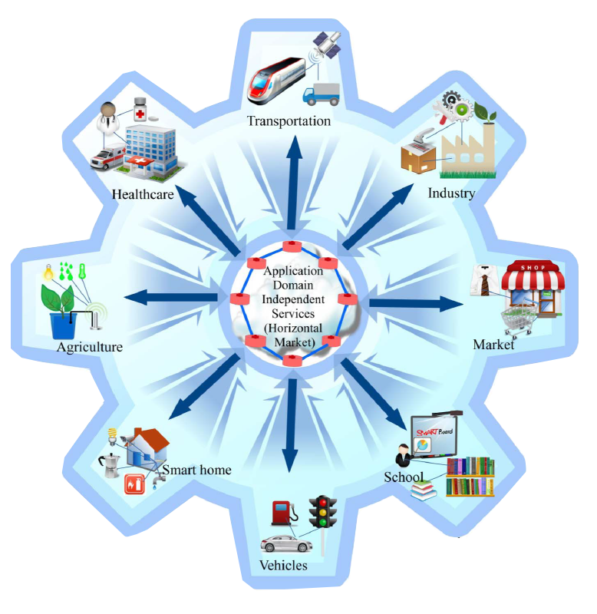

IoT Concept
Raw data To Cloud
Action based on Analytics
Intra domain sensor/
actuator communi-
cation
Notes:
The Figure illustrates the overall concept of the IoT in which every domain specific application is interacting with domain independent services, whereas in each domain sensors and actuators communicate directly with each other.

Slide 3
Definition of IoT Architecture
IOT is Internet of Things
Architecture is Science of designing and building structures, layout, formation, arrangement (Babylon dictionary)
What is “IOT Architecture”?

Slide 4
IOT Architecture (European Lighthouse Integrated Project)

Slide 5
Type of IoT Architectures
Three Layers
Middle-ware based
Service Oriented Architecture
Five Layers

Slide 6
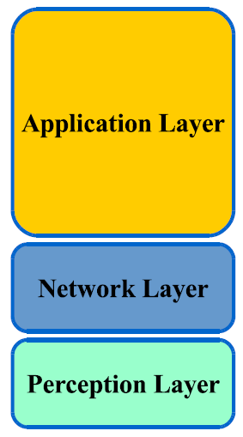
Three Layers
Notes:
The Perception layer is also known as ‘Device Layer’. It consists of the physical objects and sensor devices. The sensors can be RFID, 2D-barcode, or Infrared sensor depending upon objects identification method. This layer basically deals with the identification and collection of objects specific information by the sensor devices. Depending on the type of sensors, the information can be about location, temperature, orientation, motion, vibration, acceleration, humidity, chemical changes in the air etc. The collected information is then passed to Network layer for its secure transmission to the information processing system.
The Network layer can also be called ‘Transmission Layer’. This layer securely transfers the information from sensor devices to the information processing system. The transmission medium can be wired or wireless and technology can be 3G, UMTS, Wifi, Bluetooth, infrared, ZigBee, etc depending upon the sensor devices. Thus, the Network layer transfers the information from Perception layer to Middleware layer.
Application layer provides global management of the data from the Network Layer. The applications implemented by IoT can be smart health, smart farming, smart home, smart city, intelligent transportation, etc.

Slide 7
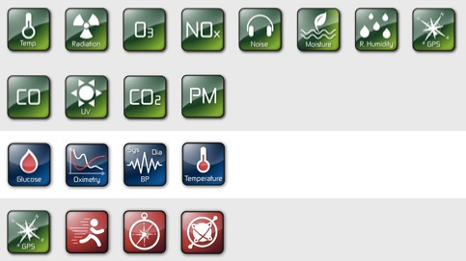
Perception Layers - Sensors (Smart or Simple)
Smart Sensors
Simple Sensors
Onboarding
Receive Notifications
Receive Config
Send Data / Events

Slide 8
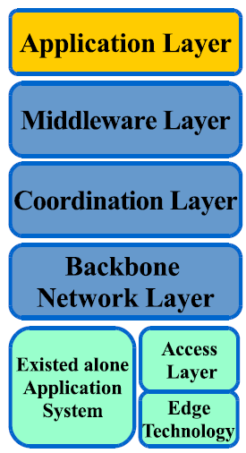
Middle-ware based
Notes:
A backbone network or network backbone is a part of computer network infrastructure that interconnects various pieces of network, providing a path for the exchange of information between different LANs or subnetworks.^{[1]} A backbone can tie together diverse networks in the same building, in different buildings in a campus environment, or over wide areas. Normally, the backbone's capacity is greater than the networks connected to it.
Coordination Layer is added to facilitate communication between different applications.
Middleware Layer is responsible for the service management and has link to the database.
Application Layer provides global management of the application based on the objects information processed in the Middleware layer. The applications implemented by IoT can be smart health, smart farming, smart home, smart city, intelligent transportation, etc.

Slide 9
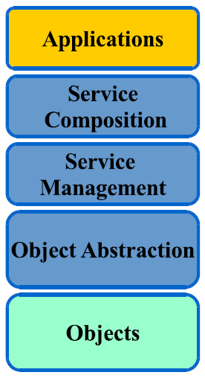
Service Oriented Architecture
Notes:
Object layer, the Objects (devices) or perception layer, re- presents the physical sensors of the IoT that aim to collect and process information. This layer includes sensors and actuators to perform different functionalities such as querying location, temperature, weight, motion, vibration, acceleration, humidity. Standardized plug-and-play mechanisms need to be used by the perception layer to configure heterogeneous objects [17], [18]. The perception layer digitizes and transfers data to the Object Abstraction layer through secure channels. The big data created by the IoT are initiated at this layer.
Object Abstraction transfers data produced by the Objects layer to the Service Management layer through secure channels. Data can be transferred through various technologies such as RFID, 3G, GSM, UMTS, WiFi, Bluetooth Low Energy, infrared, ZigBee, etc. Furthermore, other functions like cloud computing and data management processes are handled at this layer.
Service Management or Middleware (pairing) layer pairs a service with its requester based on addresses and names. This layer enables the IoT application programmers to work with heterogeneous objects without consideration to a specific hardware platform. Also, this layer processes received data, makes decisions, and delivers the required services over the network wire protocols.
The service composition layer acts in a true sense as a repository of all presently connected service instances that are executed or invoked at runtime to construct the composed services
The application layer provides the services requested by customers. For instance, the application layer can provide temperature and air humidity measurements to the customer who asks for that data. The importance of this layer for the IoT is that it has the ability to provide high-quality smart services to meet customers’ needs. The application layer covers numerous vertical markets such as smart home, smart building, transporta- tion, industrial automation and smart healthcare.

Slide 10
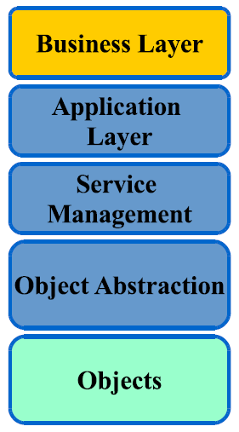
Five Layers
Notes:
The business (management) layer manages the overall IoT system activities and services. The responsibilities of this layer are to build a business model, graphs, flowcharts, etc. based on the received data from the Application layer. It is also supposed to design, analyze, implement, evaluate, monitor, and develop IoT system related elements. The Business Layer makes it pos- sible to support decision-making processes based on Big Data analysis. In addition, monitoring and management of the under- lying four layers is achieved at this layer. Moreover, this layer compares the output of each layer with the expected output to enhance services and maintain users’ privacy.

Slide 11
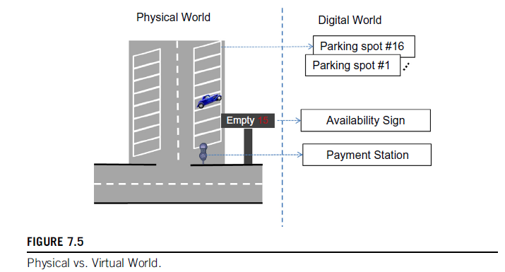
Problems Example

Slide 12
Problems Example
Bos Pengelola sebuah Kawasan Parkir merencanakan area parkir miliknya menjadi 16 slot. Tiap-tiap slot akan diletakkan sensor. Tempat parkir tersebut memiliki kasir utk membayar biaya parkir dan sebuah papan informasi tentang slot parkir yang kosong. Sering Customer mendownload aplikasi parkir di smartphone mereka yang dapat memberitahu nomor slot parkir ke berapa yang masih kosong meskipun customer tersebut tidak sedang melihat papan informasi spot kosong. Dari keterangan diatas, coba design IOT arsitektur berasas Five Layers sehingga tujuan:
- mengetahui tempat parkir yang kosong segera
- menghitung total biaya parkir
- memberi tahu customer yang kosong melalui smartphone dan papan informasi
- membuat report bulanan pengelolain parkir
dapat terpenuhi.

