Slide 1

Predicting Post-Procedural Complications
Faisal Maqbool
Supervisor: Dr. Saeed Ul Hassan
Information Technology University of the Punjab
Lahore, Pakistan

Slide 2

Outline
Introduction
Motivation
Challenges
Problem Statement
Literature Review
Dataset
Proposed Technique

Slide 3


Introduction
Deep learning models have revolutionized many fields including computer vision, natural language processing, speech recognition, and is being increasingly used in clinical healthcare applications
Early hospital mortality, length of stay, obesity and ICD-9 code group prediction is critical as intensivists strive to make efficient decisions about ill patients admitted in hospitals

Slide 4








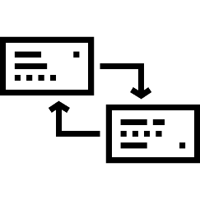


Motivation
Quick and accurate decisions for the patients are needed for which doctors process electronic health record and prescribe medicine or do research on particular medicinal field which is time consuming and expensive. Why not have applications which can do the following and more:
Extract sensitive information from admission and discharge summaries
Extract symptoms
Prescribe medicine & propose health matrices
Aid doctors in giving accurate information
Predict LOS, mortality, cause and other sensitive information using the clinical text

Slide 5


Problem Statement
Benchmarking results for several clinical prediction tasks such as mortality prediction, length of stay prediction, and ICD-9 code group prediction using Deep Learning models and development of system predicting these valued information by combining NLP and Deep learning

Slide 6


Objective
“Regardless of wide variety and complexity of features inherent in electronic health records, develop a model using NLP techniques and AI to predict several clinical tasks to aid doctors”

Slide 7

Challenges
Terminological variations and irregularities in clinical information
Morphological rules are required to cope with different variants in records
Health records have specific formats
Text retrieval, NLP and advanced DNN techniques are required to outperform already developed systems
Approaches that enable faster and more collaborative research while protecting patient privacy and confidentiality are becoming more important

Slide 8


Literature Review
Gentimis, Thanos, Alnaser Ala'J, Alex Durante, Kyle Cook, and Robert Steele. "Predicting Hospital Length of Stay Using Neural Networks on MIMIC III Data." In 2017 IEEE 15th Intl Conf on Dependable, Autonomic and Secure Computing, 15th Intl Conf on Pervasive Intelligence and Computing, 3rd Intl Conf on Big Data Intelligence and Computing and Cyber Science and Technology Congress (DASC/PiCom/DataCom/CyberSciTech), pp. 1194-1201. IEEE, 2017. [1]
Sadeghi, Reza, Tanvi Banerjee, and William Romine. "Early hospital mortality prediction using vital signals." Smart Health9 (2018): 265-274. [2]
Purushotham, Sanjay, Chuizheng Meng, Zhengping Che, and Yan Liu. "Benchmark of deep learning models on large healthcare mimic datasets." arXiv preprint arXiv:1710.08531(2017). [3]

Slide 9
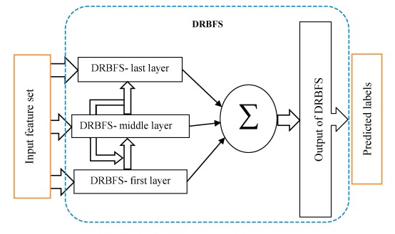
Paper | Dataset | Features | Model | Results
Early hospital mortality prediction using vital signals." Smart Health9 (2018) | MIMIC-III | Heart Rate Quantitative Features (Max, Min, Skewness, Range etc.) | Random Forrest, Decision Trees | RF F1 Score : 0.97 DT F1 Score : 0.91
Benchmark of deep learning models on large healthcare mimic datasets. Journal of biomedical informatics 79 (2017) - Preprint | MIMIC-III | Three feature Sets for different prediction tasks | FFN RNN MMDL : FFN + RNN | AUROC : 85 % MMDL
Mortality prediction in intensive care units (ICUs) using a deep rule-based fuzzy classifier. Journal of biomedical informatics 79 (2018) | MIMIC-III | Demographics Vital Signs and Lab Events | DRBFS | AUROC : 73.60 % DRBFS
Explainable prediction of medical codes from clinical text. arXiv preprint arXiv:1802.05695(2018) | MIMIC-III | Discharge Summaries | Convolutional Attention for Multi-Label classification (CAML) | Precision@8 of 0.71 and a Micro-F1 of 0.54

Slide 10

MIMIC-III Database
A freely accessible critical care database
Developed by the MIT Lab for Computational Physiology, comprising DE identified health data associated with ~40,000 critical care patients. It includes demographics, vital signs, laboratory tests, medications, and more
Each year, having conferences, journal publications, books and chapters related to critical care, health and medicine using MIMIC-III

Slide 11

MIMIC-III Data Access
Requires research ethics and compliance training courses (completed)
Took “Data or Specimens Only Research under requirements set by “Massachusetts Institute of Technology Affiliates”
15 modules:
Research and Human Subjects
Privacy and Confidentiality
Assessing Risks
History and Ethical Principles
Regulations and Process
Genetics Research
International Research
HIPAA
Conflicts and Interest in Research

Slide 12


Slide 13
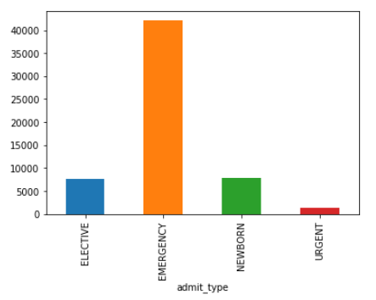
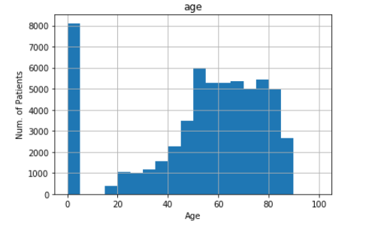
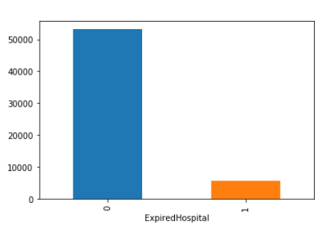
Initial Exploration
Figure 1: Age Distribution
Figure 2: Admit Type Distribution
Figure 3: Expired At Hospital Dist.

Slide 14

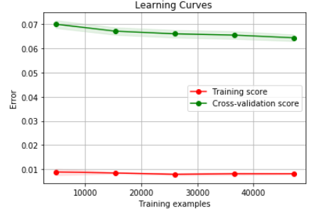
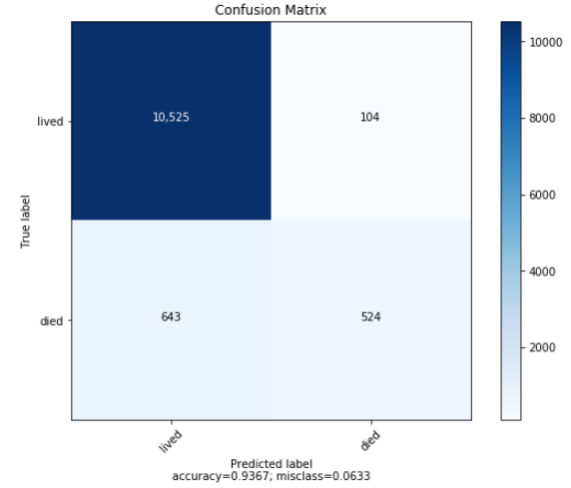
Experiments Mortality Prediction
Random Forrest :

Slide 15
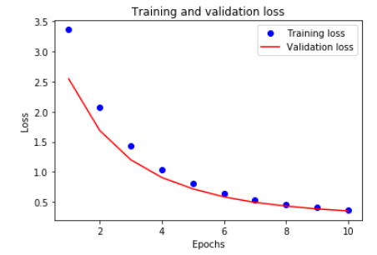

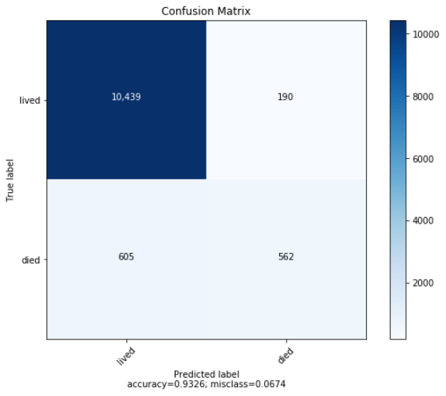
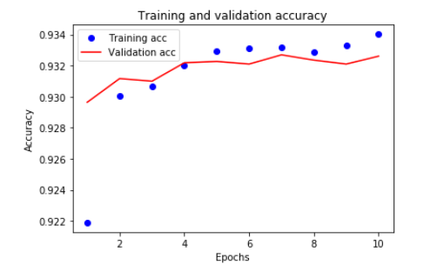
Cont..
NN:

Slide 16
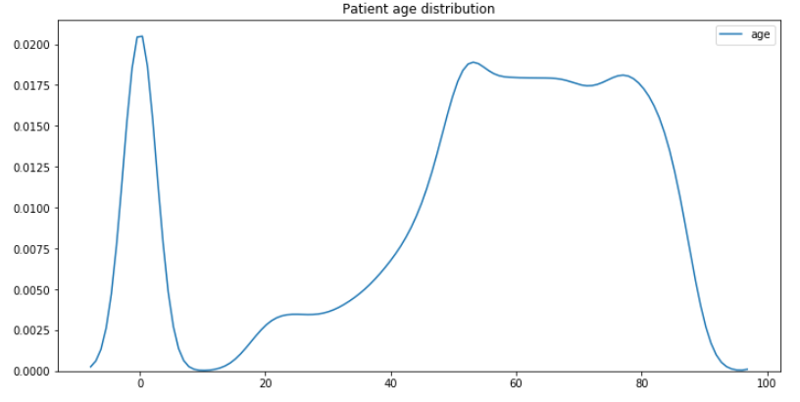
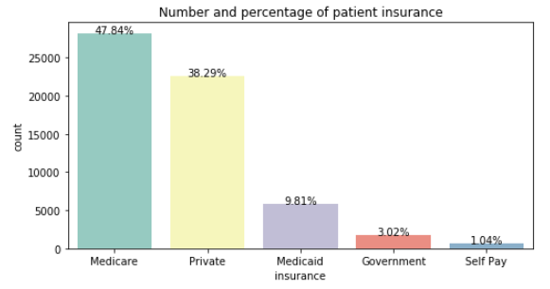
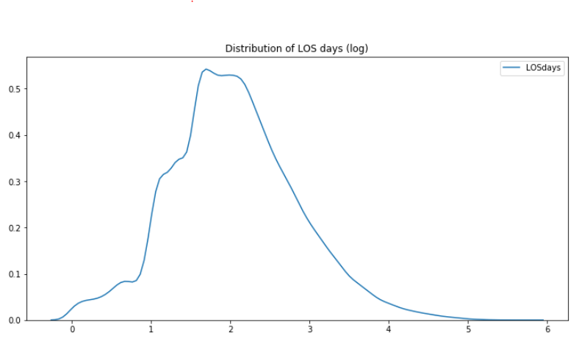
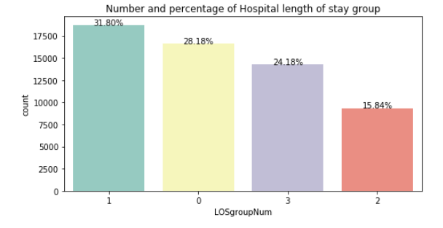
Initial Exploration Cont..

Slide 17
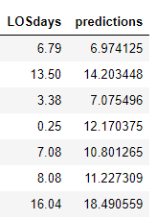
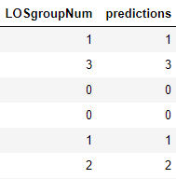
Experiments Length of Stay Prediction
Gradient Boosting Regression
Figure 2. Length of Stay Prediction (Labels vs Prediction)
Figure 1. LOS Group Prediction (Labels vs Prediction)

Slide 18

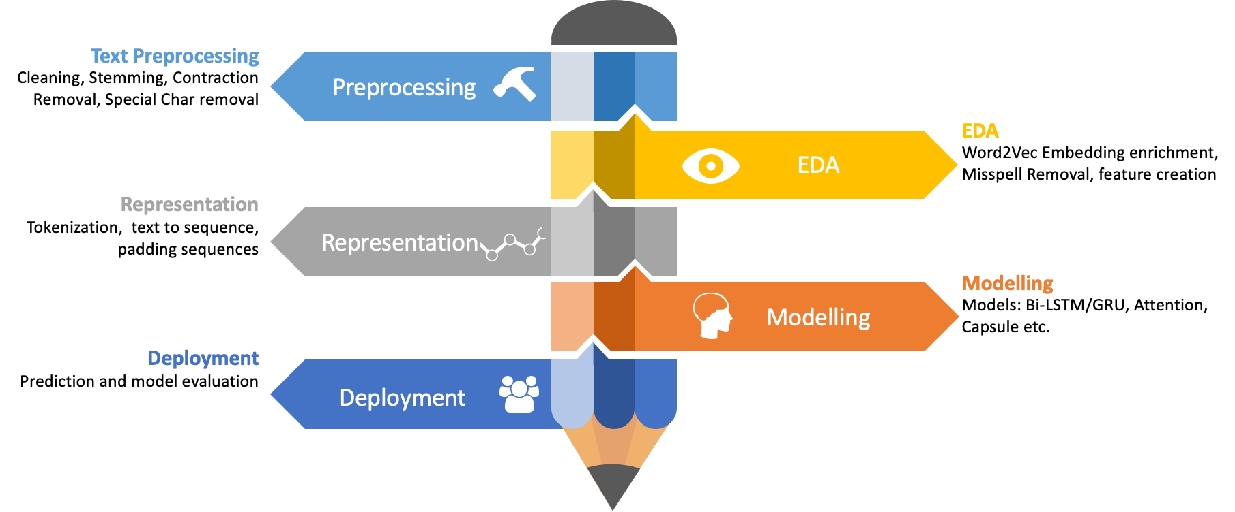
Proposed Technique

Slide 19

References
[1] Gentimis, Thanos, Alnaser Ala'J, Alex Durante, Kyle Cook, and Robert Steele. "Predicting Hospital Length of Stay Using Neural Networks on MIMIC III Data." In 2017 IEEE 15th Intl Conf on Dependable, Autonomic and Secure Computing, 15th Intl Conf on Pervasive Intelligence and Computing, 3rd Intl Conf on Big Data Intelligence and Computing and Cyber Science and Technology Congress (DASC/PiCom/DataCom/CyberSciTech), pp. 1194-1201. IEEE, 2017.
[2] Sadeghi, Reza, Tanvi Banerjee, and William Romine. "Early hospital mortality prediction using vital signals." Smart Health9 (2018): 265-274.
[3] Purushotham, Sanjay, Chuizheng Meng, Zhengping Che, and Yan Liu. "Benchmark of deep learning models on large healthcare mimic datasets." arXiv preprint arXiv:1710.08531(2017).
[4] Purushotham, Sanjay, Chuizheng Meng, Zhengping Che, and Yan Liu. "Benchmark of deep learning models on large healthcare mimic datasets." arXiv preprint arXiv:1710.08531(2017).
[5] Mullenbach, James, Sarah Wiegreffe, Jon Duke, Jimeng Sun, and Jacob Eisenstein. "Explainable prediction of medical codes from clinical text." arXiv preprint arXiv:1802.05695(2018).

Slide 20
References
[6] http://kaggle.com/drscarlat/mimic3a/

Slide 21




Classes of Data
Billing (Against DRG codes and ICD Classification)
Descriptive (Demographics, Admissions)
Dictionaries (Lookup Information for ICD and Items)
Interventions (Procedures Dialysis, imaging studies)
Laboratory (Blood Chemistry, Urine Analysis)
Medication (Medications, Caregivers)
Notes (Discharge summaries, Clinicians or nurses notes)
Physiologic (Nurse verified vital signs)
Reports (Text reports of Electrocardiogram)

Slide 22
