Slide 1
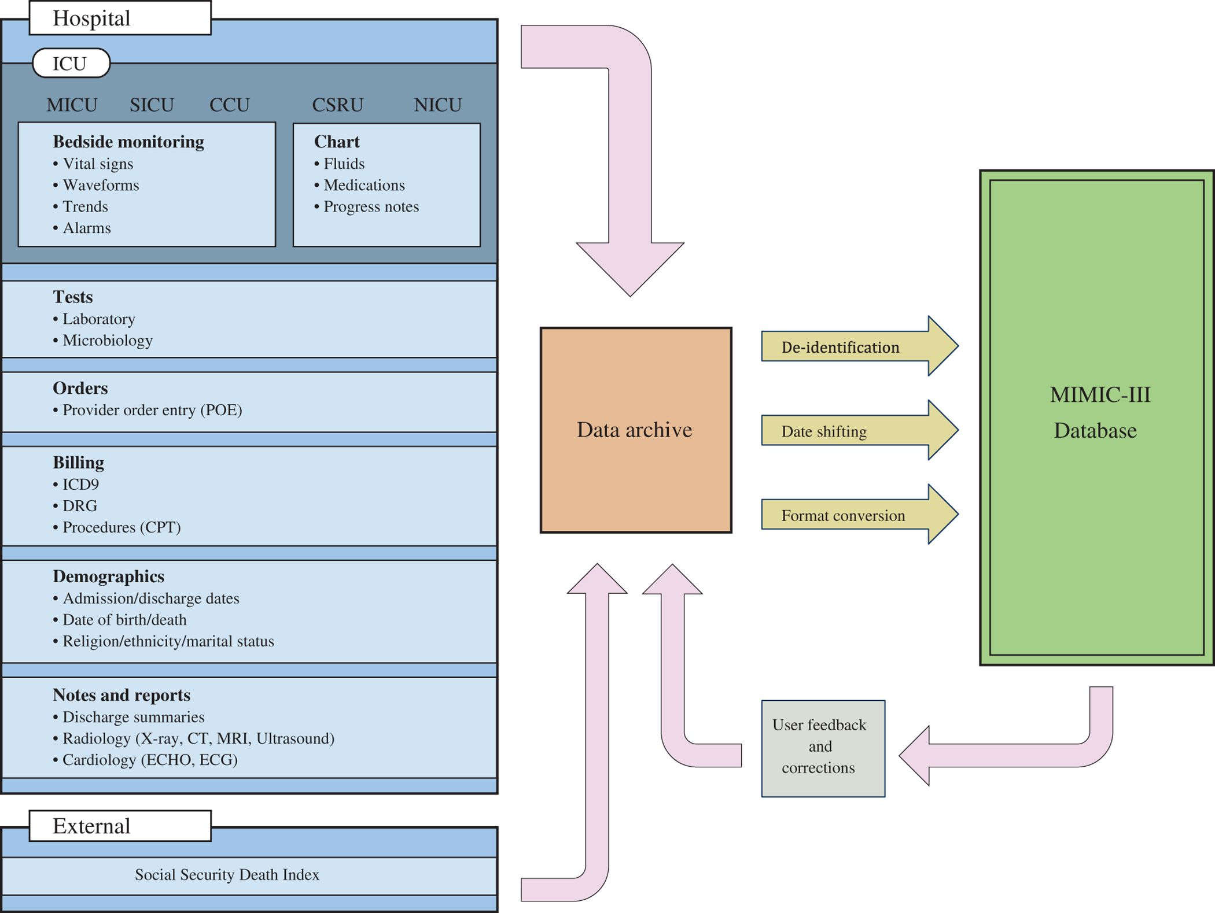

Slide 2
Paper | Dataset | Features | Model | Results
Predicting intensive care unit readmission with machine learning using electronic health record data." Annals of the American Thoracic Society 15, no. 7 (2018) | MIMIC-III | Demographics, Chart Events Medications | Gradient-boosted | Area under the receiver operating curve, 0.76
Benchmark of deep learning models on large healthcare mimic datasets (2017) | MIMIC-III | Three different set of features different prediction tasks | FFN RNN MMDL : FFN + RNN | AUROC : 85
Machine learning for real-time prediction of complications in critical care: a retrospective study." The Lancet Respiratory Medicine 6, no. 12 (2018) | MIMIC-III | Demographics, Chart Events Medications | RNN | Sensitivity 0·85 for mortality, 0·87 and 0·94 for renal failure, and 0·84 and 0·74 for bleeding.
Predicting Surgical Complications in Adult Patients Undergoing Anterior Cervical Discectomy and Fusion Using Machine Learning." Neurospine 15, no. 4 (2018) | ACDF | Demographics, Chart Events Medications | ANN LR SVM | (p < 0.05)

Slide 3
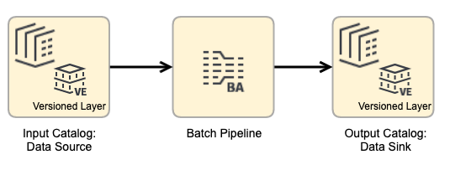
PostgresSQL Database
Tables, Views, Dynamic Queries
For huge files of Chart Events and Lab Events, for features extraction did Batch processing in Python
Dervied concepts from multiple care systems mentioned earlier

Slide 4
Class of Data | Summary
Comorbidity | These scripts derive binary ﬂags indicating the presence of various comorbidities using billing codes (ICD-9) assigned to the patient at hospital discharge.
First day | The ﬁrst day subfolder contains scripts used to calculate various clinical concepts on the ﬁrst day of a patient’s admission to the ICU, such as the highest blood pressure, lowest temperature, etc. This folder contains many useful scripts which can be adapted to capture data outside the ﬁrst day.
Sepsis | Deﬁnitions of sepsis, a common cause of mortality for intensive care unit patients.
Severity Scores | Severity of illness scores which summarize the acuity of a patient’s illness on admission to the intensive care unit (usually in the ﬁrst 24 hours).
Durations | Start and stop times for administration of various treatments or durations of various phenomena, including: medical agents which have a vasoactive effect on a patient’s circulatory system, continuous renal replacement therapy (CRRT), and mechanical ventilation.
Organ Failure | This script derives binary flags for major organ failures

Slide 5
Our Features
Demographics - insurance,marital_status, gender
Admissions (Package, Chart)
ICU Stays (Services)
Lab Events (PlateletCount,RedBloodCells,WhiteBloodCells etc)
Chart Events (BP, Services, Caregiver)
Dervied Concepts: Organ Failures and Major Diseases
ICD-9 Code = 996 for complications (Main class) will later extend to specific complication

Slide 6







Subset each Batch
Reading to DataFrame
Filtering Features
Keeping Track of Features
DB Tables, Views and Files
Lookup for Chart Event, Diagnoses and Procedure
Compiling Features

