Slide 1

Predicting Post-Procedural Complications Using MIMIC-III
Faisal Maqbool
Supervisor: Dr. Saeed Ul Hassan
Information Technology University of the Punjab
Lahore, Pakistan

Slide 2






Outline
Introduction
Problem Statement
Objective
Challenges
Literature Review
Dataset
Methodology
Sampling
Results
Future Work

Slide 3






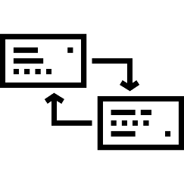




Introduction
Analyzing health using EHR
ICU patients requires precise and accurate decisions
Features: worth, capacity, access and dimensionality
Diagnoses and Procedures
Post-Procedural complications
Stakeholders: Patients, families, doctors, hospital management

Slide 4

Problem Statement
Generalizing all the Post-Diagnoses or Post-Procedural complications to one class of having or not. Can we perform ETL on EHR (Medical Data Mart) and engineer specific features to predict that ICD class (996) to seek if complications can lead to death or not?

Slide 5
Objective
“Regardless of wide variety and complexity of features inherent in electronic health records, develop models using ML techniques to predict ICD-9 code 996 to aid doctors, hospital management and families ”
ETL Process
Feature Extraction (Available and Derived Concepts)
Balance Dataset
Predict 996 (Binary Class)

Slide 6






Challenges
Terminological variations and irregularities in clinical information
Morphological rules to cope with different variants in records
Health records have specific formats (ICD, HL7)
ETL , Mining Important Features
Imbalance in Classes
Protecting Health Information (PHI), HIPPA Compliances
Subjectivity of problem
Near Zero Variance vs Huge Variance Gaps

Slide 7


Literature Review

Slide 8
Paper | Dataset | Features | Model | Results
Predicting intensive care unit readmission with machine learning using electronic health record data. Annals of the American Thoracic Society 15, no. 7 (2018) | MIMIC-III | Demographics, Chart Events Diagnoses Items | Gradient-boosting | AUROC 0.76
Machine learning for real-time prediction of complications in critical care: a retrospective study. The Lancet Respiratory Medicine 6, no. 12 (2018) | MIMIC-III | Demographics, Chart Events Lab Events | RNN | Sensitivity 0·85 for mortality, 0·87 and 0·94 for renal failure, and 0·84 and 0·74 for bleeding.
Predicting Surgical Complications in Adult Patients Undergoing Anterior Cervical Discectomy and Fusion Using Machine Learning. Neurospine 15, no. 4 (2018) | ACDF | Demographics, Chart Events Lab Items and Scores | ANN LR SVM | (p < 0.05)

Slide 9
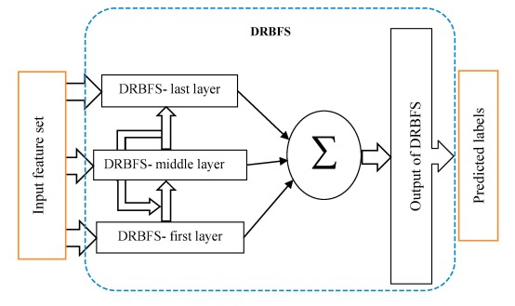
Paper | Dataset | Features | Model | Results
Early hospital mortality prediction using vital signals." Smart Health9 (2018) | MIMIC-III | Heart Rate Quantitative Features (Max, Min, Skewness, Range etc.) | Random Forrest, Decision Trees | RF F1 Score : 0.97 DT F1 Score : 0.91
Benchmark of deep learning models on large healthcare mimic datasets. Journal of biomedical informatics 79 (2017) | MIMIC-III | Three feature Sets for different prediction tasks | FFN RNN MMDL : FFN + RNN | AUROC : 85 % MMDL
Mortality prediction in intensive care units (ICUs) using a deep rule-based fuzzy classifier. Journal of biomedical informatics 79 (2018) | MIMIC-III | Demographics Vital Signs and Lab Events | DRBFS | AUROC : 73.60 % DRBFS
Explainable prediction of medical codes from clinical text. arXiv preprint arXiv:1802.05695(2018) | MIMIC-III | Discharge Summaries | Convolutional Attention for Multi-Label classification (CAML) | Precision@8 of 0.71 and a Micro-F1 of 0.54

Slide 10



MIMIC-III Database
A freely accessible critical care database
Developed by the MIT Lab for Computational Physiology, comprising DE identified health data associated with ~40,000 critical care patients. It includes demographics, vital signs, laboratory tests, medications, and more, Beth Israel Deaconess Medical Center from 2001 to 2012
Each year, having conferences, journal publications, books and chapters related to critical care, health and medicine using MIMIC-III
26 Files

Slide 11

MIMIC-III Data Access
Requires research ethics and compliance training courses (completed)
Data or Specimens Only Research under requirements set by “Massachusetts Institute of Technology Affiliates”
15 modules:
Research and Human Subjects
Privacy and Confidentiality
Assessing Risks
History and Ethical Principles
Regulations and Process
Genetics Research
International Research
HIPAA
Conflicts and Interest in Research

Slide 12


Slide 13
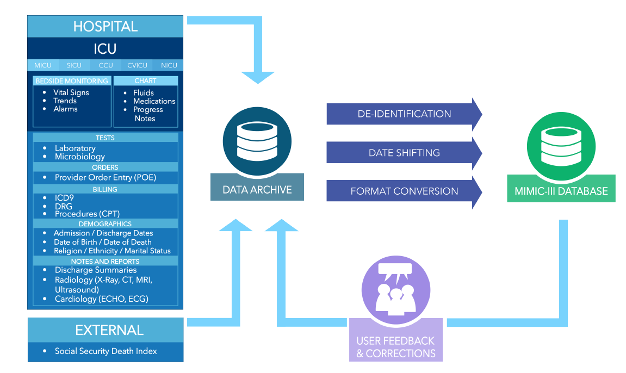

MIMIC-III Construction

Slide 14
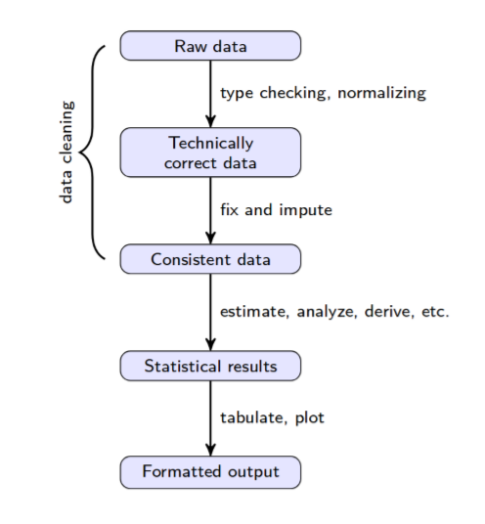




ETL Process – Python, R, PostgreSQL …

Slide 15
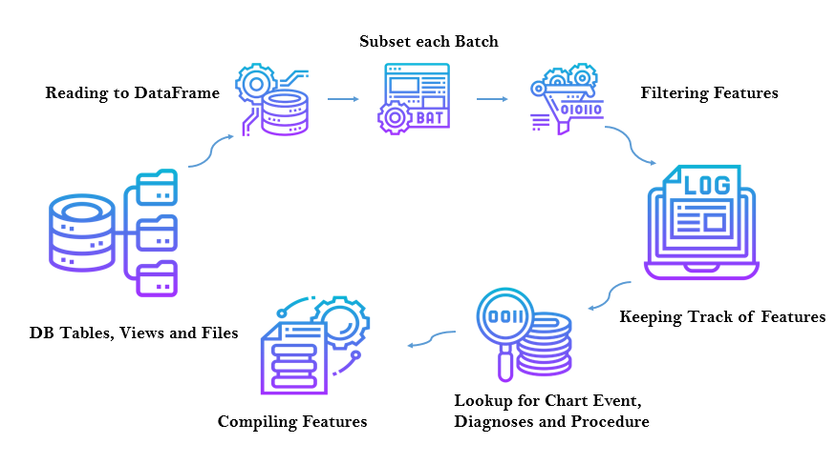
Chart Events and Lab Events Processing

Slide 16

Features Special thanks to Dr. Zulfiqar Ali Congo, Cardiologist, Internal Medicine Specialist, Endocrinologist, Diabetologist
General: Insurance, Martial status, Hospital Expire Flag, Length of Stay, Calculated Bicarbonate, TotalCo2, Chloride, Free Calcium, Glucose, Hematocrit, Hemoglobin, Lactate, Oxygen, Oxygen Saturation, PCO2, PH, Potassium, Sodium, Temperature, Calcium Total, Centromere, Creatinine, Globulin, Blood Glucose, Blood Lipase, Blood Magnesium, Blood Potassium, Blood Sodium, Platelets Counts, Red Blood Cells, White Blood Cells, Lymphocytes
Engineered Concepts (Derived Comorbidities): Hypothyroidism, Renal Failure, Liver Disease, Peptic Ulcer, Aids, Lymphoma, Metastatic Cancer, Solid Tumor, Rheumatoid Arthritis, Coagulopathy, Obesity, Weight Loss, Fluid Electrolyte, Blood Loss Anemia, Alcohol Abuse, Drug Abuse, Psychoses, Depression, Congestive Heart Failure, Cardiac Arrhythmias, Valvular Disease, Pulmonary Circulation, Peripheral Vascular, Hypertension, Paralysis, Other Neurological, Chronic Pulmonary, Diabetes Uncomplicated, Diabetes Complicated

Slide 17

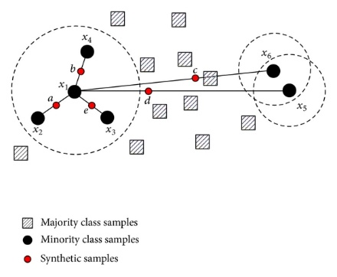
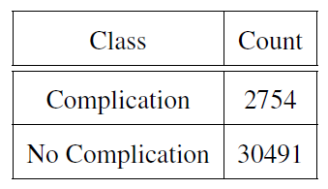
Over Sampling
SMOTE: Synthetic Minority Over-Sampling Technique
ADASYN: Adaptive Synthetic Sampling
SMOTE

Slide 18
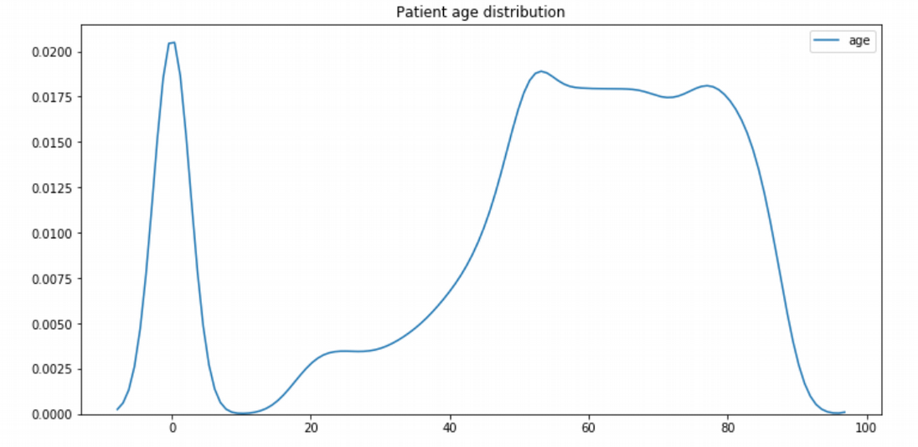
Experiments and Results…

Slide 19
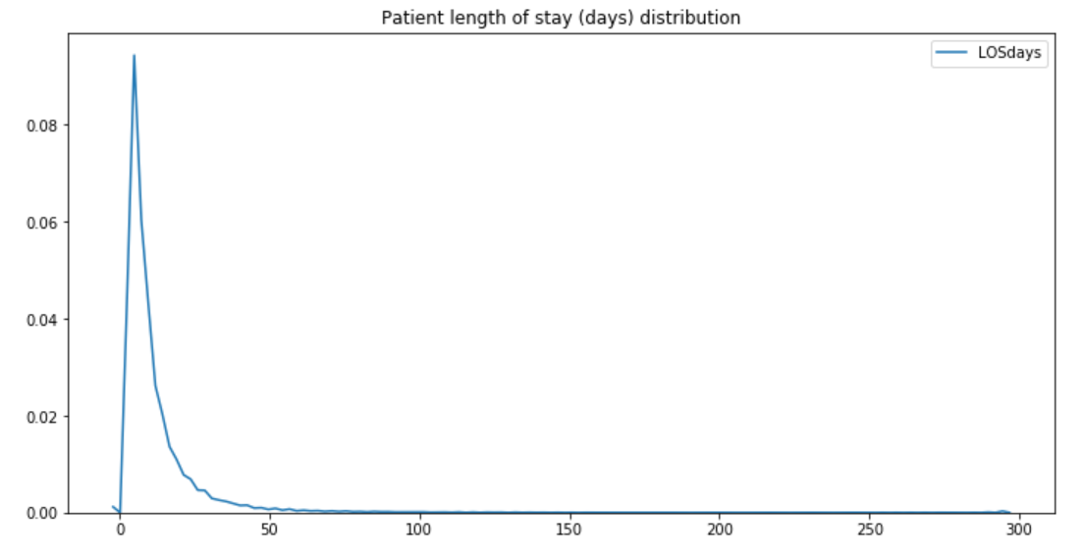
Experiments and Results…

Slide 20
Experiments and Results…
Patients with Complications | Patients Died at Hospital
2754 | 576

Slide 21
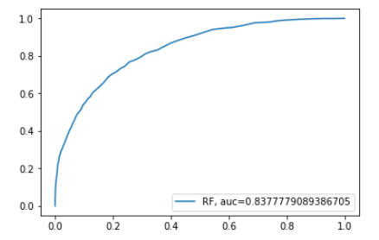
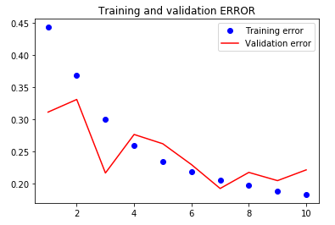
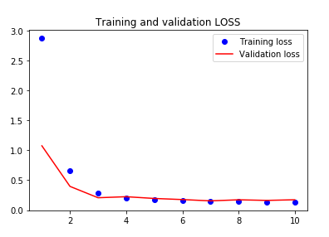


ADASYN
Model | Accuracy | AUROC
Logistic Regression | 65 % | 0.72
Linear SVC | 66% | 0.72
Random Forrest | 86% | 0.83
ANN | 81% | 0.82

Slide 22
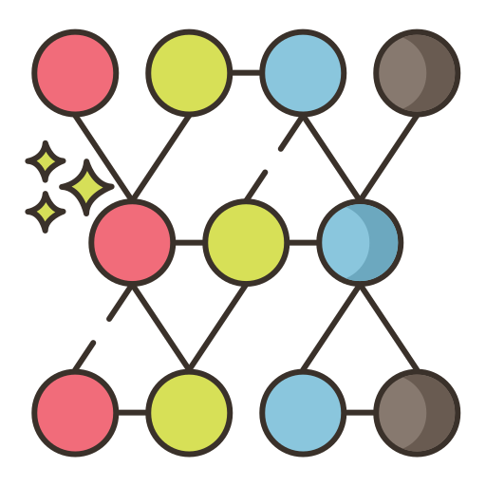
SMOTE
Model | Accuracy | AUROC
Logistic Regression | 67 % | 0.72
Linear SVC | 67% | 0.73
Random Forrest | 85% | 0.82
ANN | 84% | 0.83
Results with SMOTE Data Sampling

Slide 23

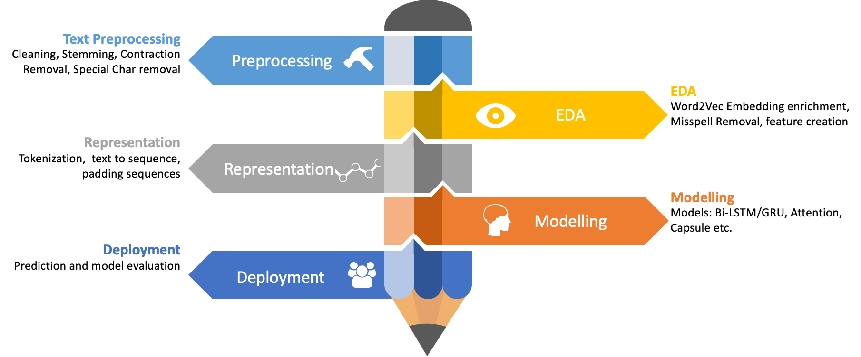
Future Work: Notes and Medicine Notes

Slide 24
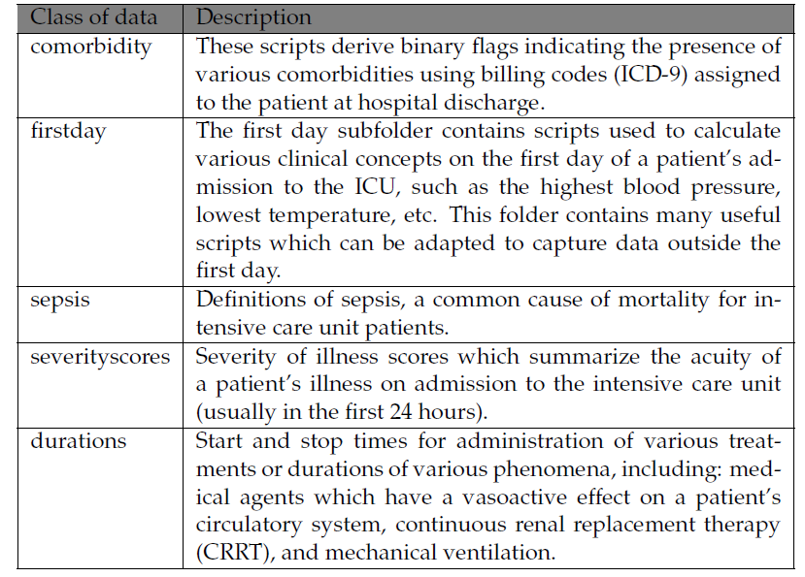
Future Work: Derived Concepts

Slide 25


Future Work: Subclasses of Complications

Slide 26

References
[1] Johnson, Alistair EW, Tom J. Pollard, Lu Shen, H. Lehman Li-wei, Mengling Feng, Mohammad Ghassemi, Benjamin Moody, Peter Szolovits, Leo Anthony Celi, and Roger G. Mark. "MIMIC-III, a freely accessible critical care database." Scientific data 3 (2016): 160035. Available at: https://mimic.physionet.org/
[2] He, Haibo, Yang Bai, Edwardo A. Garcia, and Shutao Li. "ADASYN: Adaptive synthetic sampling approach for imbalanced learning." In 2008 IEEE International Joint Conference on Neural Networks (IEEE World Congress on Computational Intelligence), pp. 1322-1328. IEEE, 2008.
[3] Available code repository:
https://github.com/faisalmaqbool94/Thesis-Bioinformatics-MIMICIII-
[4] Repository of code shared development community provided by MIT Laboratory for Computational Physiology
https://github.com/MIT-LCP/mimic-code
[5] International Classification of Diseases. Available at https://www.cdc.gov/nchs/icd/icd9.htm

Slide 27
References
[6] Chawla, Nitesh V., Kevin W. Bowyer, Lawrence O. Hall, and W. Philip Kegelmeyer. "SMOTE: synthetic minority over-sampling technique." Journal of artificial intelligence research 16 (2002): 321-357.
[7] Davoodi, Raheleh, and Mohammad Hassan Moradi. "Mortality prediction in intensive care units (ICUs) using a deep rule-based fuzzy classifier." Journal of biomedical informatics 79 (2018): 48-59.
[8] Meyer, A., Zverinski, D., Pfahringer, B., Kempfert, J., Kuehne, T., Sündermann, S.H., Stamm, C., Hofmann, T., Falk, V. and Eickhoff, C., 2018. Machine learning for real-time prediction of complications in critical care: a retrospective study. The Lancet Respiratory Medicine, 6(12), pp.905-914.
[9] Rojas, Juan C., Kyle A. Carey, Dana P. Edelson, Laura R. Venable, Michael D. Howell, and Matthew M. Churpek. "Predicting intensive care unit readmission with machine learning using electronic health record data." Annals of the American Thoracic Society 15, no. 7 (2018): 846-853.

Slide 28
References
[10] Arvind, Varun, Jun S. Kim, Eric K. Oermann, Deepak Kaji, and Samuel K. Cho. "Predicting Surgical Complications in Adult Patients Undergoing Anterior Cervical Discectomy and Fusion Using Machine Learning." Neurospine 15, no. 4 (2018): 329.
[11] Purushotham, Sanjay, Chuizheng Meng, Zhengping Che, and Yan Liu. "Benchmark of deep learning models on large healthcare mimic datasets." arXiv preprint arXiv:1710.08531 (2017).
[12] Mullenbach, James, Sarah Wiegreffe, Jon Duke, Jimeng Sun, and Jacob Eisenstein. "Explainable prediction of medical codes from clinical text." arXiv preprint arXiv:1802.05695 (2018).
[13] Sadeghi, Reza, Tanvi Banerjee, and William Romine. "Early hospital mortality prediction using vital signals." Smart Health 9 (2018): 265-274.

Slide 29
Thank You

