Slide 1



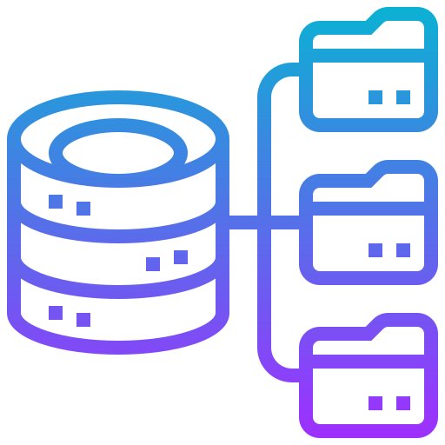
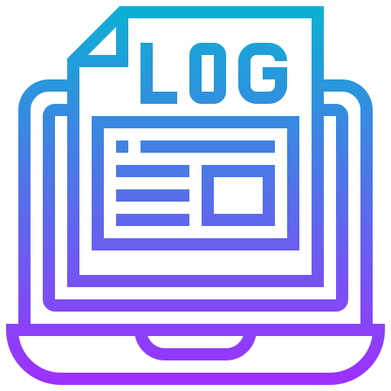
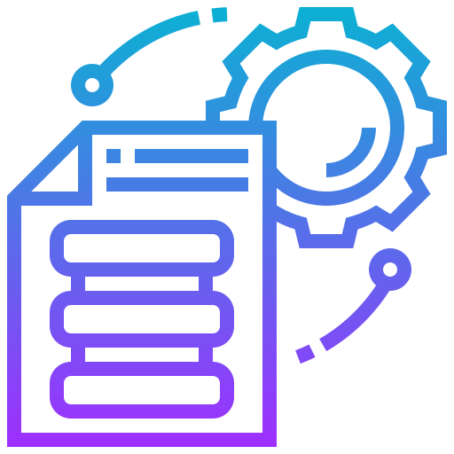

Subset each Batch
Reading to DataFrame
Filtering Features
Keeping Track of Features
DB Tables, Views and Files
Lookup for Chart Event, Diagnoses and Procedure
Compiling Features

