Slide 1

Customer Shopping Behavior Analysis
This project analyzes 3,900 purchases across multiple product categories to surface spending patterns, customer segments, product preferences, and subscription behavior. The objective: translate transactional insights into actionable business recommendations that improve revenue, retention, and marketing precision.

Slide 2
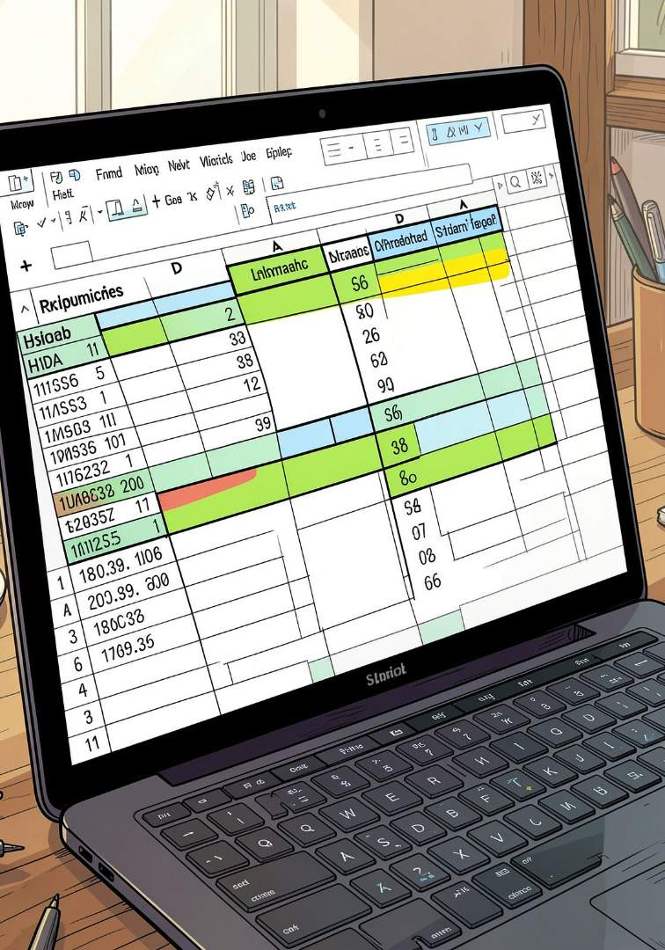
Dataset & Key Features
Dataset summary: 3,900 rows and 18 columns. Key features include customer demographics (age, gender, location, subscription status), purchase details (item, category, amount, season, size, color), and shopping behavior (discount applied, promo code used, prior purchases, purchase frequency, review rating, shipping type). Missing data: 37 values in Review Rating.

Slide 3

Data Preparation & Cleaning (Python)
We loaded data with pandas, inspected structure with df.info() and .describe(), checked nulls, and imputed 37 missing review ratings using median rating per product category. Columns were standardized to snake_case for readability and documentation. Redundant promo_code_used was dropped after consistency checks with discount_applied.
Imputation
Renaming
Review ratings imputed by category median.
Columns standardized to snake_case.
Dropped Field
Removed promo_code_used after redundancy check.

Slide 4
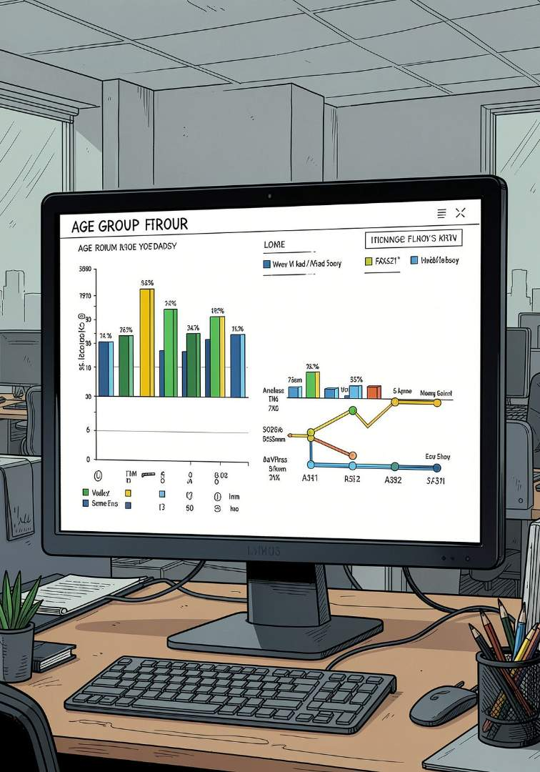
Feature Engineering
Created age_group by binning ages to analyze revenue by cohort. Derived purchase_frequency_days from timestamps to measure recency and loyalty. Engineered flags for discount usage and subscription status to segment behavior and link to spend patterns.

Slide 5




SQL Analysis: Revenue & High-Value Behavior
Using PostgreSQL, we answered core business questions: revenue by gender, high-spending users who used discounts (spent above average despite discounts), and subscribers vs non-subscribers — comparing average spend and total revenue across subscription status to quantify subscriber value.
Revenue by Gender
Compared total revenue between male and female customers to inform targeting.
High-Spend Discount Users
Identified customers using discounts who still spend above average.
Subscribers vs. Non-Subscribers
Measured average spend and total revenue by subscription status.

Slide 6

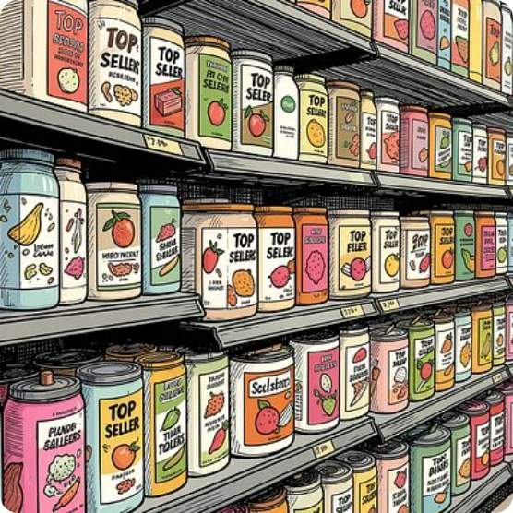
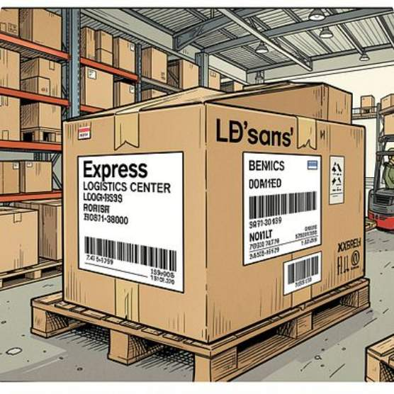
Product & Shipping Insights
Top 5 products by average rating and the top 3 products per category were extracted to inform product positioning. Shipping analysis compared average purchase amounts between Standard and Express shipping to evaluate premium shipping value and cross-sell opportunities.

Slide 7
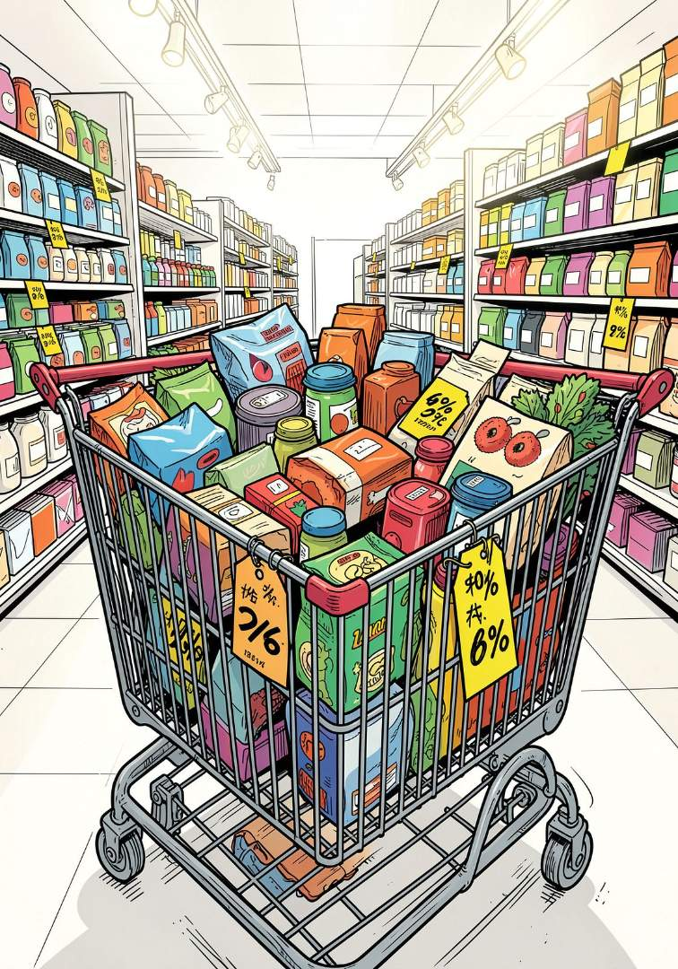
Discount Dependence & Repeat Buyers
Identified five products with the highest percentage of discounted purchases to flag pricing risk. Examined repeat buyers: customers with more than five purchases were analyzed to see if they're more likely to subscribe — informing loyalty program targeting and retention tactics.
Discount-Dependent Products
Top 5 products with largest share of discounted purchases.
Repeat Buyer Behavior
Customers with >5 purchases evaluated for subscription likelihood.

Slide 8
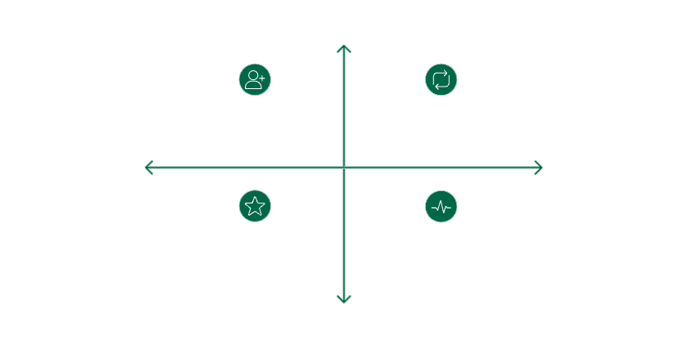
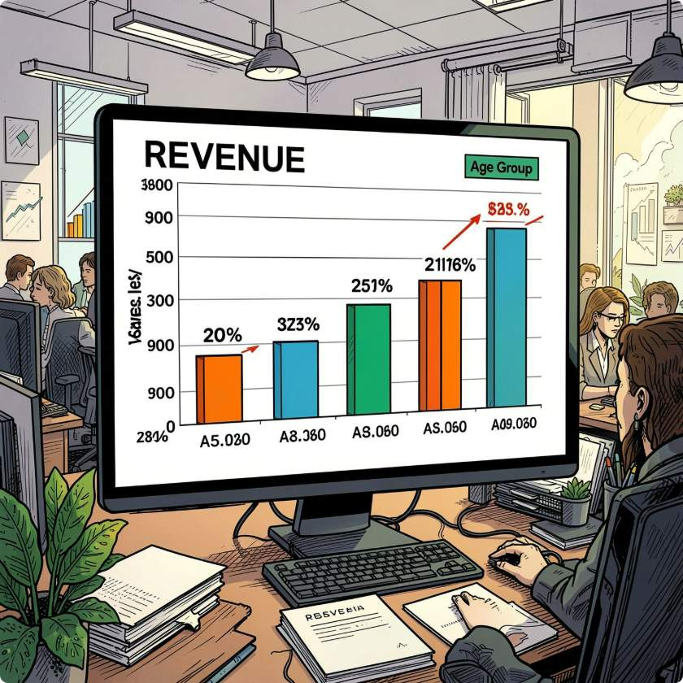
Customer Segmentation & Revenue by Age
Segmented customers into New, Returning, and Loyal based on purchase history for targeted strategies. Calculated revenue contribution by age_group to prioritize marketing spend on high-revenue cohorts and tailor creative and offers for each demographic.
High Revenue Contribution
New Customers - First purchase, low spend
Returning Customers - Repeat buyers, moderate spend
Low Frequency
High Frequency
Loyal Customers - Frequent buyers, high spend
At-Risk Customers - Infrequent, declining spend
Low Revenue Contribution
Revenue by age group highlights which cohorts drive the most revenue and should be the focus of targeted campaigns and subscription promotions.

Slide 9
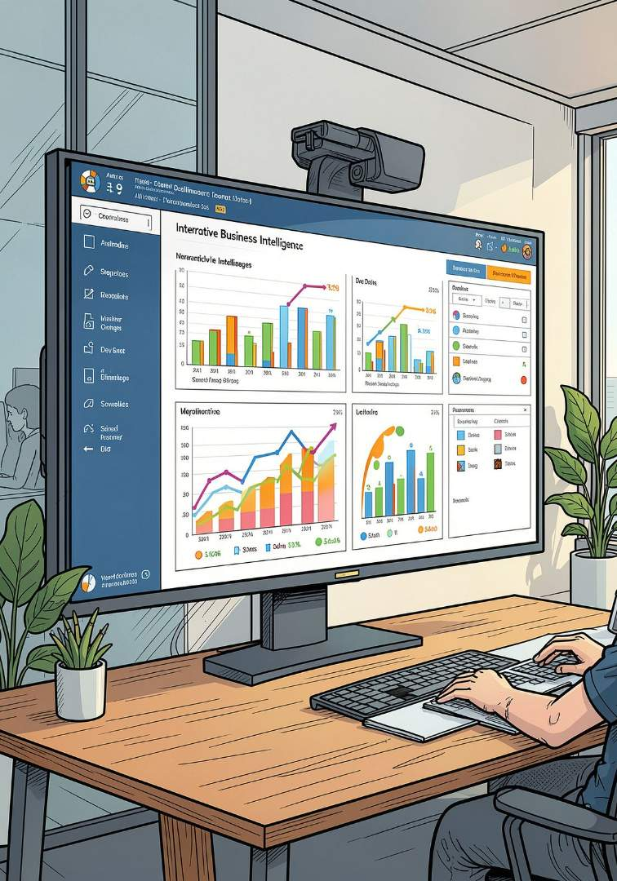
Power BI Dashboard
An interactive Power BI dashboard was built to visualize KPIs: revenue breakdowns, top products, discount dependency, subscriber value, shipping comparisons, and segment performance. The dashboard enables stakeholders to filter by category, age_group, subscription status, and shipping type for on-demand insight.

Slide 10





Business Recommendations
Boost Subscriptions
Customer Loyalty Programs
Review Discount Policy
Product Positioning
Promote exclusive benefits to increase subscriber conversion and capture higher average spend from subscribers.
Balance short-term sales boosts with margin control by revising discount strategies for discount-dependent products.
Highlight top-rated and best-selling products in campaigns to capitalize on social proof and conversion lift.
Reward repeat buyers to move them into the Loyal segment and increase lifetime value.
Targeted Marketing
Focus marketing on high-revenue age groups and express-shipping users to maximize ROI on ad spend and promotions.
Next steps: prioritize dashboard KPIs, run A/B tests on subscription offers, and re-evaluate discount depth for the five risk products.

