Slide 1


Honda Sales AI Automation
End-to-End Automated Reporting
Faisal Mohsin

Slide 2
Business Problem
How can Honda sales data be automatically collected, centralized, and transformed into actionable insights so that management can monitor sales performance, profitability, customer trends, and regional performance more efficiently?

Slide 3
Objective
Automate the collection and processing of Honda sales data using n8n.
Store and organize sales data in a centralized MySQL database.
Reduce manual data handling and reporting efforts.
Analyze sales, revenue, costs, discounts, and profit-related data.
Identify important sales trends across models, dealers, cities, and states.
Generate business insights and suggestions based on the analyzed sales data.
Support data-driven decision-making through automated analysis

Slide 4







Technology Stack
n8n Cloud
Gmail & Google Drive
Aiven MySQL
SQL and JavaScript
Google Gemini AI
HTML Reporting

Slide 5
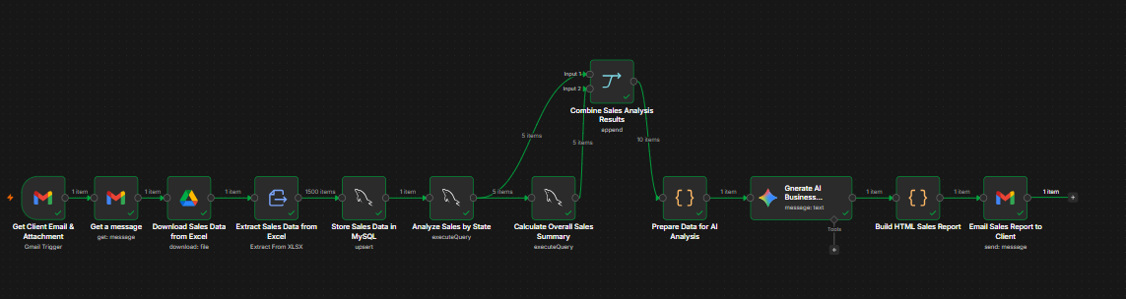



Architecture
Trigger: Gmail arrives with sales data
Storage: Google Drive and XLSX Extraction
Database: Aiven MySQL Upsert (honda_sales)
Analytics: SQL Aggregation (State & Overall)
AI: Gemini analysis of supplied metrics
Delivery: JavaScript HTML & Gmail Send

Slide 6



Data Model
Architecture
Aiven MySQL honda_sales table design
Order_ID
Metrics
Dimensions
Customer Data
Primary Key (VARCHAR 50) used as the match column for upserts.
Includes On_Road_Price, Discount, Gross_Profit, and Net_Sales.
Covers State, City, Dealer_Name, Bike_Model, and Segment.
Includes Age, Gender, and Customer_Rating metrics.

Slide 7


Data Pipeline
Pipeline Rules
01
Automated XLSX to structured row conversion
1,500
28
02
MySQL Insert or Update based on Order_ID
Rows extracted per XLSX file
Database columns processed
03
Production path excludes DROP TABLE for data safety

Slide 8

SQL Analytics
Automated metric extraction from Aiven MySQL
State-wise Analysis
Total orders by state, sum of On_Road_Price,
ordered by sales volume.
Overall Summary
Unique order count, total aggregate sales, and average customer age calculation.

Slide 9
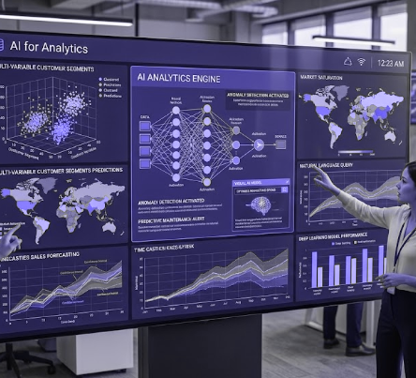
AI Layer
Google Gemini Business-Insight Generation
01
Evidence-Based
AI interprets supplied SQL metrics without inventing figures.
02
Prompt Strategy
Returns 3-5 concise practical suggestions for the client.
03
Trend Analysis
Compares states based on total sales and order counts.

Slide 10
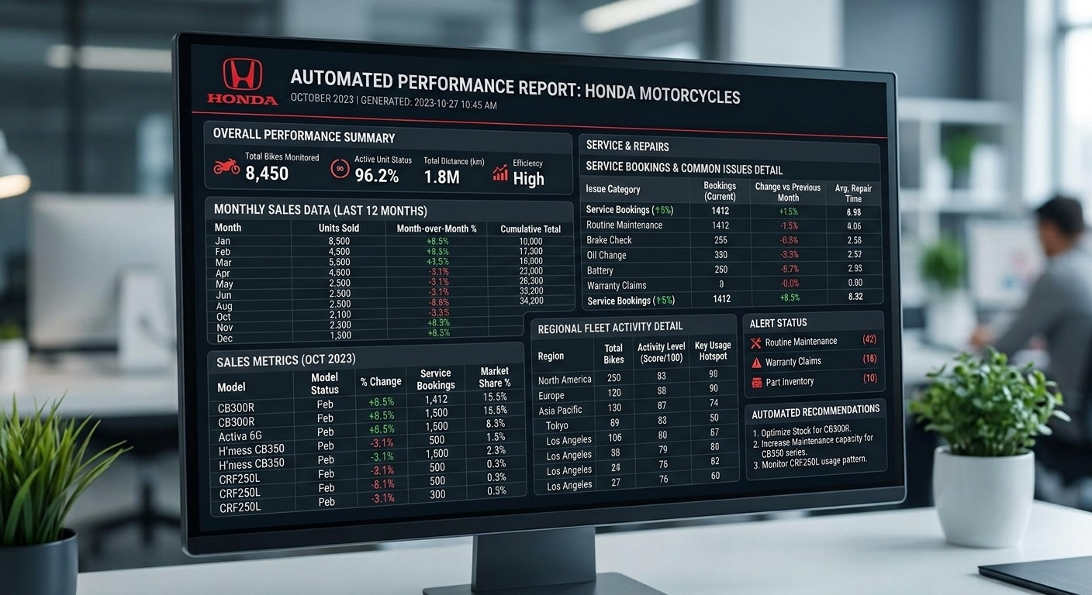


Automated Report
Dynamic HTML email generation via JavaScript
Summary metrics: Total Sales & Unique Orders
Structured state-wise sales data table
Integrated Gemini business suggestions
Automated delivery through Gmail node

Slide 11

Execution
n8n workflow testing results
11
Total n8n nodes in pipeline
100%
Success rate in end-to-end testing
Workflow successfully processed 1,500 items, executed SQL analysis, generated AI insights, and produced the final report object.

Slide 12
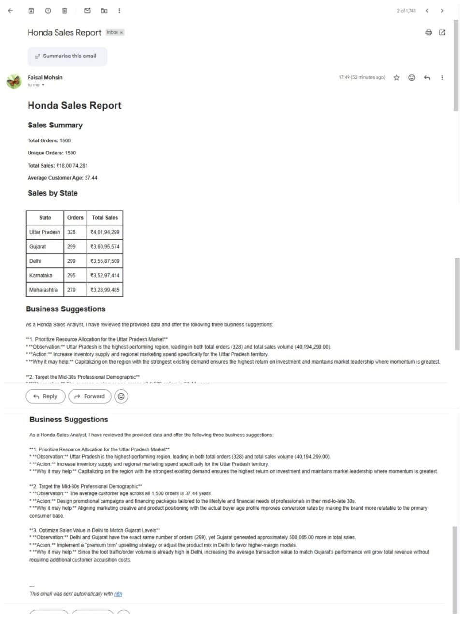
Email Proof
Final Gmail delivery successful. The system outputs a client-ready HTML report containing formatted data tables and AI-generated narrative summaries.

Slide 13
GitHub Repository
Project Documentation and Architecture
Path | Purpose
README.md | Project explanation and evidence
SQL | Detailed SQL, AI, and Schema notes
n8n | Sanitized n8n JSON export
suceessful email repor | Execution proof from each node

Slide 14




Skills Demonstrated
n8n Workflow Orchestration
ETL Processing and MySQL Upserts
SQL Aggregation and Analytics
AI Prompt Engineering (Gemini)
Dynamic HTML Email Generation
Cloud Database and API Integration

Slide 15
Conclusion
The project establishes a reusable pipeline that converts structured sales data into automatically delivered reporting, replacing manual efforts with deterministic metrics and AI-driven insights.

