Slide 1
Automating Prepaid Plan Data Collection
RPA bot built with Automation Anywhere A360
Faisal Mohsin | Jamia Hamdard
AI Hackathon for Builders (GL Bajaj Institute, via Unstop)
Notes:
Introduce yourself. Say honestly: I took part in the AI Hackathon for Builders organised by GL Bajaj and received a certificate of participation. This deck covers an automation project I built in A360 that shows the kind of problem I like to solve.

Slide 2
The Business Problem
Plans change constantly
Telecom operators revise prices, data benefits and validity often.
Manual tracking is slow
Analysts copy plan details from the website into Excel by hand.
Errors and stale data
Copy-paste mistakes and outdated sheets lead to wrong comparisons.
Notes:
Frame the problem: anyone doing plan comparison or market research needs accurate, current plan data. Doing it manually does not scale.

Slide 3
The Solution
An A360 bot that reads plan details from the Vi India prepaid recharge page and writes them into Excel automatically.
Extract
Structure
Repeat
Price, data benefit and validity for every plan
Clean rows and columns in VI.xlsx
Loops until no more plans remain on the page
Notes:
Keep it simple: the bot opens the page, loops through each plan card, pulls three fields, and writes them to Excel.

Slide 4
How the Bot Works (A360 Workflow)
1
Browser: Open
2
Excel: Open
Launch Vi recharge page in Microsoft Edge
Open VI.xlsx as the output file
3
Loop
4
Recorder: Capture
Repeat while a plan label exists on the page
Read price, data and validity text (HTML InnerText)
5
Excel: Set cell
6
Increment
Write values to columns A, B, C of the current row
Move to the next row and next plan
Notes:
Tools used: Automation Anywhere A360, Browser and Recorder actions, Excel Advanced, Loop, Number variables, Message box for debugging.

Slide 5
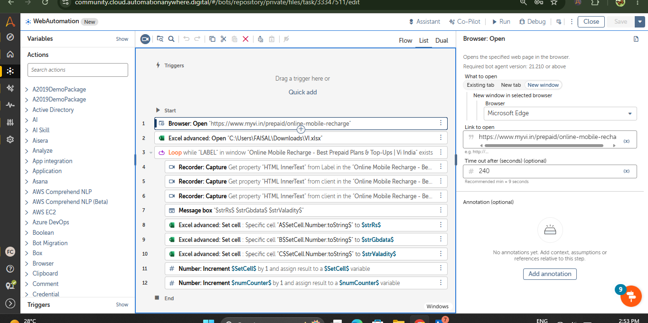
Proof: A360 Workflow
Notes:
Walk through the bot top to bottom: open browser, open Excel, loop, capture, write, increment.

Slide 6
Result: Structured Plan Data in Excel
Price | Data | Validity
Rs 3599 | Unlimited | 84 Days
Rs 3999 | Unlimited | 365 Days
Rs 979 | Unlimited | 84 Days
Rs 349 | Unlimited | 28 Days
Rs 199 | Data pack | 28 Days
Rs 2249 | Data pack | 365 Days
20+
plans captured automatically in one run, across 28-day to 365-day validities
Known gap: a few Data values are truncated (e.g. "/day"). Next step is refining the selectors and adding a cleanup step.
Sample of the extracted output
Notes:
Be upfront about the limitation. Saying what you would improve shows maturity.

Slide 7
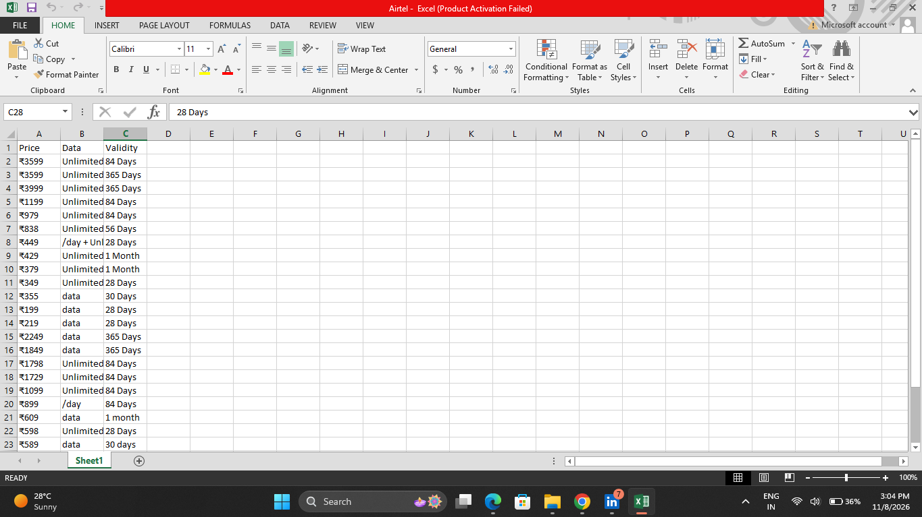
Proof: Excel Output
Notes:
Show the VI.xlsx result with Price, Data and Validity columns populated by the bot.

Slide 8
Impact and Next Steps
Impact
Next Steps
Replaces manual copy-paste with a repeatable run
Consistent Excel format ready for analysis
Reduces human error in plan comparison
Fix truncated fields with better selectors
Extend to Airtel and Jio for comparison
Schedule runs to track price changes
Add AI to recommend best plan by need
Hackathon link: the AI Hackathon for Builders pushed me to think about where automation and AI solve real problems.
Notes:
Connect to the hackathon truthfully: participation motivated you to build and think about AI-driven automation.

