Slide 1
Airline Customer Experience Analytics
An Interactive Power BI Portfolio Project
Customer Satisfaction • Flight Disruptions • Complaints • Route Performance
Reporting Period: July 2025 – June 2026
Tools: Power BI | Python | SQL

Slide 2
Business Problem & Project Objectives
UNDERSTANDING CUSTOMER SATISFACTION, COMPLAINTS AND OPERATIONAL DISRUPTIONS
Business Problem
Customer experience can vary across journeys, particularly when flights are delayed or disrupted. Teams need clear evidence to identify where improvement may be needed.
Analytical Objectives
Measure satisfaction, complaint and disruption rates. Assess customer outcomes across delay severity bands. Compare route performance and passenger segments. Examine service-case resolution and compensation.
Business Questions
How are delays and disruptions associated with customer satisfaction and complaints? Which high-volume routes have higher complaint rates? Where could service recovery processes be improved?
Expected Value
A consolidated Power BI dashboard to support performance monitoring, identify areas for investigation and prioritise evidence-based improvements.

Slide 3
Data Architecture & Analytical Approach
FROM RAW DATASETS TO ACTIONABLE CUSTOMER EXPERIENCE INSIGHTS
01 | DATA SOURCES
Customer Journey - 50,000 records Airport Reference - 27 records Flight Schedule - 29,200 records Service Cases - 878 records
02 | DATA PREPARATION
Inspected data types, missing values and duplicates. Prepared date fields and analytical categories. Created delay bands and route keys. Reviewed data consistency and relationships.
03 | DATA MODELLING
Organised data into fact and dimension tables. Created date and route dimensions. Connected airport dimensions for origin and destination analysis. Configured relationships to support interactive filtering.
04 | ANALYTICS & VISUALISATION
Developed DAX measures for key performance indicators. Analysed satisfaction, complaints, disruptions and delays. Compared route volumes and passenger segments. Built interactive Power BI dashboards and an executive action plan.
AWS CLOUD APPROACH: Amazon S3 | AWS Glue Data Catalog | Amazon Athena
TOOLS: Power BI | DAX | Power Query | Python | SQL | AWS

Slide 4
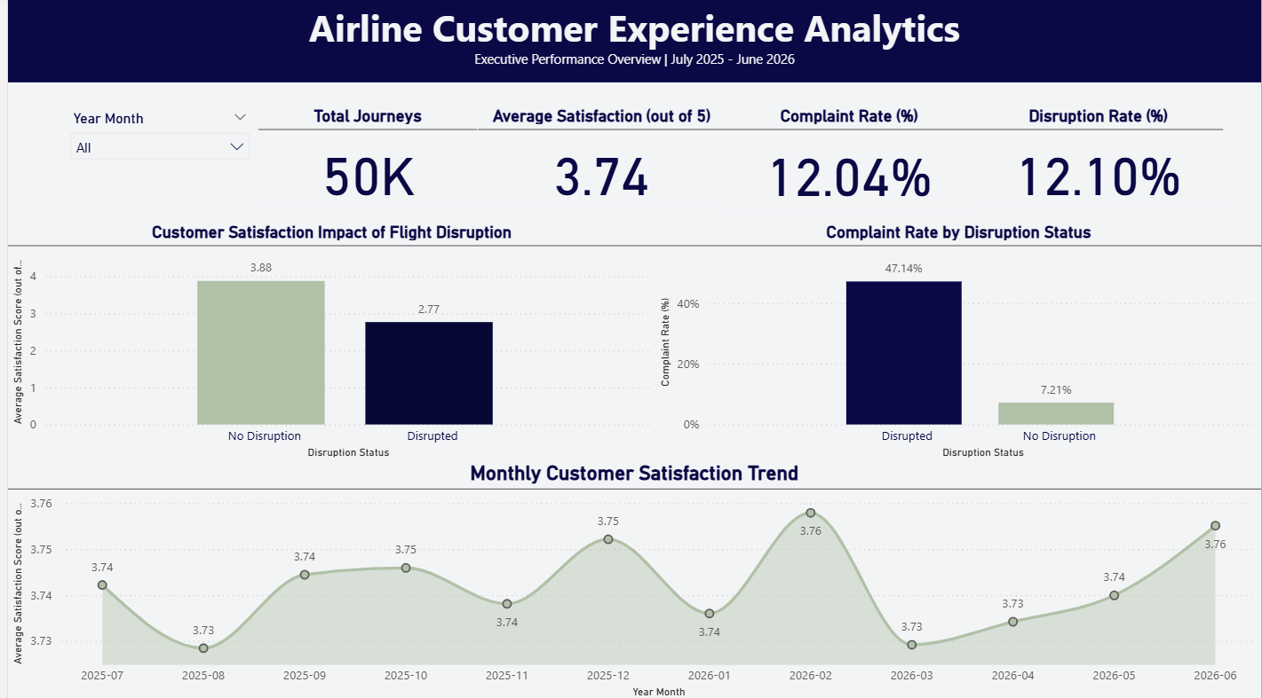
Executive Overview & Key Performance Indicators
Customer Experience Performance | July 2025 – June 2026
KEY PERFORMANCE INDICATORS
Total Journeys
50,000
Average Satisfaction
3.74 / 5
Complaint Rate
12.04%
Disruption Rate
12.10%
KEY FINDINGS
01 | Disruption and Satisfaction
Disrupted journeys recorded average satisfaction of 2.77/5, compared with 3.88/5 for journeys without disruption.
02 | Complaint Rate
The complaint rate was 47.14% for disrupted journeys, compared with 7.21% for non-disrupted journeys.
03 | Monthly Performance
Average monthly satisfaction remained relatively stable, ranging from approximately 3.73 to 3.76 during the reporting period.
BUSINESS IMPLICATION
Prioritise investigation of disruption-related customer outcomes and monitor satisfaction and complaint rates over time.

Slide 5
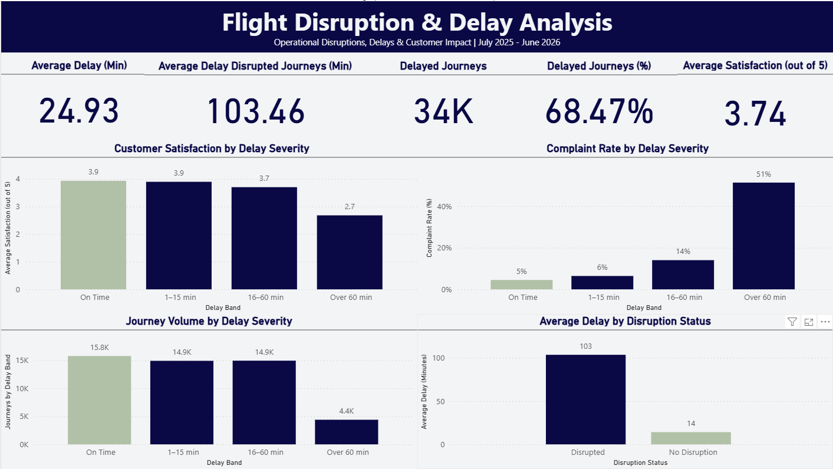
FLIGHT DISRUPTION & DELAY ANALYSIS
Assessing delay severity and its relationship with customer outcomes
OPERATIONAL PERFORMANCE
24.93 min
Average delay
68.47%
Journeys delayed
103.46 min
Average Delay - Disrupted Journeys
KEY FINDINGS
01 | Longer Delays, Lower Satisfaction
Average satisfaction remained around 3.9/5 for journeys delayed by up to 15 minutes, declining to 2.7/5 for journeys delayed over 60 minutes.
02 | Complaint Rates Increase with Delay Severity
The complaint rate rose from approximately 5% for on-time journeys to 51% for journeys delayed over 60 minutes.
03 | Disruption and Operational Impact
Journeys classified as disrupted had an average delay of 103.46 minutes, compared with approximately 14 minutes for journeys without disruption.
BUSINESS IMPLICATION
Prioritise investigation of journeys experiencing severe delays, review disruption-response processes, and monitor satisfaction and complaint rates by delay band.

Slide 6
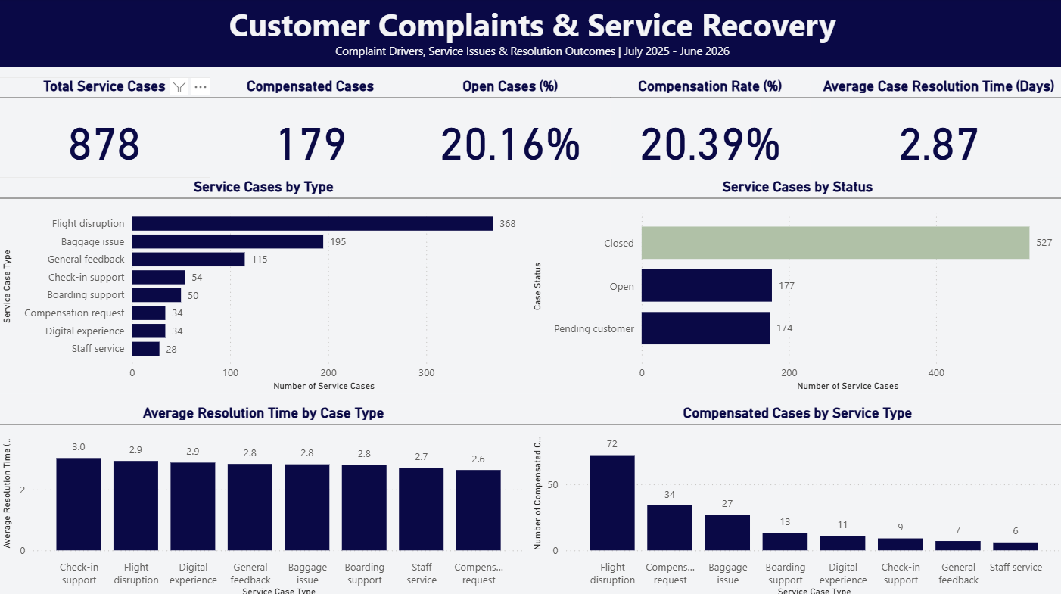
CUSTOMER COMPLAINTS & SERVICE RECOVERY
Understanding service-case volumes, resolution and compensation
SERVICE PERFORMANCE
878
Total Service Cases
20.16%
Open Cases
2.87 days
Average Case Resolution Time
KEY FINDINGS
01 | Service-Case Backlog
Of 878 service cases, 177 were open and 174 were pending customer response. This means 351 cases, or approximately 40%, were not marked as closed.
02 | Resolution Performance
Average case-resolution time was 2.87 days. Review resolution times by case type to identify where further investigation may be useful.
03 | Compensation & Recovery
179 cases were marked as compensated, representing approximately 20.39% of all service cases. Monitor compensation alongside case type and resolution outcomes.
BUSINESS IMPLICATION
Review outstanding cases, clarify ownership of unresolved cases, and monitor resolution time and compensation to identify opportunities to improve service recovery.

Slide 7
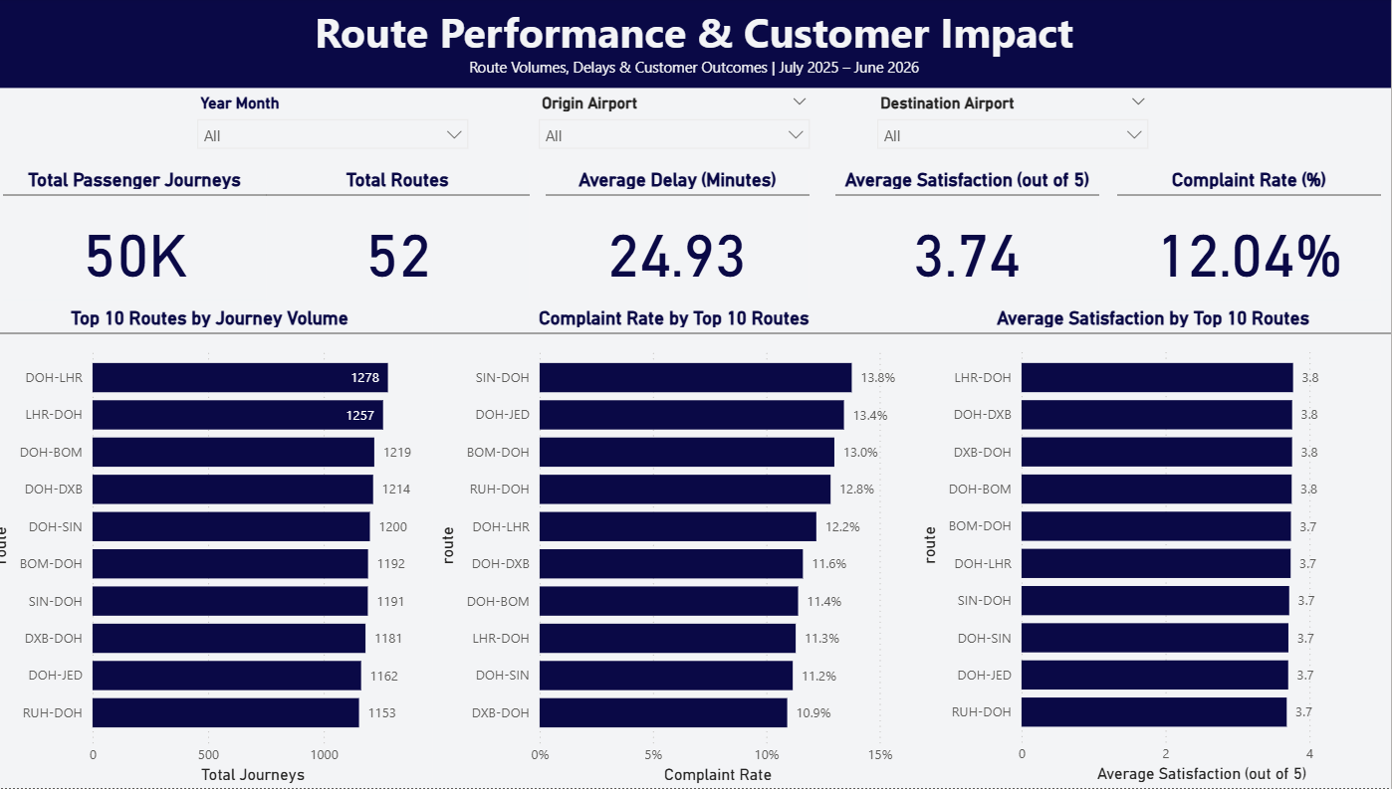
PASSENGER EXPERIENCE & ROUTE PERFORMANCE
Comparing passenger segments, route volumes and customer outcomes
PROJECT SNAPSHOT
50,000
Passenger Journeys
52
Routes Analysed
7.25 / 10
Average Recommendation Score
KEY FINDINGS
01 | Passenger Experience
Average satisfaction was broadly similar across cabin classes, ranging from approximately 3.74 to 3.76 out of 5.
02 | Route-Level Complaint Rates
Complaint rates varied across the ten highest-volume routes, ranging from approximately 10.9% to 13.8% in the full reporting period.
03 | Route Performance
Compare route volumes, complaint rates and average satisfaction to identify routes that may warrant further investigation. Validate sample sizes before prioritising operational action.
BUSINESS IMPLICATION
Use passenger and route-level insights to target further investigation, while avoiding strong conclusions from small differences between passenger segments.

Slide 8
EXECUTIVE RECOMMENDATIONS & ACTION PLAN
PRIORITY ACTIONS, SUCCESS METRICS & PERFORMANCE MONITORING
01 | Reduce Disruption Impact
Finding: Disrupted journeys have lower satisfaction and higher complaint rates.
Action: Review disruption-response procedures and improve proactive passenger communication.
Measure: Satisfaction and complaint rate by disruption status.
High priority
02 | Improve Complaint Handling
Finding: 351 of 878 service cases are open or pending customer response.
Action: Review case ownership, outstanding cases and resolution delays.
Measure: Open cases and average resolution time.
High priority
03 | Investigate Route Differences
Finding: Complaint rates vary across the ten highest-volume routes.
Action: Investigate routes with higher complaint rates alongside volume and delay severity.
Measure: Complaint rate, satisfaction and journey volume by route.
Medium priority
04 | Monitor Customer Outcomes
Finding: Overall satisfaction is 3.74/5, with a 12.04% complaint rate.
Action: Review performance trends and track agreed follow-up actions.
Measure: Satisfaction, complaints, disruptions and resolution time.
Priority: Ongoing
BUSINESS OUTCOME
Use customer and operational insights to prioritise investigations, monitor performance and support evidence-based service improvements.

