Slide 1

Mu’tah University
Faculty of IT, Department of Software Engineering
Computer Ethics and Communication Skills
Chapter 1: Introduction

Slide 2
Ethics and Communication Skills
Chapter 1: Introduction

Slide 3
What We Will Cover
The Pace of Change
Change and Unexpected Developments
Themes
Ethics
21

Slide 4
1.1 Introduction : The Pace of Change
Information Age
Era characterized by exceptional access to information.
الحقبة الزمنية الان تتمتع بوصول غير متوقع للمعلومات
Catalysts المحفزات
Low-cost computers
High-speed communication networks

Slide 5
Samsung Galaxy A2 Product of the Information Age
Low-cost computers and high-speed communication networks make possible the products of the Information Age, such as the Samsung Galaxy A2.
It functions as a phone, email client, Web browser, camera, video recorder, digital compass, and more. (Marian Stanca/Alamy)

Slide 6
Advances in Past Two Decades
Smartphones
MP3 players
Digital photography
Email
World Wide Web
Notes:
In 1990 few people other than college professors used email. Today more than a billion people around the world have email accounts. Email messages are routed instantaneously for very low cost, which can be both a blessing and a curse
The World Wide Web was still being designed in 1990; today it contains more than a trillion pages and makes possible extraordinarily valuable information retrieval systems

Slide 7
Technology and Values
Dynamic between people, technology
People adopt technology
Technology changes society
Using technology can change people
Our experiences physically change our brains (e.g., London taxi drivers)
Experiences with technology can have psychological effects, too (e.g., effects of dependency on cell phones)
Technologies solve problem, but may create new problems.
Notes:
New technologies are adopted to solve problems, but they often create problems, too. The automobile has given people the ability to travel where they want, when they want. On the other hand, millions of people spend an hour or more each day stuck in traffic commuting between home and work. Refrigerators make it possible for us to keep food fresh for long periods of time. We save time because we don’t have to go grocery shopping every day. Unfortunately, Freon leaking from refrigerators has contributed to the depletion of the ozone layer that protects us from harmful ultraviolet rays. New communication technologies have made it possible for us to get access to news and entertainment from around the world. However, the same technologies have enabled major software companies to move thousands of jobs to India, China, and Vietnam, putting downward pressure on the salaries of computer programmers in the United States

Slide 8
2. Change and Unexpected Developments..
“It is precisely this unique human capacity to transcend the present, to live one’s life by purposes stretching into the future – to live not at the mercy of the world, but as a builder and designer of that world – that is the distinction between human and animal behavior, or between the human being and the machine.”
̶ Betty Friedan³
هذه القدرة البشرية الفريدة على وجه التحديد هي تجاوز الحاضر ، وعيش حياة المرء من خلال أهداف تمتد إلى المستقبل - للعيش ليس تحت رحمة العالم ، ولكن كبناء ومصمم لذلك العالم - وهذا هو التمييز بين الإنسان و سلوك الحيوان ، أو بين الإنسان والآلة ".
25

Slide 9
2. Change and Unexpected Developments
1. Cell Phones
Relatively few in 1990s. Approximately five billion worldwide in 2011.
Used for conversations and messaging, but also for:
taking and sharing pictures
downloading music and watching videos
checking email and playing games
banking and managing investments
finding maps
Smartphone apps for many tasks, including:
monitoring diabetes مرض السكري
locating water in remote areas اكتشاف الماء ف المناطق النائية
25-26
Notes:
Writers describe the dramatic changes with observations such as, “A Masai warrior with a smartphone and Google has access to more information than the President did 15 years ago” and “More folks have access to a cellphone than to a toilet.”⁴

Slide 10
2. Change and Unexpected Developments..
Cell Phones (cont.):
Rudeness is an issue with cellphones. People use them in inappropriate places, disturbing others.
Location tracking raises privacy concerns.
Cameras in cell phones affect privacy in public and non-public places.
Cell phones can interfere with solitude, quiet and concentration. هدوء وعزلة وتركيز
Talking on cell phones while driving is dangerous.
26-27
Notes:
Cameras in cell phones threaten privacy. Where is the line between capturing news events and evidence of crimes, and voyeurism?
Some states have passed laws prohibiting use of hand-held devices while driving. Recent studies show hands-free devices, while freeing up the hands, do not reduce distractions, particularly among young adult and teenage drivers who often text message while driving.

Slide 11
2. Change and Unexpected Developments..
2. Kill switches
آلية لإيقاف تشغيل الجهاز فجأة ، خاصة في حالات الطوارئ.
Allow a remote entity to disable applications and delete files. السماح لكيان بعيد بتعطيل التطبيقات وحذف الملفات.
Are in operating systems for smartphones, tablets and some computers.
Used mainly for security, but raise concerns about user autonomy.
27-28
Notes:
Kills switches could remove content that infringes copyrights. Could also be used to remove content that a company or government deems offensive.

Slide 12
2. Change and Unexpected Developments..
Kill switches(cont.)
What if malicious hackers found a way to operate the skill switches on our devices?
What pressures might governments put on companies to use the kill switches?
will companies use them carefully for improved security?

Slide 13
2. Change and Unexpected Developments..
3. Social Networking:
First online social networking site was www.classmates.com in 1995.
Founded in 2003, Myspace had roughly 100 million member profiles by 2006.
Facebook was started at Harvard as an online version of student directories.
Social networking is popular with hundreds of millions of people because of the ease with which they can share aspects of their lives.
28-29
Notes:
Sites like Second Life (www.secondlife.com) combine many of the features of social networking sites with the 3-D aspects of video games. What new problems/benefits arise when a person can take on a physical persona (an avatar) that may be completely different from who they are in real life? Some people with physical disabilities can interact with others without revealing their disability.

Slide 14
2. Change and Unexpected Developments..
Social Networking (cont.):
Businesses connect with customers.
Organizations seek donations.
Groups organize volunteers.) helpers)
Protesters organize demonstrations and revolutions..
Individuals pool resources through “crowd funding”.
28-29

Slide 15
Change and Unexpected Developments
Social Networking (cont.):
social network companies developed sophisticated privacy controls and feedback systems to reduce problems, though they certainly have not eliminated them.
Overall, to most people, the benefits outweigh the problems, and social networking has become the new way of communicating.
28-29

Slide 16
2. Change and Unexpected Developments..
Social Networking (cont.):
How do social networking sites affect people and relationships?
People can have hundreds of friends and contacts, but have they traded quality of in-person relationships for quantity of superficial digital relationships?
Does the time spent online reduce the time spent on physical activity and staying healthy?
28-29
Notes:
Researchers find that people use social networks mostly to keep in touch with friends and family and that the easy, frequent contact enhances relationships, empathy, and a sense of community. On the other hand, young people who spend a lot of time on a social network do poorly in school and have behavioral problems. (Are these people who would have problems in any case? Does the access to the networks exacerbate preexisting emotional problems?)

Slide 17
2. Change and Unexpected Developments..
4. Communication and the Web
In the 1980s, email messages were short and contained only text.
Email was first used mostly by computer scientists, As more people and businesses connected to computer networks, use of email expanded to science researchers, then to millions of other people.
29-30
Notes:
People worldwide still send several billion emails daily (not counting spam), although texting, tweeting, and other social media have replaced email as the favored communication method in many contexts.⁹

Slide 18
Change and Unexpected Developments
Communication and the Web:
High-energy physicists established the World Wide Web in Europe in 1990 to share their work with colleagues and researchers in other countries.
In the mid- and late 1990s,the Web became an environment for ordinary users and for electronic commerce.’
Today there are billions of Web pages.

Slide 19
2. Change and Unexpected Developments..
Communication and the Web:
The Web has grown from an idea to a huge library and news source, a huge shopping mall, an entertainment center, and a multimedia.
It gives us access to information and access to audiences unimaginable a generation ago.
It empowers ordinary people to make better decisions about everything from selecting a bicycle to selecting medical treatments.

Slide 20
2. Change and Unexpected Developments..
Communication and the Web:
Software tools, many available for free, help us analyze the healthiness of our diet or plan a budget. We can find references and forms for legal processes

Slide 21
2. Change and Unexpected Developments..
Communication and the Web
Blogs (“Web log”) began as outlets for هواة amateurs wanting to express ideas, but they have become significant source of news and entertainment.
Inexpensive video cameras and video-manipulation tools have resulted in a burst of amateur videos (TickTok).
Many videos on the Web can infringeانتهاك copyrights owned by entertainment companies.
30-31

Slide 22
2. Change and Unexpected Developments..
5. Collaboration
Wikipedia: The online, collaborative encyclopedia written by volunteers.متطوعين
Informal communities of programmers create and maintain free software.
Watch-dogs on the Web: Informal, decentralized groups of people help investigate crimes.
كلاب المراقبة على الويب: تساعد المجموعات اللامركزية غير الرسمية في التحقيق في الجرائم.
33-34
Notes:
Wikipedia’s reliability was brought into question when a major contributor was found to be a 14 year-old boy instead of a scientist with a PhD and years of experience. He got most of his information from other Web sources.
Web Watch-dog sites are controversial. Mobs and individuals emotionally involved in a political, religious, or moral cause do not always pause to consider consequences or follow due process.

Slide 23
2. Change and Unexpected Developments..
6. E-commerce
Amazon.com started in 1994 selling books on the Web. It has grown to be one of the most popular, reliable, and user-friendly commercial sites.
Benefits (obvious):
Consumers can save time, money, and gasoline while researching products.
Benefits (less obvious)
Auction sites give people access to customers they could not have found efficiently before.
Lower overhead and ease of comparison shopping have brought down prices of many products.
Small businesses and artists can sell directly to buyers, avoiding fees to middlemen and distributors. The Web has enabled a peer-to-peer economy.
34

Slide 24
2. Change and Unexpected Developments..
E-commerce
eBay.com facilitates online auctions.
Online sales in the United States now total hundreds of billions of dollars a year.
Sellers can sell directly to buyers, resulting in a peer-to-peer economy.
34

Slide 25
2. Change and Unexpected Developments..
E-commerce and trust concerns
People were reluctant to provide credit card information to make online purchases, so PayPal.com grew out of need for trusted intermediary to handle payments.
Encryption and secure servers made payments safer.
The Better Business Bureau established a Web site to help consumers see if others have complained about a business.
As online sales increased, competition led traditional stores to adopt some of the practices of e-commerce, such as consumer-friendly return policies.
34-35
Notes:
Growth of commerce on the Web required solutions to several problems. One was trust
Enter PayPal, a company built on the idea of having a trusted intermediary handle payments.

Slide 26
2. Change and Unexpected Developments..
7. Free stuff
Email programs and email accounts, browsers, filters, firewalls, encryption software, word processors, spreadsheets, software for viewing documents, software to manipulate photos and video, and much more.
Phone services using VOIP such as Skype.
الصوت عبر بروتوكول الإنترنت
University lectures.
35

Slide 27
2. Change and Unexpected Developments..
Free stuff (cont.)
In order for companies to earn ad revenue to fund multimillion-dollar services, many free sites collect information about our online activities and sell it to advertisers.
36
Notes:
This tracking is not always obvious; we consider it in Chapter 2.

Slide 28
2. Change and Unexpected Developments..
8. Artificial intelligence
A branch of computer science that makes computers perform tasks normally requiring human intelligence.
Learning is a characteristic of many AI programs.
Researchers realized that narrow, specialized skills were easier for computers than what a five-year-old does: recognize people, carry on a conversation, respond intelligently to the environment.
36
Notes:
In 1997, IBM’s chess computer, Deep Blue, beat World Champion Garry Kasparov in a tournament.
In 2011, another IBM computer system called Watson defeated human Jeopardy! champions by answering questions more quickly than the humans.

Slide 29
2. Change and Unexpected Developments..
Artificial intelligence (cont.)
Many AI applications involve pattern recognition.
Applications include reading handwriting, matching fingerprints, and matching faces in photos.
Speech recognition is now a common tool.
37
Notes:
AI applications involving pattern recognition: Reading handwriting for automatic mail sorting, matching fingerprints, matching faces in photos.
Personal assistants in smartphones use speech recognition to respond to users’ questions.

Slide 30
2. Change and Unexpected Developments..
Artificial intelligence (cont.)
Turing Test: If the computer convinces the human subject that the computer is human, the computer is said to “pass”.
37
Notes:
Philosopher John Searle argues that computers cannot be intelligent. They do not think; they manipulate symbols. They do so at a very high speed, and they can store, access, and manipulate a huge quantity of data, but they are not conscious. They do not understand; they simulate understanding.
Searle might say that although Watson won at Jeopardy!, Watson does not know it won.

Slide 31
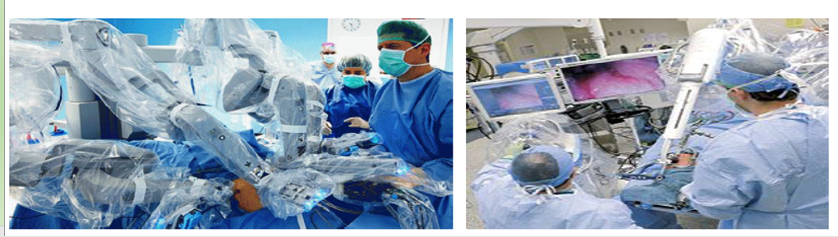

Slide 32
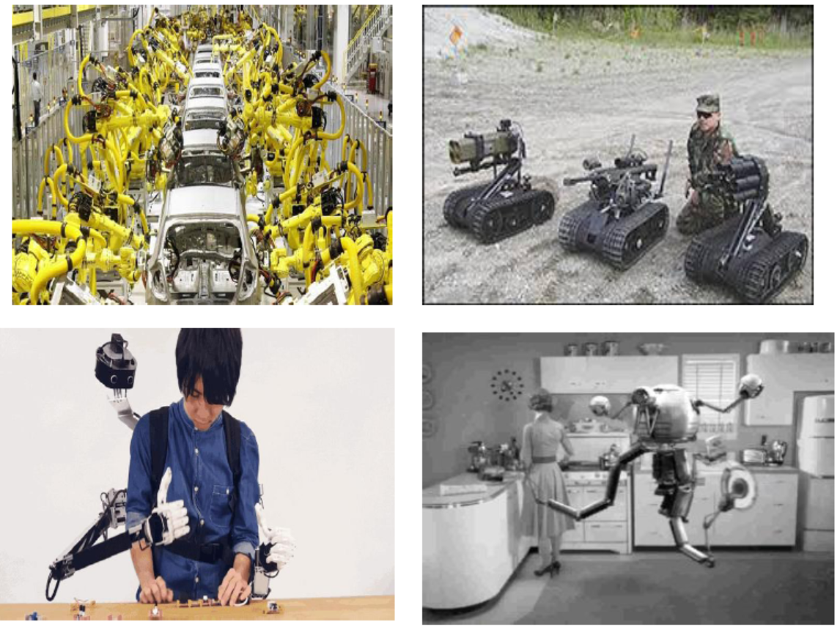

Slide 33
2. Change and Unexpected Developments..
Discussion Questions:
How will we react when we can go into a hospital for surgery performed entirely by a machine? Will it be scarier than riding in the first automatic elevators or airplanes?
How will we react when we can have a conversation and not know if we are conversing with a human or a machine?
How will we react when chips implanted in our brains enhance our memory with gigabytes of data and a search engine? Will we still be human?
38

Slide 34
2. Change and Unexpected Developments..
Robots
Mechanical devices that perform physical tasks traditionally done by humans.
Can operate in environments that are hazardous for people. خطرة على الناس.
Smart sensors, motion, and control
Motion sensing devices are used to give robots the ability to walk, trigger airbags in a crash, and protect laptops when dropped.
Sensors can detect leaks, acceleration, position, temperature, and moisture. يمكن لأجهزة الاستشعار اكتشاف التسربات والتسارع والموضع ودرجة الحرارة والرطوبة.
38-39
Notes:
Robots inspect undersea structures and communication cables, search for survivors in buildings collapsed by bombs or earthquakes, explore volcanoes and other planets, and move or process nuclear and other hazardous wastes.

Slide 35
2. Change and Unexpected Developments..
Tools for disabled people
Assistive technology مساعدة devices help restore productivity and independence to people with disabilities.
Researchers are experimenting with chips that convert brain signals to controls for leg and arm muscles.
40-42
Notes:
A blind person can use handheld devices that combine optical-character-recognition with a speech synthesizer to read menus and receipts.
Flexible, responsive prosthetic devices can now be digitally controlled, enabling amputees to walk, climb stairs, even participate in sports and fly airplanes.
People who cannot use their hands can dictate documents to a word processor and give commands to a computer to control household appliances.

Slide 36
3. Themes مواضيع
Old problems in a new context
Cyberspace الفضاءالالكتروني has many of the problems, annoyances, and controversies of non-cyber life: crime, violent fiction and games, advertising, copyright infringement, and products that do not work right.
المضايقات والخلافات المتعلقة بالحياة غير الإلكترونية: الجريمة ، والألعاب الخيالية العنيفة ، والإعلان ، وانتهاك حقوق النشر ، والمنتجات التي لا تعمل بشكل صحيح.
42-43

Slide 37
3. Themes …
Adapting to new technology
Changes in technology require adaptive changes in laws, social institutions, business policies, personal skills, attitudes, and behavior.
We have to relearn standards for deciding when to trust what we read. The major impact of computer technology on privacy means we have to think in new ways about how to protect ourselves. We have to decide when privacy is important and when we are willing to put it at risk for some other benefit.
42-43

Slide 38
3. Themes …
Varied sources of solutions to problems
Solutions for problems that result from new technology come from more or improved technology, the market, management policies, education and public awareness, volunteer efforts, and law.
Market mechanisms ( like competition and consumer demand) generate many improvements.
42-43

Slide 39
3. Themes …
Global reach of Net
The ease of communication with distant countries has profound آثار social, economic, and political effects—some beneficial, some not.
The Net makes information and opportunities more easily available to people isolated المعزولينby geography or by political system.
42-43

Slide 40
3. Themes….
Global reach of Net
It makes crime fighting and law enforcement more difficult, because criminals can steal and disrupt services from outside the victim’s country.
مكافحة الجريمة وإنفاذ القانون أكثر صعوبة لأن المجرمين يمكنهم سرقة الخدمات وتعطيلها من خارج بلد الضحية.
Laws in one country prohibiting certain content on the Web or certain kinds of Web services restrict people and businesses in other countries because the Web is accessible worldwide.
42-43

Slide 41
3. Themes …
Perfection is a direction, not an option.
when evaluating new technologies and applications, we should not compare them to some ideal of perfect service or zero side effects and zero risk. That is impossible to achieve in most aspects of life. Instead, we should compare them to the alternatives and weigh the problems against the benefits.
The ideal shows us the direction to go as we endeavor عندما نسعى to seek improvements and solutions to problems.
Another reason that we cannot expect perfection الكمال حد is that we all have different ideas of what perfection is.
43-45

Slide 42
3. Themes …
Differences between personal choices, business policies, and law
The criteria for making personal choices, for making policies for businesses and organizations, and for writing laws are fundamentally different.
43-45
Notes:
We can make a personal choice—for example, about what social networks to join, what apps to put on our phones, or what ebooks to buy—according to our individual values and situation.
A business bases its policies on many factors, including the manager’s perception of consumer preferences, what competitors are doing, responsibilities to stockholders, the ethics of the business owners or managers, and relevant laws.
Laws are fundamentally different from personal choices and organizational policies because they impose decisions by force on people who did not make them. Arguments for passing a law should be qualitatively different from reasons for adopting a personal or organizational policy. It might seem odd at first, but arguments on the merits of the proposal—for example, that it is a good idea, or is efficient, or is good for business, or is helpful to consumers—are not good arguments for a law. We can use these arguments to try to convince a person or organization to adopt a particular policy voluntarily. Arguments for a law must show why the decision should be enforced against someone 26 Chapter 1 Unwrapping the Gift who does not agree that it is a good idea. It is better to base laws on the notion of rights rather than on personal views about their benefits or how we want people to behave.

Slide 43
4. Ethics
What is Ethics:
Study of what it means to “do the right thing”.
Assumes people are rational and make free choices.
Rules to follow in our interactions and our actions that affect others.
45-46

Slide 44
4. Ethics …
Most ethical theories attempt to achieve the same goal: to enhance human dignity منزلة, peace, happiness, and well-being.
Ethical rules apply to all of us and are intended تهدف to achieve good results for people in general, and for situations in general—not just for ourselves, not just for one situation.
45-46

Slide 45
4. Ethics….
A variety of ethical views:
Deontological theories. النظريات الأخلاقية
Utilitarianism. المنفعة
Negative rights (liberties) الحقوق السلبية (الحريات)
The right to act without interference
الحق في التصرف دون تدخل
Positive rights (claim-rights)
An obligation of some people to provide certain things for others.
التزام بعض الناس بتقديم أشياء معينة للآخرين.
47-50

Slide 46
4. Ethics …
Golden rules
Treat others as you would want them to treat you.
Contributing to society
Doing one’s work honestly, responsibly, ethically, creatively, and well is virtuous مرغوب/مفضل .
Social contracts and a theory of political justice
People willingly submit يخضع الناس عن طيب خاطرto a common law in order to live in a civil مدني/ آمن society.
51-52

Slide 47
4. Ethics …
No simple answers
Human behavior and real human situations are complex. There are often trade-offs to consider.
Ethical theories help to identify important principles or guidelines.
Do organizations have ethics?
Ultimately, it is individuals who are making decisions and taking actions. We can hold both the individuals and the organization responsible for their acts.
54-55
Notes:
Ethical theories do not provide clear, incontrovertibly correct positions on most issues. We can use the approaches we described to support opposite sides of many an issue.

Slide 48
4. Ethics….
Some important distinctions الفروقات :
Right, wrong, and okay
Distinguishing wrong and harm التمييز بين الخطأ والضرر
Separating goals from constraints فصل الأهداف عن القيود
Personal preference and ethics التفضيل الشخصي والأخلاق
Law and ethics
55-59
Notes:
We can think of acts as either ethically obligatory, ethically prohibited, or ethically acceptable.
Harm alone is not a sufficient criterion to determine that an act is unethical.
The ethical character of a company depends on whether the actions taken to achieve the goal are consistent with ethical constraints.
It can be difficult to draw a line between what we consider ethically right or wrong and what we personally approve or disapprove of.
Ethics precedes law in the sense that ethical principles help determine whether or not we should pass specific laws. A good law will set minimal standards that can apply to all situations, leaving a large range of voluntary choices. Ethics fills the gap between general legal standards that apply to all cases and the particular choices made in a specific case.

