Slide 1
Chapter 4
Data Structures~ review

Slide 2
Outline
Introduction
Self-Referential Structures
Dynamic Memory Allocation
Linked Lists
Stacks
Queues
Trees
Graphs

Slide 3
Introduction
Dynamic data structures
  Data structures that grow and shrink during execution
Linked lists
  Allow insertions and removals anywhere
Stacks
  Allow insertions and removals only at top of stack
Queues
  Allow insertions at the back and removals from the front
Binary trees
  High-speed searching and sorting of data and efficient elimination of duplicate data items

Slide 4
Self-Referential Structures
Self-referential structures
  Structure that contains a pointer to a structure of the same type
  Can be linked together to form useful data structures such as lists, queues, stacks and trees
  Terminated with a NULL pointer (0)
Diagram of two self-referential structure objects linked together
15
10
Data member and pointer
NULL pointer (points to nothing)

Slide 5
Self-Referential Classes
      struct node {
      int data;
      struct node *nextPtr;
      }
nextPtr
  Points to an object of type node
  Referred to as a link
    Ties one node to another node

Slide 6
Dynamic Memory Allocation
Dynamic memory allocation
  Obtain and release memory during execution
malloc
  Takes number of bytes to allocate
    Use sizeof to determine the size of an object
  Returns pointer of type void *
    A void * pointer may be assigned to any pointer
    If no memory available, returns NULL
  Example
    newPtr = malloc( sizeof( struct node ) );
free
  Deallocates memory allocated by malloc
  Takes a pointer as an argument
  free ( newPtr );

Slide 7
Linked Lists
Linked list
  Linear collection of self-referential class objects, called nodes
  Connected by pointer links
  Accessed via a pointer to the first node of the list
  Subsequent nodes are accessed via the link-pointer member of the current node
  Link pointer in the last node is set to null to mark the list’s end
Use a linked list instead of an array when
  You have an unpredictable number of data elements
  Your list needs to be sorted quickly

Slide 8


Linked Lists
Types of linked lists:
  Singly linked list
    Begins with a pointer to the first node
    Terminates with a null pointer
    Only traversed in one direction
  Circular, singly linked
    Pointer in the last node points back to the first node

Slide 9

Linked Lists
- Doubly linked list
    Two “start pointers” – first element and last element
    Each node has a forward pointer and a backward pointer
    Allows traversals both forwards and backwards
- Circular, doubly linked list
  Forward pointer of the last node points to the first node and backward pointer of the first node points to the last node

Slide 10
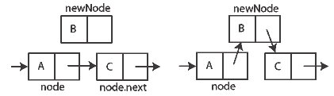
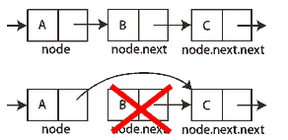
Linked Lists
-Insert a node to a singly linked list
-Remove a node from a singly linked list

Slide 11
1 /* Fig. 12.3: fig12_03.c
2 Operating and maintaining a list */
3 #include <stdio.h>
4 #include <stdlib.h>
1. Define struct
1.1 Function prototypes
1.2 Initialize variables
2. Input choice
5
6 struct listNode { /* self-referential structure */
7 char data;
8 struct listNode *nextPtr;
9 };
10
11 typedef struct listNode ListNode;
12 typedef ListNode *ListNodePtr;
13
14 void insert( ListNodePtr *, char );
15 char delete( ListNodePtr *, char );
16 int isEmpty( ListNodePtr );
17 void printList( ListNodePtr );
18 void instructions( void );
19
20 int main()
21 {
22 ListNodePtr startPtr = NULL;
23 int choice;
24 char item;
25
26 instructions(); /* display the menu */
27 printf( "? " );
28 scanf( "%d", &choice );

Slide 12
29
30 while ( choice != 3 ) {
31
32 switch ( choice ) {
2.1 switch statement
33 case 1:
34 printf( "Enter a character: " );
35 scanf( "\n%c", &item );
36 insert( &startPtr, item );
37 printList( startPtr );
38 break;
39 case 2:
40 if ( !isEmpty( startPtr ) ) {
41 printf( "Enter character to be deleted: " );
42 scanf( "\n%c", &item );
43
44 if ( delete( &startPtr, item ) ) {
45 printf( "%c deleted.\n", item );
46 printList( startPtr );
47 }
48 else
49 printf( "%c not found.\n\n", item );
50 }
51 else
52 printf( "List is empty.\n\n" );
53
54 break;
55 default:
56 printf( "Invalid choice.\n\n" );
57 instructions();
58 break;
59 }

Slide 13
60
61 printf( "? " );
62 scanf( "%d", &choice );
63 }
3. Function definitions
64
65 printf( "End of run.\n" );
66 return 0;
67 }
68
69 /* Print the instructions */
70 void instructions( void )
71 {
72 printf( "Enter your choice:\n"
73 " 1 to insert an element into the list.\n"
74 " 2 to delete an element from the list.\n"
75 " 3 to end.\n" );
76 }
77
78 /* Insert a new value into the list in sorted order */
79 void insert( ListNodePtr *sPtr, char value )
80 {
81 ListNodePtr newPtr, previousPtr, currentPtr;
82
83 newPtr = malloc( sizeof( ListNode ) );
84
85 if ( newPtr != NULL ) { /* is space available */
86 newPtr->data = value;
87 newPtr->nextPtr = NULL;
88
89 previousPtr = NULL;
90 currentPtr = *sPtr;

Slide 14
91
92 while ( currentPtr != NULL && value > currentPtr->data ) {
93 previousPtr = currentPtr; /* walk to ... */
94 currentPtr = currentPtr->nextPtr; /* ... next node */
3. Function definitions
95 }
96
97 if ( previousPtr == NULL ) {
98 newPtr->nextPtr = *sPtr;
99 *sPtr = newPtr;
100 }
101 else {
102 previousPtr->nextPtr = newPtr;
103 newPtr->nextPtr = currentPtr;
104 }
105 }
106 else
107 printf( "%c not inserted. No memory available.\n", value );
108 }
109
110 /* Delete a list element */
111 char delete( ListNodePtr *sPtr, char value )
112 {
113 ListNodePtr previousPtr, currentPtr, tempPtr;
114
115 if ( value == ( *sPtr )->data ) {
116 tempPtr = *sPtr;
117 *sPtr = ( *sPtr )->nextPtr; /* de-thread the node */
118 free( tempPtr ); /* free the de-threaded node */
119 return value;
120 }

Slide 15
121 else {
122 previousPtr = *sPtr;
123 currentPtr = ( *sPtr )->nextPtr;
124
3. Function definitions
125 while ( currentPtr != NULL && currentPtr->data != value ) {
126 previousPtr = currentPtr; /* walk to ... */
127 currentPtr = currentPtr->nextPtr; /* ... next node */
128 }
129
130 if ( currentPtr != NULL ) {
131 tempPtr = currentPtr;
132 previousPtr->nextPtr = currentPtr->nextPtr;
133 free( tempPtr );
134 return value;
135 }
136 }
137
138 return '\0';
139 }
140
141 /* Return 1 if the list is empty, 0 otherwise */
142 int isEmpty( ListNodePtr sPtr )
143 {
144 return sPtr == NULL;
145 }
146
147 /* Print the list */
148 void printList( ListNodePtr currentPtr )
149 {
150 if ( currentPtr == NULL )

Slide 16
151 printf( "List is empty.\n\n" );
152 else {
153 printf( "The list is:\n" );
154
155 while ( currentPtr != NULL ) {
3. Function definitions
156 printf( "%c --> ", currentPtr->data );
157 currentPtr = currentPtr->nextPtr;
158 }
159
160 printf( "NULL\n\n" );
161 }
162 }

Slide 17
Enter your choice:
1 to insert an element into the list.
2 to delete an element from the list.
3 to end.
? 1
Enter a character: B
The list is:
B --> NULL
? 1
Enter a character: A
The list is:
A --> B --> NULL
? 1
Enter a character: C
The list is:
A --> B --> C --> NULL
? 2
Enter character to be deleted: D
D not found.
? 2
Enter character to be deleted: B
B deleted.
The list is:
A --> C --> NULL
Program Output

Slide 18
Stacks
Stack
  New nodes can be added and removed only at the top
  Similar to a pile of dishes
  Last-in, first-out (LIFO)
  Bottom of stack indicated by a link member to NULL
  Constrained version of a linked list
push
  Adds a new node to the top of the stack
pop
  Removes a node from the top
  Stores the popped value
  Returns true if pop was successful

Slide 19
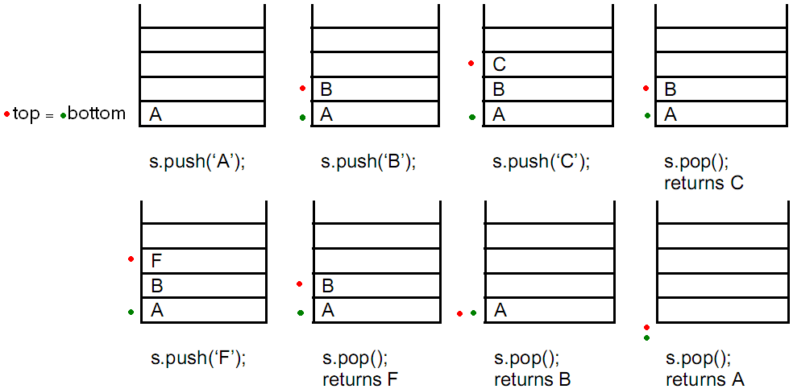
Stacks
Example top = bottom

Slide 20
1 /* Fig. 12.8: fig12_08.c
2 dynamic stack program */
3 #include <stdio.h>
4 #include <stdlib.h>
1. Define struct
1.1 Function definitions
1.2 Initialize variables
2. Input choice
5
6 struct stackNode { /* self-referential structure */
7 int data;
8 struct stackNode *nextPtr;
9 };
10
11 typedef struct stackNode StackNode;
12 typedef StackNode *StackNodePtr;
13
14 void push( StackNodePtr *, int );
15 int pop( StackNodePtr * );
16 int isEmpty( StackNodePtr );
17 void printStack( StackNodePtr );
18 void instructions( void );
19
20 int main()
21 {
22 StackNodePtr stackPtr = NULL; /* points to stack top */
23 int choice, value;
24
25 instructions();
26 printf( "? " );
27 scanf( "%d", &choice );
28

Slide 21
29 while ( choice != 3 ) {
30
31 switch ( choice ) {
32 case 1: /* push value onto stack */
2.1 switch statement
33 printf( "Enter an integer: " );
34 scanf( "%d", &value );
35 push( &stackPtr, value );
36 printStack( stackPtr );
37 break;
38 case 2: /* pop value off stack */
39 if ( !isEmpty( stackPtr ) )
40 printf( "The popped value is %d.\n",
41 pop( &stackPtr ) );
42
43 printStack( stackPtr );
44 break;
45 default:
46 printf( "Invalid choice.\n\n" );
47 instructions();
48 break;
49 }
50
51 printf( "? " );
52 scanf( "%d", &choice );
53 }
54
55 printf( "End of run.\n" );
56 return 0;
57 }
58

Slide 22
59 /* Print the instructions */
60 void instructions( void )
61 {
62 printf( "Enter choice:\n"
3. Function definitions
63 "1 to push a value on the stack\n"
64 "2 to pop a value off the stack\n"
65 "3 to end program\n" );
66 }
67
68 /* Insert a node at the stack top */
69 void push( StackNodePtr *topPtr, int info )
70 {
71 StackNodePtr newPtr;
72
73 newPtr = malloc( sizeof( StackNode ) );
74 if ( newPtr != NULL ) {
75 newPtr->data = info;
76 newPtr->nextPtr = *topPtr;
77 *topPtr = newPtr;
78 }
79 else
80 printf( "%d not inserted. No memory available.\n",
81 info );
82 }
83

Slide 23
84 /* Remove a node from the stack top */
85 int pop( StackNodePtr *topPtr )
86 {
3. Function definitions
87 StackNodePtr tempPtr;
88 int popValue;
89
90 tempPtr = *topPtr;
91 popValue = ( *topPtr )->data;
92 *topPtr = ( *topPtr )->nextPtr;
93 free( tempPtr );
94 return popValue;
95 }
96
97 /* Print the stack */
98 void printStack( StackNodePtr currentPtr )
99 {
100 if ( currentPtr == NULL )
101 printf( "The stack is empty.\n\n" );
102 else {
103 printf( "The stack is:\n" );
104
105 while ( currentPtr != NULL ) {
106 printf( "%d --> ", currentPtr->data );
107 currentPtr = currentPtr->nextPtr;
108 }
109
110 printf( "NULL\n\n" );
111 }
112 }
113

Slide 24
114 /* Is the stack empty? */
115 int isEmpty( StackNodePtr topPtr )
116 {
117 return topPtr == NULL;
3. Function definitions
Program Output
118 }
Enter choice:
1 to push a value on the stack
2 to pop a value off the stack
3 to end program
? 1
Enter an integer: 5
The stack is:
5 --> NULL
? 1
Enter an integer: 6
The stack is:
6 --> 5 --> NULL
? 1
Enter an integer: 4
The stack is:
4 --> 6 --> 5 --> NULL
? 2
The popped value is 4.
The stack is:
6 --> 5 --> NULL

Slide 25
? 2
The popped value is 6.
The stack is:
5 --> NULL
? 2
The popped value is 5.
The stack is empty.
? 2
The stack is empty.
? 4
Invalid choice.
Enter choice:
1 to push a value on the stack
2 to pop a value off the stack
3 to end program
? 3
End of run.
Program Output

Slide 26
Queues
Queue
  Similar to a supermarket checkout line
  First-in, first-out (FIFO)
  Nodes are removed only from the head
  Nodes are inserted only at the tail
Insert and remove operations
  Enqueue (insert) and dequeue (remove)

Slide 27

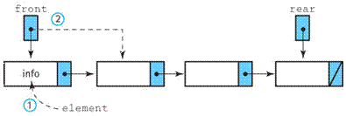
Queues
Enqueue (insert)
Dequeue (remove)

Slide 28
1 /* Fig. 12.13: fig12_13.c
2 Operating and maintaining a queue */
3
4 #include <stdio.h>
1. Define struct
1.1 Function prototypes
1.1 Initialize variables
2. Input choice
5 #include <stdlib.h>
6
7 struct queueNode { /* self-referential structure */
8 char data;
9 struct queueNode *nextPtr;
10 };
11
12 typedef struct queueNode QueueNode;
13 typedef QueueNode *QueueNodePtr;
14
15 /* function prototypes */
16 void printQueue( QueueNodePtr );
17 int isEmpty( QueueNodePtr );
18 char dequeue( QueueNodePtr *, QueueNodePtr * );
19 void enqueue( QueueNodePtr *, QueueNodePtr *, char );
20 void instructions( void );
21
22 int main()
23 {
24 QueueNodePtr headPtr = NULL, tailPtr = NULL;
25 int choice;
26 char item;
27
28 instructions();
29 printf( "? " );
30 scanf( "%d", &choice );

Slide 29
31
32 while ( choice != 3 ) {
33
34 switch( choice ) {
35
2.1 switch statement
36 case 1:
37 printf( "Enter a character: " );
38 scanf( "\n%c", &item );
39 enqueue( &headPtr, &tailPtr, item );
40 printQueue( headPtr );
41 break;
42 case 2:
43 if ( !isEmpty( headPtr ) ) {
44 item = dequeue( &headPtr, &tailPtr );
45 printf( "%c has been dequeued.\n", item );
46 }
47
48 printQueue( headPtr );
49 break;
50
51 default:
52 printf( "Invalid choice.\n\n" );
53 instructions();
54 break;
55 }
56
57 printf( "? " );
58 scanf( "%d", &choice );
59 }
60
61 printf( "End of run.\n" );
62 return 0;
63 }
64

Slide 30
65 void instructions( void )
66 {
67 printf ( "Enter your choice:\n"
68 " 1 to add an item to the queue\n"
3. Function definitions
69 " 2 to remove an item from the queue\n"
70 " 3 to end\n" );
71 }
72
73 void enqueue( QueueNodePtr *headPtr, QueueNodePtr *tailPtr,
74 char value )
75 {
76 QueueNodePtr newPtr;
77
78 newPtr = malloc( sizeof( QueueNode ) );
79
80 if ( newPtr != NULL ) {
81 newPtr->data = value;
82 newPtr->nextPtr = NULL;
83
84 if ( isEmpty( *headPtr ) )
85 *headPtr = newPtr;
86 else
87 ( *tailPtr )->nextPtr = newPtr;
88
89 *tailPtr = newPtr;
90 }
91 else
92 printf( "%c not inserted. No memory available.\n",
93 value );
94 }
95

Slide 31
96 char dequeue( QueueNodePtr *headPtr, QueueNodePtr *tailPtr )
97 {
98 char value;
99 QueueNodePtr tempPtr;
3. Function definitions
100
101 value = ( *headPtr )->data;
102 tempPtr = *headPtr;
103 *headPtr = ( *headPtr )->nextPtr;
104
105 if ( *headPtr == NULL )
106 *tailPtr = NULL;
107
108 free( tempPtr );
109 return value;
110 }
111
112 int isEmpty( QueueNodePtr headPtr )
113 {
114 return headPtr == NULL;
115 }
116
117 void printQueue( QueueNodePtr currentPtr )
118 {
119 if ( currentPtr == NULL )
120 printf( "Queue is empty.\n\n" );
121 else {
122 printf( "The queue is:\n" );

Slide 32
123
124 while ( currentPtr != NULL ) {
125 printf( "%c --> ", currentPtr->data );
126 currentPtr = currentPtr->nextPtr;
3. Function definitions
Program Output
127 }
128
129 printf( "NULL\n\n" );
130 }
131 }
Enter your choice:
1 to add an item to the queue
2 to remove an item from the queue
3 to end
? 1
Enter a character: A
The queue is:
A --> NULL
? 1
Enter a character: B
The queue is:
A --> B --> NULL
? 1
Enter a character: C
The queue is:
A --> B --> C --> NULL

Slide 33
? 2
A has been dequeued.
The queue is:
B --> C --> NULL
? 2
B has been dequeued.
The queue is:
C --> NULL
? 2
C has been dequeued.
Queue is empty.
? 2
Queue is empty.
? 4
Invalid choice.
Enter your choice:
1 to add an item to the queue
2 to remove an item from the queue
3 to end
? 3
End of run.
Program Output

Slide 34
Trees
Tree nodes contain two or more links
  All other data structures we have discussed only contain one
Binary trees
  All nodes contain two links
    None, one, or both of which may be NULL
  The root node is the first node in a tree.
  Each link in the root node refers to a child
  A node with no children is called a leaf node

Slide 35
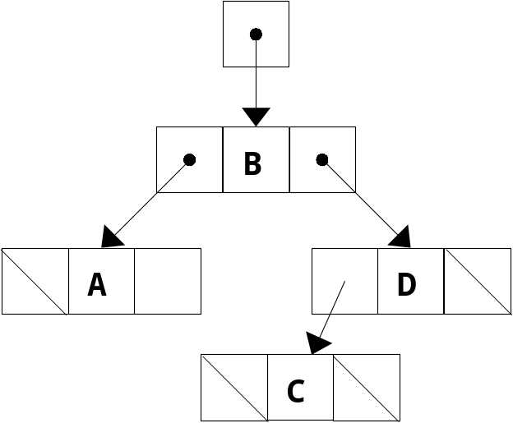
Trees
Diagram of a binary tree

Slide 36
Trees
Binary search tree
  Values in left subtree less than parent
  Values in right subtree greater than parent
  Facilitates duplicate elimination
  Fast searches - for a balanced tree, maximum of log n comparisons
2
47
25
77
11
43
65
93
7
17
31
44
68

Slide 37
Trees
Tree traversals:
  Inorder traversal – prints the node values in ascending order
    1. Traverse the left subtree with an inorder traversal
    2. Process the value in the node (i.e., print the node value)
    3. Traverse the right subtree with an inorder traversal
  Preorder traversal
    1. Process the value in the node
    2. Traverse the left subtree with a preorder traversal
    3. Traverse the right subtree with a preorder traversal
  Postorder traversal
    1. Traverse the left subtree with a postorder traversal
    2. Traverse the right subtree with a postorder traversal
    3. Process the value in the node

Slide 38
1 /* Fig. 12.19: fig12_19.c
2 Create a binary tree and traverse it
3 preorder, inorder, and postorder */
4 #include <stdio.h>
1. Define structure
1.1 Function prototypes
1.2 Initialize variables
5 #include <stdlib.h>
6 #include <time.h>
7
8 struct treeNode {
9 struct treeNode *leftPtr;
10 int data;
11 struct treeNode *rightPtr;
12 };
13
14 typedef struct treeNode TreeNode;
15 typedef TreeNode *TreeNodePtr;
16
17 void insertNode( TreeNodePtr *, int );
18 void inOrder( TreeNodePtr );
19 void preOrder( TreeNodePtr );
20 void postOrder( TreeNodePtr );
21
22 int main()
23 {
24 int i, item;
25 TreeNodePtr rootPtr = NULL;
26
27 srand( time( NULL ) );
28

Slide 39
29 /* insert random values between 1 and 15 in the tree */
30 printf( "The numbers being placed in the tree are:\n" );
31
32 for ( i = 1; i <= 10; i++ ) {
33 item = rand() % 15;
1.3 Insert random elements
2. Function calls
3. Function definitions
34 printf( "%3d", item );
35 insertNode( &rootPtr, item );
36 }
37
38 /* traverse the tree preOrder */
39 printf( "\n\nThe preOrder traversal is:\n" );
40 preOrder( rootPtr );
41
42 /* traverse the tree inOrder */
43 printf( "\n\nThe inOrder traversal is:\n" );
44 inOrder( rootPtr );
45
46 /* traverse the tree postOrder */
47 printf( "\n\nThe postOrder traversal is:\n" );
48 postOrder( rootPtr );
49
50 return 0;
51 }
52
53 void insertNode( TreeNodePtr *treePtr, int value )
54 {
55 if ( *treePtr == NULL ) { /* *treePtr is NULL */
56 *treePtr = malloc( sizeof( TreeNode ) );
57
58 if ( *treePtr != NULL ) {
59 ( *treePtr )->data = value;
60 ( *treePtr )->leftPtr = NULL;
61 ( *treePtr )->rightPtr = NULL;
62 }

Slide 40
63 else
64 printf( "%d not inserted. No memory available.\n",
65 value );
66 }
3. Function definitions
67 else
68 if ( value < ( *treePtr )->data )
69 insertNode( &( ( *treePtr )->leftPtr ), value );
70 else if ( value > ( *treePtr )->data )
71 insertNode( &( ( *treePtr )->rightPtr ), value );
72 else
73 printf( "dup" );
74 }
75
76 void inOrder( TreeNodePtr treePtr )
77 {
78 if ( treePtr != NULL ) {
79 inOrder( treePtr->leftPtr );
80 printf( "%3d", treePtr->data );
81 inOrder( treePtr->rightPtr );
82 }
83 }
84
85 void preOrder( TreeNodePtr treePtr )
86 {
87 if ( treePtr != NULL ) {
88 printf( "%3d", treePtr->data );
89 preOrder( treePtr->leftPtr );
90 preOrder( treePtr->rightPtr );
91 }
92 }

Slide 41
93
94 void postOrder( TreeNodePtr treePtr )
95 {
96 if ( treePtr != NULL ) {
3. Function definitions
Program Output
97 postOrder( treePtr->leftPtr );
98 postOrder( treePtr->rightPtr );
99 printf( "%3d", treePtr->data );
100 }
101 }
The numbers being placed in the tree are:
7 8 0 6 14 1 0dup 13 0dup 7dup
The preOrder traversal is:
7 0 6 1 8 14 13
The inOrder traversal is:
0 1 6 7 8 13 14
The postOrder traversal is:
1 6 0 13 14 8 7

Slide 42
Graphs
A graph G = (V,E) is composed of:
V: set of vertices
E: set of edges connecting the vertices in V
An edge e = (u,v) is a pair of vertices
Example:
a
b
V= {a,b,c,d,e}
E= {(a,b),(a,c),(a,d),
(b,e),(c,d),(c,e),
(d,e)}
c
d
e

Slide 43
Directed vs. Undirected Graph
An undirected graph is one in which the pair of vertices in a edge is unordered, (v0, v1) = (v1,v0)
A directed graph is one in which each edge is a directed pair of vertices, <v0, v1> != <v1,v0>

Slide 44
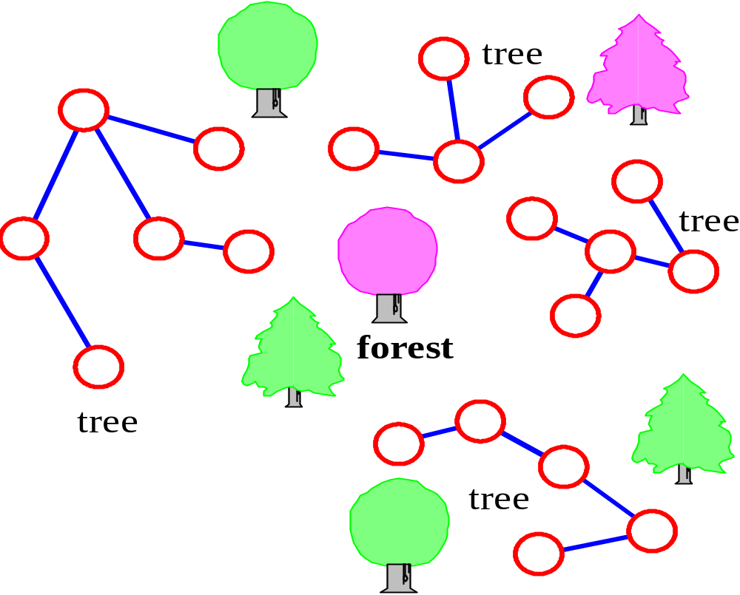
Graphs
tree - connected graph without cycles
forest - collection of trees

Slide 45
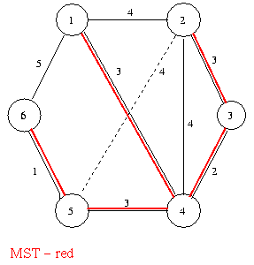
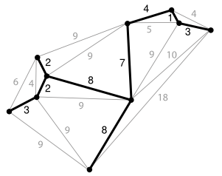
Spanning trees
A spanning tree T of a connected, undirected graph G is a tree composed of all the vertices and some (or perhaps all) of the edges of G

Slide 46
ADT for Graph
Graph Create()::=return an empty graph
Graph InsertVertex(graph, v)::= return a graph with v inserted. v has no
incident edge.
Graph InsertEdge(graph, v1,v2)::= return a graph with new edge
between v1 and v2
Graph DeleteVertex(graph, v)::= return a graph in which v and all edges
incident to it are removed
Graph DeleteEdge(graph, v1, v2)::=return a graph in which the edge (v1, v2)
is removed
Boolean IsEmpty(graph)::= if (graph==empty graph) return TRUE
else return FALSE
List Adjacent(graph,v)::= return a list of all vertices that are adjacent to v

Slide 47
Graph Representations
Adjacency Matrix
Adjacency Lists

Slide 48
Adjacency Matrix
Let G=(V,E) be a graph with n vertices.
The adjacency matrix of G is a two-dimensional
n by n array, say adj_mat
If the edge (vi, vj) is in E(G), adj_mat[i][j]=1
If there is no such edge in E(G), adj_mat[i][j]=0
The adjacency matrix for an undirected graph is symmetric; the adjacency matrix for a digraph
need not be symmetric

Slide 49
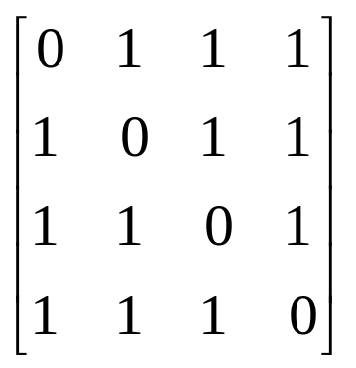
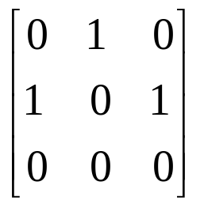
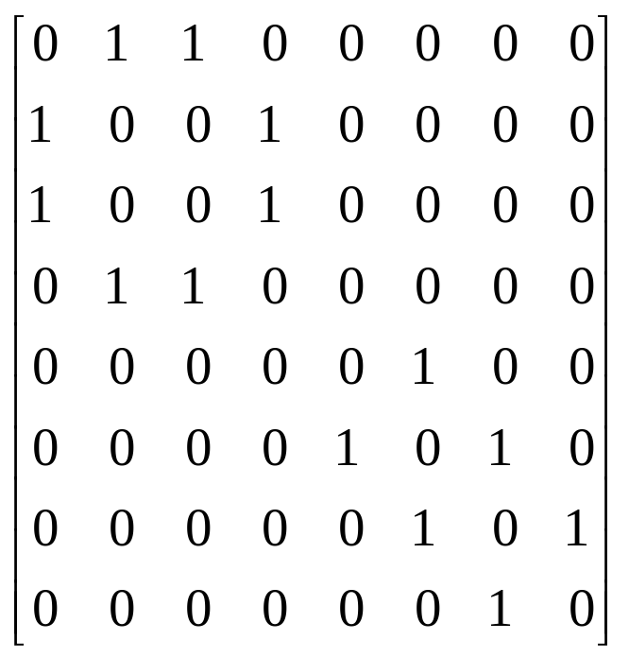
Examples for Adjacency Matrix
0
0
4
0
2
1
5
1
2
3
6
3
1
7
2
G2
G1
symmetric
undirected: n²/2
directed: n²
G3

Slide 50
Adjacency Lists (data structures)
Each row in adjacency matrix is represented as an adjacency list.
#define MAX_VERTICES 50
typedef struct node *node_pointer;
typedef struct node {
int vertex;
struct node *link;
};
node_pointer graph[MAX_VERTICES];
int n=0; /* vertices currently in use */

Slide 51
0
0
4
2
1
5
1
2
3
6
3
7
0
1
2
3
1
2
3
0
1
2
3
4
5
6
7
1
2
0
2
3
0
3
0
1
3
0
3
0
1
2
1
2
G1
0
5
4
6
0
1
2
1
5
7
0
2
1
6
G2
G3
2
An undirected graph with n vertices and e edges ==> n head nodes and 2e list nodes

Slide 52
Comparison
 | Binary Search Tree | Array-based Linear List | Linked List
Constructor | O(1) | O(1) | O(1)
Destructor | O(N) | O(1) (non-pointers) | O(N)
MakeEmpty | O(N) | O(1) | O(N)
GetLength | O(N) | O(1) | O(1)
IsFull | O(1) | O(1) | O(1)
IsEmpty | O(1) | O(1) | O(1)
RetrieveItem | O(log₂N) | O(log₂N) | O(N)
InsertItem | O(log₂N) | O(N) | O(N)
DeleteItem | O(log₂N) | O(N) | O(N)

Slide 53
Lab Work
Apply and program all the studies data structures mentioned in this lecture.
And compare their time complexity

