Slide 1
Medium Access Control Sublayer
Chapter 4
  Channel Allocation Problem
  Multiple Access Protocols
  Ethernet
  Wireless LANs
  Broadband Wireless
  Bluetooth
  RFID
  Data Link Layer Switching
Revised: August 2011
CN5E by Tanenbaum & Wetherall, © Pearson Education-Prentice Hall and D. Wetherall, 2011
Notes:
Gray units can be optionally omitted without causing later gaps

Slide 2
The MAC Sublayer
Two types of Networks:
  Point-to-point connection
  Broadcast channels
    Multi-access channels or random access channel
    The key issue is to decide who gets to send on the → MAC
    Medium Access Control sublayer
An important part of the link layer, especially for LANs
Application
Transport
Network
Link
Physical
MAC is in here!
CN5E by Tanenbaum & Wetherall, © Pearson Education-Prentice Hall and D. Wetherall, 2011

Slide 3
Channel Allocation Problem
For fixed channel and traffic from N users
  Divide up bandwidth using FTM, TDM, CDMA, etc.
  This is a static allocation, e.g., FM radio
This static allocation performs poorly for bursty traffic
  Allocation to a user will sometimes go unused
CN5E by Tanenbaum & Wetherall, © Pearson Education-Prentice Hall and D. Wetherall, 2011

Slide 4
Multiple Access Protocols
  ALOHA »
  CSMA (Carrier Sense Multiple Access) »
  Collision-free protocols »
  Limited-contention protocols »
  Wireless LAN protocols »
CN5E by Tanenbaum & Wetherall, © Pearson Education-Prentice Hall and D. Wetherall, 2011

Slide 5
Pure ALOHA (1)
Users transmit frames whenever they have data; users retry after a random time for collisions.
Notes
The waiting time must be random or the same frames will collide over and over, in lockstep. Systems in which multiple users share a common channel in a way that can lead to conflicts are widely known as contention systems
CN5E by Tanenbaum & Wetherall, © Pearson Education-Prentice Hall and D. Wetherall, 2011
Notes:
Due to the feedback property of broadcasting, a sender can always find out whether its frame was destroyed by listening to the channel, the same way other users do.
With a LAN, the feedback is immediate; with a satellite, there is a delay of 270 msec before the sender knows if the transmission was successful.
If listening while transmitting is not possible for some reason, acknowledgements are needed.
If the frame was destroyed, the sender just waits a random amount of time and sends it again

Slide 6
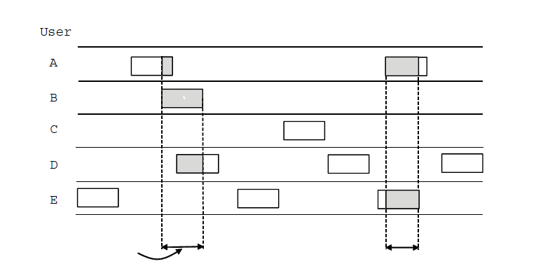
Pure ALOHA (2)
User
A
B
C
D
E
Collision
Collision
Time
  Efficient and low-delay under low load
CN5E by Tanenbaum & Wetherall, © Pearson Education-Prentice Hall and D. Wetherall, 2011

Slide 7
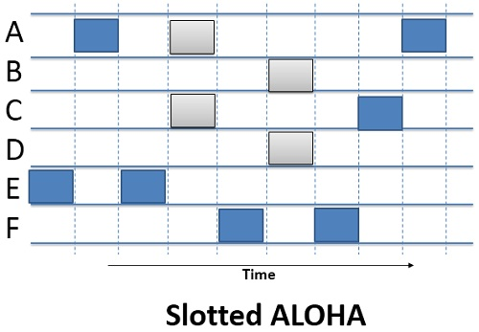
Slotted ALOHA(3)
Divide the time into discrete intervals called time slots. Each time slot corresponds to the length of the frame.
Slotted ALOHA does not allow to transmit the data whenever the station has the data to be send; the station has to wait till the next time slot begins and allow each data frame to be transmitted in the new time slot.
CN5E by Tanenbaum & Wetherall, © Pearson Education-Prentice Hall and D. Wetherall, 2011

Slide 8
CSMA (1)
CSMA improves on ALOHA by sensing the channel!
  User doesn’t send if it senses someone else
Variations on what to do if the channel is busy:
  1-persistent (greedy) sends as soon as idle
  Non-persistent waits a random time then tries again
  p-persistent sends with probability p when idle
CN5E by Tanenbaum & Wetherall, © Pearson Education-Prentice Hall and D. Wetherall, 2011
Notes:
1-persistent CSMA (Carrier Sense Multiple Access). When a station has data to send, it first listens to the channel to see if
anyone else is transmitting at that moment. If the channel is busy, the station waits until it becomes idle. When the station detects an idle channel, it transmits a frame. If a collision occurs, the station waits a random amount of time and starts all over again. The protocol is
called 1-persistent because the station transmits with a probability of 1 when it finds the channel idle.
A second carrier sense protocol is nonpersistent CSMA. In this protocol, a conscious attempt is made to be less greedy than in the previous one. Before sending, a station senses the channel. If no one else is sending, the station begins doing so itself. However, if the channel is
already in use, the station does not continually sense it for the purpose of seizing it immediately upon detecting the end of the previous transmission. Instead, it waits a random period of time and then repeats the algorithm. Consequently, this algorithm leads to better
channel utilization but longer delays than 1-persistent CSMA.
The last protocol is p-persistent CSMA. It applies to slotted channels and works as follows.
When a station becomes ready to send, it senses the channel. If it is idle, it transmits with a
probability p. With a probability q = 1 - p, it defers until the next slot. If that slot is also idle, it
either transmits or defers again, with probabilities p and q. This process is repeated until either
the frame has been transmitted or another station has begun transmitting. In the latter case,
the unlucky station acts as if there had been a collision (i.e., it waits a random time and starts
again). If the station initially senses the channel busy, it waits until the next slot and applies
the above algorithm. Figure 4-4 shows the computed throughput versus offered traffic for all
three protocols, as well as for pure and slotted ALOHA.

Slide 9
CSMA/CD (CSMA with Collision Detection)
Persistent and non-persistent CSMA protocols are clearly an improvement over ALOHA , they
    ensure that no station begins to transmit when it senses the channel busy.
    The stations have to abort their transmissions as soon as they detect a collision(if two stations sense the channel to be idle and begin transmitting at the same time, they will both detect the collision almost immediately. Rather than finish transmitting their frames -which are garbled anyway- they should stop transmitting as soon as the collision is detected. Quickly terminating damaged frames saves time and bandwidth)
This protocol, known as CSMA/CD (CSMA with Collision Detection), its widely used on LANs in the MAC sublayer.(it is the basis of the popular Ethernet LAN.)
CN5E by Tanenbaum & Wetherall, © Pearson Education-Prentice Hall and D. Wetherall, 2011

Slide 10
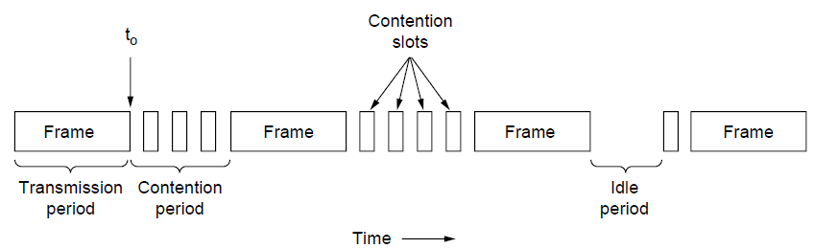
CSMA (3) – Collision Detection
CSMA/CD can be in one of three states: contention, transmission, or idle.
Reduced contention times improve performance
Collision time is much shorter than frame time
Notes
CN5E by Tanenbaum & Wetherall, © Pearson Education-Prentice Hall and D. Wetherall, 2011
Notes:
At the point marked t0, a station has finished transmitting its frame.

Slide 11
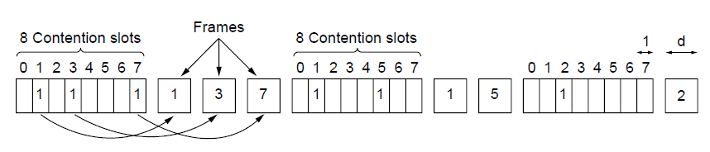
Collision-Free (1) – Bitmap
Collision-free protocols avoid collisions entirely
  Senders must know when it is their turn to send
The basic bit-map protocol:
  Sender set a bit in contention slot if they have data
  Senders send in turn; everyone knows who has data
CN5E by Tanenbaum & Wetherall, © Pearson Education-Prentice Hall and D. Wetherall, 2011

Slide 12
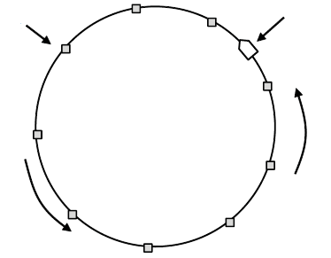
Collision-Free (2) – Token Ring
Token sent round ring defines the sending order
  Station with token may send a frame before passing
  Idea can be used without ring too, e.g., token bus
Token
Station
Direction of
transmission
CN5E by Tanenbaum & Wetherall, © Pearson Education-Prentice Hall and D. Wetherall, 2011

Slide 13
Wireless LAN
The rise of laptop computers and other mobile devices (PDAs and cell phones) created an obvious application level demand for wireless local area networking.
Companies jumped in, quickly developing incompatible wireless products in the 1990’s.
Industry decided to entrust standardization to IEEE committee that dealt with wired LANS – namely, the IEEE 802 committee!!
CN5E by Tanenbaum & Wetherall, © Pearson Education-Prentice Hall and D. Wetherall, 2011

Slide 14



















Elements of a wireless network
network
infrastructure
6-<number>
Wireless, Mobile Networks

Slide 15



Elements of a wireless network
wireless hosts
laptop, smartphone
run applications
may be stationary (non-mobile) or mobile
  wireless does not always mean mobility
network
infrastructure
6-<number>
Wireless, Mobile Networks

Slide 16

Elements of a wireless network
base station
typically connected to wired network
relay - responsible for sending packets between wired network and wireless host(s) in its “area”
  e.g., cell towers, 802.11 access points
network
infrastructure
6-<number>
Wireless, Mobile Networks

Slide 17
Elements of a wireless network
wireless link
typically used to connect mobile(s) to base station
also used as backbone link
multiple access protocol coordinates link access
various data rates, transmission distance
network
infrastructure
6-<number>
Wireless, Mobile Networks

Slide 18
Elements of a wireless network
infrastructure mode
base station connects mobiles into wired network
handoff: mobile changes base station providing connection into wired network
network
infrastructure
6-<number>
Wireless, Mobile Networks

Slide 19


Elements of a wireless network
ad hoc mode
no base stations
nodes can only transmit to other nodes within link coverage
nodes organize themselves into a network: route among themselves
6-<number>
Wireless, Mobile Networks

Slide 20
Wireless Link Characteristics
important differences from wired link ….
  decreased signal strength: radio signal attenuates as it propagates through matter (path loss)
  interference from other sources: standardized wireless network frequencies (e.g., 2.4 GHz) shared by other devices (e.g., phone); devices (motors) interfere as well
  multipath propagation: radio signal reflects off objects ground, arriving ad destination at slightly different times
→make communication across (even a point to point) wireless link much more “difficult”

Slide 21
Issues
The main issues need to be addressed while designing a MAC protocol for ad hoc wireless networks:
  Bandwidth efficiency is defined at the ratio of the bandwidth used for actual data transmission to the total available bandwidth. The MAC protocol for ad-hoc networks should maximize it.
  Quality of service support is fundamental for time-critical applications. The MAC protocol for ad-hoc networks should consider the constraint of ad-hoc networks.
  Synchronization can be achieved by exchange of control packets.

Slide 22
Issues
The main issues need to be addressed while designing a MAC protocol for ad hoc wireless networks:
  Hidden and exposed terminal problems:
    Hidden nodes:
      Hidden stations: Carrier sensing may fail to detect another station. For example, A and D.
      Fading: The strength of radio signals diminished rapidly with the distance from the transmitter. For example, A and C.
    Exposed nodes:
      Exposed stations: B is sending to A. C can detect it. C might want to send to E but conclude it cannot transmit because C hears B.
      Collision masking: The local signal might drown out the remote transmission.
  Error-Prone Shared Broadcast Channel
  Distributed Nature/Lack of Central Coordination
  Mobility of Nodes: Nodes are mobile most of the time.

Slide 23
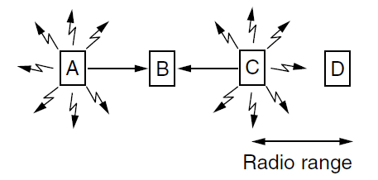
Wireless LANs (2) – Hidden terminals
Hidden terminals are senders that cannot sense each other but nonetheless collide at intended receiver
  Want to prevent; loss of efficiency
  A and C are hidden terminals when sending to B
CN5E by Tanenbaum & Wetherall, © Pearson Education-Prentice Hall and D. Wetherall, 2011
Notes:
Wireless stations have transmission ranges and not all stations are within radio range of each other.
Simple CSMA will not work!
C transmits to B.
If A “senses” the channel, it will not hear C’s transmission and falsely conclude that A can begin a transmission to B.

Slide 24
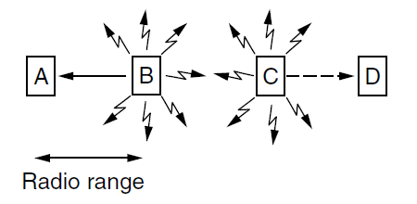
Wireless LANs (3) – Exposed terminals
Exposed terminals are senders who can sense each other but still transmit safely (to different receivers)
  Desirably concurrency; improves performance
  B → A and C → D are exposed terminals
CN5E by Tanenbaum & Wetherall, © Pearson Education-Prentice Hall and D. Wetherall, 2011
Notes:
This is the inverse problem.
B wants to send to C and listens to the channel.
When B hears A’s transmission, B falsely assumes that it cannot send to C.

Slide 25
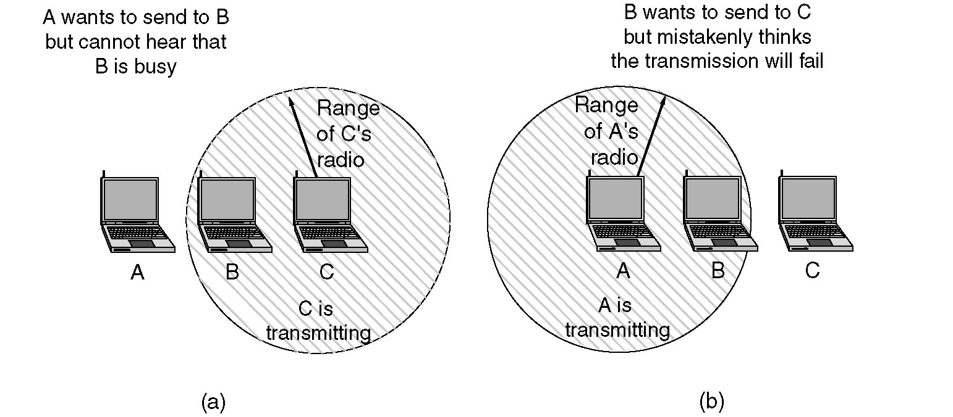
The 802.11 MAC Sublayer Protocol
(a) The hidden station problem.
(b) The exposed station problem.

Slide 26
The 802.11 MAC Sublayer Protocol
To deal with these two problems 802.11 supports two modes of operation
DCF (Distributed Coordination Function)
PCF (Point Coordination Function).
All implementations must support DCF, but PCF is optional.
CN5E by Tanenbaum & Wetherall, © Pearson Education-Prentice Hall and D. Wetherall, 2011

Slide 27
MAC Protocol: Overview
DCF: Distributed Coordination Function
  Mandatory
  Widely deployed
  Contention-based random access
  Using CSMA/CA to access the channel
  Collision avoidance via binary exponential back-off mechanism
  ACK packet for acknowledgements
  For best-effort traffic
PCF: Point Coordination Function
  Optional
  Almost never used, if ever implemented at all.
  Contention-free
  Access point polls stations according to a list
  For delay-sensitive application
PCF
MAC
DCF
Physical Layer (PHY)

Slide 28
Wireless LAN Protocols
MACA protocol solved hidden, exposed terminal:
  Send Ready-to-Send (RTS) and Clear-to-Send (CTS) first
  RTS, CTS helps determine who else is in range or busy (Collision avoidance).
  Can a collision still occur?
Networks: Wireless LANs
Notes:
This protocol solves the issue of expensive collisions too, since the RTS/CTS are short packets – if there is a collision it will be brief, not as long as a data frame.

Slide 29

MACA examples
MACA avoids the problem of hidden terminals
  A and C want to
  send to B
  A sends RTS first
  C waits after receiving
  CTS from B
MACA avoids the problem of exposed terminals
  B wants to send to A, C
  to another terminal
  now C does not have
  to wait for it cannot
  receive CTS from A
RTS
CTS
CTS
A
B
C
RTS
RTS
CTS
A
B
C

Slide 30
MACAW
Variants of this method can be found in IEEE 802.11 as DFWMAC (Distributed Foundation Wireless MAC),
MACAW (MACA for Wireless) is a revision of MACA.
  The sender senses the carrier to see and transmits a RTS (Request To Send) frame if no nearby station transmits a RTS.
  The receiver replies with a CTS (Clear To Send) frame.
  Neighbors
    see CTS, then keep quiet.
    see RTS but not CTS, then keep quiet until the CTS is back to the sender.
  The receiver sends an ACK when receiving an frame.
    Neighbors keep silent until see ACK.
  Collisions
    There is no collision detection.
    The senders know collision when they don’t receive CTS.
    They each wait for the exponential backoff time.

Slide 31
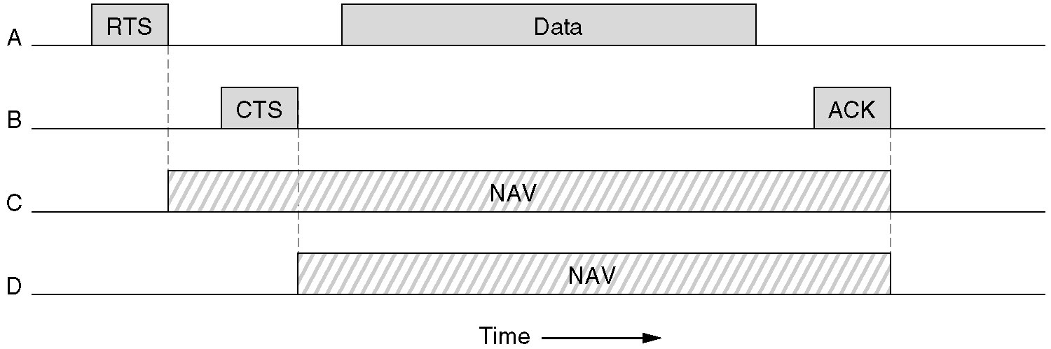
Virtual Channel Sensing in CSMA/CA
Figure 4-27. The use of virtual channel sensing using CSMA/CA.
C (in range of A) receives the RTS and based on information in RTS creates a virtual channel busy NAV(Network Allocation Vector).
D (in range of B) receives the CTS and creates a shorter NAV.
Networks: Wireless LANs

Slide 32
Virtual Channel Sensing in CSMA/CA
What is the advantage of RTS/CTS?
RTS is 20 bytes, and CTS is 14 bytes.
MPDU can be 2300 bytes.
“virtual” implies source station sets duration field in data frame or in RTS and CTS frames.
Stations then adjust their NAV accordingly!
Networks: Wireless LANs

Slide 33
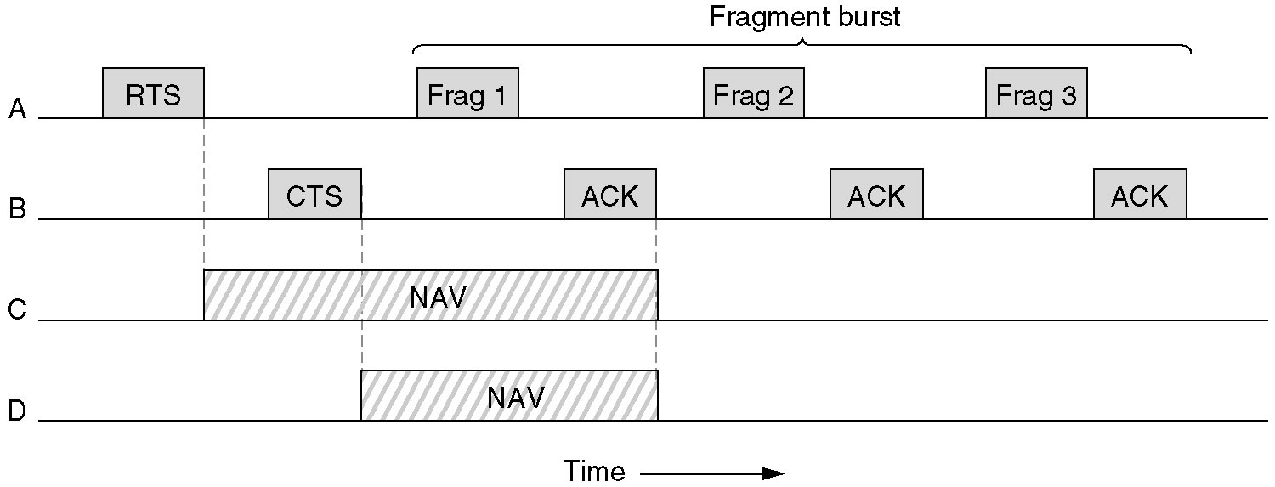
Figure 4-28.Fragmentation in 802.11
High wireless error rates ➔ long packets have less probability of being successfully transmitted.
Solution: MAC layer fragmentation with stop-and-wait protocol on the fragments.
Networks: Wireless LANs

Slide 34
Point Coordinated Function (PCF)
PCF uses a base station to poll other stations to see if they have frames to send.
No collisions occur.
Base station sends beacon frame periodically.
Base station can tell another station to sleep to save on batteries and base stations holds frames for sleeping station.
Networks: Wireless LANs

Slide 35
Inter-frame spaces
IEEE 802.11 has defined different inter frame spaces
  SIFS (Short Inter Frame Spacing)
    Highest priority, for ACK, CTS, Polling response
  PIFS (PCF IFS)
    PIFS = SIFS + slot time
    Medium priority, for time-bounded service using PCF
  DIFS (DCF IFS)
    DIFS = SIFS + 2 x slot time
    Lowest priority, for asynchronous data service
  SIFS < PIFS < DIFS <

Slide 36
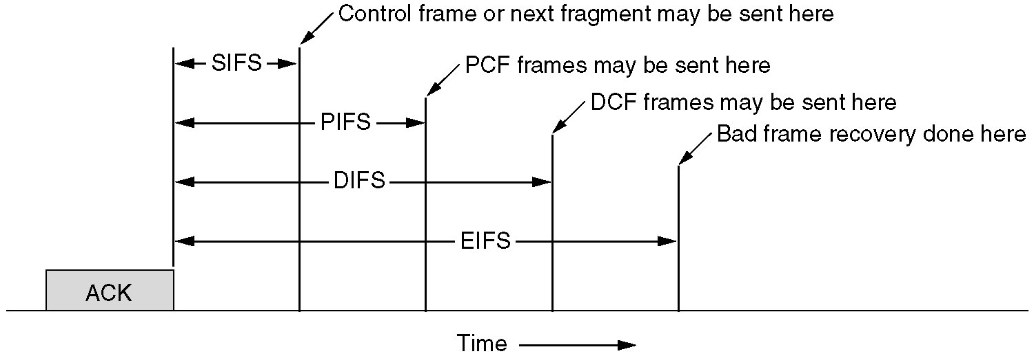
Figure 4-29. Interframe Spacing in 802.11.
Networks: Wireless LANs

