Slide 1
Hubs, Bridges and Switches
Lecture 3
Lecture 3
#<number>

Slide 2
Interconnecting LANs
Q: Why not just one big LAN?
Limited amount of supportable traffic: on single LAN, all stations must share bandwidth
limited length: 802.3 (Ethernet) specifies maximum cable length
large “collision domain” (can collide with many stations)
limited number of stations: 802.5 (token ring) have token passing delays at each station
Lecture 3
#<number>

Slide 3
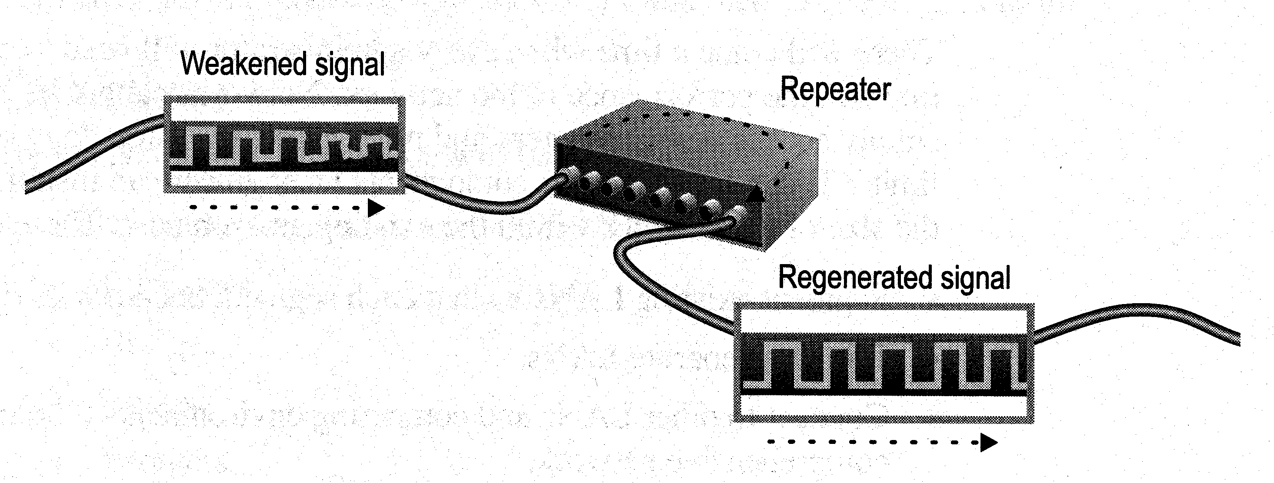
Repeaters & Hubs
Physical Layer devices: essentially repeaters operating at bit levels: repeat received bits on one interface to all other interfaces.
Lecture 3
#<number>

Slide 4
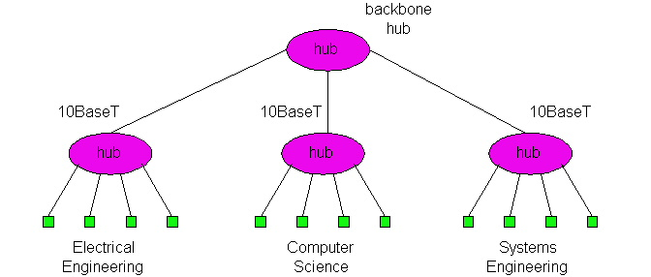
Repeaters & Hubs
Hubs can be arranged in a hierarchy (or multi-tier design), with backbone hub at its top
Lecture 3
#<number>

Slide 5
Repeaters & Hubs (more)
Each connected LAN referred to as LAN segment
Hubs do not isolate collision domains: node may collide with any node residing at any segment in LAN
Hub Advantages:
  simple, inexpensive device
  Multi-tier provides graceful degradation: portions of the LAN continue to operate if one hub malfunctions
  extends maximum distance between node pairs (100m per Hub)
Lecture 3
#<number>

Slide 6
Repeaters & Hubs limitations
Cannot link unlike segments
Cannot join segments with different access methods (e.g. CSMA/CD and token passing)
Do not isolate and filter packets
Lecture 3
#<number>

Slide 7
Bridges
Link Layer devices: operate on Ethernet frames, examining frame header and selectively forwarding frame based on its destination
Bridge isolates collision domains since it buffers frames
When frame is to be forwarded on segment, bridge uses CSMA/CD to access segment and transmit
Lecture 3
#<number>

Slide 8
Bridges (more)
Bridge advantages:
  Isolates collision domains resulting in higher total max throughput, and does not limit the number of nodes nor geographical coverage
  Can connect different type Ethernet since it is a store and forward device
  Transparent: no need for any change to hosts LAN adapters
Lecture 3
#<number>

Slide 9
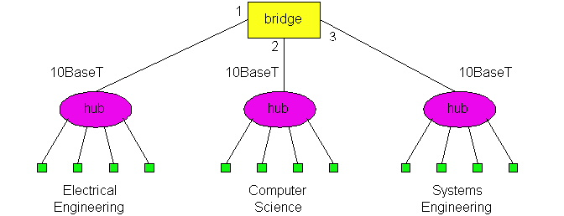
Backbone Bridge
Lecture 3
#<number>

Slide 10
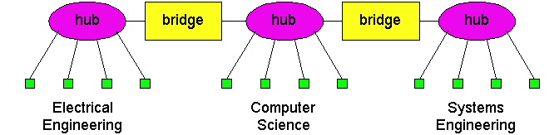
Interconnection Without Backbone
Not recommended for two reasons:
  - single point of failure at Computer Science hub
  - all traffic between EE and SE must path over CS segment
Lecture 3
#<number>

Slide 11
Bridges: frame filtering, forwarding
bridges filter packets
  same-LAN -segment frames not forwarded onto other LAN segments
forwarding:
  how to know on which LAN segment to forward frame?
Lecture 3
#<number>

Slide 12
Bridge Filtering
bridges learn which hosts can be reached through which interfaces: maintain filtering tables
  when frame received, bridge “learns” location of sender: incoming LAN segment
  records sender location in filtering table
filtering table entry:
  (Node LAN Address, Bridge Interface, Time Stamp)
  old entries in Filtering Table dropped (TTL can be 60 minutes)
Lecture 3
#<number>

Slide 13
Bridge Operation
bridge procedure (in_MAC, in_port,out_MAC)
  Set filtering table (in_MAC) to in_port /*learning*/
  lookup in filtering table (out_MAC) receive out_port
  if (out_port not valid) /* no entry found for destination */
  then flood; /* forward on all but the interface on which the frame arrived*/
  if (in_port = out_port) /*destination is on LAN on which frame was received */
  then drop the frame
  Otherwise (out_port is valid) /*entry found for destination */
        then forward the frame on interface indicate
Lecture 3
#<number>

Slide 14
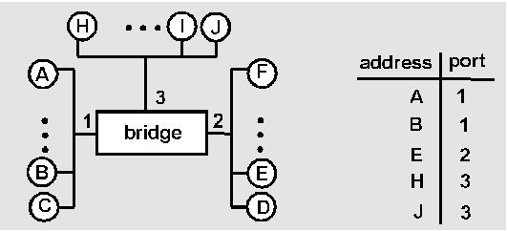
Bridge Learning: example
Suppose C sends frame to D and D replies back with frame to C
C sends frame, bridge has no info about D, so floods to both LANs
  bridge notes that C is on port 1
  frame ignored on upper LAN
  frame received by D
Lecture 3
#<number>

Slide 15
Bridge Learning: example
C 1
D generates reply to C, sends
  bridge sees frame from D
  bridge notes that D is on interface 2
  bridge knows C on interface 1, so selectively forwards frame out via interface 1
Lecture 3
#<number>

Slide 16

Bridges vs. Routers
both store-and-forward devices
  routers: network layer devices (examine network layer headers)
  bridges are Link Layer devices
routers maintain routing tables, implement routing algorithms
bridges maintain filtering tables, implement filtering, learning and spanning tree algorithms
Lecture 3
#<number>

Slide 17
Routers vs. Bridges
Bridges + and -
+ Bridge operation is simpler requiring less processing
- Topologies are restricted with bridges: a spanning tree must be built to avoid cycles
- Bridges do not offer protection from broadcast storms (endless broadcasting by a host will be forwarded by a bridge)
Lecture 3
#<number>

Slide 18
Routers vs. Bridges
Routers + and -
+ arbitrary topologies can be supported, cycling is limited by TTL counters (and good routing protocols)
+ provide firewall protection against broadcast storms
- require IP address configuration (not plug and play)
- require higher processing
bridges do well in small (few hundred hosts) while routers used in large networks (thousands of hosts)
Lecture 3
#<number>

Slide 19
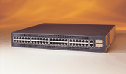
Switches
Switches operate at the Data Link layer
Can interpret address information
Switches resemble bridges and can be considered as multiport bridges
By having multi-ports,
can better use limited
bandwidth and prove
more cost-effective
than bridge
Cisco Catalyst 2900 switch

Slide 20
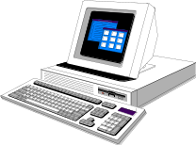
Switches
Switches divide a network into several isolated channels.
Packets sending from 1 channel will not go to another if not specify.
Each channel has its own capacity and need not be shared with other channels.
Hub
3.3Mbps
10Mbps
Switch
3.3Mbps
3.3Mbps
10Mbps
10Mbps
10Mbps

Slide 21
Advantages of Switches
Switches divide a network into several isolated channels (or collision domains)
  Reduce the possibility of collision
    Collision only occurs when two devices try to get access to one channel.
    Can be solved by buffering one of them for later access.
  Each channel has its own network capacity
    Suitable for real-time applications, e.g. video conferencing
  Since isolated, hence secure
    Data will only go to the destination, but not others

Slide 22
Limitations of Switches
Although contains buffers to accommodate bursts of traffic, can become flooded by heavy traffic
  Device cannot detect collision when buffer full
    CSMA/CD scheme will not work since the data channels are isolated, not the case as in Ethernet
  Some higher level protocols do not detect error
    E.g. UDP
  Those data packets are continuously pumped to the switch and introduce more problems

Slide 23
Using Switches to Create VLANs
Switches can logically group together some ports to form a virtual local area network (VLAN)
Switches can be configured to communicate only within the devices in the group
SW1
VLAN1
VLAN2
Hub
SW2
Hub
SW3
Hub

