Slide 1
Network Layer
Chapter 5
  Design Issues
  Routing Algorithms
  Congestion Control
  Quality of Service
  Internetworking
  Network Layer of the Internet
Revised: August 2011
CN5E by Tanenbaum & Wetherall, © Pearson Education-Prentice Hall and D. Wetherall, 2011
Notes:
Gray units can be optionally omitted without causing later gaps

Slide 2
The Network Layer
Responsible for delivering packets between endpoints over multiple links
Application
Transport
Network
Link
Physical
Notes
CN5E by Tanenbaum & Wetherall, © Pearson Education-Prentice Hall and D. Wetherall, 2011
Notes:
To achieve this, nw layer must know about the topology of the communication(set of all routers) and choose appropriate paths through it.
It must also take care to choose routes to avoid overloading some of the communication lines and routers while
leaving others idle.
Finally, when the source and destination are in different networks, new problems occur. It is up to the network layer to deal with them.

Slide 3
Design Issues
  Store-and-forward packet switching »
  Connectionless service – datagrams »
  Connection-oriented service – virtual circuits »
  Comparison of virtual-circuits and datagrams »
CN5E by Tanenbaum & Wetherall, © Pearson Education-Prentice Hall and D. Wetherall, 2011

Slide 4
What is Circuit Switching?
One of the switching technologies used to send messages from one point to another using a dedicated point-to-point link throughout the session.
They are mainly used in PSTN (Public Switched Telephone Network) where the caller and receiver exchange information on a dedicated channel using an end-to-end link.
This is a connection oriented channel which is established between the sender and the receiver using a dedicated signaling protocol. When either of them disconnects the call, the circuit breaks thereby terminating the session
CN5E by Tanenbaum & Wetherall, © Pearson Education-Prentice Hall and D. Wetherall, 2011

Slide 5
What is Packet Switching?
Packet switching makes the most out of the network bandwidth by breaking the message into small units called data packets which seek the most efficient routing path to reach its destination.
Each data packet is assigned a header containing signaling information including the sender and receiver address, and then transmitted individually through the network.
Each data packet may take a different route as addressed by its associated header.
CN5E by Tanenbaum & Wetherall, © Pearson Education-Prentice Hall and D. Wetherall, 2011

Slide 6
What is Packet Switching?
The data is processed at all intermediate nodes located at various points before reaching its destination where all the packets are reassembled and recompiled into the original message.
It’s a more robust and efficient method to transmit data that can withstand some delays during the session. It’s mainly used for data and voice communication.
Known as Datagram networks
CN5E by Tanenbaum & Wetherall, © Pearson Education-Prentice Hall and D. Wetherall, 2011

Slide 7
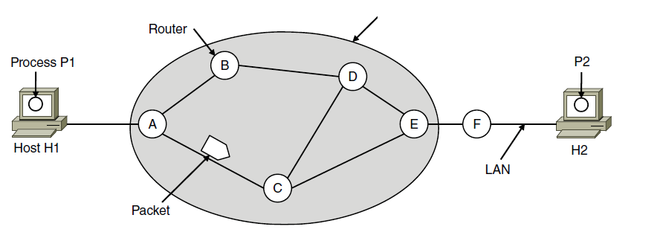
Environment of the network layer protocols
ISP’s equipment
CN5E by Tanenbaum & Wetherall, © Pearson Education-Prentice Hall and D. Wetherall, 2011

Slide 8
Store-and-Forward Packet Switching
A host with a packet to send transmits it to the nearest router, either on its own LAN or over a point-to-point link to the carrier.
The packet is stored there until it has fully arrived so the checksum can be verified. Then it is forwarded to the next router along the path until it reaches the destination host, where it is delivered. (store-and-forward packet switching
CN5E by Tanenbaum & Wetherall, © Pearson Education-Prentice Hall and D. Wetherall, 2011
Notes:
Routers treat packets as messages, receiving (storing) them and then forwarding them based on how the message is addressed.
For completeness, it is a process running on the host that sends the packet into the network and receives packets at the destination.

Slide 9
Services Provided to the Transport Layer
The services should be independent of the router technology.
The transport layer should be shielded from the number, type, and topology of the routers present.
The network addresses made available to the transport layer should use a uniform numbering plan, even across LANs and WANs.
Notes
CN5E by Tanenbaum & Wetherall, © Pearson Education-Prentice Hall and D. Wetherall, 2011
Notes:
Given these goals, the designers of the network layer have a lot of freedom in writing detailed specifications of the services to be offered to the transport layer. This freedom often degenerates into a raging battle between two warring factions. The discussion centers on whether the network layer should provide connection-oriented service or connectionless service.

Slide 10
Service Types
connectionless service → packets are injected into the subnet individually and routed independently of each other. No advance setup is needed. In this context, the packets are frequently called datagrams, and the subnet is called a datagram subnet.
connection-oriented service → a path from the source router to the destination router must be established before any data packets can be sent. This connection is called a VC (virtual circuit), in analogy with the physical circuits set up by the telephone system, and the subnet is called a virtual-circuit subnet.
CN5E by Tanenbaum & Wetherall, © Pearson Education-Prentice Hall and D. Wetherall, 2011

Slide 11
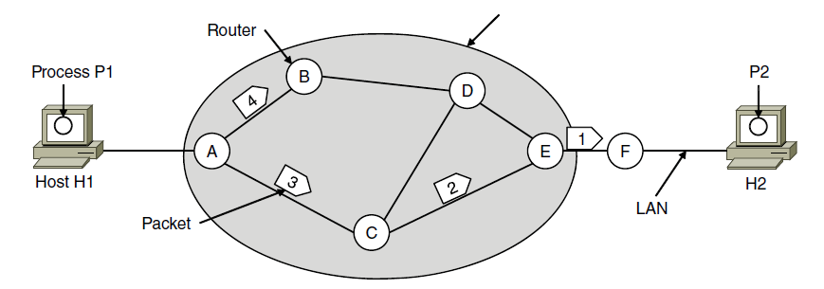
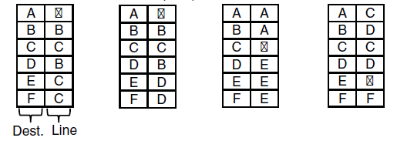

Connectionless Service – Datagrams
Packet is forwarded using destination address inside it
  Different packets may take different paths
ISP’s equipment
A’s table (initially) A’s table (later) C’s Table E’s Table
CN5E by Tanenbaum & Wetherall, © Pearson Education-Prentice Hall and D. Wetherall, 2011
Notes:
This model is like the postal service – each letter is sent through the network independently.
Datagram is a packet that contains an absolute destination address; routers need only look up the destination address in a table to find the outgoing line to send the packet on its way.

Slide 12
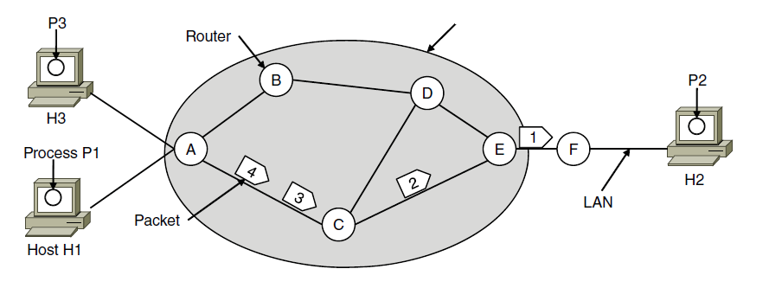



Connection-Oriented – Virtual Circuits
Packet is forwarded along a virtual circuit using tag inside it
  Virtual circuit (VC) is set up ahead of time
ISP’s equipment
A’s table C’s Table E’s Table
CN5E by Tanenbaum & Wetherall, © Pearson Education-Prentice Hall and D. Wetherall, 2011
Notes:
This model is like the telephone network.
Packets contain tags that are not full addresses; they only need to be unique at a given link and thus are re-written at each router from an incoming tag to an outgoing tag. The virtual circuit is set up with the tag mapping along the entire path. Then packets are sent along it. The packets will thus all follow the same path (and arrive in order).
“Virtual” refers to the fact that real/physical telephone circuits have both a path and a fixed bandwidth reservation of 64Kbps, whereas virtual circuits may have a variable bandwidth depending on how many VCs use a single link.

Slide 13
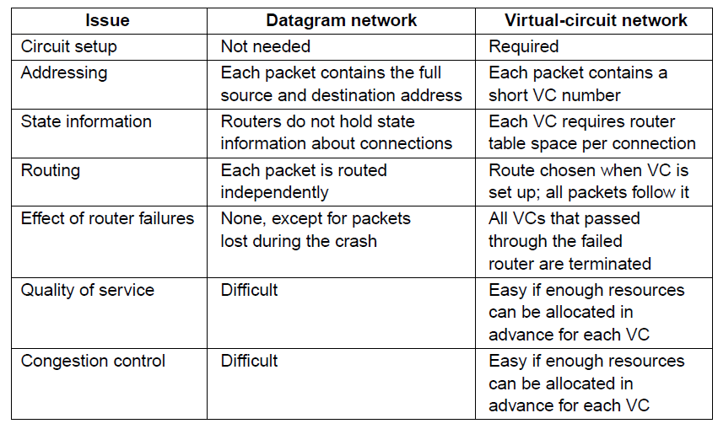
Comparison of Virtual-Circuits & Datagrams
CN5E by Tanenbaum & Wetherall, © Pearson Education-Prentice Hall and D. Wetherall, 2011
Notes:
Virtual circuits have some advantages in guaranteeing quality of service and avoiding
congestion within the subnet because resources (e.g., buffers, bandwidth, and CPU cycles) can
be reserved in advance, when the connection is established. Once the packets start arriving,
the necessary bandwidth and router capacity will be there. With a datagram subnet,
congestion avoidance is more difficult.

Slide 14
Routing Algorithms
  Optimality principle »
  Shortest path algorithm »
  Flooding »
  Distance vector routing »
  Link state routing »
  Hierarchical routing »
  Broadcast routing »
  Multicast routing »
  Anycast routing »
  Routing for mobile hosts »
  Routing in ad hoc networks »
CN5E by Tanenbaum & Wetherall, © Pearson Education-Prentice Hall and D. Wetherall, 2011
Notes:
Grayed out topics are optional and can be omitted without loss of continuity

Slide 15
Routing Algorithms
The main function of the network layer is routing packets from the source machine to the destination machine.
The routing algorithm is that part of the network layer software responsible for deciding which output line an incoming packet should be transmitted on.
CN5E by Tanenbaum & Wetherall, © Pearson Education-Prentice Hall and D. Wetherall, 2011

Slide 16
Routing Algorithms
If the subnet uses datagrams internally, routing decision must be made anew for every arriving data packet since the best route may have changed since last time.
If the subnet uses virtual circuits internally, routing decisions are made only when a new virtual circuit is being set up. Thereafter, data packets just follow the previously-established route. The latter case is sometimes called session routing because a route remains in force for an entire user session.
CN5E by Tanenbaum & Wetherall, © Pearson Education-Prentice Hall and D. Wetherall, 2011

Slide 17
Routing: making the decision which routes to use.
Forwarding :what happens when a packet arrives.
One can think of a router as having two processes inside it. one of them handles each packet as it arrives, looking up the outgoing line to use for it in the routing tables. This process is forwarding. The other process is responsible for filling in and updating the routing tables. That is where the routing algorithm comes into play.
CN5E by Tanenbaum & Wetherall, © Pearson Education-Prentice Hall and D. Wetherall, 2011

Slide 18
Properties of desirable routing algorithms
Correctness: should get packets eventually to the correct destination
Simplicity: this usually implies faster
Robustness: should be able to handle new routers coming online, as well as, handle other going off or malfunctioning
Stability: under constant conditions should converge to some balane level .
Fairness and Optimality: these are hard to satisfy at the same time. For example, in the situation below it might occur that to optimize flow we would not allow traffic between X and X´, a situation which is not fair.
CN5E by Tanenbaum & Wetherall, © Pearson Education-Prentice Hall and D. Wetherall, 2011

Slide 19
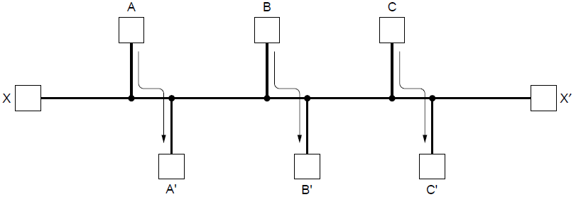
Fairness and Optimality
  Decide what to optimize (e.g., fairness vs efficiency)
CN5E by Tanenbaum & Wetherall, © Pearson Education-Prentice Hall and D. Wetherall, 2011
Notes:
We focus on adaptive routing schemes that update routes in response to failures. Some traffic-aware schemes also adapt to changes in traffic, but we do not consider them in the algorithms that follow.
For the graph, the traffic demands are A->A’, B->B’, C->C’ and X->X’. What would be fair? For each flow the get the same amount of bandwidth. If all network links have unit capacity then we would give each flow ½ a unit of capacity. The total network traffic is then 2 units. What would be efficient? If we gave the X->X’ flow no bandwidth then we could give each of the other three flows 1 unit. The total network traffic is then 3 units. So it is more efficient, but it is not fair. So we will have to decide what we want to optimize.

Slide 20
Routing algorithms Classes
.
CN5E by Tanenbaum & Wetherall, © Pearson Education-Prentice Hall and D. Wetherall, 2011

Slide 21
Non-adaptive algorithms
Do not base their routing decisions on measurements or estimates of the current traffic and topology. Instead, the choice of the route to use to get from I to J (for all I and J) is computed in advance, off-line, and downloaded to the routers when the network is booted.
This procedure is sometimes called static routing.
CN5E by Tanenbaum & Wetherall, © Pearson Education-Prentice Hall and D. Wetherall, 2011

Slide 22
Adaptive algorithms
Change their routing decisions to reflect changes in the topology, and usually the traffic as well.
Adaptive algorithms differ in:
    Where they get their information (e.g., locally, from adjacent routers, or from all routers),
    When they change the routes
    What metric is used for optimization (e.g., distance, number of hops, or estimated transit time).
This procedure is sometimes called Dynamic routing
CN5E by Tanenbaum & Wetherall, © Pearson Education-Prentice Hall and D. Wetherall, 2011

Slide 23
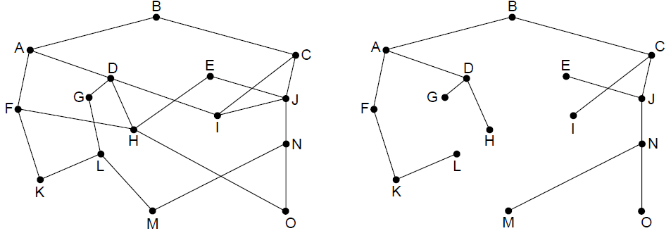
The Optimality Principle
Each portion of a best path is also a best path; the union of them to a router is a tree called the sink tree
  Best means fewest hops in the example
B
Network
Sink tree of best paths to router B
CN5E by Tanenbaum & Wetherall, © Pearson Education-Prentice Hall and D. Wetherall, 2011
Notes:
Proof by contradiction: if a portion of a best path is not a best path then there is something better. Substitute this better portion and you would have a better overall path, which cannot be the case if the overall path is a best path.
For sink trees, if there are multiple paths that are equally good, then one best path from one node to another is chosen at random. For example, H can be reached in 3 hops via H-D-A-B as shown, or by H-F-A-D (not shown). This is simple and useful as there is a single route from each router to each destination. If, instead, all equally best paths are kept then their union is a DAG (directed acyclic graph). This is a more general case that permits multiple paths from a router to a destination.

Slide 24
Shortest Path Algorithm (1)
Dijkstra’s algorithm computes a sink tree on the graph:
  Each link is assigned a non-negative weight/distance
  Shortest path is the one with lowest total weight
  Using weights of 1 gives paths with fewest hops
Algorithm:
  Start with sink, set distance at other nodes to infinity
  Relax distance to other nodes
  Pick the lowest distance node, add it to sink tree
  Repeat until all nodes are in the sink tree
CN5E by Tanenbaum & Wetherall, © Pearson Education-Prentice Hall and D. Wetherall, 2011
Notes:
The notion of weight generalizes distance to other cost metrics. Setting weights to be 1 gives paths with fewest hops. Setting weight to be distance gives paths that are shortest or lowest delay. Setting weight to be lower for higher capacity links favors higher capacity paths.

Slide 25
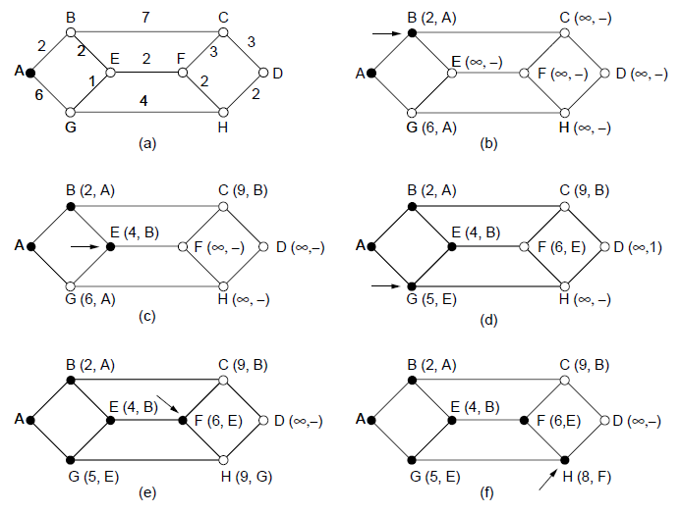
Shortest Path Algorithm (2)
A network and first five steps in computing the shortest paths from A to D. Pink arrows show the sink tree so far.
CN5E by Tanenbaum & Wetherall, © Pearson Education-Prentice Hall and D. Wetherall, 2011

Slide 26
Flooding
A simple method to send a packet to all network nodes
Each node floods a new packet received on an incoming link by sending it out all of the other links
Nodes need to keep track of flooded packets to stop the flood; even using a hop limit can blow up exponentially
CN5E by Tanenbaum & Wetherall, © Pearson Education-Prentice Hall and D. Wetherall, 2011
Notes:
Note that flooding doesn’t actually find any routes that can be reused.

Slide 27
Distance Vector Routing (1)
Distance vector is a distributed routing algorithm
  Shortest path computation is split across nodes
Algorithm:
  Each node knows distance of links to its neighbors
  Each node advertises vector of lowest known distances to all neighbors
  Each node uses received vectors to update its own
  Repeat periodically
CN5E by Tanenbaum & Wetherall, © Pearson Education-Prentice Hall and D. Wetherall, 2011
Notes:
How long will it take to converge? The diameter of the network.

