Slide 1
Computer Network
Lecture 1

Slide 2
Computer Network
Text Books :
  Computer Networks, by Andrew S. Tanenbaum.
  Data communications and networking, by Behrouz A. Forouzan, Catherine Ann Coombs, Sophia Chung Fegan
  Computer Networks: A Systems Approach, by Larry L. Peterson, Bruce S. Davie

Slide 3
Computer Network
Grading:
  Participation 10 %
  First Exam 20 %
  Second Exam 20%
  Final Exam 50%

Slide 4
Computer Network
Chapter 1: Overview
1.1. Introduction
The creation of the first network can be traced back to the early 1960s, and later on developed to the concept of internetworking. It is all started at the US Dept of Defense
Advanced Research Project Agency (ARPA);

Slide 5
The need for researchers and scientists to share information and have remote access to data in different universities and research centers was the reason for the internetworking concept to be the focus of research at ARPA, and by the 1970s the early Internet had emerged.
➔ Thus, networks came first, and internetworking followed evolving today's Internet.

Slide 6
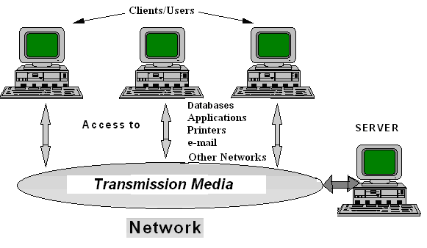
Fig.1: A Network Setup

Slide 7
Computer network
Computer network was defined as a collection of devices that can store and manipulate electronic data, interconnected in such a way that networks’ users can store, retrieve and share information.
Notes:
Connected devices include microcomputers, minicomputers, mainframe computers, terminals, printers, fax machines, pagers, mobiles, ect

Slide 8
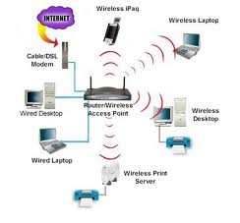
Computer Networking

Slide 9
Benefits of Network
Powerful, flexible collaboration
Freedom to choose the right tools
Resource sharing
  Physical resources, such as printers, scanners & CD-ROM drives, and
  Logical resources (software), such as databases and applications.
Worldwide, instantaneous access to information.
Effective worldwide communications.
Easy, Immediate information dissemination.

Slide 10
Types of Networks
Depending on the role they perform, computers on the networks can be classified into the following types:
  Client Computers → use networks resources.
  Peer Computer→ use and provide networks resources
  Server Computers→ only provide networks resources.

Slide 11
Types of Networks
According to the mentioned kinds of computer we can classify networks into three categories:
  Peer-to-Peer Networks.
  Client-Server Networks.
  Hybrid Networks.

Slide 12

Peer-to-Peer Networks
Group of computer communicate directly with each other rather than a central server.
No role of servers.
Example:
  File Sharing Networks.

Slide 13
Peer-to-Peer Advantages
Simple configuration.
Allow economical communication with other user when there is a limited amount of data to exchange.
Inexpensive network (no server hardware and no administrator)

Slide 14
Peer-to-peer disadvantages
All users must be in the same area
May not be practical for intensive file transfer/ storage or heavy printer sharing applications.
Network security is lax.
The problems will arise due increasing the numbers of workstations

Slide 15
Client-server network
A client-server network involves multiple clients connecting to a single server
Describes the relationship between two computer programs.

Slide 16
Client-server advantages
Provides powerful and secure communication to workgroups from 3 to hundreds of users
Network control and administrating is easier than a peer to peer network
Workstations my be equipped with less memory and smaller hard drives.
Revolves around powerful machines that take care of the security and administration
A server have specific roles in the network, therefore it split the support network’s objectives

Slide 17
Network Vs Distributed Systems
 | Network | Distributed Systems
1. | Multiple autonomous computers are visible | Autonomous computers are not visible.
2. | User oriented management. A user logs into a particular machine and explicitly submit jobs remotely, moves files around and generally handles all management personally, being aware of its location on the network. | System oriented management. A user logs in to a distributed system not being aware which processor, memory or storage being used. Nothing has to be done explicitly, all automatically done by the system.

Slide 18
The Basic Network Model
Computer networks can be divided into two areas, which are fundamental to the ability to transfer data between computer systems:
  Network Hardware Systems
  Communication Protocols (Software)
➔ In this course we'll be discussing concepts in both areas!

Slide 19
Existing Types of Computer Network
Personal Area Networks (PAN)
Local Area Networks (LAN)
Metropolitan Area Network (MAN)
Wide Area Network (WAN)
The INTERNET (Internetworking System)
➔ The most common type is LAN; extremely popular and it can be setup using different Technologies.

Slide 20
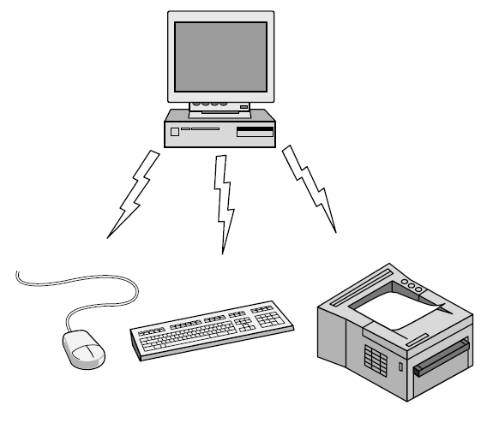
Personal Area Network
Connect devices over the range of a person
Example of a Bluetooth (wireless) PAN:
CN5E by Tanenbaum & Wetherall, © Pearson Education-Prentice Hall and D. Wetherall, 2011

Slide 21
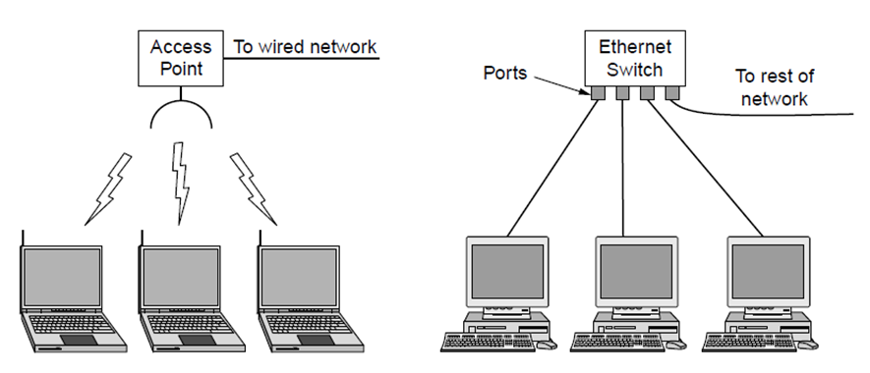
Local Area Networks
Connect devices in a home or office building
Called enterprise network in a company
Wireless LAN
with 802.11
Wired LAN with
switched Ethernet
CN5E by Tanenbaum & Wetherall, © Pearson Education-Prentice Hall and D. Wetherall, 2011

Slide 22
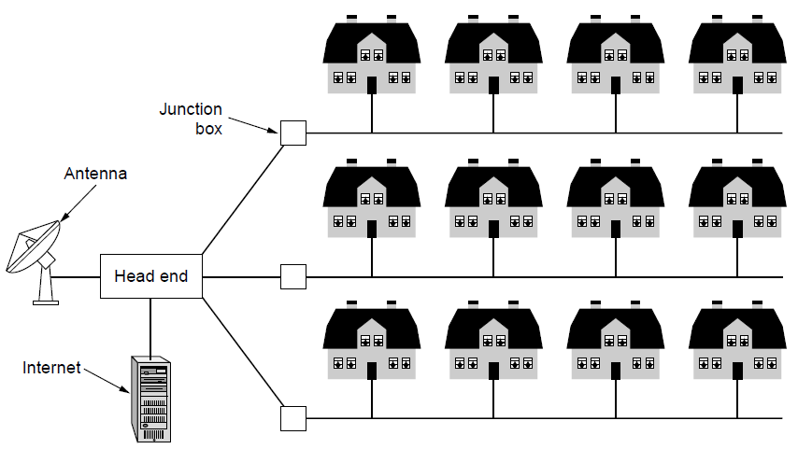
Metropolitan Area Networks
Connect devices over a metropolitan area
Example MAN based on cable TV:
CN5E by Tanenbaum & Wetherall, © Pearson Education-Prentice Hall and D. Wetherall, 2011
Notes:
This is a common way in which home subscribers obtain access to the Internet in the US.

Slide 23
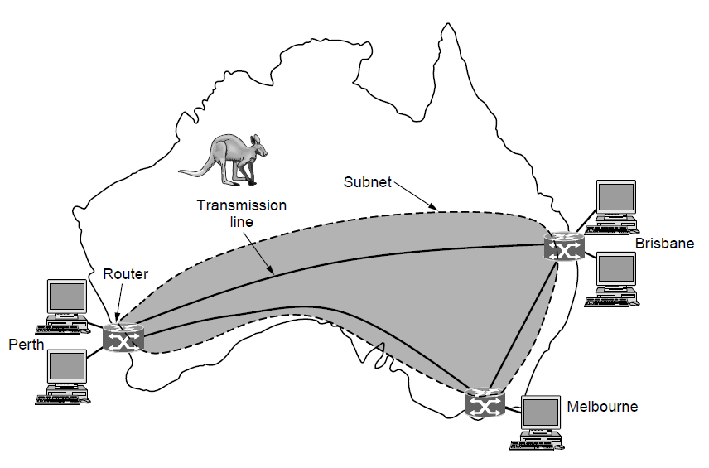
Wide Area Networks (1)
Connect devices over a country
Example WAN connecting three branch offices:
CN5E by Tanenbaum & Wetherall, © Pearson Education-Prentice Hall and D. Wetherall, 2011
Notes:
The company probably leases the transmission lines (since most companies do not have their own lines).

Slide 24
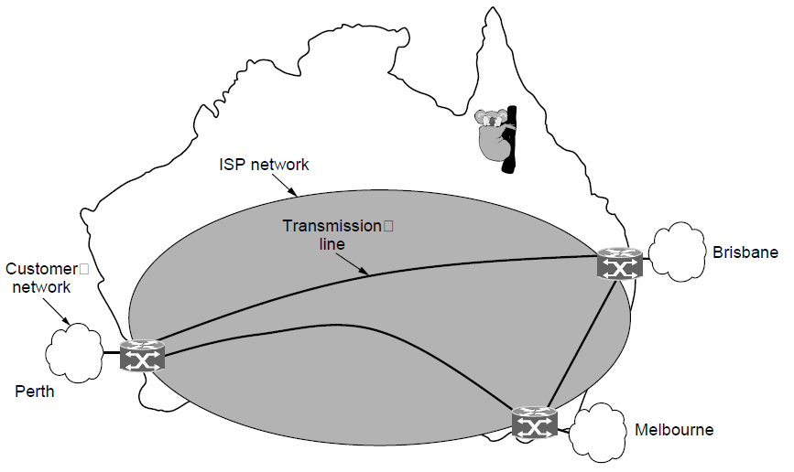
Wide Area Networks (2)
An ISP (Internet Service Provider) network is also a WAN.
Customers buy connectivity from the ISP to use it.
CN5E by Tanenbaum & Wetherall, © Pearson Education-Prentice Hall and D. Wetherall, 2011
Notes:
Now the company/customer buys service from an ISP who uses its own lines to deliver packets.

Slide 25
Network Software
  Protocol layers »
  Open Systems Interconnection (OSI) Model
  Connection-oriented vs. connectionless service »
CN5E by Tanenbaum & Wetherall, © Pearson Education-Prentice Hall and D. Wetherall, 2011

Slide 26
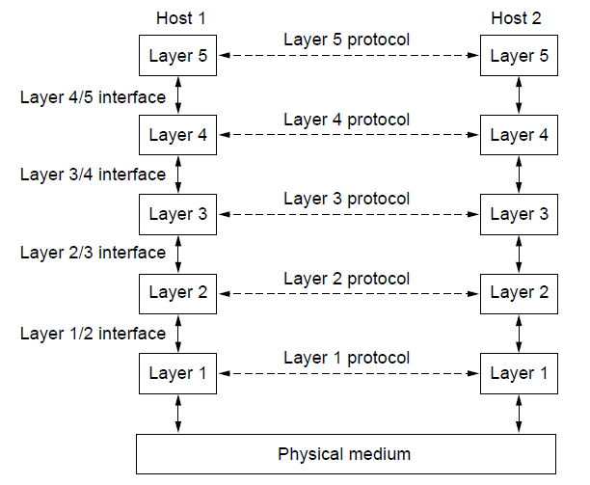
Protocol Layers (1)
Protocol layering is the main structuring method used to divide up network functionality.
Each protocol instance talks virtually to its peer
Each layer communicates only by using the one below
Lower layer services are accessed by an interface
At bottom, messages are carried by the medium
CN5E by Tanenbaum & Wetherall, © Pearson Education-Prentice Hall and D. Wetherall, 2011

Slide 27
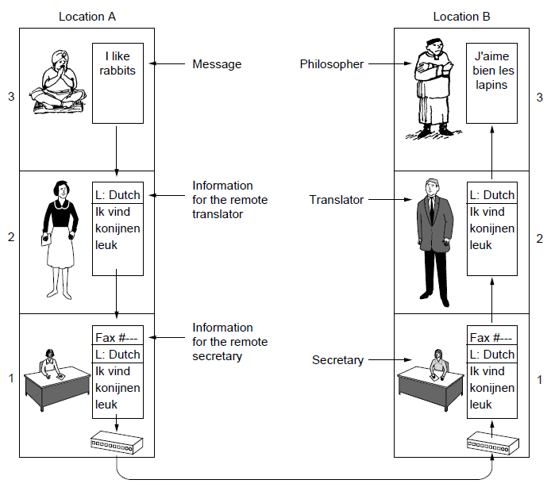
Protocol Layers (2)
Example: the philosopher-translator-secretary architecture
Each protocol at different layers serves a different purpose
CN5E by Tanenbaum & Wetherall, © Pearson Education-Prentice Hall and D. Wetherall, 2011

Slide 28
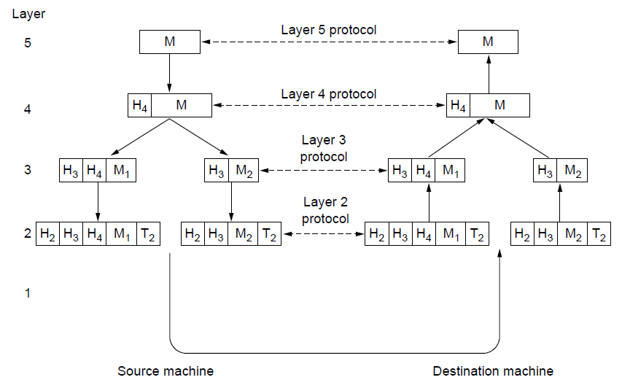
Protocol Layers (3)
Each lower layer adds its own header (with control inform-ation) to the message to transmit and removes it on receive
Layers may also split and join messages, etc.
CN5E by Tanenbaum & Wetherall, © Pearson Education-Prentice Hall and D. Wetherall, 2011
Notes:
Header contains controls informaion (seq num, size, time…)

Slide 29
Open Systems Interconnection (OSI) Model
International standard organization (ISO) established a committee in 1977 to develop an architecture for computer communication.
Open Systems Interconnection (OSI) reference model is the result of this effort.
In 1984, the Open Systems Interconnection (OSI) reference model was approved as an international standard for communications architecture.
Term “open” denotes the ability to connect any two systems which conform to the reference model and associated standards.

Slide 30
OSI Reference Model
The OSI model is now considered the primary Architectural model for inter-computer communications.
The OSI reference model divides the problem of moving information between computers over a network medium into SEVEN smaller and more manageable problems .
This separation into smaller more manageable functions is known as layering.

Slide 31
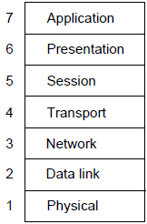
OSI Reference Model
A principled, international standard, seven layer model to connect different systems
– Provides functions needed by users
– Converts different representations
– Manages task dialogs
– Provides end-to-end delivery
– Sends packets over multiple links
– Sends frames of information
– Sends bits as signals
CN5E by Tanenbaum & Wetherall, © Pearson Education-Prentice Hall and D. Wetherall, 2011

Slide 32
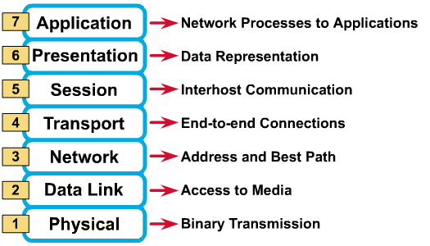
OSI Reference Model: 7 Layers

Slide 33
OSI: A Layered Network Model
The process of breaking up the functions or tasks of networking into layers reduces complexity.
Each layer communicates with the same layer’s software or hardware on other computers.
The lower 4 layers (transport, network, data link and physical —Layers 4, 3, 2, and 1) are concerned with the flow of data from end to end through the network.
The upper four layers of the OSI model (application, presentation and session—Layers 7, 6 and 5) are orientated more toward services to the applications.
Data is Encapsulated with the necessary protocol information as it moves down the layers before network transit.

Slide 34
OSI in Action
A message begins at the top application layer and moves down the OSI layers to the bottom physical layer.
As the message descends, each successive OSI model layer adds a header to it.
A header is layer-specific information that basically explains what functions the layer carried out.
Conversely, at the receiving end, headers are striped from the message as it travels up the corresponding layers.

Slide 35
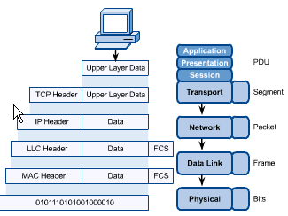
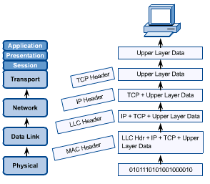

Slide 36
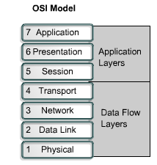
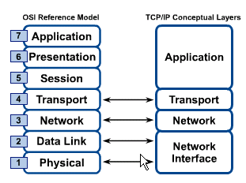
OSI & TCP/IP Models

Slide 37
Connection oriented Vs connectionless
In connectionless communication there is no need to establish connection between source (sender) and destination (receiver). But in connection-oriented communication connection must established before data transfer.
In connection-oriented communication information can be resend if there is an error in receiver side ( missing data, corrupt data etc. ).But in connectionless communication it is not possible because the destination does not inform the source about data is received or not.

Slide 38
Connection oriented Vs connectionless
Connection-oriented communication have higher overhead and place greater demands on bandwidth. But in connectionless communication requires far less overhead than connection-oriented communication.
Connection-oriented communication is more reliable then connectionless communication.

Slide 39
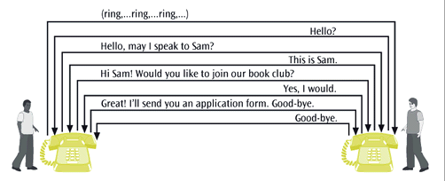
Connection-oriented telephone call

Slide 40
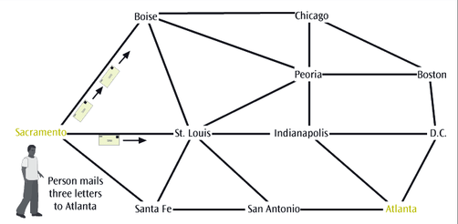
Connectionless postal system

