Slide 1
University of Bologna
Faisal Ramzan
Department of Artificial Intelligence (DISI)
Reg. no : 0001005787
Faisal.Ramzan@studio.unibo.it
Combinatorial and Decision Making

Slide 2
BackPropogation
Implementation of backpropogation

Slide 3
Content
Introduction
Problem
Forward propogation
Backward propogation
Optimization of parameter’s (Weight)
Chain Rule (Derivatives)
Implementation(Code)
Gradient Decent (Implementation)

Slide 4
Why we use Backpropogation
Neural Network Basics
Why we use Backward Propogation instead of forward?
Example of manual adjusting weights for optimized output

Slide 5
Backpropogation
The algorithm is used to effectively train a neural network through a method called chain rule.
The purpose of the training NN is for better prediction.
In simple terms, after each forward pass through a network, backpropagation performs a backward pass while adjusting the model’s parameters (weights and biases).

Slide 6
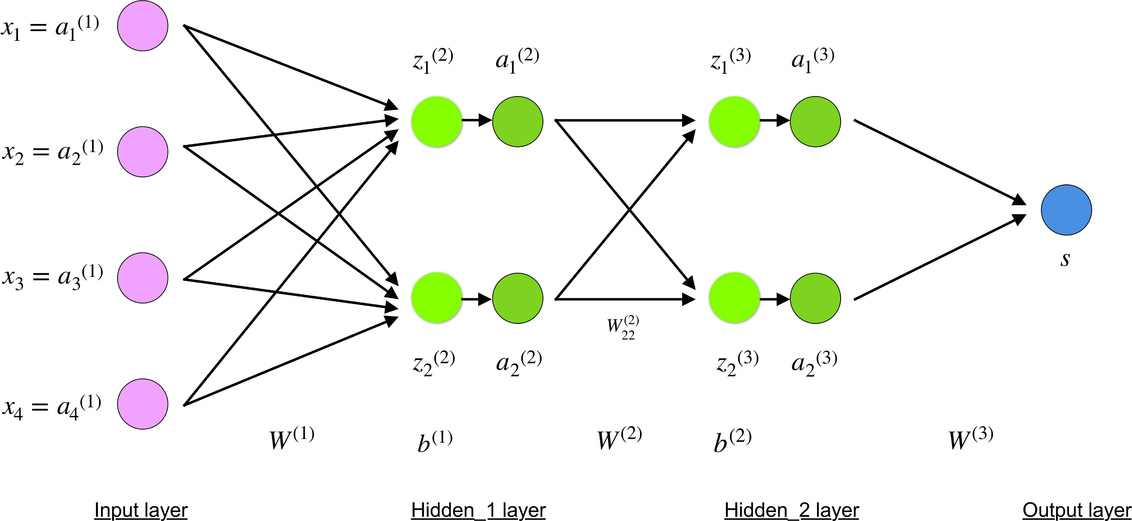
Defining a model

Slide 7
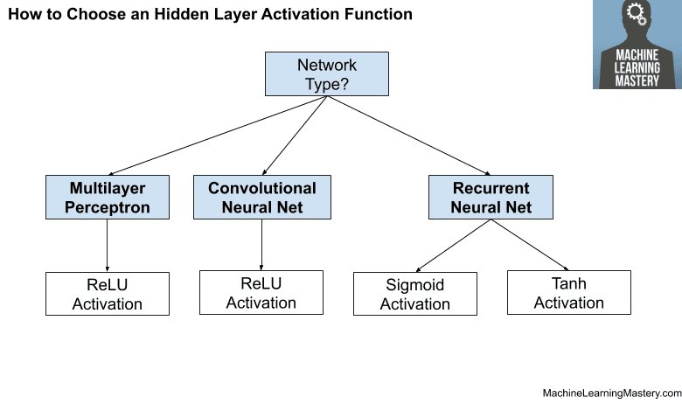
Activation Function

Slide 8
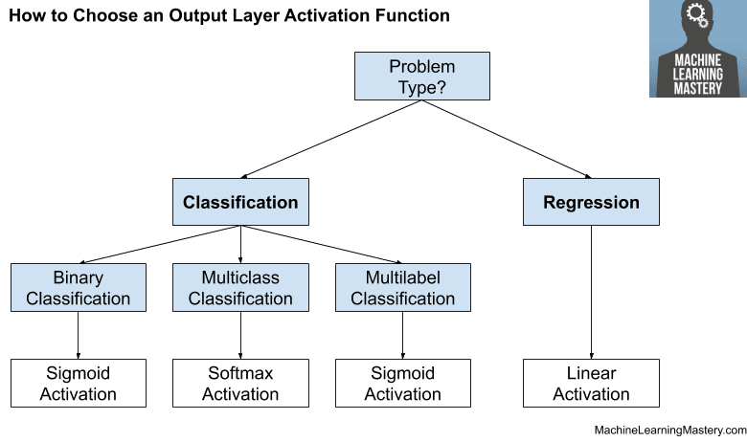
Activation Function

Slide 9
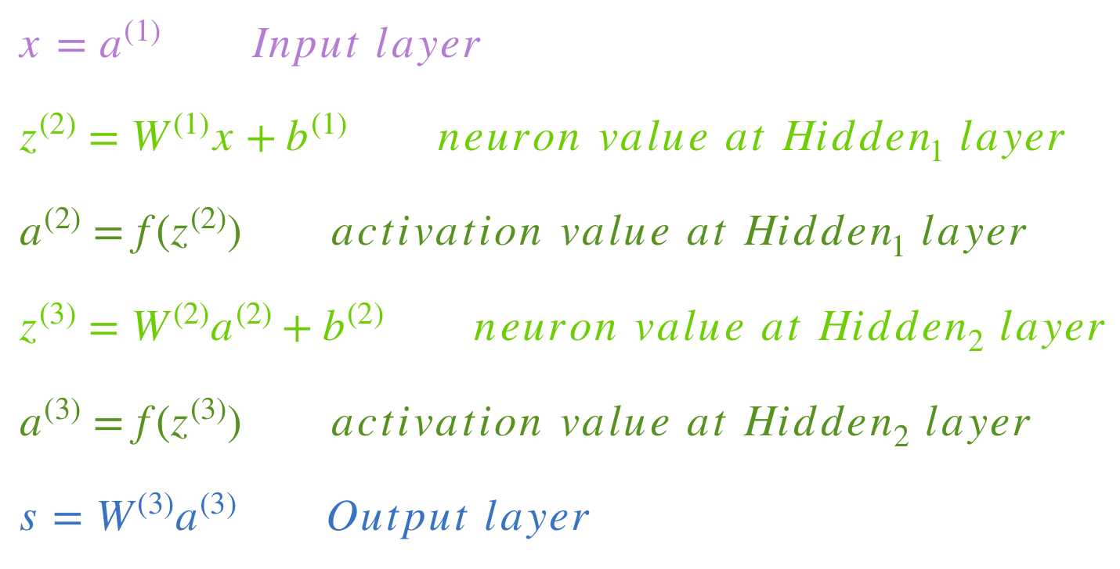
Forward Propogation and Evaluations

Slide 10
Backpropogation (LOSS Function)
A "loss function" that measures how good the network's predictions are.
ERROR = PREDICTED - ACTUAL RESULT
An "optimizer" that can tell the network how to change its weights.
Mean Squared Error Loss
Mean Squared Error loss, or MSE for short, is calculated as the average of the squared differences between the predicted and actual values.

Slide 11
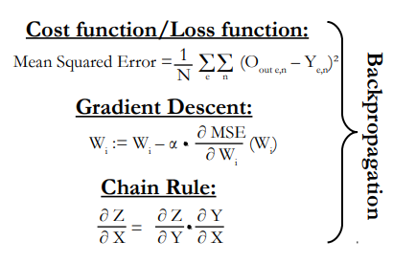
How do you determine the right parameters for the algorithm?
Backpropagation aims to minimize the cost function by adjusting network’s weights and biases.

