Slide 1

TnT Part of Speech Tagger
Faisal Riaz (F2019313020)
Talha Rasool(F2019313039)
Waseem Abbas(F2019313001)

Slide 2
Outline
This paper presents evaluation of statistical part of speech tagging method using second order Hidden Markov Model. A POS tagger is a piece of software that reads text in some language and assigns a part of speech tag to each one of the words. Predicting the part of speech (POS) tag of an unknown word in a sentence is a significant challenge. We will discover about the TnT Tagger with the help of following:
Why?
What is it?
How well?
Conclusion

Slide 3
Why then
One of the first to show that tagger based on Markov models can yield state-of-the-art results.
In corpus linguistics, part-of-speech tagging (POS tagging or POS tagging or POST), also called grammatical tagging or word-category disambiguation.
Fall into two distinctive groups:
Rule-based
Stochastic

Slide 4
Why Now?
Tested across different languages.
Tested across different domains.
The current citation count is 2133.

Slide 5
What is it?
A second order Hidden Markov Model.
Equipped with careful decisions handling.
Ability of handling of start- and end-of-sequence .
Smoothing.
Capitalization
Handling of unknown words
Improving speed of tagging

Slide 6
Second Order Hidden Markov Model
Given word sequence: w1, w2, . . . , wT .Find the tag sequence: t1, t2, . . . , tT where ∀ti ∈ Tag Set.
Specifically we need s beginning-of-sequence and end-of-sequence.
Given word sequence: w1, w2, . . . , wT . Find the tag sequence: t1, t2, . . . , tT where ∀ti ∈ Tag Set
NOTE: If sentence boundaries are not marked in the input, TnT adds these tags if it encounters one of [.!?; ] as a token.

Slide 7
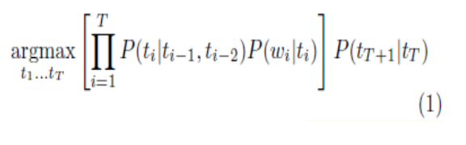
Working of TnT POS
The first term is P(ti|ti -1,ti-2), and suggests that each word tag depends on 2 previous tags.
The second term is P(wi | ti), which determines the word probability distribution given a POS tag, and refer to it from now on as the word conditional probability.
Third term P(tT+1|tT) is the probability of that tag appearing at a particular position i.e. at the beginning or the end of the sequence. tags t−1, t0, and tT+1 are beginning-of-sequence and end-of-sequence markers.

Slide 8
Define working of models
P =⇒ Maximum likelihood probability
N =⇒ Total number of tokens in the training corpus
Unigrams: P(t3) = f(t3)/N
Bigrams : P(t3|t2) = f(t2,t3)/ f(t2)
Trigrams : P(t3|t1,t2) = f(t1,t2,t3)/ f(t1,t2)
Lexical : P(w3|t3) = f(w3 ,t3)/ f(t3)
Where all t1,t2,t3 are in tag set and w3 is in the lexicon.
NOTE: P = 0 if numerator , denominator = 0

Slide 9
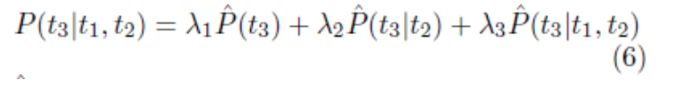
Smoothing
Author has come up with a solution to that problem with a smoothing paradigm that produced the best results in Tnt was linear interpolation . In mathematics, linear interpolation is a method of curve fitting using linear polynomials to construct new data points within the range of a discrete set of known data points.
P(t3|t1, t2) = λ1P(t3) + λ2P(t3|t2) + λ3P(t3|t1, t2) where 0 ≤ λi ≤ 1, i ∈ {1, 2, 3} such that λ1 + λ2 + λ3 = 1.
the values of λ ’s are estimated by deleted interpolation.

Slide 10

Smoothing
Tested frequency groups were assigned set of $λ$s according to following rule
One set of $λ$s for each frequency value
Two classes on low and high frequency values on the two ends of the scale.
Several frequency groupings in between them and several setting for partitioning classes.

Slide 11
Procedure to calculate λi
setλ1 =λ2 =λ3 =0
for each trigram t1, t2, t3 with f (t1, t2, t3) > 0 do
depending on maximum value
case f (t1,t2,t3)−1 / f (t1,t2)−1 : λ3 = λ3 + f (t1, t2, t3)
case f (t2,t3)−1 / f (t2)−1 : λ2 = λ2 + f (t1, t2, t3)
case f (t3)−1 / N−1 : λ1 = λ21+ f (t1, t2, t3)
end
end for
end
end for
normalize λ1, λ2, λ3

Slide 12
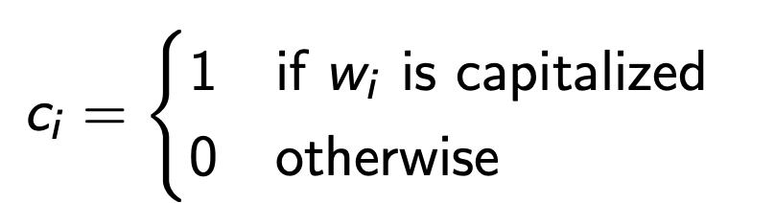
Capitalization
Capitalization plays a vital role
English: Proper nouns
German: All nouns
Probability distribution of tags around capitalized words differs from the rest.

Slide 13

Capitalization
So use P(t3, c3|t1, c1, t2, c2) instead of P(t3|t1, t2). The tri-gram model equations need to be changed accordingly.
This condition implies that in order to estimates the MLE / probability of the capitalized tokens we have to update equation (3) to (5) incorporating the flag $C_{i}$

Slide 14
Handling of Unknown Words
Handled best by suffix analysis (proposed by Samuelson in 1993) for inflected languages
Tag probabilities of unknown words are estimated according to the letters where word is ending. In English language suffix is the strong predictor of the class of the word.
In a study conducted for the words in Wall Street Journal which is a part of Penn Treebank, words (e.g. fashionable) ending with “able” are adjectives (JJ) 98% of the total words observed. Whereas, only 2% were nouns (e.g. cable, variable).
What is meant by “suffix”?
“Final sequence of characters of a word” which is not necessarily a linguistically meaningful suffix .
e.g: smoothing
G, ng, ing, hing, thing, othing, oothing, moothing, smoothing

Slide 15
Handling of Unknown Words
Probability distribution of a particular suffix is generated from all the words in the training set that share the same suffix of some predefined maximum length.
This calculates the probability of a tag t given the last m letters li of an n letter word:
P(t|ln−m+1, . . . ln). The sequence of increasingly more general contexts omits more and more characters of the suffix, such that P(t|ln−m+2, . . . , ln), P(t|ln−m+3, . . . , ln), . . . , P(t) are used for smoothing. As we have shown in the above for the case of smoothing.
Here is problem pointing to the choice of tokens/words in lexicon. . Should we use all words or fix words for suffix handling in the lexicons.
Author has assumed here that unknown words are those which are appearing less frequent in the lexicons and using the suffixes of infrequent words.
A threshold of frequency less than or equal to 10. This choice turned out to be a good choice.

Slide 16
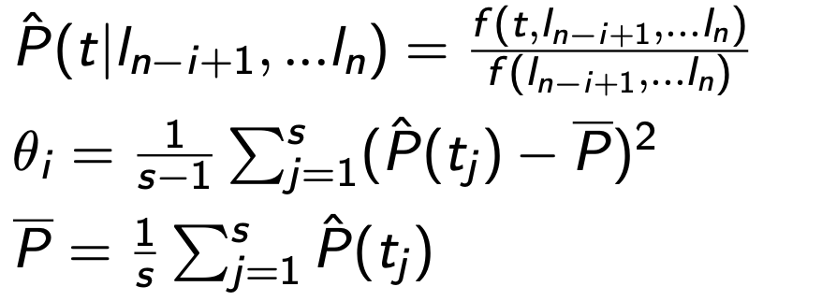
Handling of Unknown Words
Given suffix length: i = m to 0
P(ln−i+1, ...ln|t) ∝ P(t|ln−i+1, ...ln)P(t)
Define: P as the ML estimate obtained from frequencies in the lexicon
P(t) = P’(t)
P(t|ln−i+1, ...ln) = P’(t|ln−i+1,...ln)+θi P(t|ln−i ,...ln)/ 1 + θi.
Where
Here m = 10

Slide 17
Beam Search
The simplest idea is to rank all the alternatives produced so far by their probabilities, and always just expand the most likely sequences ( with highest probability). This is called a beam search.
A beam search prunes out the unpromising states at every step, leaving only the best to be used in future calculations. We can decide how many to keep using several different methods.
A faster and approximated version of Viterbi algorithm.
Explore states above a certain threshold.
Does not guarantee the correct path but performs well.

Slide 18

Beam Search
The processing time for Viterbi Algorithm can be reduced by introducing a beam search.
Each state that receives a $δ$ value smaller than the largest $δ$ divided by some threshold value $θ$ is excluded from further processing.

Slide 19
Model Evaluation and Experiments Strategy
Accuracy of tagger was evaluated for ten iterations and then averaged out as the overall accuracy. In addition to that separate accuracies for known and unknown words were also measured.
Tagger was trained over corpora of different sizes ranging from 1000 token to the entire corpus.
Author has used 90/10 Train, Test ratio.
Tagger was trained with 10 Fold cross validation and results were averaged out for single outcome.
Accuracy is calculated by dividing the no of correctly assigned tags by total no of tokens in the corpus processed.

Slide 20
Evaluation Setting DataSets
Datasets
Negra Corpus: German Newspaper corpus
Penn Treebank: The Wall Street Journal portion of Penn-Treebank corpus.
Dataset Split
Contiguous
Round-Robin
Evaluation Setting Performance Metrics
Tagging Accuracy for known, and more importantly, unknown words.
Effect of amount of training dataset on accuracy.
Accuracy of Reliable Tag Assignments.

Slide 21
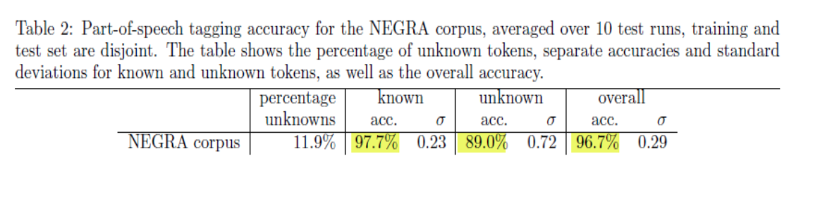
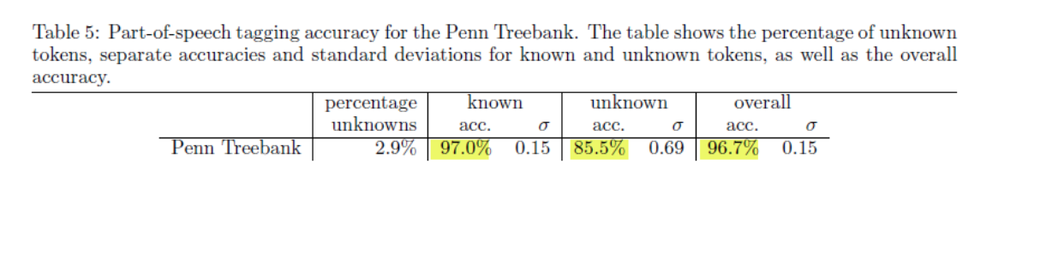
Unknown Words Accuracy

Slide 22
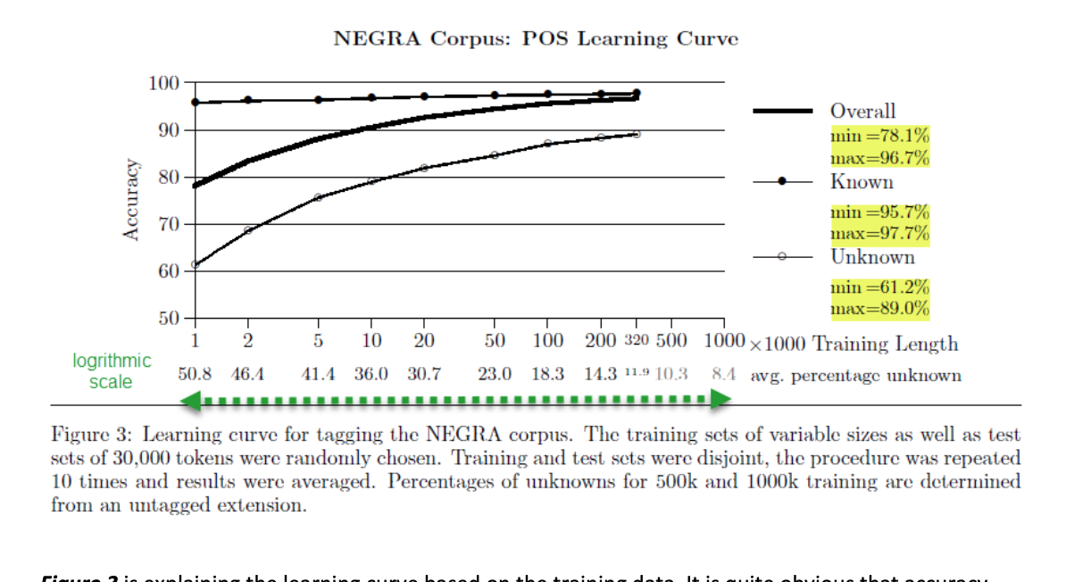
Learning curve of GERMAN NEGRA CORPUS

Slide 23
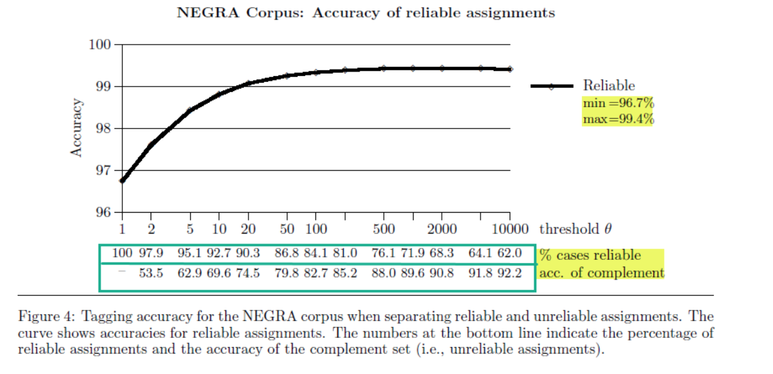
Accuracy Of Reliable Assignments

Slide 24
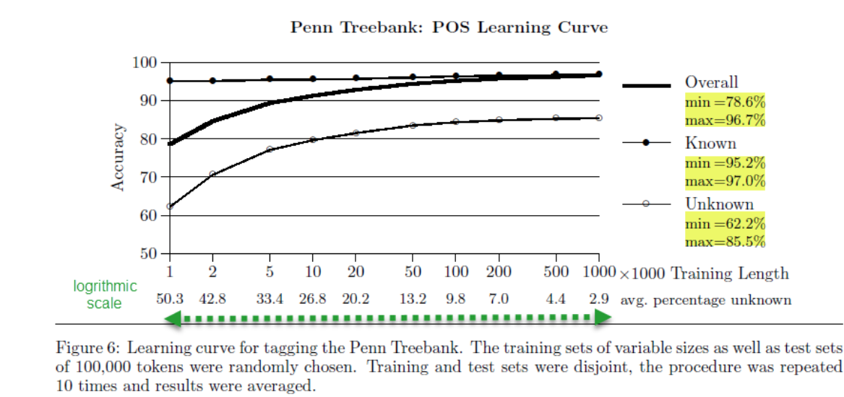
Learning curve Pen Tree Bank

Slide 25
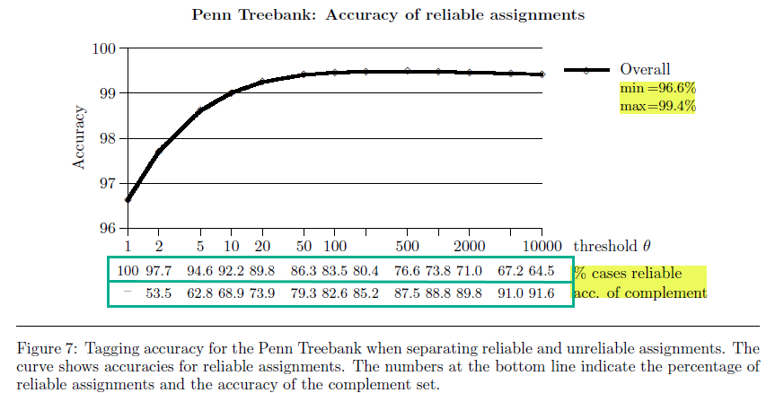
Accuracy Of Reliable Assignments

Slide 26
Different Domains
Works well for domain specific POS task.
If trained using large domain specific corpora.
If trained using large generic corpora with an additional small domain specific corpora

Slide 27
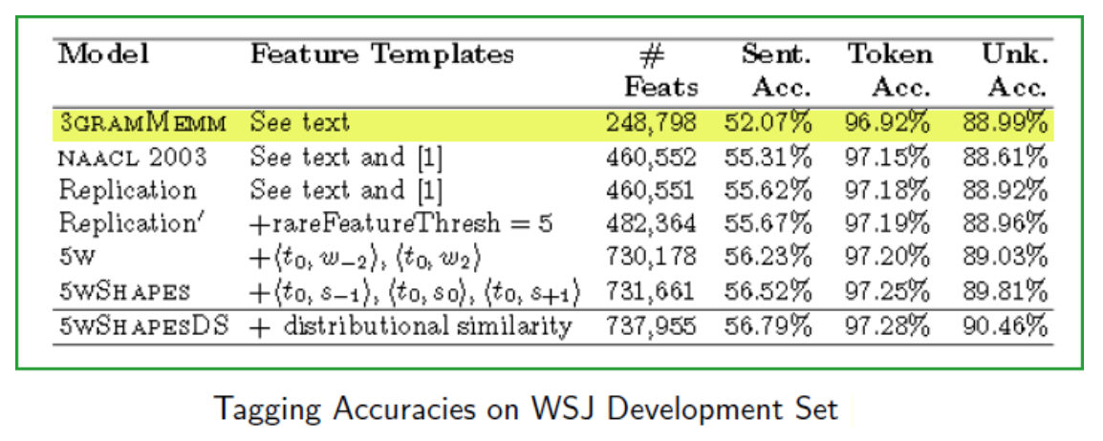
Accuracy Issue
Author has not explained anything about the sentence level accuracy.
At first glance, current part-of-speech taggers work rapidly and reliably, with per-token accuracies of slightly over 97%.

Slide 28
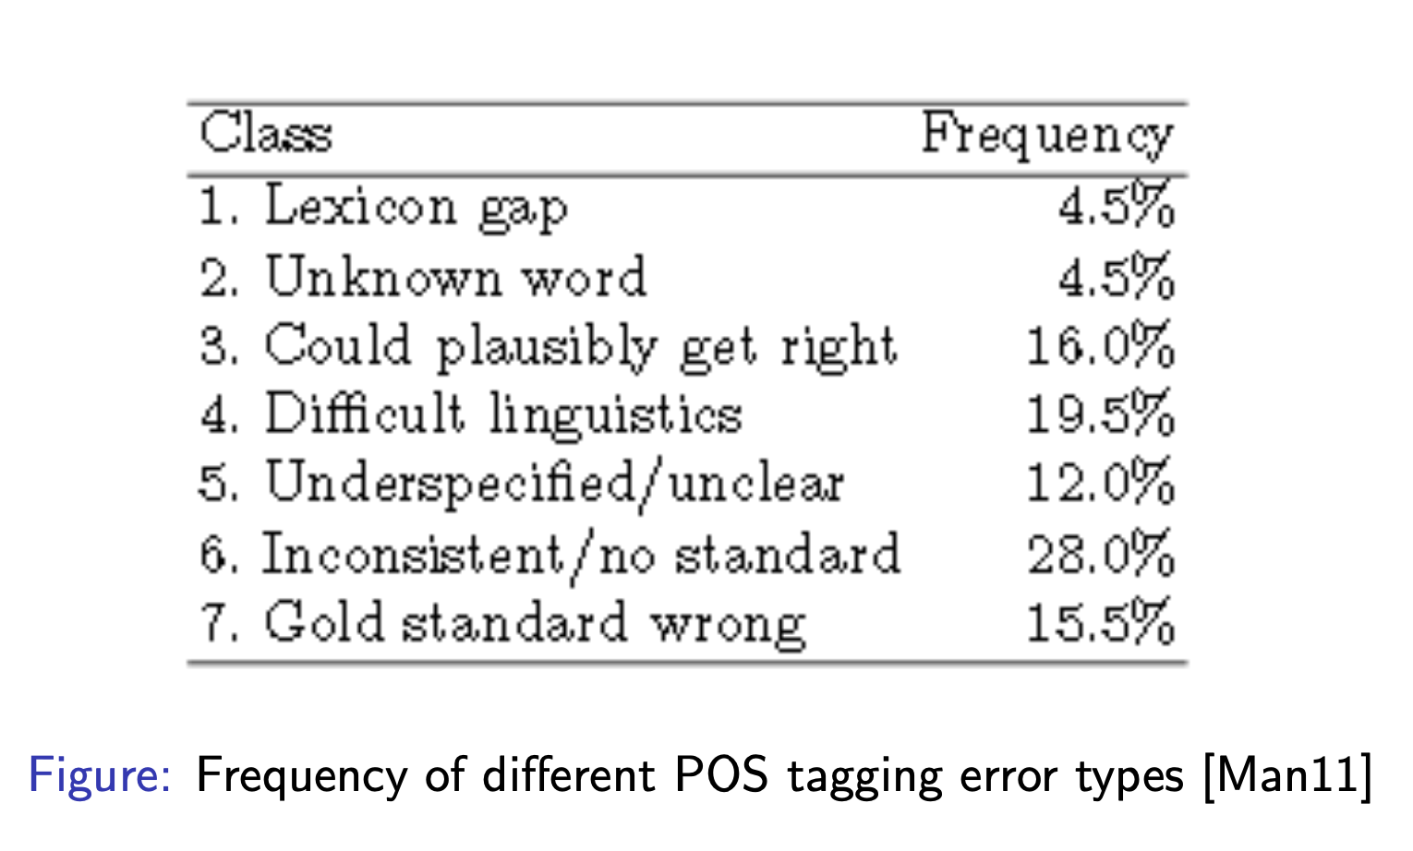
Different POS Tagging Error types

Slide 29
Morphological Languages
TnT Statistical Part of speech tagger did not perform well on morphological rich languages like Icelandic language.
Solution was proposed by (Loftsson, 2007) by filling in the gaps in the lexicon using language morphological analyzer.

Slide 30
TnT proprietary Issue
According to the code it is not open source.
An ubiquitous problem in HMM tagging originates from the standard way of calculating lexical probabilities by means of a lexicon generated during training.

Slide 31
Conclusion
A significant milestone in the history of Part-of-Speech Tagging.
A good point of entry into Statistical NLP.
Author clearly explained and outlined the procedure for handling of start and end sequence, exact smoothing technique.
. Author not only achieved good results for German and English Corpus but model also performed well for other set of languages

