Slide 1
Lending Club Case Study
Faisal Sahak
Sameer Manjrekar

Slide 2
Case Study Objectives
Business Objective:
company is the largest online loan marketplace, facilitating personal loans, business loans, and financing of medical procedures. Borrowers can easily access lower interest rate loans through a fast online interface
Problem Context:
the company wants to understand the driving factors (or driver variables) behind loan default, i.e. the variables which are strong indicators of default. The company can utilise this knowledge for its portfolio and risk assessment.
Problem Statement:
The company wants to know based on previous applicants which future applicant will likely default on their loans

Slide 3
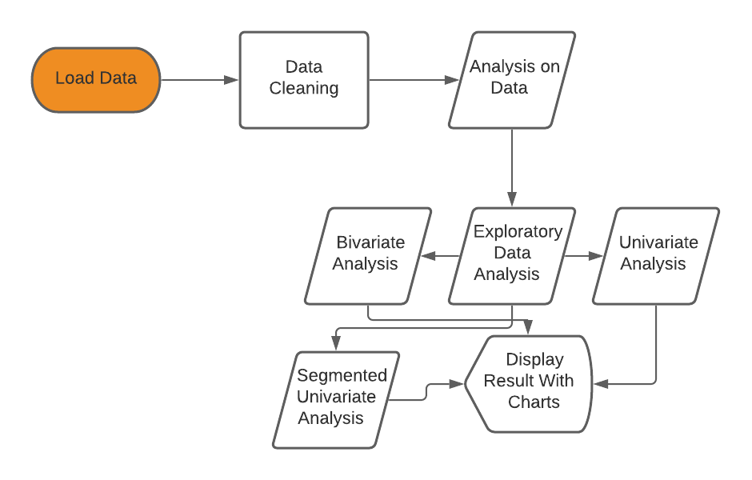
Problem Solving Methodology

Slide 4
Data Cleaning
Import Data in the form of csv
Delete unnecessary or unwanted columns, such as duplicate rows, or columns that wont add any kind of value to our analysis, e.g id
Missing Values: either drop the columns if there are too many missing values, if not then fill it with appropriate filler, such as mean or median

Slide 5
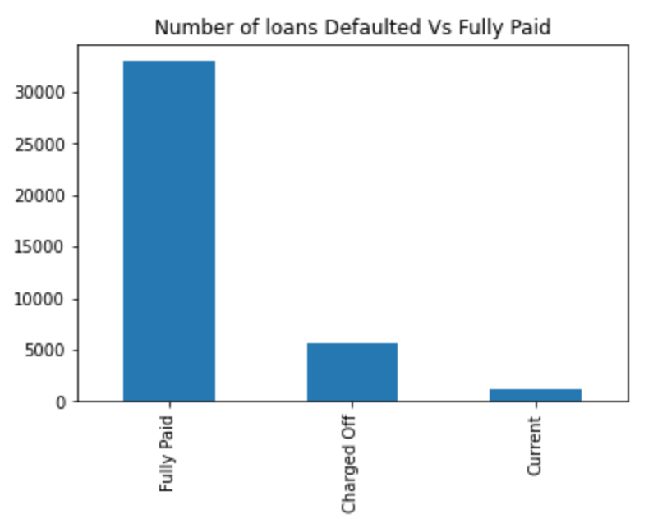
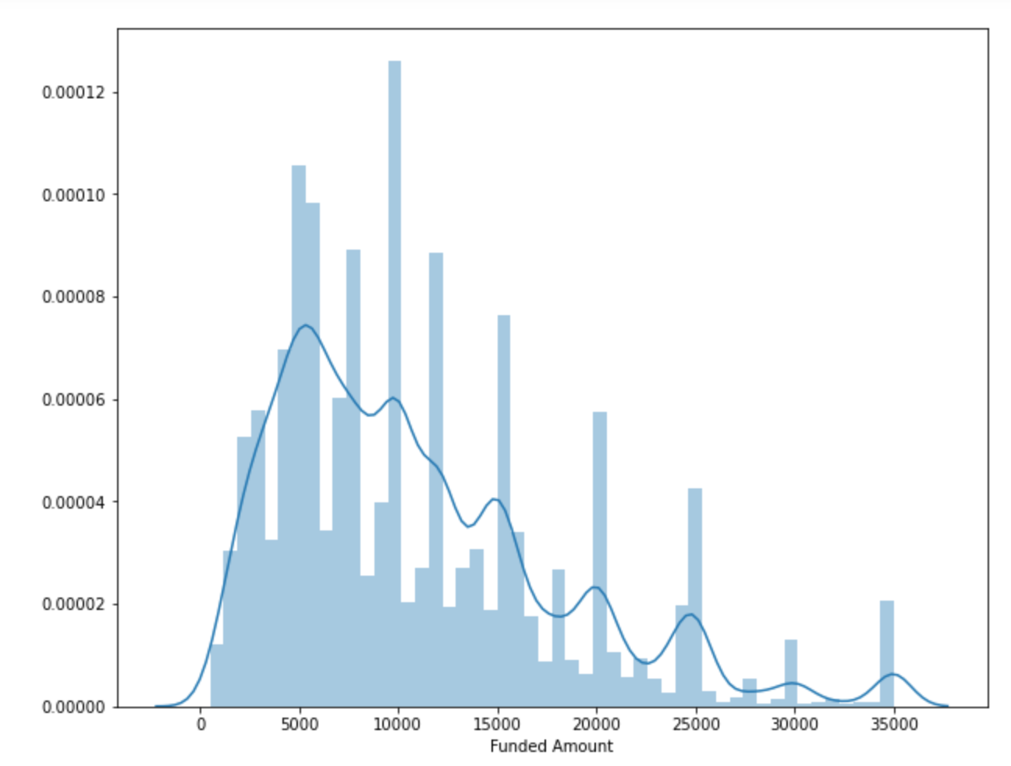
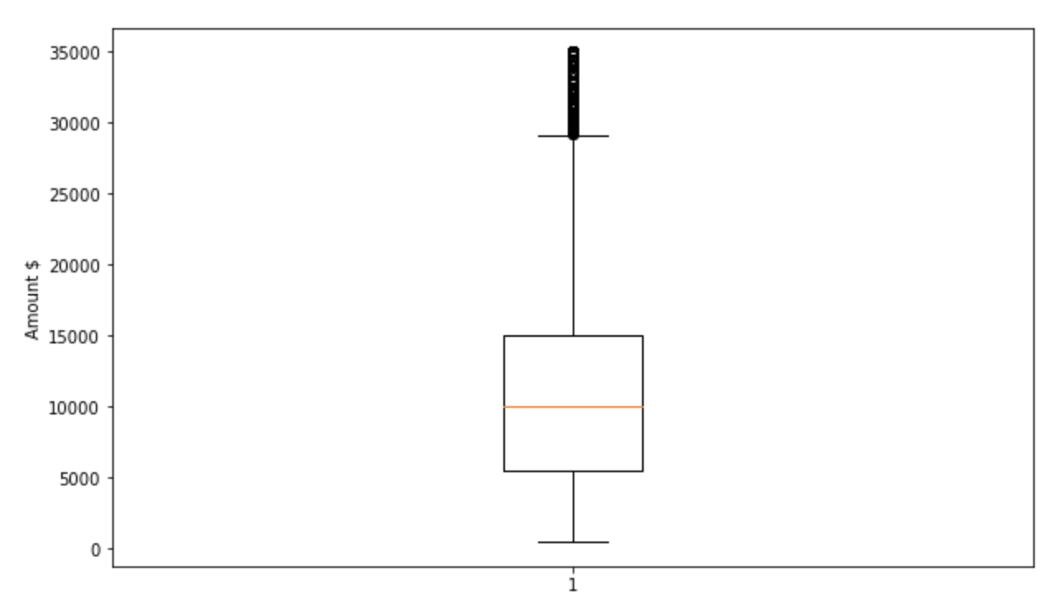
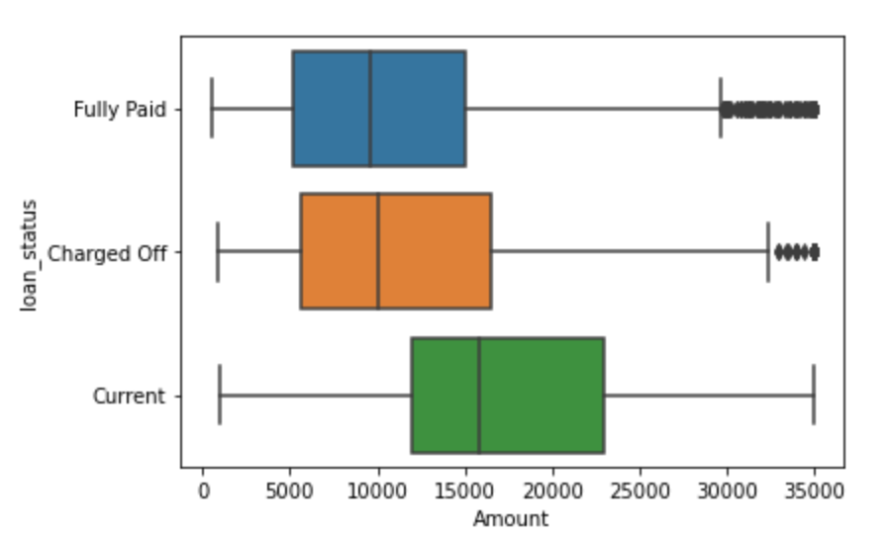
Analysis of Club’s Loans
The above bar chart displays the Club’s defaulters and those who have paid their loans in full.
The box plot indicates the loan amounts. It seems the the max amount is in the ranges of $35,000 to $40,000 and
The median is around $10,000 and the lowers seems to be in the rages of hundreds

Slide 6
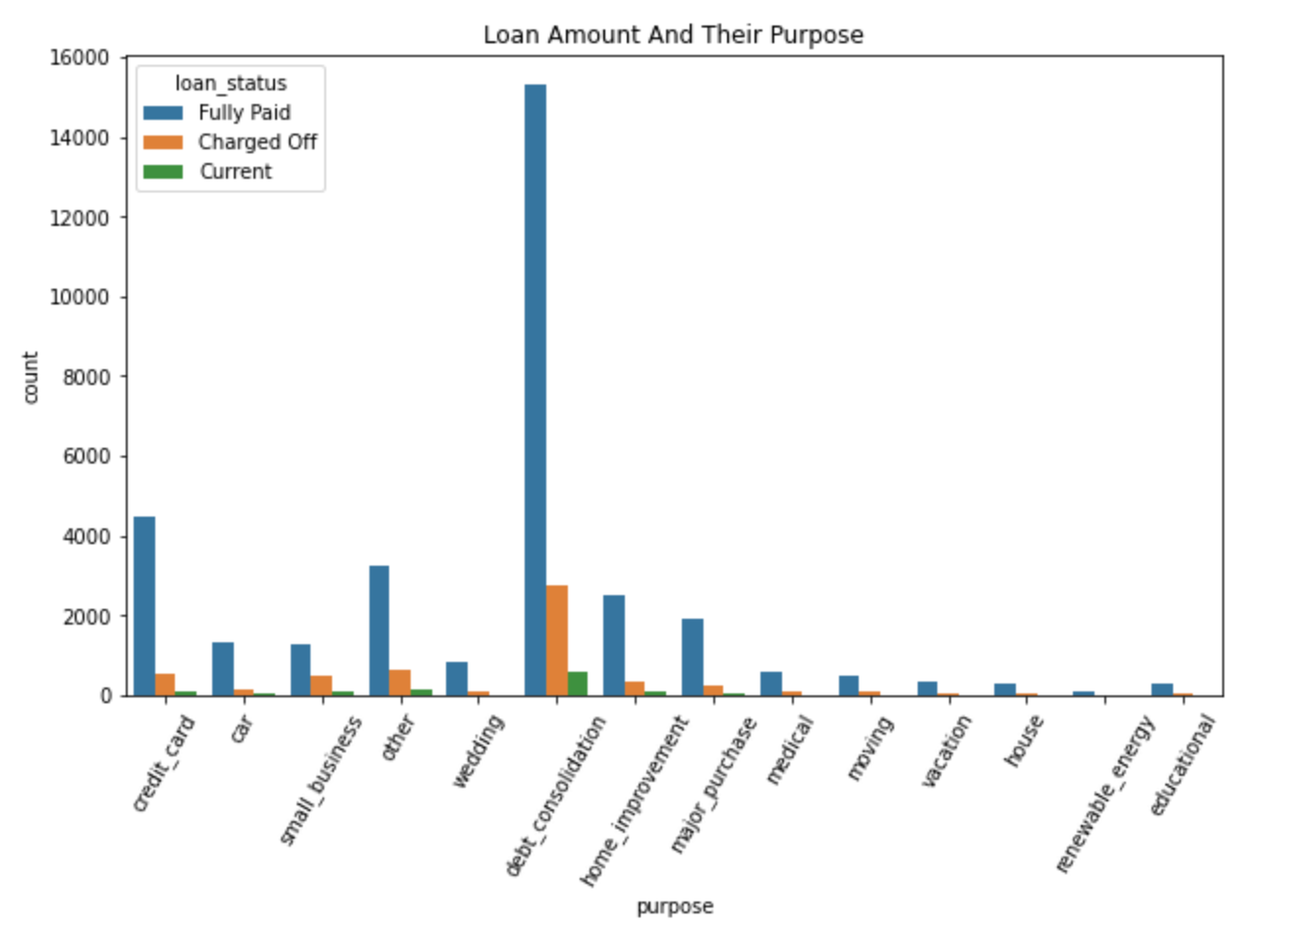
Loans taken out for Various of reasons
It seems that top reason that the borrowers are loaning money is for debt consolidation, and second being
Paying off their credit cards. While debt consolidation is the top reason why most apply for a loan, it is also the
Top reason in which where they default on their loans as well.

Slide 7
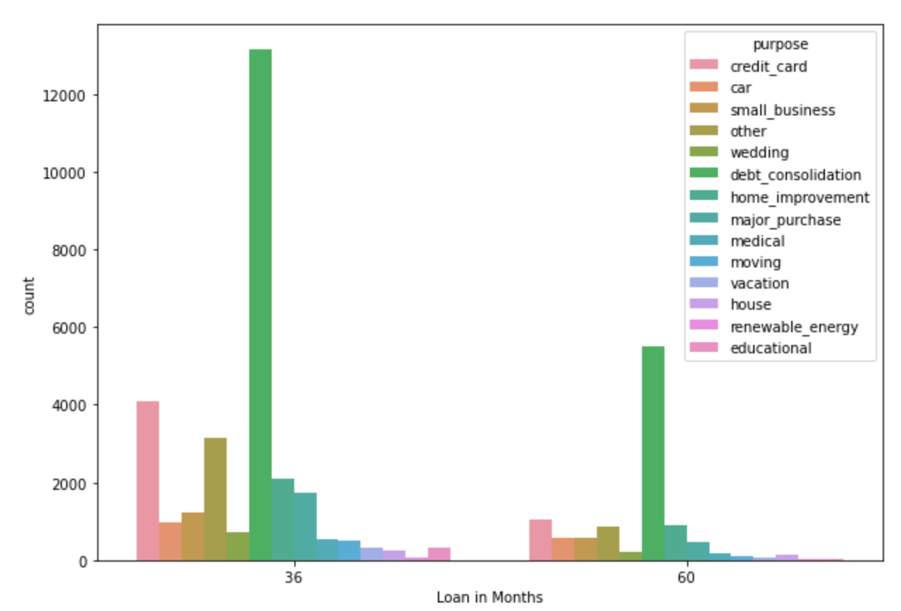
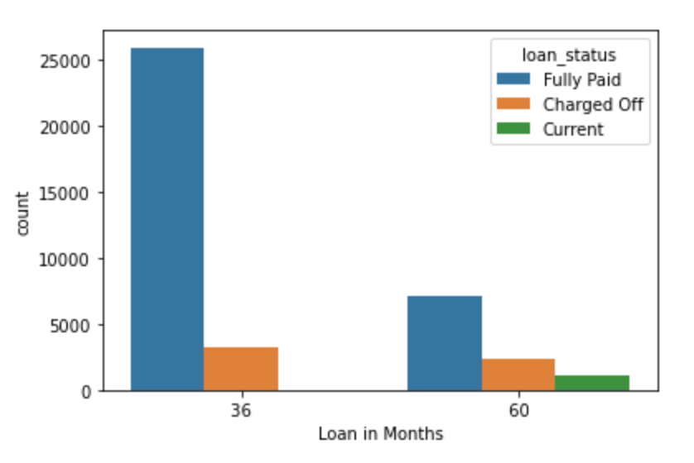
Duration of loans
The duration that most loans are taken out are for 36 and 60 months respectively,
It seems that the default ratio between those who take out loans for 36 months and those who take it out for 60
Is almost the same, there isn’t much of a correlation between the defaulters to fully paid in either of the cases

Slide 8
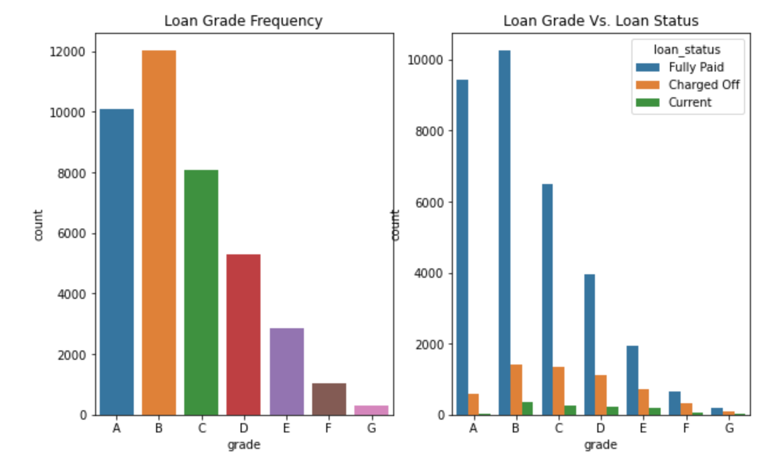
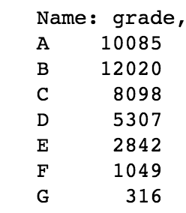
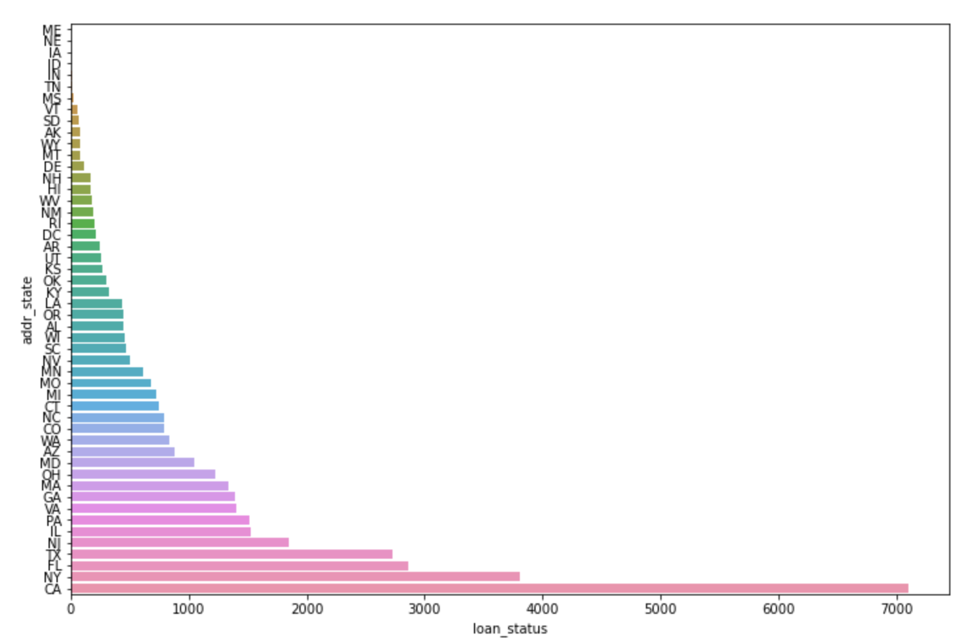
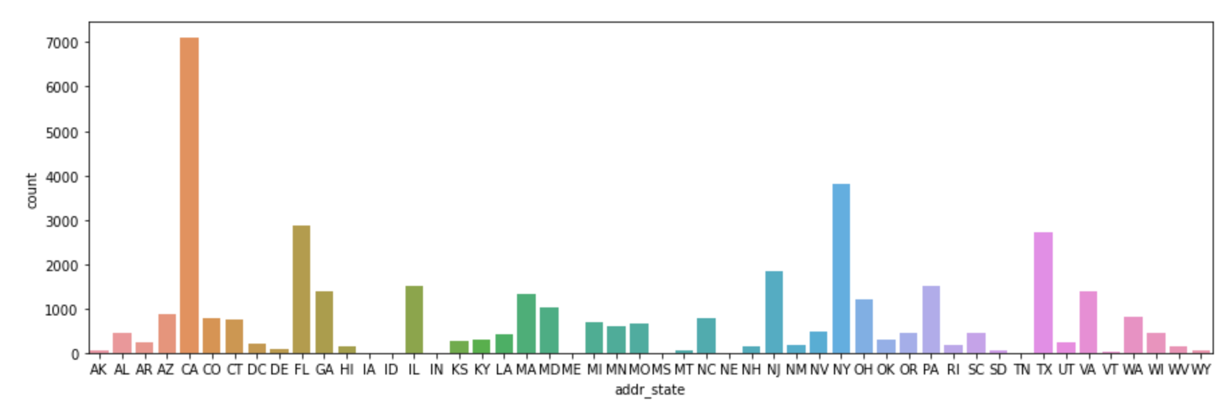
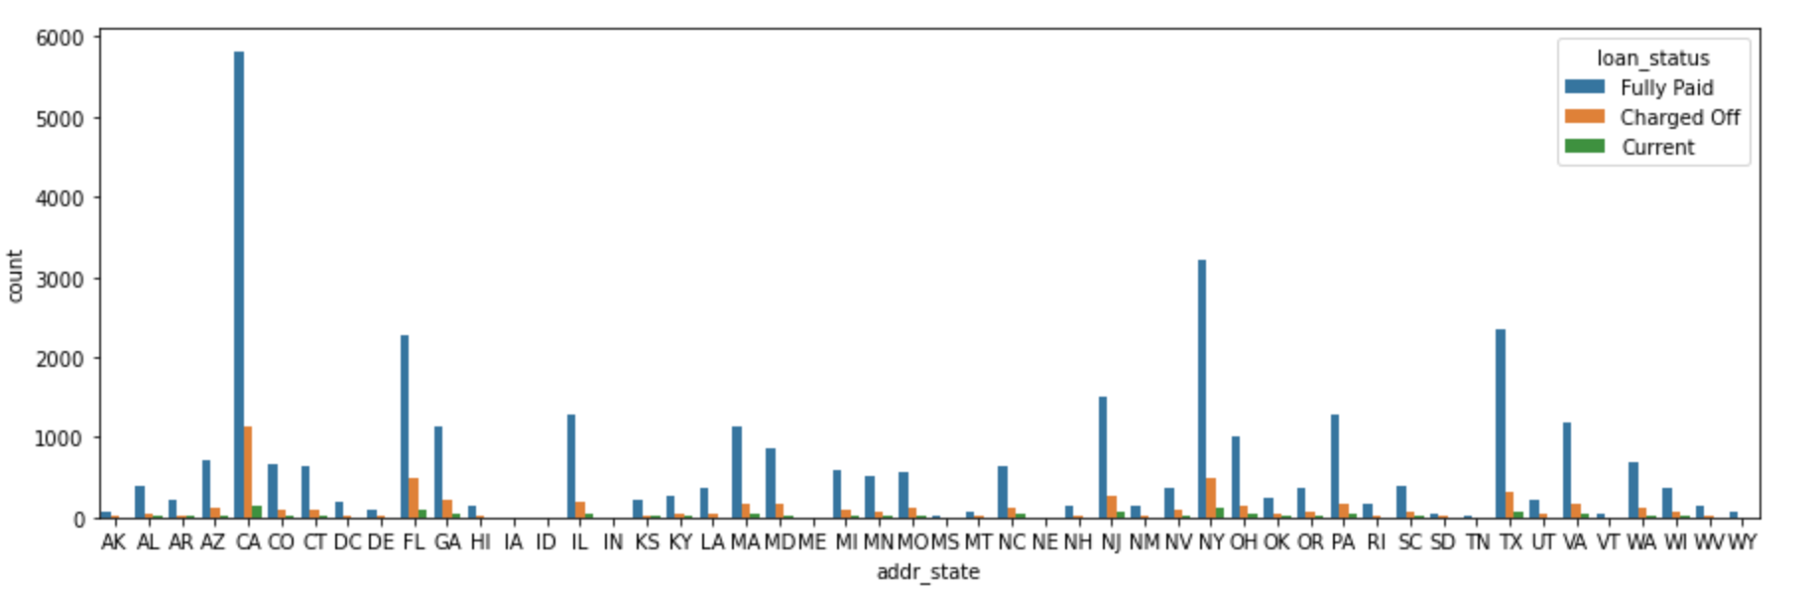
Funding By State
Top loaners are from from California, New York, and Florida and the top defaulters are also from the same States.
The top loan grade assigned by the Club is B.
It seems that the ratio of defaulters to fully paid for grade D and C is much higher than B.
Although there are more people that take out Grade B loans than C and D, the defaulters are much higher for C and D
The second highest number of loaners belong to grade A but the default ratio is much smaller compared to fully paid,
Which could mean that those who belong to Grade A do not want to default on their loans and pay them on time, which
Could mean that they have good credit

Slide 9
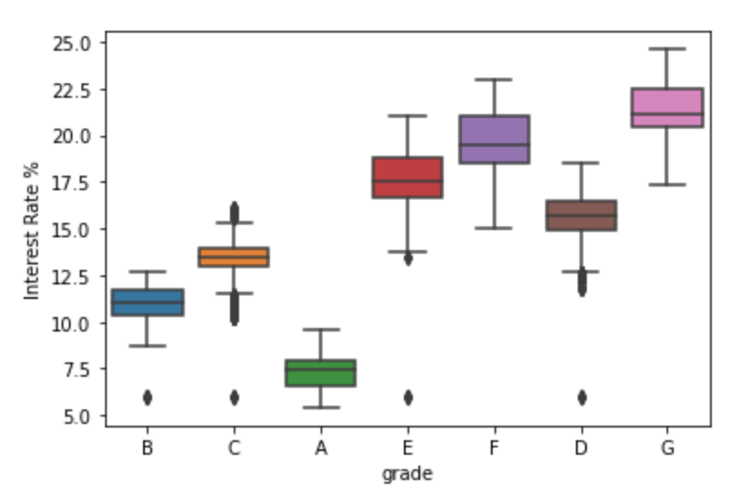
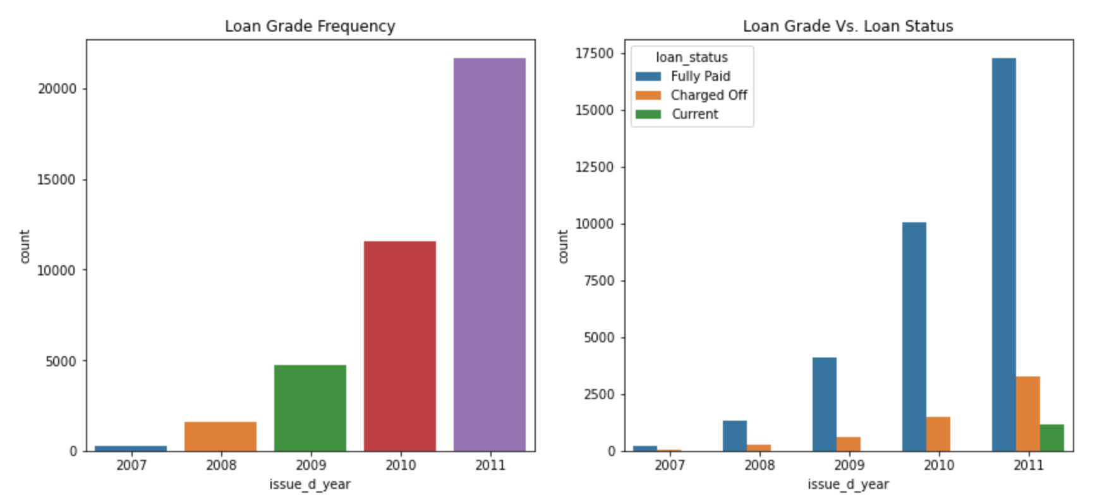
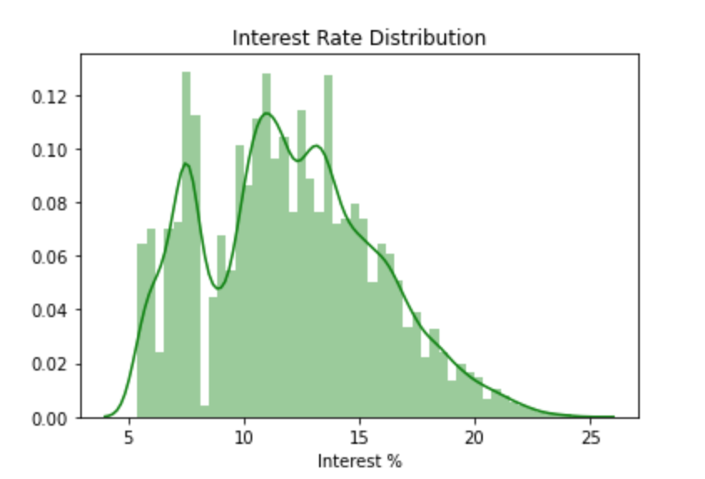
Loan Distribution and Interest rate
It looks like as the years go by the number of loaners increase almost quadratically
The interest rate fluctuates between 5 and 25, with most getting an interest rate of between 10 and 15 percent
It seems that those who don’t have a good history of paying back loans and/or have a bad credit history get the higher ranges of the interest rate.

Slide 10
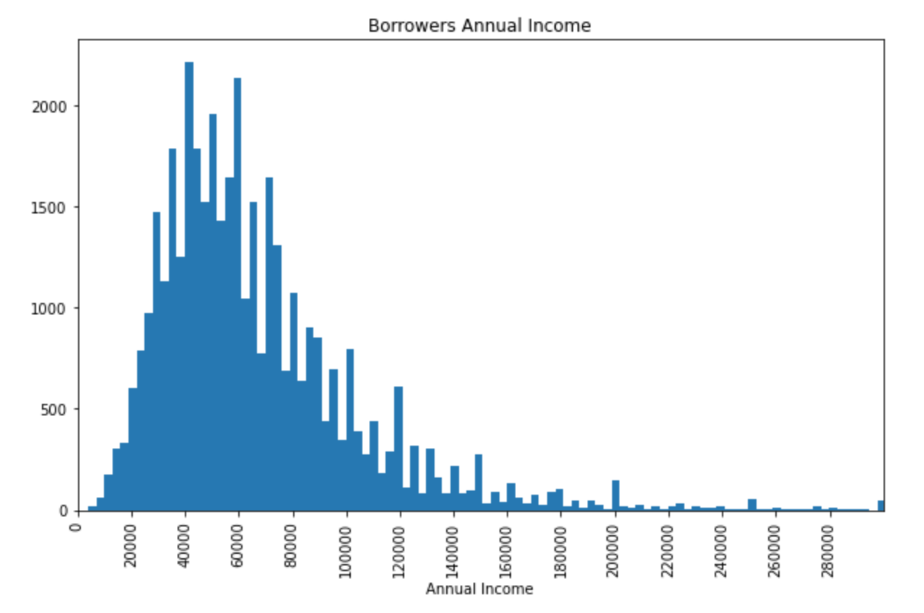
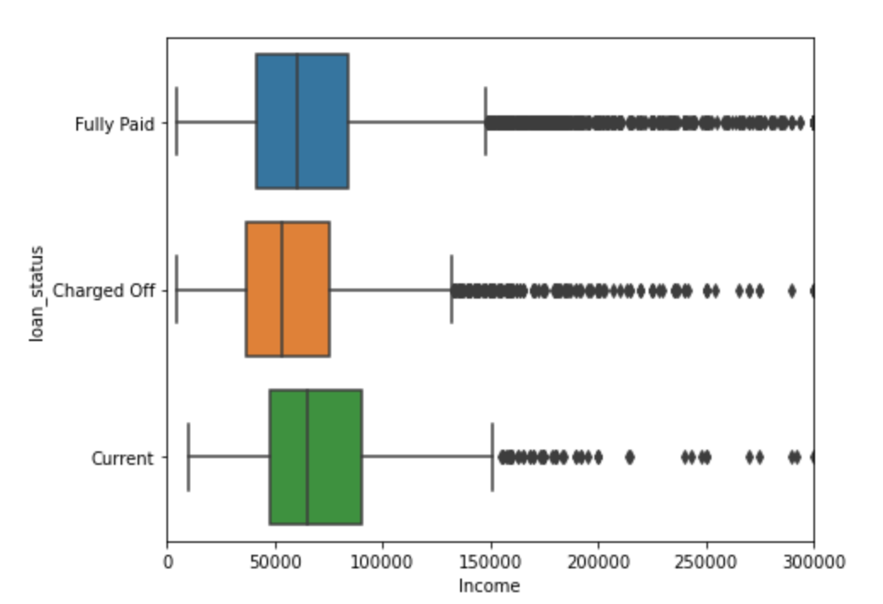
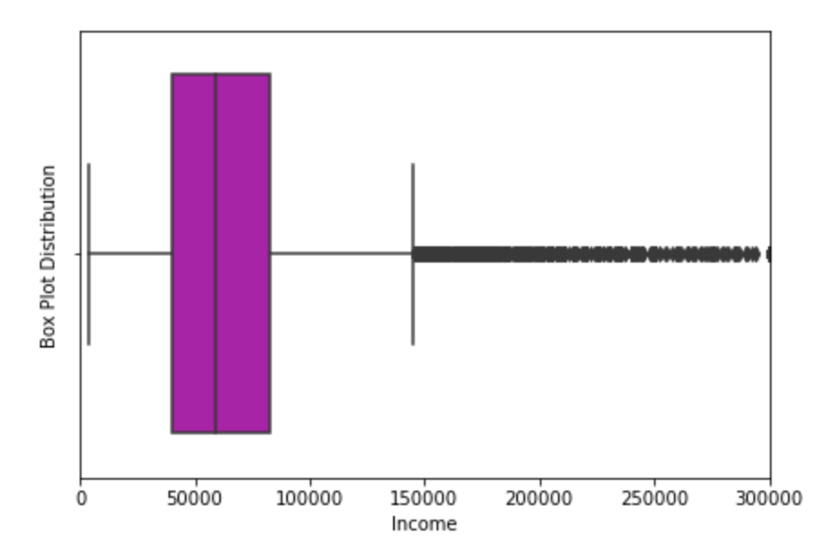
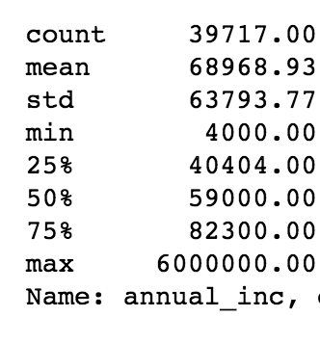
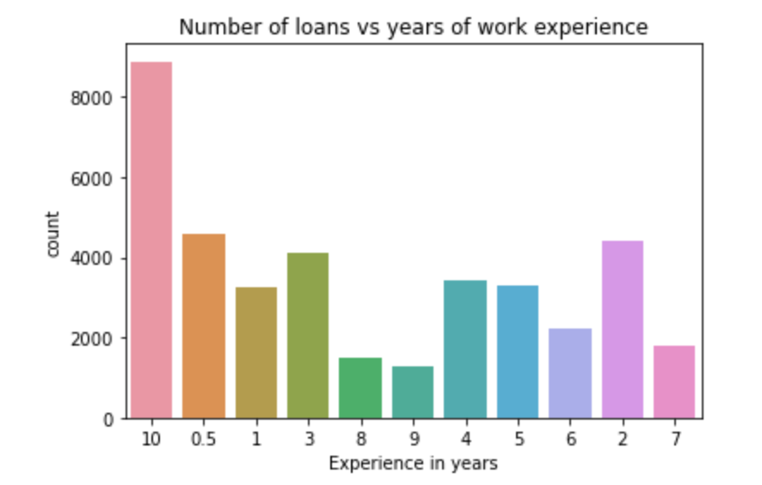
Annual Income of Borrowers
Most of the borrowers’ income seem to be between 40 - 60 thousands, with
A few outliers in the ranges of 200,000 and above, and some below 10,000
The average income of the loaners is around 68,968, the standard deviation is 63,793
the lowest income is 4,000 and the highest is 6,000,000, which really begs the
question as to what are they doing with their income. Most of the borrowers have
10 years or more of job experience, the second most borrowers seem to have less than
1 year of experience, which means that there isn’t really that much of a correlation between borrowing and years of job
experience

Slide 11
Conclusion
The Club loans anywhere between few hundreds to as high as $40,000
Those who default on their loans take out an average of $10,000
Majority of the loans are taking out for the purpose of debt consolidation and paying off credit card debts
Most loans are taken for 36 or 60 months
California, New York and Florida are the top states that take out the most loans with type B being the frequent
The average interest rate is between 10 and 15 percent, with grade A having the lowest with 5% and G having the highest with 25%
The average income of the borrowers is around 69,000 with the lowest being 4,000 and highest being 6,000,000
If an applicant selects their purpose for loan to be credit card repayment or debt consolidation, they will likely have a higher rate of defaulting on their loan.
Also those belonging to the states of CA, Fl, and NY will also have a higher change of defaulting
Those who get the lower grade loans will likely default on their loans

