Slide 1

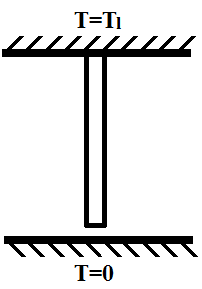
Thermo-Elastic Contact Coupling
Group 7: Bret Wainwright, Ashish Rana, Abdul Khalid, Run Si, Faisal Raja, Chuyun Guan
Applications
Hypersonic Panels
Nuclear Reactor Cooling
Electronics
Any intermittent contact with relatively large temperatures
Difficulties/Motivation
Idealized boundary conditions (perfect contact/ perfect insulation) result in lack of solutions and instability at intermediate temperatures
Full thermal-structural coupling complicates the problem
Significant research done by Barber, Dundurs, and Comninou
q_{conv}
L
g_{o}
Intentions
Analyze the 1D structure when the rod is in full contact (At large T1)
Theoretically/ Analytically (may need to be done numerically)
Simulation
Primary Variables: Temperature and Displacement
Secondary Variables: Stresses, Strains, Heat Flux
Other quantities of interest: T1 for contact to be lost, thermal contact resistance with floor

