Slide 1
Next, two pictures of faces will appear on the screen,
please carefully observe them If you're ready, press the "Space bar" to begin

Slide 2
Next, keep looking at the screen while you may see pictures of unpleasant faces and hearing unpleasant sounds. Please press "Spacebar" to continue

Slide 3
Please take a break for 5-10 minutes. Once you are ready to continue,
press "Spacebar"

Slide 4
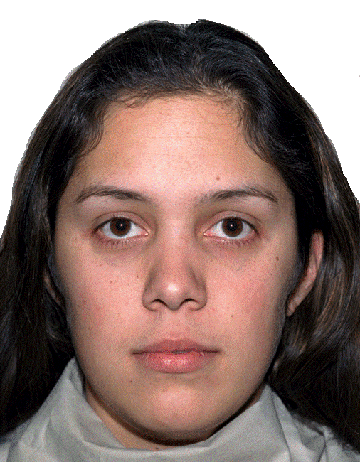
Rate the level of fear caused by the image (1: no fear, 10: extreme fear)

Slide 5
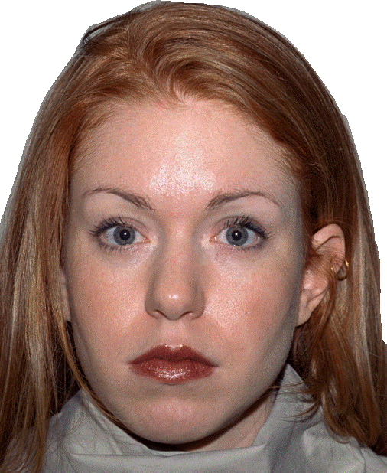
Rate the level of fear caused by the image (1: no fear, 10: extreme fear)

Slide 6
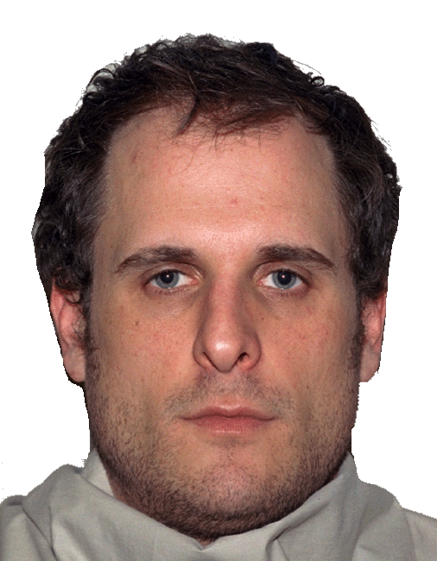
Rate the level of fear caused by the image (1: no fear, 10: extreme fear)

Slide 7
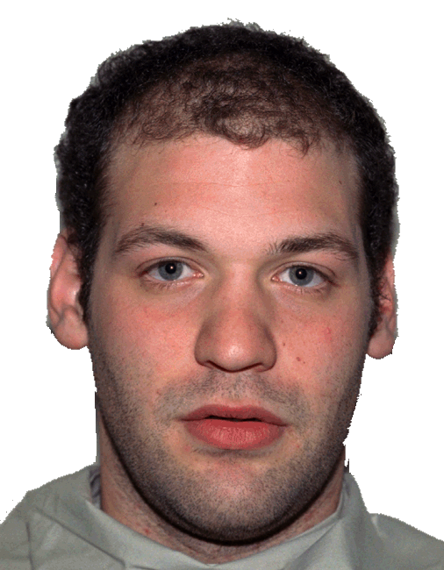
Rate the level of fear caused by the image (1: no fear, 10: extreme fear)

Slide 8
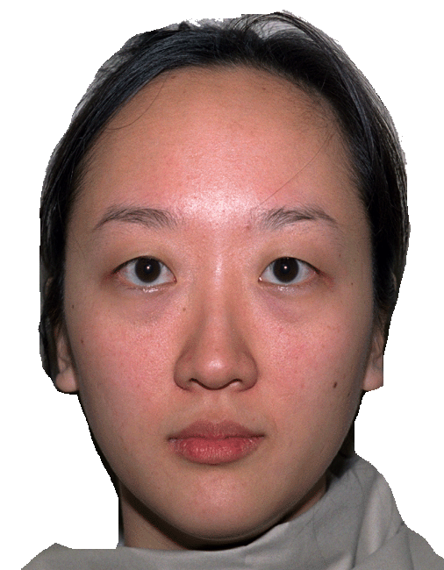
Rate the level of fear caused by the image (1: no fear, 10: extreme fear)

Slide 9
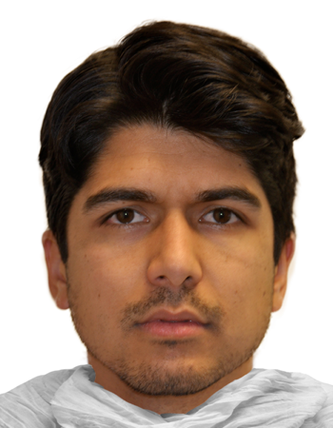
Rate the level of fear caused by the image (1: no fear, 10: extreme fear)

Slide 10
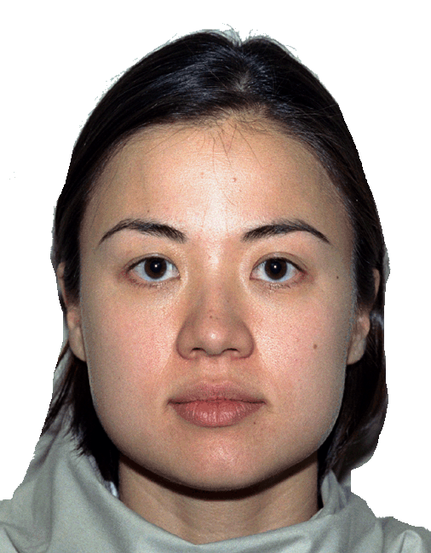
Rate the level of fear caused by the image (1: no fear, 10: extreme fear)

