Slide 1
AWS Sales Data Pipeline
A Cloud-Based Data Engineering Solution for Automated Sales Data Processing and Business Insights
CLOUD FOUNDATIONS VIRTUAL BOOTCAMP
Prepared by Faith Ogundusi
August 2026
Cloud data • validation • storage • monitoring • business insights
Cloud Foundations Virtual Bootcamp • AWS Sales Data Pipeline • August 2026 01

Slide 2
Introduction
From raw transactional data to validated, structured business information
WHAT
DATA
A cloud-based data engineering project that processes, validates, stores, monitors, and transforms sales data into business insights.
The Online Retail Dataset, a transactional sales dataset obtained through Kaggle.
WHY AWS
PURPOSE
Managed AWS services provide the project’s storage, processing, scheduling, database, notifications, monitoring, and access-control components.
Automate ingestion and validation, separate valid and rejected records, store accepted data, and surface sales KPIs.
CORE FLOW
Online Retail CSV → Amazon S3 → AWS Lambda → Valid / Rejected → RDS + Dashboard
Cloud Foundations Virtual Bootcamp • AWS Sales Data Pipeline • August 2026 02

Slide 3
Business Problem
Why automated data quality and organization matter
01
Incomplete / invalid records
Raw sales data can contain missing required fields, zero or negative quantities, and zero or negative unit prices.
02
Manual effort
Identifying invalid records, maintaining organized datasets, and preparing data for analysis can be time-consuming.
03
Reliable analysis
Business users need accepted data in a structured form that can support reporting and decision-making.
04
Traceability
Rejected records should remain available for review rather than disappearing from the workflow.
KEY PROBLEM • How can raw sales data be processed automatically, invalid records separated, accepted records stored, and useful sales information made available for business analysis?
Cloud Foundations Virtual Bootcamp • AWS Sales Data Pipeline • August 2026 03

Slide 4
Proposed Solution
A managed AWS workflow for ingestion, validation, storage, notification, monitoring, and visualization
VALID / REJECTED
Online Retail CSV
Amazon S3 Raw
AWS Lambda Python 3.12
Data Validation
VALID RECORDS
Amazon S3 → Amazon RDS (MySQL)
REJECTED RECORDS
AUTOMATION
MONITORING
Amazon S3 • retained with error information
Amazon EventBridge schedules the Lambda processing function.
Amazon CloudWatch supports Lambda execution logs and error review.
NOTIFICATIONS + INSIGHTS
Amazon SNS provides completion / alert notifications. Accepted data feeds the Sales KPI Dashboard.
Cloud Foundations Virtual Bootcamp • AWS Sales Data Pipeline • August 2026 04

Slide 5
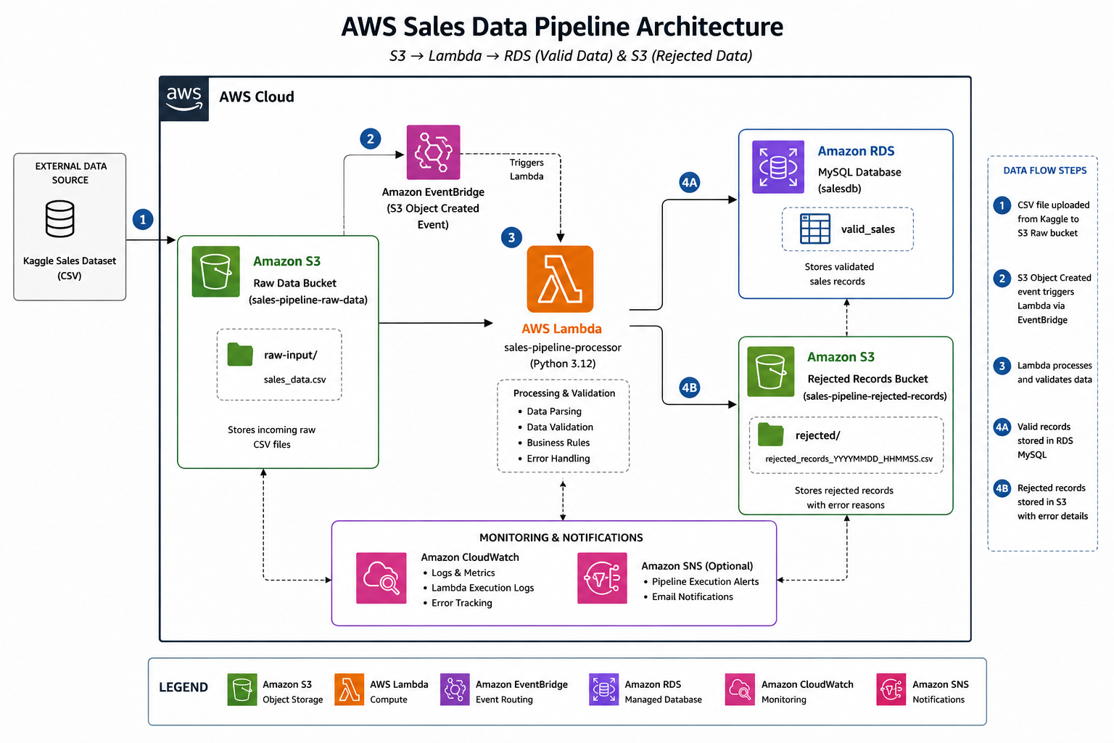
AWS Solution Architecture
Project architecture from the report / repository
AWS SERVICE ROLES
Amazon S3
Raw, valid, and rejected sales data
AWS Lambda
Serverless processing and validation
Amazon RDS
Accepted records in MySQL
Amazon SNS
Completion and alert notifications
Amazon EventBridge
Scheduled pipeline execution
Amazon CloudWatch
Lambda logs and error monitoring
AWS IAM
Access and permissions
Cloud Foundations Virtual Bootcamp • AWS Sales Data Pipeline • August 2026 05

Slide 6
Pipeline Implementation
Nine stages documented in the project report
1
Data ingestion
2
Scheduled automation
3
Lambda processing
Online Retail CSV uploaded to Amazon S3 raw storage.
EventBridge rule sales-pipeline-monthly-trigger targets Lambda.
AWS Lambda reads and parses records using Python 3.12.
4
Data validation
5
Valid / rejected split
6
RDS storage
Checks missing required values, quantity, and unit price rules.
Accepted records continue; rejected records are retained with issue information.
Accepted records loaded into Amazon RDS MySQL for structured access.
7
SNS notifications
8
CloudWatch monitoring
9
Business visualization
Completion and alert notifications provide operational visibility.
Lambda execution logs and errors support monitoring and troubleshooting.
Accepted data powers the Sales KPI Dashboard via GitHub Pages.
SCHEDULE: MIDNIGHT UTC • 1ST OF EVERY MONTH
Cloud Foundations Virtual Bootcamp • AWS Sales Data Pipeline • August 2026 06

Slide 7
Data Validation & Pipeline Results
50,000 records processed — with rejected data retained for traceability
TOTAL RECORDS
30,315
60.6% valid
50,000
19,685
39.4% rejected
60.6%
Pipeline execution result
VALID / ACCEPTED
VALIDATION RULES
• Missing required values • Zero / negative quantity • Zero / negative unit price
TRACEABILITY
Rejected records were retained separately in Amazon S3 with error details.
Cloud Foundations Virtual Bootcamp • AWS Sales Data Pipeline • August 2026 07

Slide 8
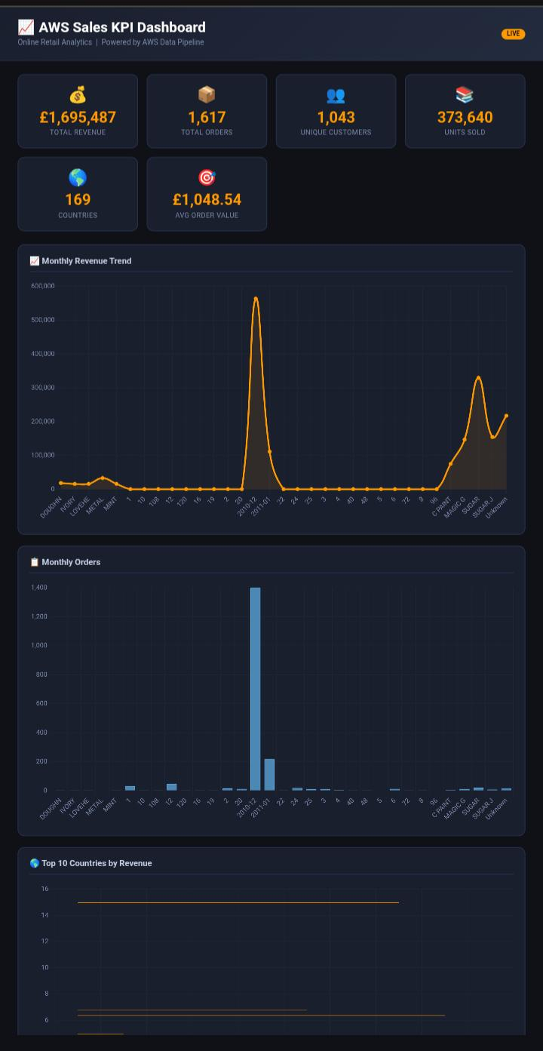
Sales KPI Dashboard
Accepted sales data transformed into business-focused information
DASHBOARD CONTENT
Revenue KPIs
Order trends
Top products by revenue
Top products by quantity
Revenue by country
Top customers
Sales trends over time
DEPLOYMENT
visualizations/dashboard.html • GitHub Pages
Cloud Foundations Virtual Bootcamp • AWS Sales Data Pipeline • August 2026 08

Slide 9
Business Benefits, Challenges & Lessons Learned
What the project delivered — and what the build taught
BENEFITS
CHALLENGES
LESSONS LEARNED
• Improved data quality
• Understanding AWS service integration
• Data quality is essential
• Reduced manual processing
• IAM permissions
• Serverless data processing
• Better data organization
• Data-quality issues
• IAM & service integration
• Structured data access
• Lambda-to-RDS connectivity
• Data traceability
• Operational visibility
• Dashboard development
• Relational database storage
• Business insights
• GitHub documentation
• Data visualization
• Scalability
• Technical documentation
Cloud Foundations Virtual Bootcamp • AWS Sales Data Pipeline • August 2026 09

Slide 10
Conclusion & Project Links
A practical AWS cloud data engineering solution
1
Built a cloud-based AWS sales data pipeline.
PROJECT LINKS
2
Processed and validated 50,000 sales records.
GitHub Repository
github.com/faith-ogundusi/ aws-sales-data-pipeline
3
Separated valid and rejected data, retaining rejected records for review.
Live Dashboard
faith-ogundusi.github.io/ aws-sales-data-pipeline/
4
Stored accepted data in Amazon RDS and provided business insights through the dashboard.
AUTHOR
Faith Ogundusi
Data Engineer | AWS Cloud | Building Data Pipelines & Scalable Data Solutions
Cloud Foundations Virtual Bootcamp • AWS Sales Data Pipeline • August 2026 10

