Slide 1
Aircraft Risks Statistics
Risks involved in the Aviation Industry

Slide 2
Business problem
Our company is expanding their portfolio
by offering aviation services. Let’s look into
the risks involved before launching these
services to the public.

Slide 3
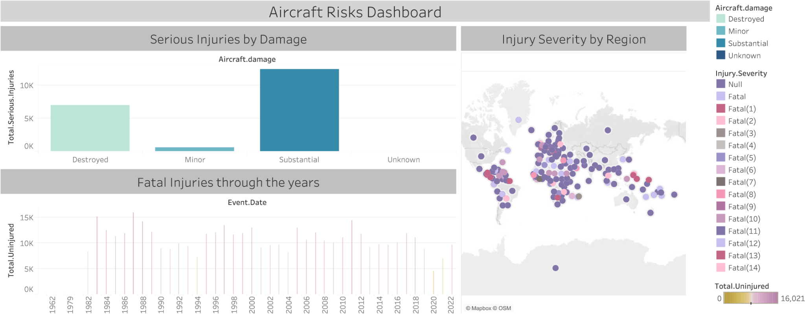
Injuries by Damage
This visual illustrates that substantial damage to the aircraft led to a huge amount of injuries

Slide 4
Severity by Region
For this graph, we’re looking at the severity of injuries by the region and we can see it is evenly spread out through the countries.

Slide 5
Injuries through the years
From this graph, we are able to see that the fatalities associated with the industry vary, but not by a lot. They are quite high but can be managed with the appropriate solutions.

Slide 6
Observations
From the graphs above, we have been able to make the following observations;
All fatalities are common regardless of the region but some regions are more prone to fatal accidents than others.
The number of injuries throughout the years varies but rarely experiences a drastic change.
Planes that had the most damage caused most serious and fatal injuries.

Slide 7
Solutions
1. **Enhanced Training and Procedures:** Provides additional training to pilots and flight crews to address common causes of accidents or incidents. Implement standardized procedures to improve safety protocols.
2. **Improved Maintenance Protocols:** Implement more stringent maintenance schedules and procedures to ensure aircraft are properly maintained and operated safely.
3. **Technology Upgrades** Invest in technology upgrades to aircraft systems, air traffic control and safety equipment to improve overall safety and efficiency.
4. **Air Traffic Management Solutions** Develop strategies to manage air traffic flows more efficiently, including route optimization, airspace redesign, and improved communication systems.
5. **Regulatory Reform:** Advocate for regulatory reform to address identified safety issues and improve overall aviation safety standards.

Slide 8
Conclusion
From the study we have conducted, we’ve been able to find out that the aviation industry is good as long as it is well implemented.
The End.

