Slide 1
吐槽网
我们毕业啦
其实是答辩的标题地方
答辩人
徐毅飞
指导老师
段荣盛

Slide 2
CONTANTS
项目小组成员以及负责模块介绍
项目文档展示
项目功能展示
项目心得分享

Slide 3

项目小组成员以及负责模块介绍
It was the best of times, it was the worst of times; it was the age of wisdom, it was the age of foolishness.

Slide 4
“
项目小组成员：徐毅飞 邓建新 夏福兴
徐源锴
模块介绍：首页
详情页面
投稿页面
登录注册页面
”

Slide 5
项目文档展示
It was the best of times, it was the worst of times; it was the age of wisdom, it was the age of foolishness.

Slide 6
文档展示
1.项目立项及开发规划说明书
2.项目开发计划表
3.需求规格说明书
4.系统设计说明书

Slide 7
项目功能展示
It was the best of times, it was the worst of times; it was the age of wisdom, it was the age of foolishness.

Slide 8
功能
TEXT
TEXT
TEXT
TEXT
首页
精华页面
投稿页面
登录注册

Slide 9
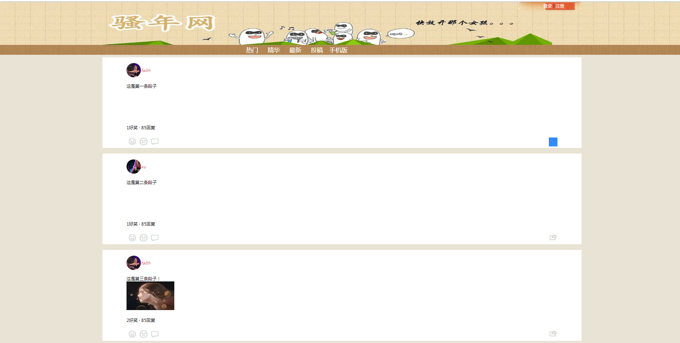
首页
It was the best of times, it was the worst of times; it was the age of wisdom, it was the age of foolishness.

Slide 10
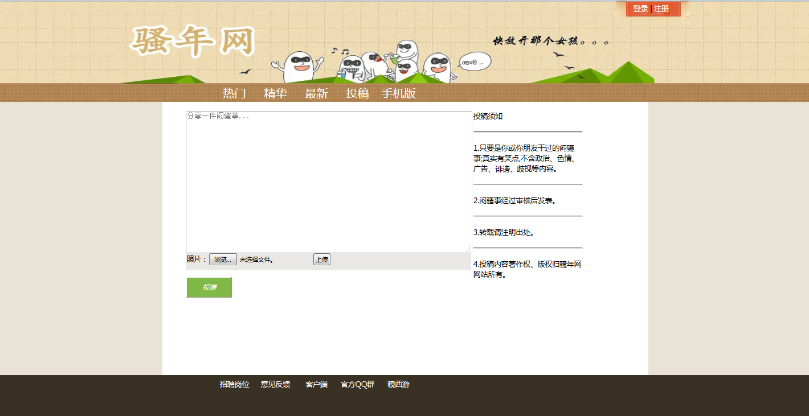
投稿页面

Slide 11
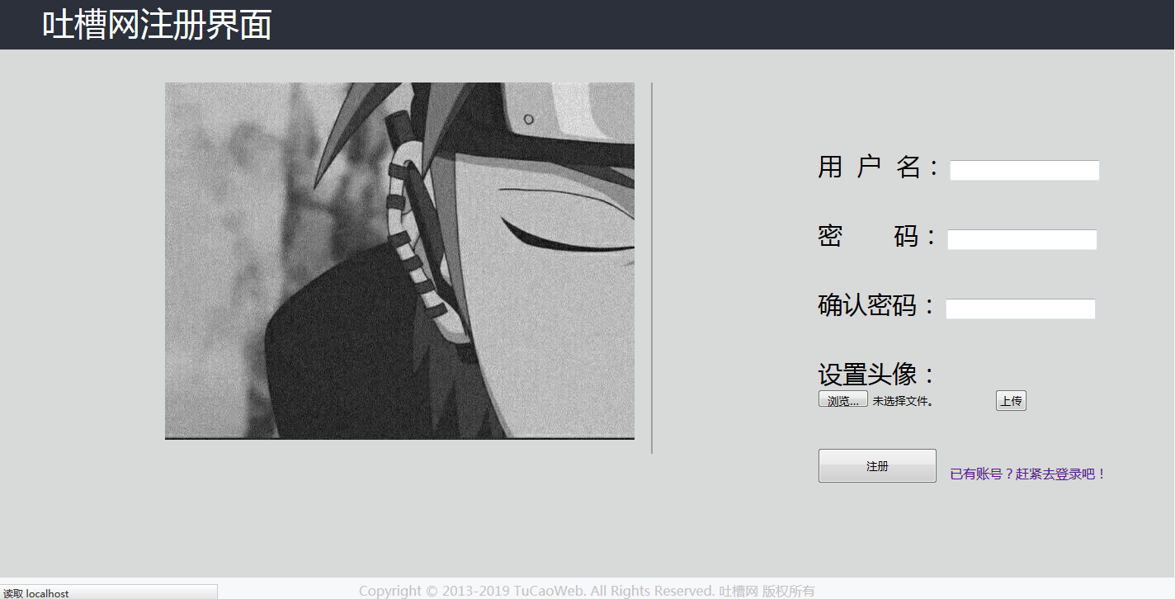
注册

Slide 12
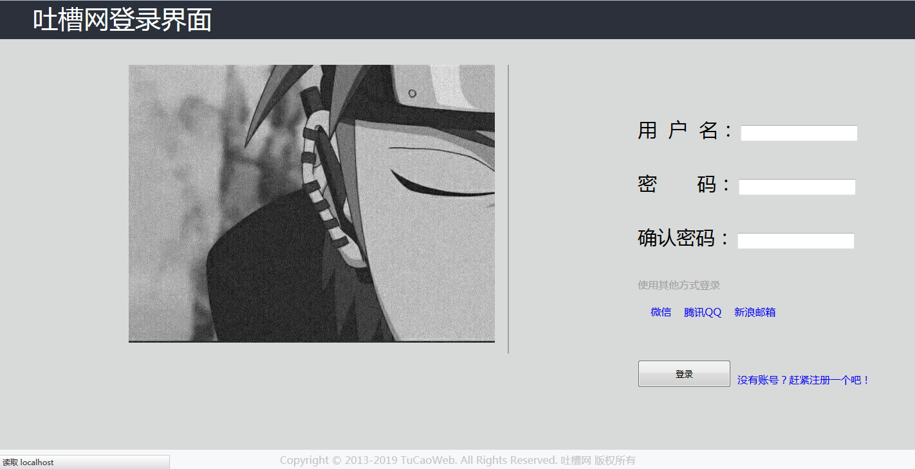
登录

Slide 13
项目心得分享
It was the best of times, it was the worst of times; it was the age of wisdom, it was the age of foolishness.

Slide 14
项目总结
1
做项目的时候，最重要的不是自己如何快速地将自己分配的任务做完，而是要注重团队合作。
2
项目的开展需要团队合作交流，它不仅关系着项目开展的进度快慢的问题，而且关系这一个团队能否坚持到最后

Slide 15
THANKS
NAME
DAMEN

