Slide 1
SALES PERFORMANCE — DATA STORY
Is the sales performance evenly distributed across all regions?
The total profits made across the five regions is $127M whereby the difference is 18% between the highest and the lowest , without one region dramatically underperforming.
50K
1.27M
3.19M
Units Sold
Total Profits
Total Revenue
1

Slide 2
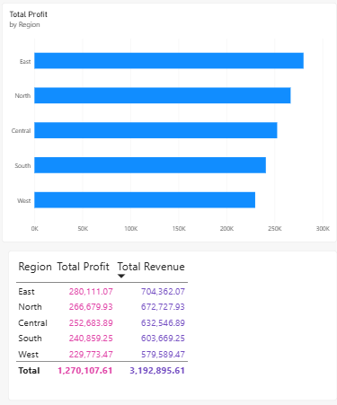
BUSINESS CONTEXT
ONE-SENTENCE TAKEAWAY
If one region contributes substantially more than others, the business may be exposed to regional risks.
That tiny difference in percentage is enough to show: The business has a more balanced geographical contribution.
2

Slide 3
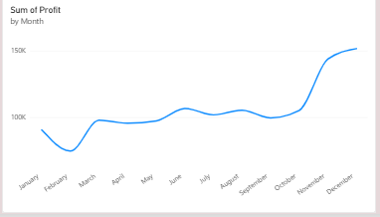
EVIDENCE — PART 1
The balance holds even during the holiday surge
ONE-SENTENCE TAKEAWAY
Every region gets 23 – 25 % f its yearly revenue from November t December, the holiday is not isolated to one region.
If one region benefited disproportionately from the year-end surge , that would be a real gap. The seasonal pattern lift all five regions almost identically, reinforcing that regional performance really performance really is even, not just on average but across.
3

Slide 4
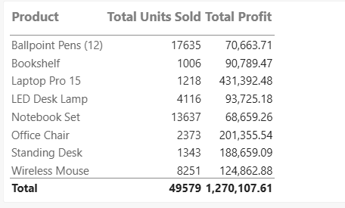
EVIDENCE — PART 2
The real concentration risk isn’t geographical
ONE-SENTENCE TAKEAWAY
Laptop Pro 15 alone drives 46% of total revenue, the top 2 product is 61%
Regions are balanced but products are not. If demand for laptop Pro 15 drops, no single region absorbs that shock evenly. Every region is simultaneously exposed since they all sell the same product.
4

Slide 5
RECOMMENDATION
Diversify by product , not by region
1
Keep regional strategy uniform
Performance and seasonal timing are consistent across all 5 regions , so region-specific interventions aren’t needed right now.
2
Reduce reliance on Laptop Pro 15
With 46% of revenue tied to one product consider promoting mid-tier products to spread risks.
5

