Slide 1
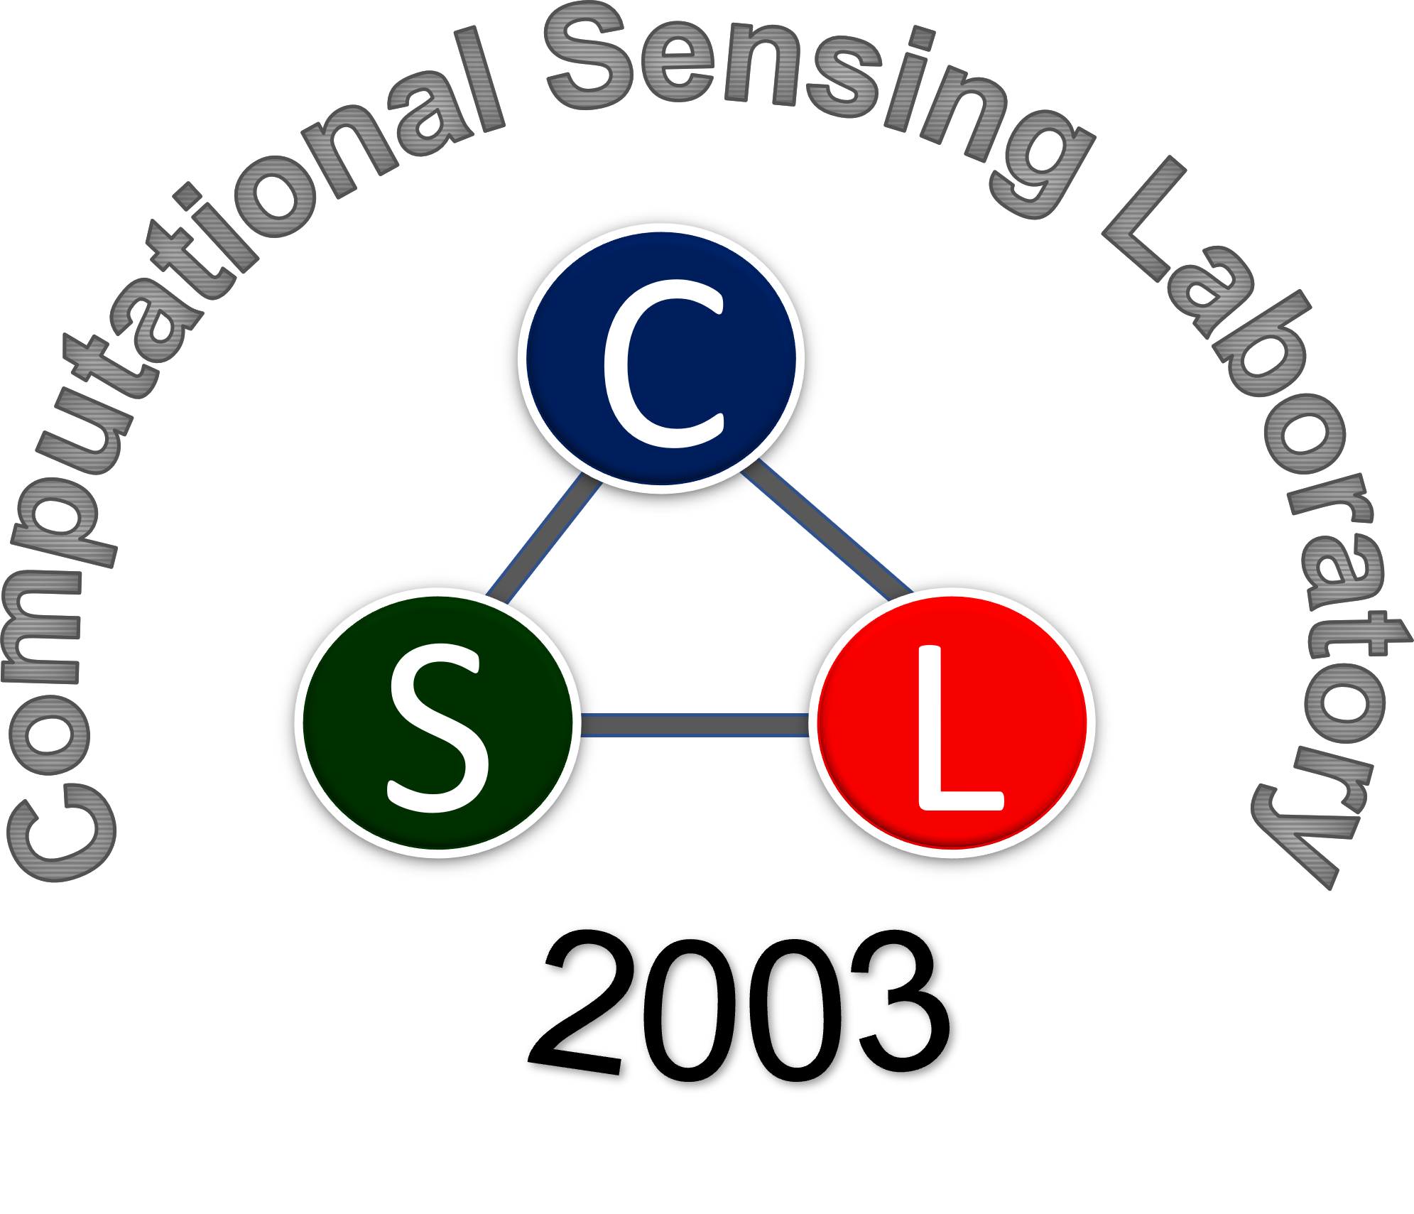

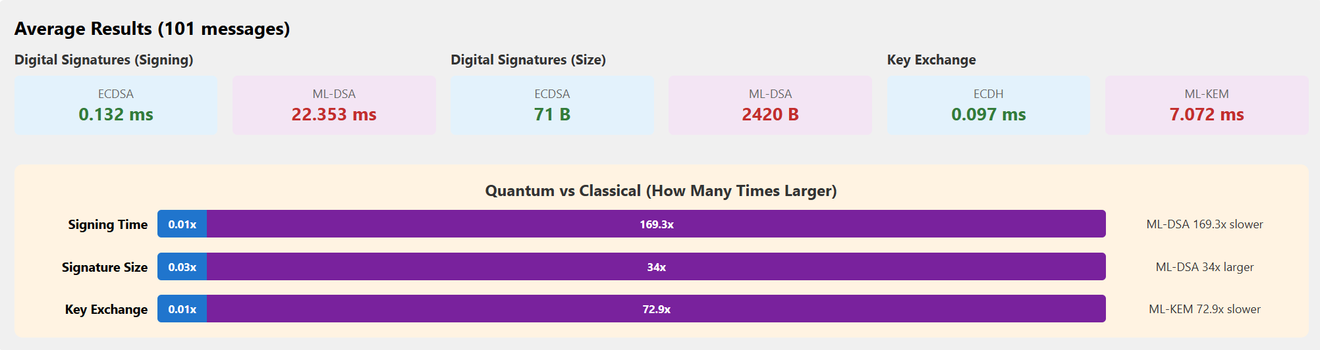
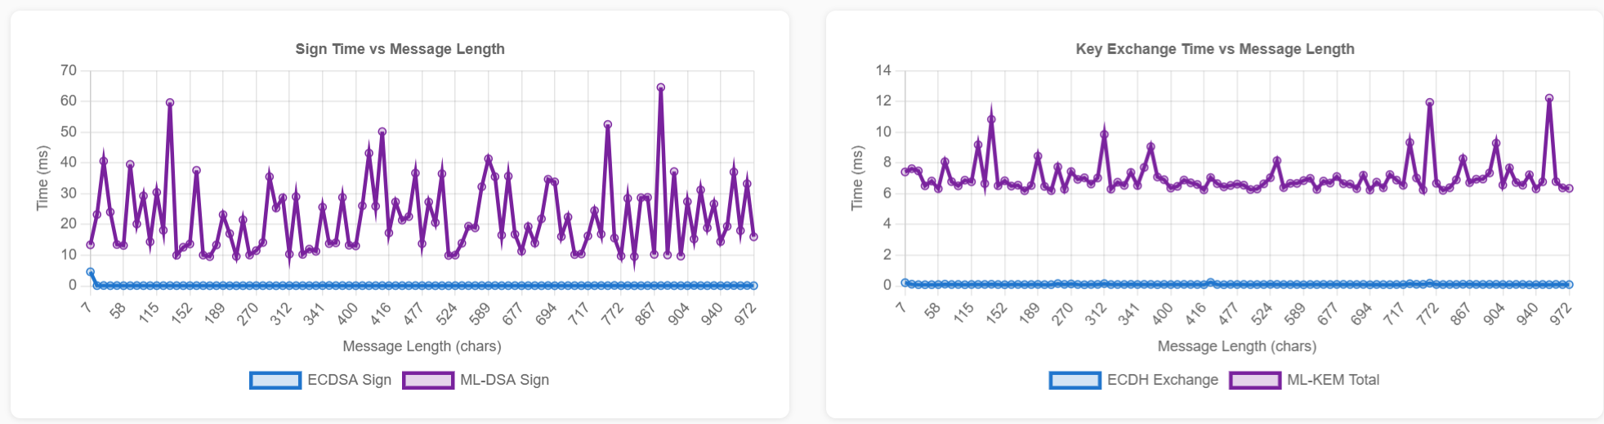
Classical vs. Post-Quantum Cryptography:
A Performance and Implementation Comparison
Allison Buckingham and Faith Puppala
School of Computing
Faculty Mentor: Stefan A. Robila
Acknowledgement
Project Developped as part of the CSIT 567/697: Course
Objective
Abstract
Research
The objective of our project was to show the performance differences between public key cryptography and post-quantum cryptography. Post-quantum cryptography by design takes a lot more computational resources and time as compared to classical cryptography.
Much of modern digital security relies on encryption algorithms that protect everything from online banking to interpersonal communication. Security relies heavily on key based cryptographic methods; with many based on number theory and concepts that rely on how difficult it is to complete a specific computation (such as factoring a large number). These approaches are vulnerable to future quantum computers, which could break them far faster than classical machines.
We implemented two classical algorithms (Elliptic Curve Digital Signature Algorithm (ECDSA) and Elliptic Curve Diffie-Hellman (ECDH) on the P-256 curve) alongside their post-quantum counterparts recently standardized by the National Institute of Standards and Technology
(NIST): ML-DSA-44 for digital signatures and ML-KEM-768 for secure key exchange. A Python-based web application allows interactive side-by-side comparison and the ability to upload a csv to upload a list of messages. Results are shown on a comparison page as raw data and as charts.
NIST (National Institute of Standards and Technology). We read the standards available for classical encryption. SP 800-56A for key agreement and SP 800-186 for approved curves.
NIST finalized FIPS 204 in August 2024, designating the Module-Lattice-Based Digital Signature Algorithm (ML-DSA) as the primary standard for quantum-resistant digital signatures.
Shor’s algorithm developed by Peter Shor in 1994 is the still the leader in being one of the only algorithms to use quantum computing in a way that classical computing cannot. It describes a mechanism by which quantum computers can find prime factors far more efficiently than their classical counterparts.
Results
References
Conclusion & Future Work
[1] A. Scrivano, “A Comparative Study of Classical and Post-Quantum Cryptographic Algorithms in the Era of Quantum Computing,” arXiv:2508.00832, 2025. [Online]. Available: https://arxiv.org/abs/2508.00832
[2] D. Goodin, “Google quantum-proofs HTTPS by squeezing 15kB of data into 700-byte space,” Ars Technica, Feb. 28, 2026. https://arstechnica.com/security/2026/02/google-is-using-clever-math-to-quantum-proof-https-certificates/
[3] Google, “Post-Quantum Cryptography: Standards and Progress,” Google Online Security Blog, Aug. 13, 2024. https://security.googleblog.com/2024/08/post-quantum-cryptography-standards.html
Post-quantum encryption takes about 40 times more resources than classical encryption. We encrypted only small messages but for large volumes of data, this will consume substantial resources. Google Chrome has already enabled ML-KEM (PQC) by default for TLS 1.3.
As PQC is deployed to the public, ways to improve the performance need to be found. Like many things, the main security threat is users who are frustrated that PQC is taking too long and turn it off, leaving them vulnerable.

