Slide 1
BINARY CLASSIFIER WITH LOGISTIC REGRESSION
FAITH NWOKOMA

Slide 2
Content
Task description
Model description
Evaluation methods
Result analysis

Slide 3
Task description
Given the features, various tests run on patients, determine if a patient is diabetic or not.
Adopted model – Logistic regression
Logistic regression : Widely used in medical field, logistic regression is a good statistical prediction model used to determine the probability of occurrence of an event as either pass or fail, win/lose, alive/dead, healthy/sick and so on.

Slide 4
Attributes
1. Number of times pregnant = pregnant
2. Plasma glucose concentration, a 2 hours in an oral glucose tolerance test = plasma_glucose
3. Diastolic blood pressure (mm Hg) = DBP
4. Triceps skin fold thickness (mm) = skin_thickness
5. 2-Hour serum insulin (mu U/ml) = insulin
6. Body mass index (weight in kg/(height in m)^2) = BMI
7. Diabetes pedigree function = diabetes_function
8. Age (years) = age

Slide 5
Class (Label)
Class (Label)
9. Class variable (0 or 1) = Target
Source
https://gist.github.com/ktisha/c21e73a1bd1700294ef790c56c8aec1f

Slide 6
Model Description
Step 1. Download data, convert into csv, take a look at the data.
Step 2. The editor is prepared, libraries are imported, and features are separated from label
Step 3. Split the data into training and testing sets.
Step 4. The training and testing set are cleaned up, replacing missing values (zeros) with mean values to get D1 and D2 respectively.
Step 5. Feature selection is conducted on D1, with 5 feature selection, to obtain D3.
Step 6. I fit D2 also to 5 feature selection for D3 testing, hence D4.

Slide 7
Model Description
Step 7. Prediction is performed on D4 with D3 model
Step 8. Training is also performed on D1. The dataset here has 8 features
Step 9. Prediction is performed on D2 with model trained with D1. The dataset here has 8 features
Step 10. To take my comparison further, Training is also performed on x_train. This the raw data with missing values as 0s
Step 11. Prediction is performed on x_test with model trained with x_train. This the raw data with missing values as 0s.

Slide 8
Evaluation Method
Precision - Precision is the ratio of correctly predicted positive observations to the total predicted positive observations. Of all persons tested and that are labeled as diabetic, how many are actually diabetic?
Precision = TP/TP+FP
Recall (Sensitivity) - Recall gives the ratio of correctly predicted positive observations to the all observations in actual class - Target. Of all the persons that really have diabetes, how many did I label?
Recall = TP/TP+FN

Slide 9
Evaluation Method
F-score – F-Score is the weighted average of Precision and Recall. As such, this takes both false positives and false negatives into account. F-score is usually more useful than accuracy, especially if you have a distribution of uneven class.
F-Score = 2*(Recall * Precision) / (Recall + Precision)

Slide 10
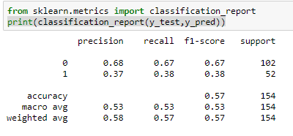
Result Analysis
1st Evaluation: Prediction evaluation on D4 using D3 model

Slide 11
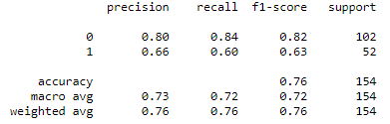
Result Analysis
2nd Evaluation: Prediction evaluation on D2 using D1 model

Slide 12
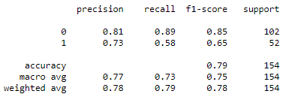
Result Analysis
3rd Evaluation: Prediction evaluation on x_test using x_train model

Slide 13
Result Analysis
From the tables above, you could see that the performance of the model is better with more features as can be seen between table two that has 8 features compared to table one with 5 selected features. Table three has the best scores. I think this is coming from the fact that zero values that were replaced with mean value probably may have degraded the result being that this is a sensitive classification that has to take a binary decision. Being that this is a medical report, data preprocessing is to be performed with expert judgement.

Slide 14
Reference
https://machinelearningmastery.com/feature-selection-machine-learning-python/
https://github.com/microsoft/LightGBM/blob/master/examples/python-guide/advanced_example.py
https://github.com/bhattbhavesh91/GA_Sessions/blob/master/ga_dsmp_5jan2019/16_feature_selection.ipynb
https://stackoverflow.com/questions/32011359/convert-categorical-data-in-pandas-dataframe/32011969
https://stackoverflow.com/questions/11285613/selecting-multiple-columns-in-a-pandas-dataframe
https://blog.exsilio.com/all/accuracy-precision-recall-f1-score-interpretation-of-performance-measures/

Slide 15
Thank You
Questions

