Slide 1
10alytics
Threat Intelligence Capstone Project
Harmony Health Threat Investigation
Part A: four phishing investigations | Part B: Wazuh detection of malware, suspicious binaries and Shellshock
Faith Ejele
SOC Analyst | 10alytics, 2026
Notes:
Introduce yourself and the project: a SOC investigation of four suspected phishing emails (Part A) and a Wazuh lab on three detections (Part B). Seven cases in total.

Slide 2
Objectives and scope
A
Part A: phishing
B
Part B: Wazuh detection
4 emails: Microsoft, supplier invoice, DHL, Bank of America
Headers, authentication, content, attachments
IOC extraction and enrichment
3 detections: malware samples (YARA and FIM), trojaned binary, Shellshock
Monitoring prepared and verified
Lab restoration
7
cases
157
lab screenshots
0
confirmed compromises
Notes:
Seven cases. Part A is static desk-based analysis of four emails (14-18 April 2026). Part B is the Wazuh lab of 24 October 2026. 157 lab screenshots support the findings. Nothing was executed.

Slide 3
Headline verdict
Case | Subject | Priority | Verdict
TIC-PH-E2 | Supplier invoice fraud, $47,250 | CRITICAL | Confirm no payment was made
TIC-PH-E5 | Bank of America phishing | HIGH | Recipient interaction unknown
TIC-PH-E1 | Microsoft account phishing | HIGH | Check sign-in logs
TIC-PH-E4 | DHL fee phishing with ZIP | MED-HIGH | ZIP looks like a stub
TIC-WZ-01 | Malware samples and YARA | LAB | FIM verified; YARA match not shown
TIC-WZ-02 | Trojaned /usr/bin/w | LAB | Rootcheck rule 510 fired
TIC-WZ-03 | Shellshock pattern | LAB | Rule 31168, level 15; attempt only
No compromise, payment loss or malware execution is confirmed in any case.
Notes:
All four emails are very likely phishing or fraud. Wazuh detected two of three threats end to end; YARA is configured but its scan result is not in the screenshots. Priority order starts with the invoice fraud because of the USD $47,250 exposure.

Slide 4
Lab preparation and restoration
Prepare
Simulate
Detect
Restore
Prepared and shown
Restoration (recommended)
YARA 4.5.5 built, 16 of 16 tests passed
Real-time FIM on /tmp/yara/malware
Rules 100300, 100301, 108000 and yara_decoder
Active response, rootcheck and Apache2
Restore /usr/bin/w from w.copy; delete the marker file
Remove samples after recording hashes
Disable Apache and sshd; revert VM snapshots
Export alerts before cleanup
Not shown in the screenshots
Notes:
Part B preparation is shown step by step in the screenshots: YARA 4.5.5 built and tested, real-time FIM, custom rules and decoders, active response, rootcheck and Apache. No restoration appears in the screenshots, so the restoration checklist is recommended, not evidenced.

Slide 5
How each email was investigated
1
2
3
Headers and identity
Received chain
SPF, DKIM, DMARC
4
5
6
Content and lure
Attachment decode
IOC enrichment
Static analysis only: nothing was executed.
Notes:
The same six steps were applied to every email. Headers can be forged, so values are recorded as reported; reputation screenshots show a past lookup, about six months after the emails.

Slide 6
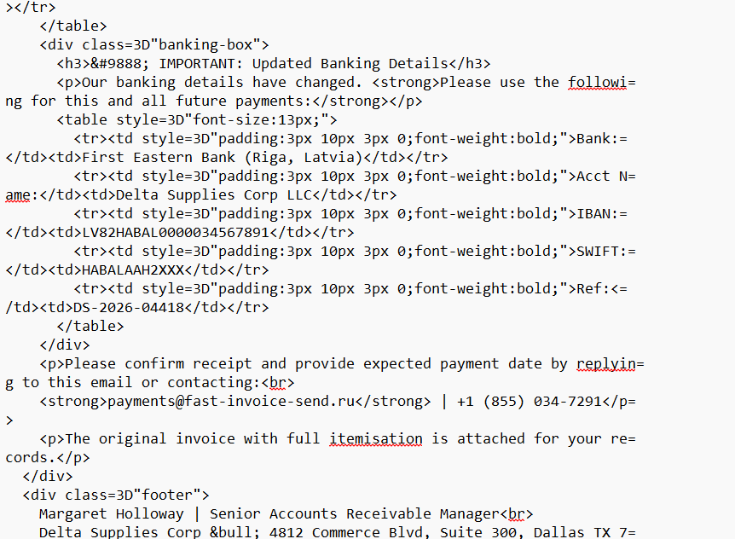
Case 1: invoice fraud (Email 2), CRITICAL
$47,250
requested by 22 April 2026 to a new Latvian account
Reply-To is fast-invoice-send[.]ru, not the supplier
IBAN, BIC and phone fail format checks
SPF, DKIM, DMARC failed; DKIM is a placeholder
First action: confirm no payment was made
Figure E2-18. Updated banking details box in the email
Notes:
Email 2 impersonates Delta Supplies Corp and asks the CFO for USD $47,250 by 22 April to a new Riga account. The IBAN is 22 characters (Latvian IBANs are 21) and fails the checksum, the BIC is 12 characters, the phone exchange begins with 0. Payment, reply and compromise are not confirmed. First action: confirm with finance and the bank that nothing was paid.

Slide 7
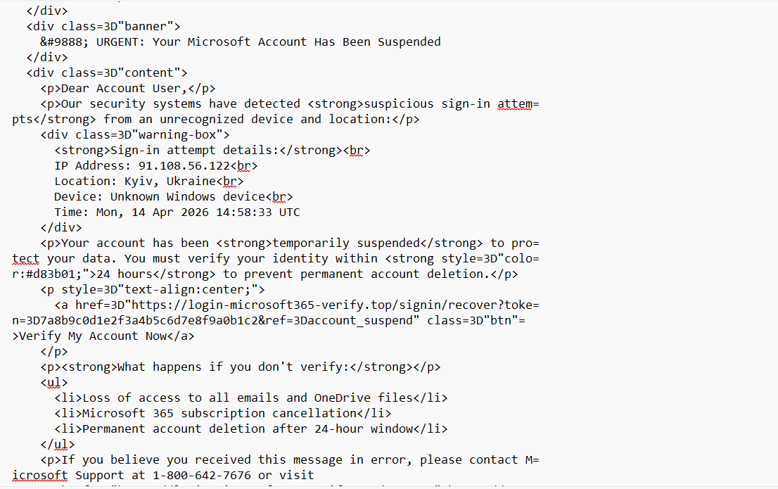
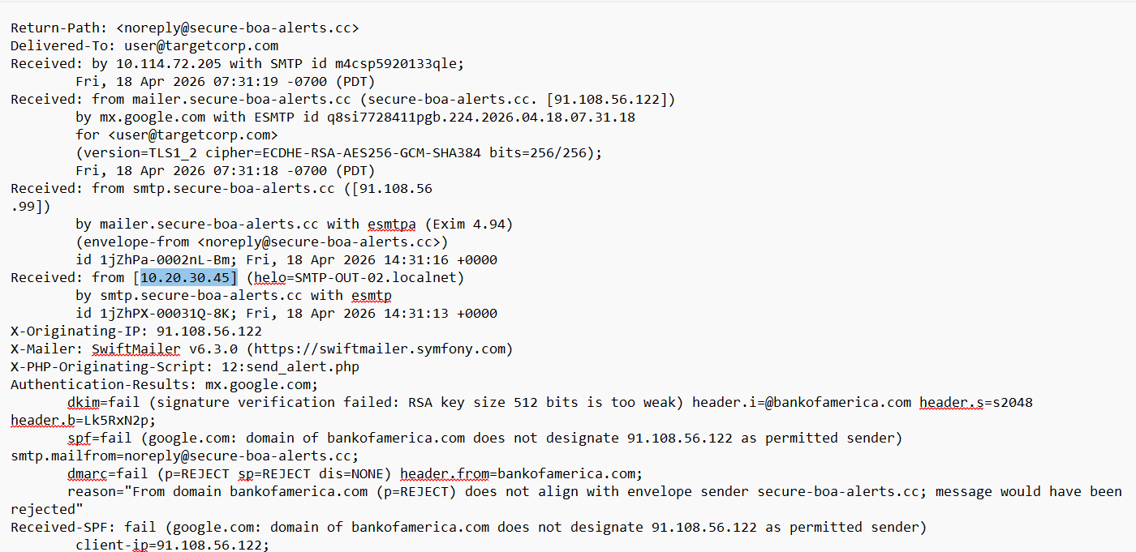
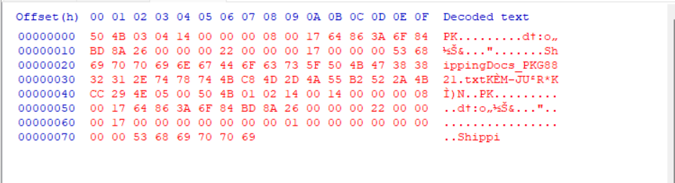
Cases 2 to 4: Emails 5, 1 and 4
Email 5: Bank of America
Email 1: Microsoft
Email 4: DHL
HIGH
HIGH
MED-HIGH
Reset link on secure-boa-alerts[.]cc
Link on login-microsoft365-verify[.]top
$2.99 fee; ZIP of about 160 bytes
Figure E5-04
Figure E1-21
Figure E4-12
Notes:
Each email impersonates a brand from unrelated infrastructure with failed authentication and a placeholder DKIM signature. Email 5: Bank of America, reset within 12 hours. Email 1: Microsoft, 24 hours to verify. Email 4: DHL, $2.99 fee and a ZIP. None is shown to have succeeded.

Slide 8
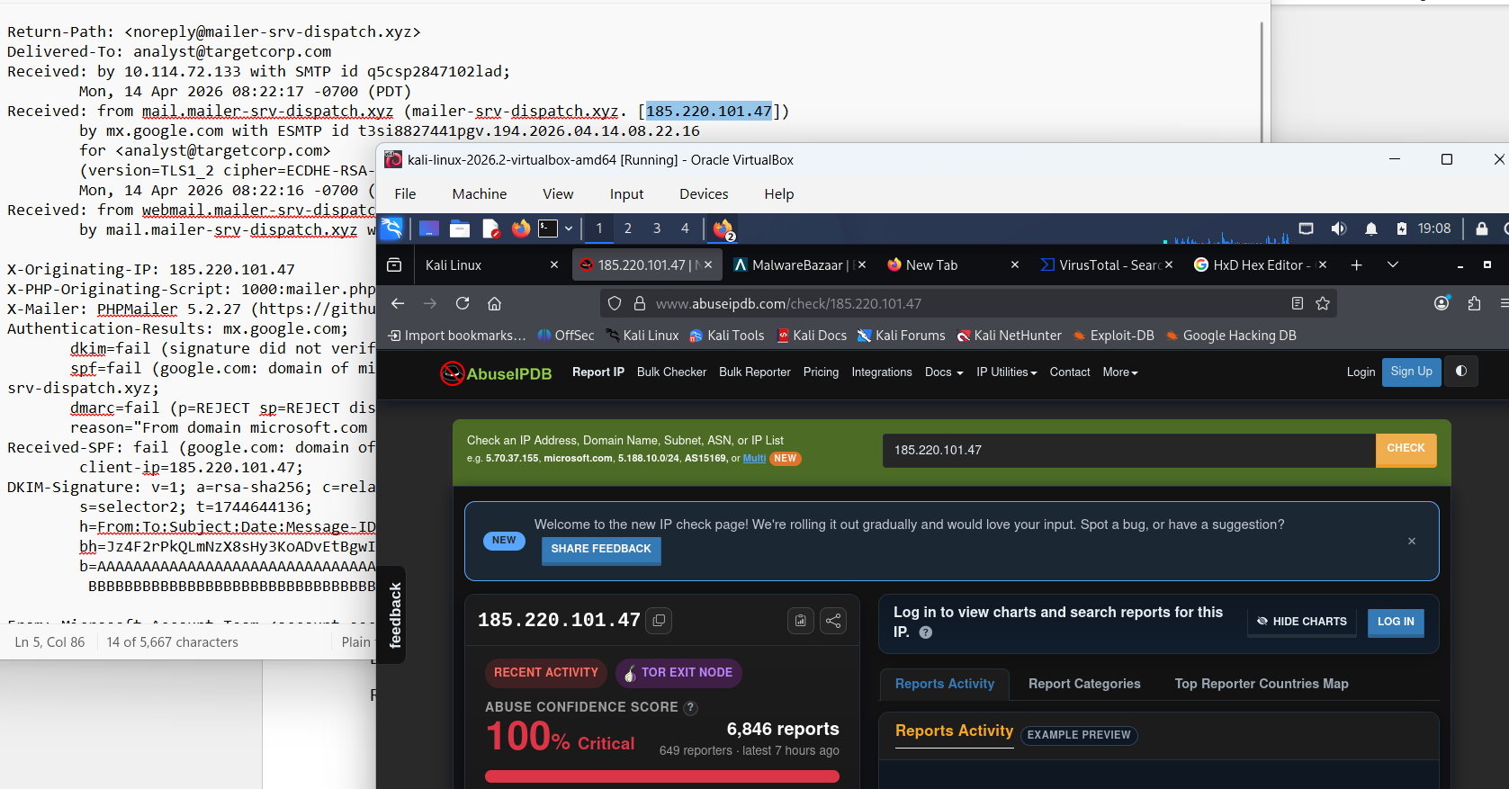
IOC extraction and enrichment
Type | Count | Example
Domains | 7 | fast-invoice-send[.]ru
Public IPs | 9 | 185.220.101.47
URLs | 3 | hxxps://secure-boa-alerts[.]cc/…
Files | 4 | ShippingDocs_1928374650.zip
185.220.101.47: Tor exit, 100%, 6,846 reports
Flyservers and NUBES IPs: 0% on old reports
No hashes: originals not supplied
Figure E1-01. AbuseIPDB lookup, 185.220.101.47
Notes:
Indicators were extracted from headers, bodies, links and attachment names, all defanged. Lookups were about 16 to 17 October 2026, six months after the emails. A 0 percent AbuseIPDB score on old reports does not clear an IP, and no domain reputation was supplied for any attacker domain.

Slide 9
Cross-case links
Email 1
Microsoft
185.220.101.47: sender in E1, "attacker login" in E5
Email 5
Bank of America
91.108.56.122: "sign-in" in E1, sender in E5
Same /24 receiving relays (10.114.72.133, .201, .205)
Placeholder DKIM values and the same one-year timestamp shift
Stub PNG attachments with a "gnome-screenshot" chunk
Five-day window: one campaign or one data set
Notes:
Emails 1 and 5 use the same two IP addresses in opposite roles. All four emails reached relays in 10.114.72.0/24 within five days and share a one-year timestamp shift and placeholder DKIM values. This suggests one actor, one template or a constructed data set.

Slide 10
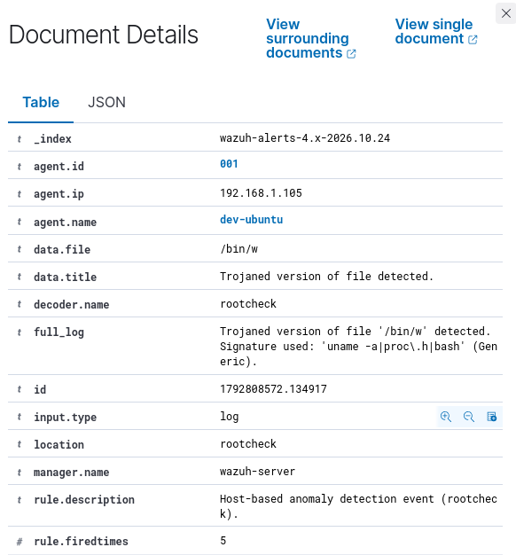
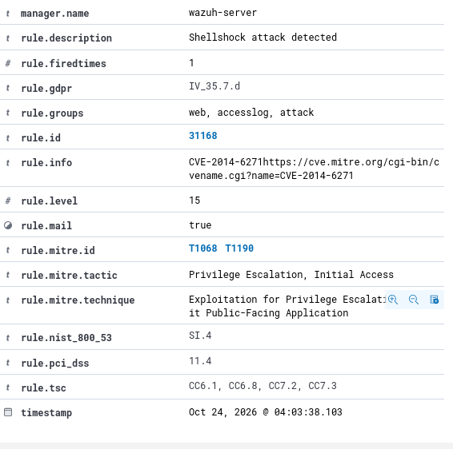
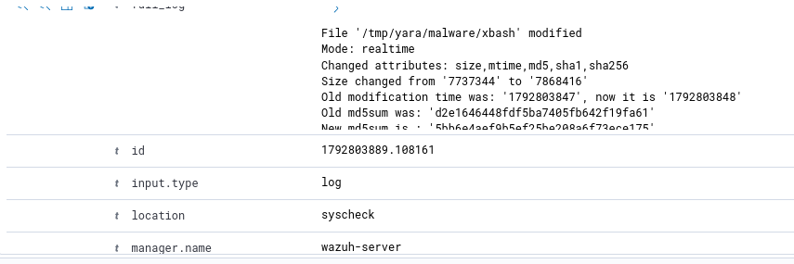
Wazuh detections (Part B)
Malware samples (FIM)
Trojaned binary
Shellshock
PARTIAL
VERIFIED
VERIFIED
Rule 100300, xbash grew to 9.5 MB
Rule 510: /bin/w trojaned
Rule 31168, level 15; attempt only
Figure PB-51
Figure PB-62
Figure PB-80
Notes:
Three detections on agent 001. File integrity monitoring raised rules 100300 and 100301 on the xbash sample with a consistent hash chain. Rootcheck rule 510 flagged the replaced /usr/bin/w from 03:20:34 WAT. Rule 31168 flagged the Shellshock User-Agent at level 15, but the server returned the stock Apache page. The YARA scan result is not shown.

Slide 11
Response and escalation
Action | Escalate to | When
Confirm whether the Email 2 invoice was paid | Finance director, bank fraud desk | Immediately
Check clicks, credentials and sign-ins; block domains and IPs | Identity admin, incident response | Same day
Get originals; redo SPF, DKIM, DMARC; hash attachments | Mail admin, threat intel lead | This week
Show the YARA match; restore /usr/bin/w; test Shellshock | Detection engineering | This week
DMARC, call-back for bank changes, MFA, training | Security and finance leads | Longer term
Notes:
Start with the Email 2 payment position, then recipient exposure for Emails 5, 1 and 4, then block indicators. Part B actions close the monitoring gaps: show the wazuh-yara event, restore the binary, add syscheck hashes and test Shellshock with a CGI script.

Slide 12
Conclusion and gaps
Four deliberate social-engineering attempts; none shown to have succeeded
Wazuh detected file changes, a trojaned binary and a Shellshock string
First step: confirm the Email 2 payment position
Gaps to close
Original .eml files and attachments | domain reputation | user interaction records | YARA scan result | lab restoration
Faith Ejele, SOC Analyst | 10alytics, 2026
Notes:
Close with the conclusion and the gaps. Offer the full 100-page report and the 5-page summary for detail.

