Slide 1

FAITH CATHERINE OTIENO C026-01-0306/2018 SUPERVISER: Madam MOSO A SYSTEM TO SHORTLIST CANDIDATES USING NATURAL LANGUAGE PROCESSING

Slide 2

BACKGROUND
Many companies have seen an increase in applications as more people are getting opportunities to learn.
HR departments may have a difficult time in scanning through resumes.
There is a need to find more efficient ways to handle the recruiting process.

Slide 3

PROBLEM STATEMENT
Companies spend too much time in reading through resumes and matching candidates that will fit the companies requirement. This system aims to solve the shortlisting part of the recruiting process using Natural Language processing and semantic matching.

Slide 4

Objectives
Main Objective
To develop a Natural Language Processing system that evaluates applications and shortlist candidates for a job.
Specific Objectives
To investigate the challenges faced by recruiters when processing job applications
To develop a model that will optimize job applications evaluation process.
To test and evaluate the proposed model.

Slide 5

Justification
This system will help recruiters save time and resources.
The system will help in identifying candidates that much a companies needs.
The system will be more efficient therefore providing better results.

Slide 6

Scope
This model will be trained to handle majorly Technical and some business skills. It will therefore be viable within the boundaries of Technical companies.

Slide 7

Literature Review
The listed below are models assisting in the recruiting process:
Ideal’s Virtual Assistant
Avrio ai Inc.
Entelo.
Myas System.
These systems assist in talent
Sourcing, recruiting or candidate
Screening and engagement.

Slide 8

The short listing model aims to use Natural language processing and semantic matching to read through resumes and compare the company’s requirements with the candidates qualification

Slide 9
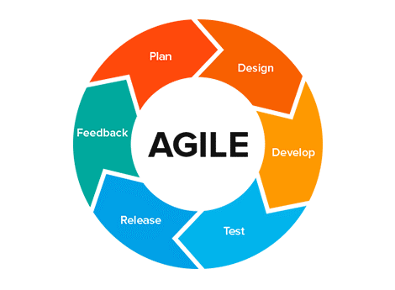
Methodology
The approach set to be used in the system development methodology is the Agile Design.
This method encourages flexible responses to change and allows for both development and testing activities to be done concurrently
Planning
Design
Develop
Test
Release
Feedback

Slide 10

Thank You

