Slide 1
Exploring the IMDB Movie Dataset
A Preliminary Analysis of Genre, Popularity, and Rating (2010-2019)
Part 2: Exploratory Analysis with SQL

Slide 2
Initial Exploration Findings
1
146,000+ movies in scope
Filtered to films released between 2010 and 2019, joined against ratings data (73,000+ titles with a rating).
2
Documentary is the highest-rated genre
Average rating of ~7.3, but the smallest average audience of any major genre (~267 votes per title).
3
Action & Sci-Fi draw the biggest audiences
Averaging 14,000+ and 19,000+ votes per title respectively, but with only middling average ratings (~5.5-5.8).
4
Drama and Comedy dominate by volume
Together they account for roughly 48,000 genre-tagged titles, far more than any other category.

Slide 3
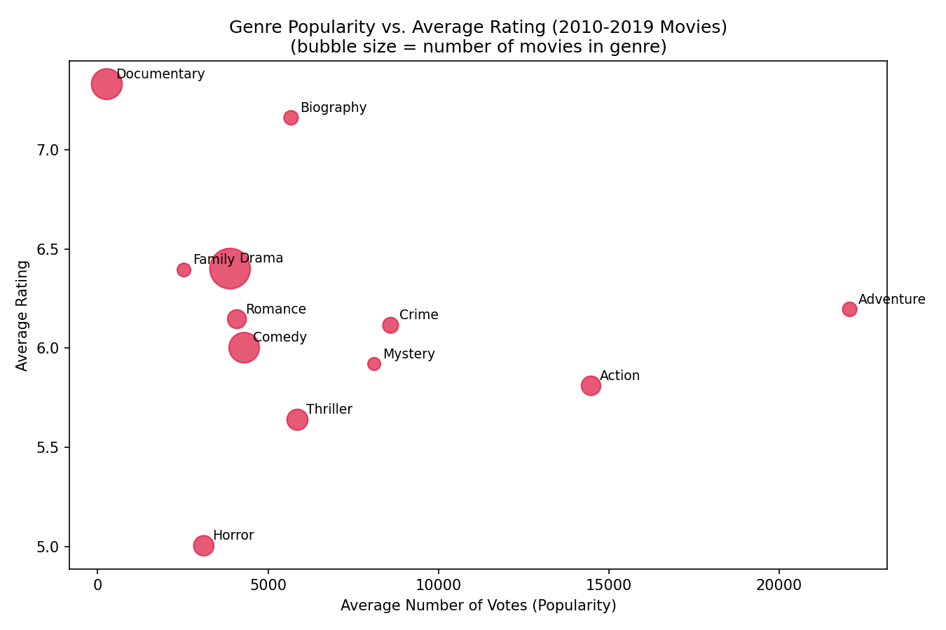
Business Question: Does Popularity Trade Off Against Rating?
For genres with the largest audiences, does critical reception (average rating) tend to be lower? If so, should marketing and content investment decisions differ for “broad reach” vs. “high regard” genres?
What the chart shows
Documentary sits high on rating, low on votes.
Action & Sci-Fi sit high on votes, lower on rating.
Drama/Comedy sit in the middle on both axes.
Bubble size = number of movies in that genre.

Slide 4
Data Cleaning Tasks Identified
Out-of-range years
Multi-value genre field
start_year includes values far outside 2010-2019 (one entry as late as 2115) — must be filtered before analysis.
genres packs several categories into one comma-separated string, requiring a split/explode step before any genre-level grouping.
Implausible runtimes
Missing genres
runtime_minutes contains outliers in the tens of thousands of minutes; not realistic for a feature film and likely a data-entry error.
A subset of titles have a null genres field; excluded from genre-based exploration rather than imputed.
Missing runtimes
A large share of runtime_minutes values are null; excluded rather than filled in for runtime-based analysis.

