Slide 1
Python Course
Databases

Slide 2
Relational Databases
Relational databases model data by storing rows and columns in tables. The power of the relational database lies in its ability to efficiently retrieve data from those tables and in particular where there are multiple tables and the relationships between those tables involved in the query.

Slide 3
Terminolgy
Database - Contains many tables
Relation (or table) - contains tuples and attributes
Tuple (or row) - is a set of fields it generally represents an “object” like a person or a music track
Attribute (also column or field) - One of possibly many elements of data corresponding to the object represented by the row

Slide 4
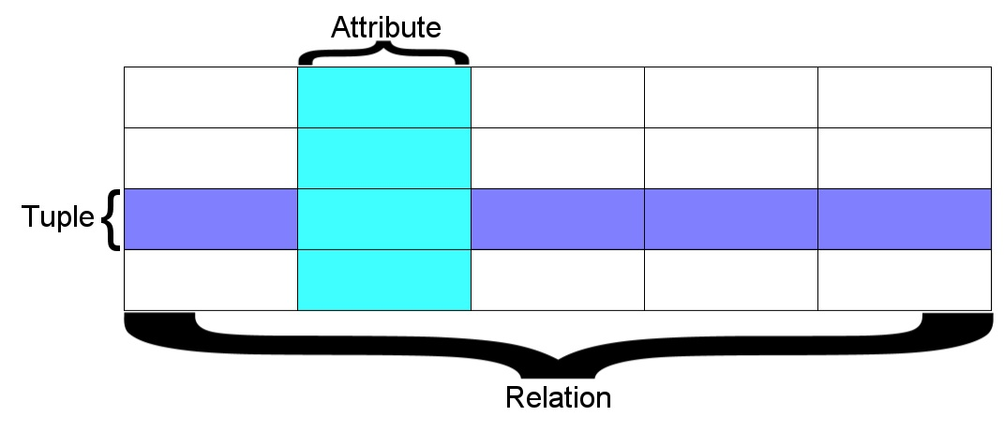
A relation is defined as a set of tuples that have the same attributes. A tuple usually represents an object and information about that object. Objects are typically physical objects or concepts. A relation is usually described as a table, which is organized into rows and columns. All the data referenced by an attribute are in the same domain and conform to the same constraints.

Slide 5
Two roles in large projects
Application Developer - Builds the logic for the application, the look and feel of the application - monitors the application for problems
Database Administrator - Monitors and adjusts the database as the program runs in production
Often both people participate in the building of the “Data model”

Slide 6

Application Structure
Application
Software
Database
Data Model
End
User
SQL
SQL
Developer
Database
Tools
DBA

Slide 7
Database Administrator (dba)
A database administrator (DBA) is a person responsible for the design, implementation, maintenance and repair of an organization's database. The role includes the development and design of database strategies, monitoring and improving database performance and capacity, and planning for future expansion requirements. They may also plan, co-ordinate and implement security measures to safeguard the database.

Slide 8
Database Model
A database model or database schema is the structure or format of a database, described in a formal language supported by the database management system, In other words, a "database model" is the application of a data model when used in conjunction with a database management system.

Slide 9
SQL
Structured Query Language is the language we use to issue commands to the database
Create a table
Retrieve some data
Insert data
Delete data

Slide 10
Common Database Systems
Three Major Database Management Systems in wide use
  Oracle - Large, commercial, enterprise-scale, very very tweakable
  MySql - Simpler but very fast and scalable - commercial open source
  SqlServer - Very nice - from Microsoft (also Access)
Many other smaller projects, free and open source
  HSQL, SQLite, Postgress, ...

Slide 11
SQLite Database Browser
SQLite is a very popular database - it is free and fast and small
We have a program to manipulate SQLite databases
  http://sqlitebrowser.sourceforge.net/
SQLite is embedded in Python and a number of other languages

Slide 12
SQLite from python
>>> import sqlite3
>>> sqlite3.version
'2.6.0'
>>>

Slide 13
SQLite from python
import sqlite3 as lite
import sys
con = None
try:
con = lite.connect(‘my.db')
cur = con.cursor()
cur.execute('SELECT SQLITE_VERSION()')
data = cur.fetchone()
print "SQLite version: %s" % data
except lite.Error, e:
print "Error %s:" % e.args[0]
sys.exit(1)
finally:
if con:
con.close()

Slide 14
SQL
Structured Query Language is the language we use to issue commands to the database
  Create a table
  Retrieve some data
  Insert data
  Delete data

Slide 15
SQL create
CREATE TABLE My_table(
my_field1 INT,
my_field2 VARCHAR(50),
my_field3 DATE NOT NULL,
PRIMARY KEY (my_field1, my_field2)
);
import sqlite3 as lite
import sys
con = lite.connect('my.db')
with con:
cur = con.cursor()
cur.execute("CREATE TABLE Stars(Ra FLOAT, Dec FLOAT, ID TEXT, Mag FLOAT)")

Slide 16
SQL insert
import sqlite3 as lite
import sys
con = lite.connect('my.db')
with con:
cur = con.cursor()
cur.execute(“INSERT INTO Stars VALUES(010.684737,+41.269035,’00424433+4116085’,9.453)”)
cur.execute(“INSERT INTO Stars VALUES(010.683469,+41.268585,’00424403+4116069’,9.321)”)
cur.execute(“INSERT INTO Stars VALUES(010.685657,+41.269550,’00424455+4116103’,10.773)”)
cur.execute(“INSERT INTO Stars VALUES(010.686026,+41.269226,’00424464+4116092’,9.299)”)
cur.execute(“INSERT INTO Stars VALUES(010.683465,+41.269676,’00424403+4116108’,11.507)”)
cur.execute(“INSERT INTO Stars VALUES(010.686015,+41.269630,’00424464+4116106’,9.399)”)
cur.execute(“INSERT INTO Stars VALUES(010.685270,+41.267124,’00424446+4116016’,12.070)”)

Slide 17
SQL Select
import sqlite3 as lite
import sys
con = lite.connect(‘my.db')
with con:
cur = con.cursor()
cur.execute("SELECT * FROM Stars")
rows = cur.fetchall()
for row in rows:
print row
<sqlite3.Cursor object at 0x7ff500415650>
(u'10.684737', 41.269035, u'00424433+4116085', 9.453)
(u'10.683469', 41.268585, u'00424403+4116069', 9.321)
(u'10.685657', 41.26955, u'00424455+4116103', 10.773)
(u'10.686026', 41.269226, u'00424464+4116092', 9.299)
(u'10.683465', 41.269676, u'00424403+4116108', 11.507)
(u'10.686015', 41.26963, u'00424464+4116106', 9.399)
(u'10.68527', 41.267124, u'00424446+4116016', 12.07)

Slide 18
SLQ Select where
The select statement retrieves a group of records - you can either retrieve all the records or a subset of the records with a WHERE clause
select * from Stars
select * from Stars where ID=‘00424403+4116108’
You can add an ORDER BY clause to SELECT statements to get the results sorted in ascending or descending order
select * from Stars order by Mag
select * from Stars order by Ra DESC

Slide 19
SQL Update. Delete
Update:
  update Stars set ID=‘bogus’ where Mag=10.7
Delete:
  Delete from Stare where Mag=10.7

Slide 20
SQL Select
>>> import sqlite3 as lite
>>> import sys
>>>
>>> con = lite.connect('my.db')
>>>
>>> with con:
... cur = con.cursor()
... cur.execute("SELECT * FROM Publication")
... rows = cur.fetchall()
... for row in rows:
... print row
...
<sqlite3.Cursor object at 0x7fadfa86c650>
(1, 10, 22, ‘Deul,Mulish’)
(2, 11, 25, ‘Deen,Carmen’)
>>>

Slide 21
SQL Select
>>> import sqlite3 as lite
>>> import sys
>>>
>>> con = lite.connect('my.db')
>>>
>>> with con:
... cur = con.cursor()
... cur.execute("SELECT Authors FROM Publication WHERE Authors LIKE ‘%Deu%’")
... rows = cur.fetchall()
... for row in rows:
... print row
...
<sqlite3.Cursor object at 0x7fadfa86c650>
(u'Deul,Mulish',)
>>>

Slide 22
Introduction to language
End

