Slide 1
Supply Chain Risk & Fulfillment Review
Evidence-based findings, business impact and management actions
Dataset: 113,097 supply-chain records across supplier countries.
Overall analytical focus: supplier performance, lead-time risk, inventory effectiveness and risk classification.
Management question: where should limited risk-management attention be concentrated first?
Headline conclusion: High Risk should receive priority because it represents the largest exposure by volume, while fulfillment is slightly weaker than the other categories.
Source: supplied dynamic supply-chain logistics dataset; analysis by ChatGPT

Slide 2
Executive Summary
Supplier-country performance varies: the lowest observed average fulfillment is 0.581 (Switzerland), versus 0.620 (Oman).
Lead time is right-skewed (skewness 0.81); a smaller group of long-lead-time cases creates disproportionate delay exposure.
Inventory is not a strong driver of fulfillment in this dataset (correlation -0.005); simply holding more stock is unlikely to solve the problem.
High Risk accounts for 74.6% of records and has fulfillment of 0.599.
Priority: High Risk first, then target the specific suppliers/routes creating the long-tail lead-time and low-fulfillment exposure.
Source: supplied dynamic supply-chain logistics dataset; analysis by ChatGPT

Slide 3
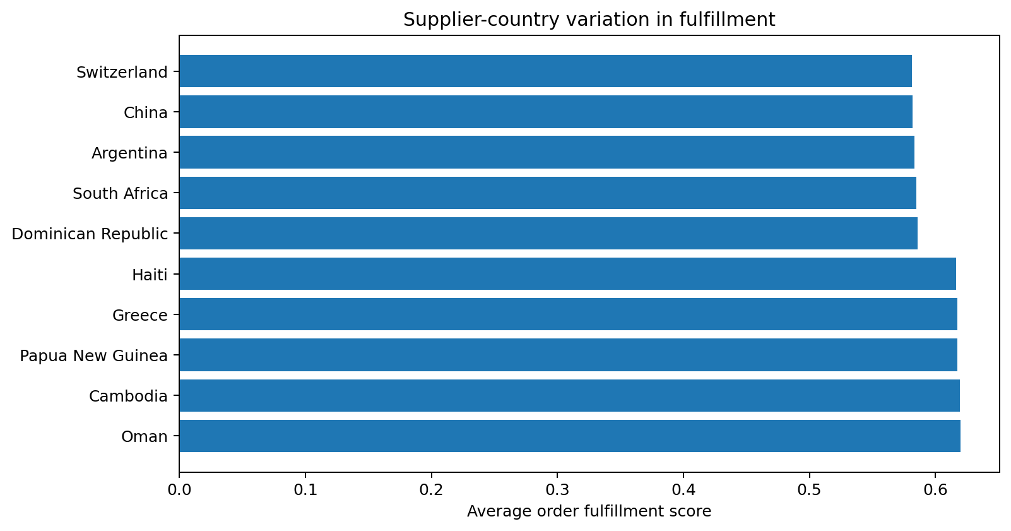
Finding 1 — Supplier Countries Show Meaningful Performance Differences
Evidence → business impact → practical action
EVIDENCE: Bottom performers include Switzerland (0.581) and China (0.582); top performers include Oman (0.620).
IMPACT: Country-level variation can signal differences in supplier execution, route reliability, customs exposure or operating conditions. This creates inconsistent service levels and customer experience.
ACTION: Introduce a supplier-country performance scorecard with quarterly review thresholds; investigate the bottom 10% and replicate practices from the top performers.
Business reasoning: management should focus on controllable supplier/route decisions rather than treating all countries as equally reliable.
Source: supplied dynamic supply-chain logistics dataset; analysis by ChatGPT

Slide 4
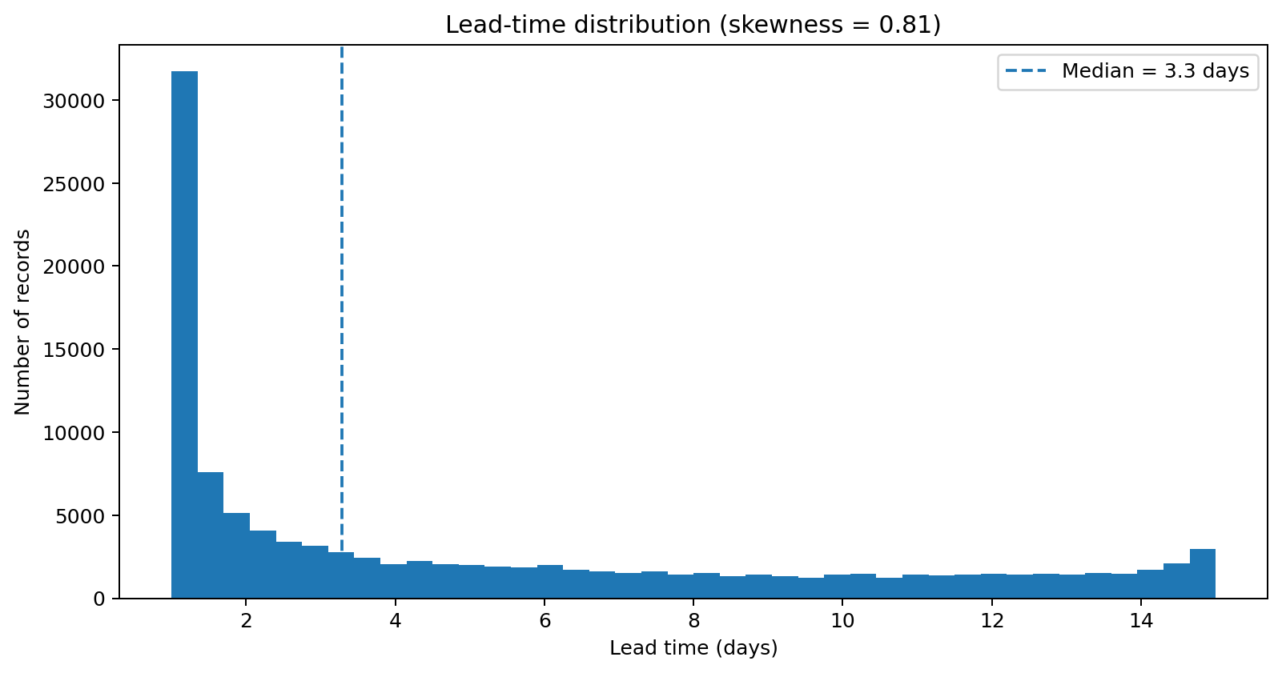
Finding 2 — Lead Time Is Skewed, Creating a Long-Tail Delay Risk
EVIDENCE: Lead-time skewness is 0.81; median is 3.3 days, while the 90th percentile is 12.9 days.
IMPACT: The average/typical shipment can look acceptable while a smaller set of very long shipments causes stockouts, missed customer commitments and expedited-freight costs.
ACTION: Create an exception-management rule for shipments above the 90th percentile; trigger early escalation, supplier contact and alternative routing.
Business reasoning: reducing the extreme delays can produce more operational benefit than trying to reduce every shipment's lead time by a small amount.
Source: supplied dynamic supply-chain logistics dataset; analysis by ChatGPT

Slide 5
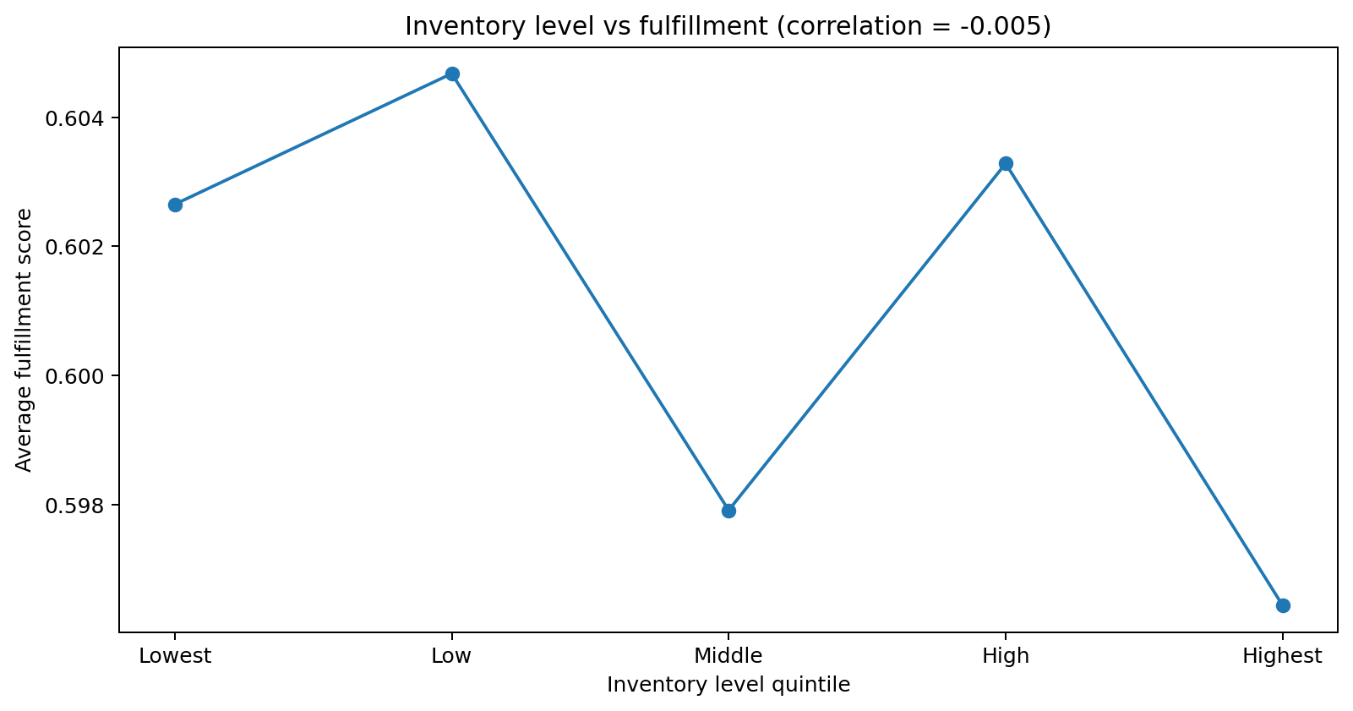
Finding 3 — Higher Inventory Does Not Clearly Improve Fulfillment
EVIDENCE: Inventory-to-fulfillment correlation is only -0.005. Fulfillment remains close to 0.60 across inventory quintiles.
IMPACT: Increasing inventory indiscriminately may tie up working capital without materially improving service. It can also increase storage, obsolescence and handling costs.
ACTION: Replace blanket inventory increases with SKU/location safety-stock rules based on demand variability, lead-time variability and service targets.
Business reasoning: inventory should be used as a targeted buffer against uncertainty, not as the default response to poor fulfillment.
Source: supplied dynamic supply-chain logistics dataset; analysis by ChatGPT

Slide 6
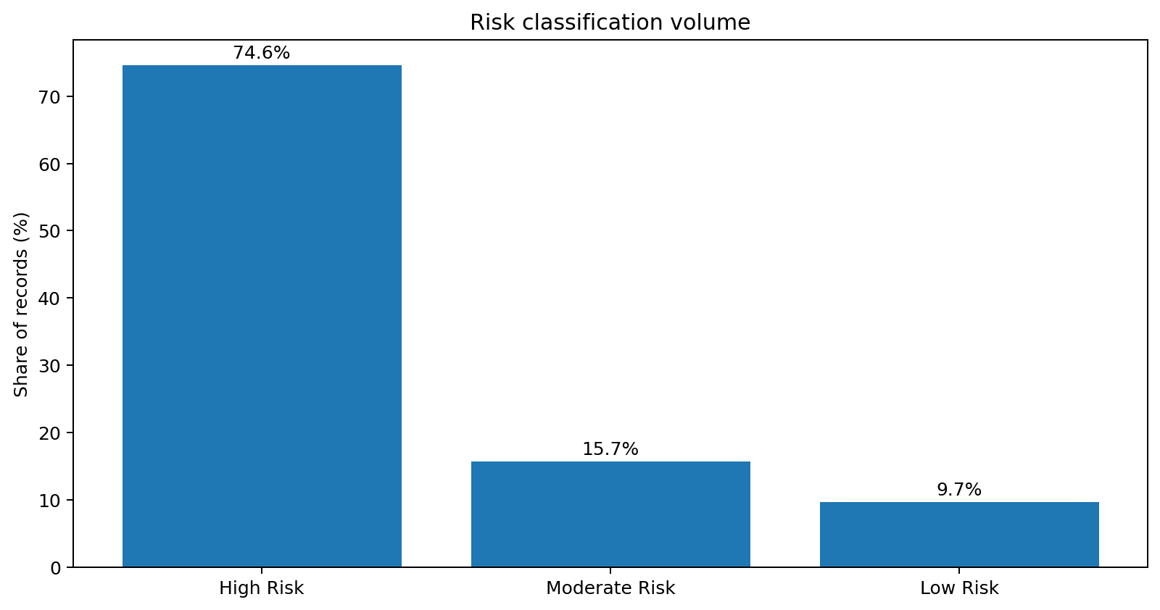
Finding 4 — Management Should Prioritize High Risk
EVIDENCE: High Risk represents 74.6% of all records (84,368). Its fulfillment score is 0.599, below Moderate Risk (0.611) and only slightly below Low Risk (0.601).
IMPACT: Even if the category gap is modest, the very large exposure means small improvements in High Risk cases can affect a much larger portion of the operation.
ACTION: Launch a High-Risk control program: weekly exception dashboard, named owners for critical suppliers/routes, and escalation for high delay/disruption cases.
Why this comes first: risk priority should combine severity with exposure. High Risk has the largest exposure, so management gets the greatest potential return from focused intervention.
Important nuance: do not assume every High Risk record is failing; use the category to prioritize investigation, then target the worst suppliers/routes within it.
Source: supplied dynamic supply-chain logistics dataset; analysis by ChatGPT

Slide 7
Recommended Management Action Plan
1. PRIORITIZE HIGH RISK — Build a weekly dashboard showing volume, fulfillment, delay probability, lead time and disruption exposure by supplier and route.
2. CONTROL THE LONG TAIL — Flag lead times above the 90th percentile for proactive escalation and recovery planning.
3. TARGET SUPPLIER/COUNTRY OUTLIERS — Review bottom-performing countries and suppliers; establish corrective-action plans with deadlines and owners.
4. OPTIMIZE INVENTORY — Avoid blanket stock increases; set safety stock using demand and lead-time variability.
5. MEASURE RESULTS — Track fulfillment improvement, late-order rate, average/90th-percentile lead time, expedite cost and working capital monthly.
Source: supplied dynamic supply-chain logistics dataset; analysis by ChatGPT

Slide 8
Conclusion & Management Message
The strongest management case is not simply 'increase inventory'. The data suggests inventory level has little relationship with fulfillment.
The more actionable risks are concentrated around high-risk exposure, supplier/country performance differences and the long tail of lead times.
Management should therefore prioritize High Risk, but use supplier- and route-level analysis to determine exactly where intervention will produce the highest return.
Data note: several operational fields are continuous scores rather than simple categories. Findings should be treated as directional evidence for prioritization and validated against operational records before major supplier or inventory decisions.
Source: supplied dynamic supply-chain logistics dataset; analysis by ChatGPT

