Slide 1
Samaritans
Analysis on Calls at Samaritans January, 2021
By Faith Ejele

Slide 2
Introduction
Samaritans is a unique charity organization dedicated to reducing feelings of Isolation and disconnection that can lead to suicide.
The Dataset contains information about contact calls made for Samaritans in January,2021.
Dataset consist of columns which include record of Branch, Region, Country, Method of Contract, Helpline name, Call Start Date, Call start time, Snap call, Call end date, Call end time, Contact duration, Caller Age, Caller Gender, Contact type.

Slide 3
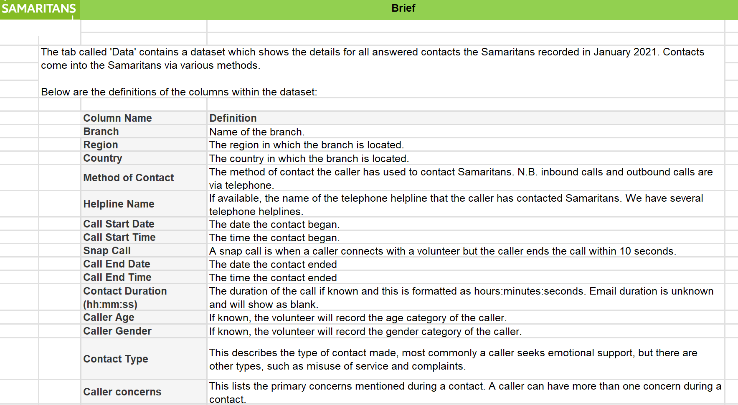

Slide 4
Caller Concern
Family; Isolation/loneliness; Mental health/illness; Physical health/illness; Relationship problems; Workplace/study;COVID-19
Bereaved by suicide
Violence/abuse; Workplace/study
Drug and/or alcohol misuse; Isolation/loneliness; Relationship problems
Gender; Isolation/loneliness; Mental health/illness; Relationship problems

Slide 5
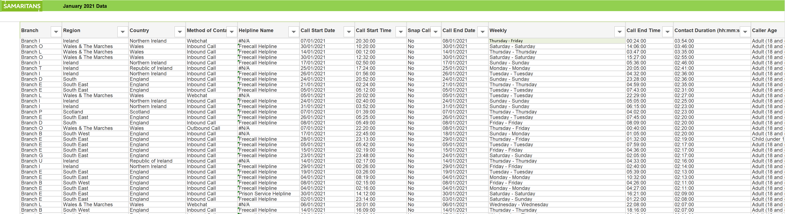

Slide 6
Total calls Male Vs Female

Slide 7
Region with highest caller concerns.

Slide 8
Total calls by Helpline name

Slide 9
Summary
Branch V responded to the most Inbound calls in January 2021.
The caller concerns calls was the highest in Ireland region while other region had reduced concerned calls.

Slide 10
Summary Contd.
There was a great increase of “emails” followed by the inbound calls. The outbound and webchat (online) had low contact calls.
The Male had more online contact calls (63%) and Female (37%)
More cases of concerned calls was linked to Adult(18 and over) than Child(under 18).

Slide 11
Chart on Summary

Slide 12
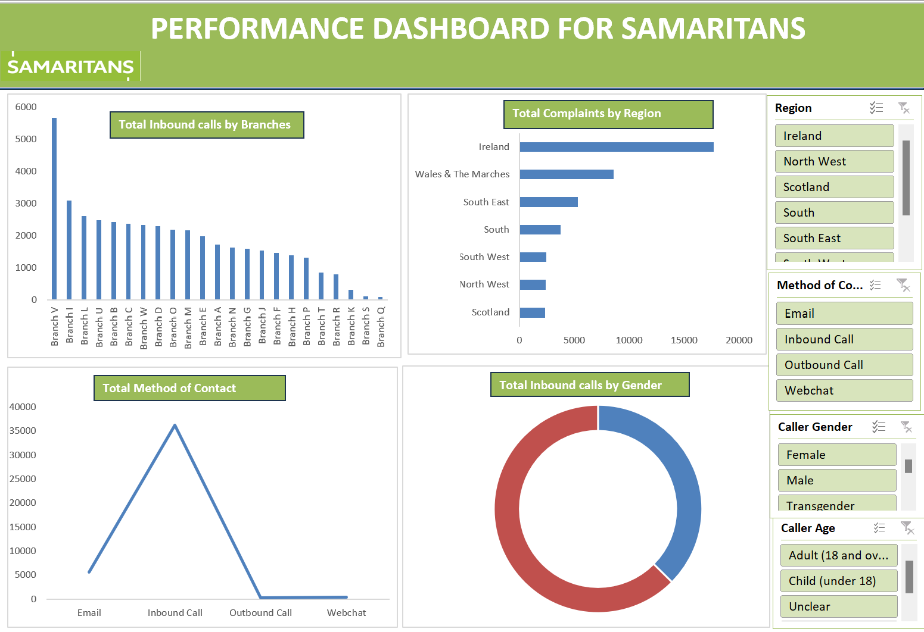

Slide 13
Thank you

