Slide 1
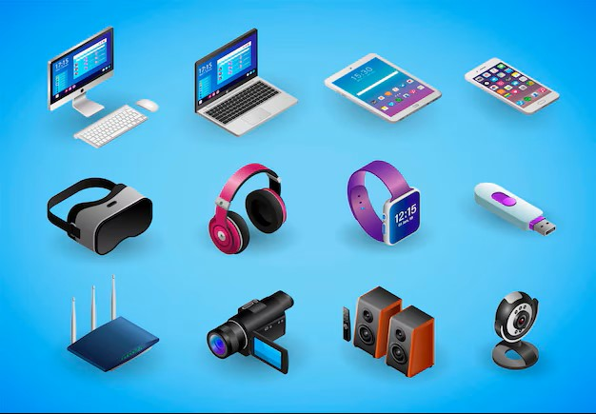
AFRITECH ELECTRONICS LTD

Slide 2
Enhancing Brand Reputation-Social Media monitoring

Slide 3
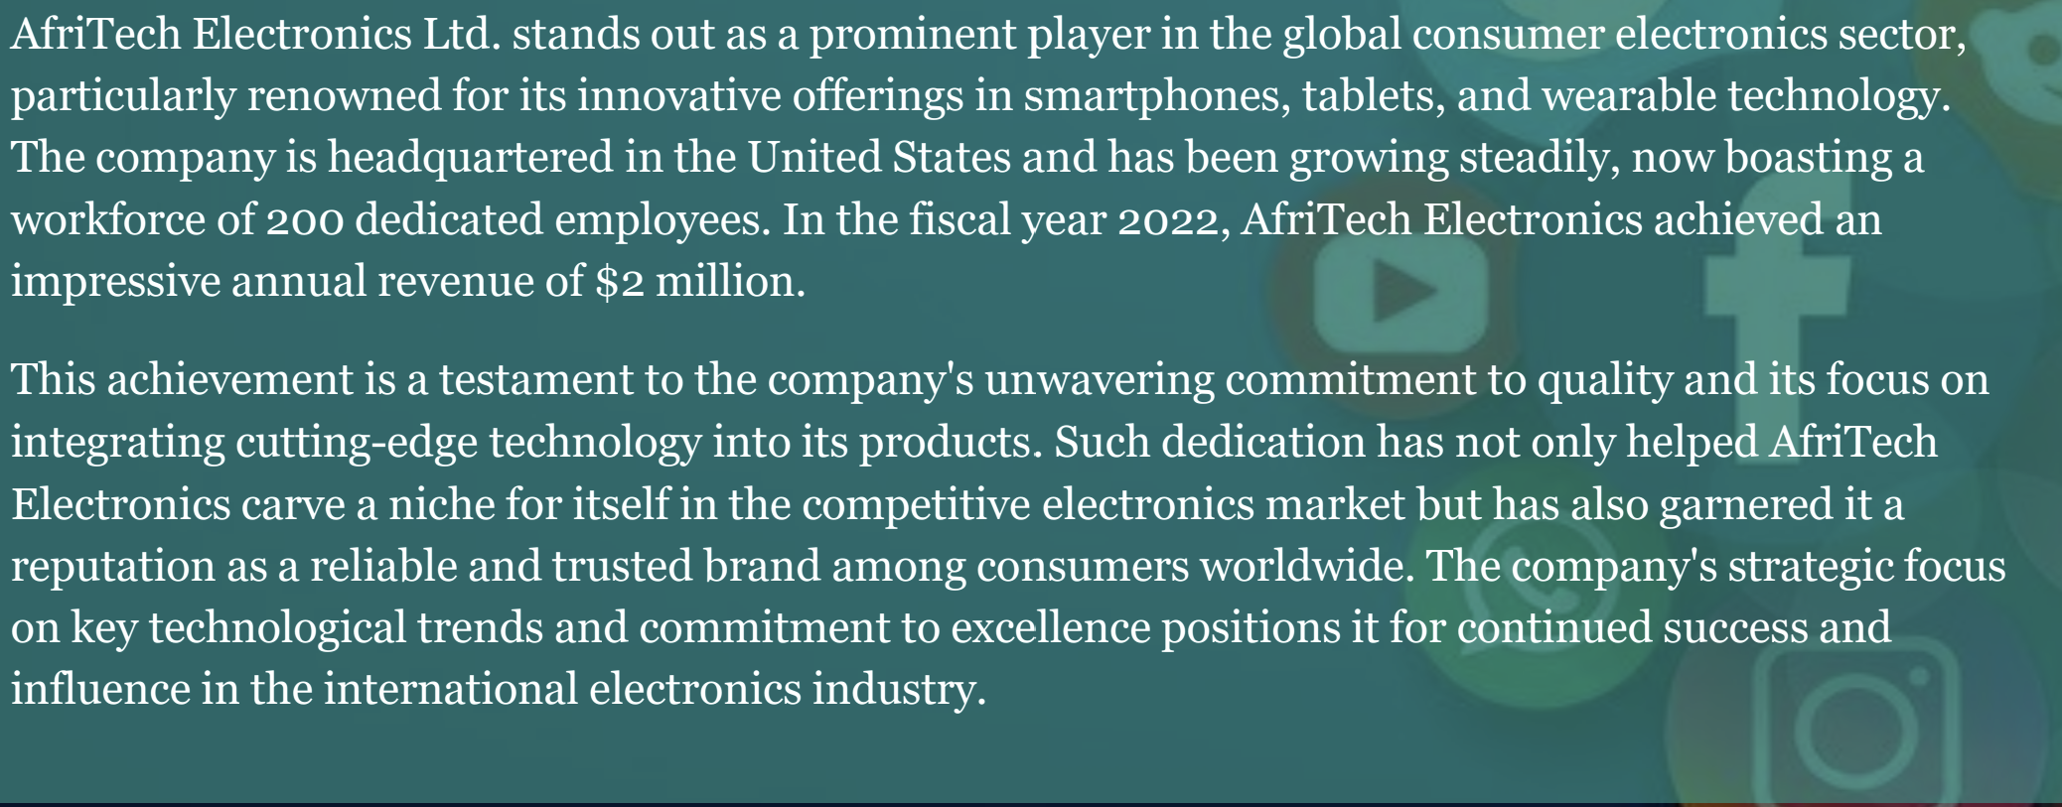
Introduction

Slide 4
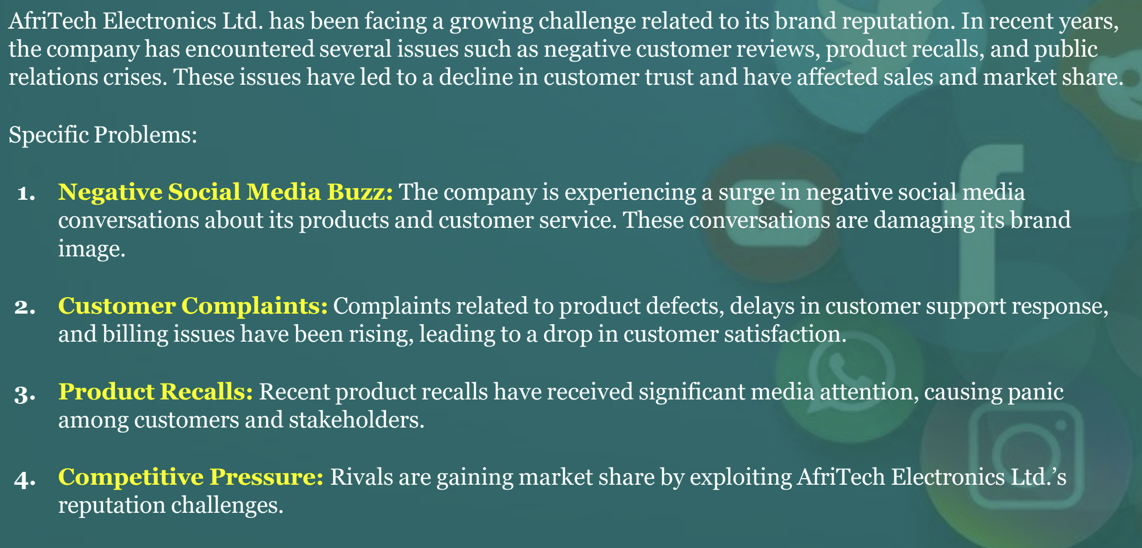
Business Problem

Slide 5
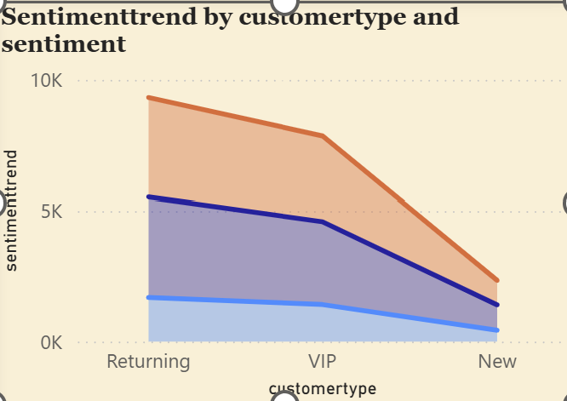
Sentimenttrend by Customertype and Sentiment

Slide 6
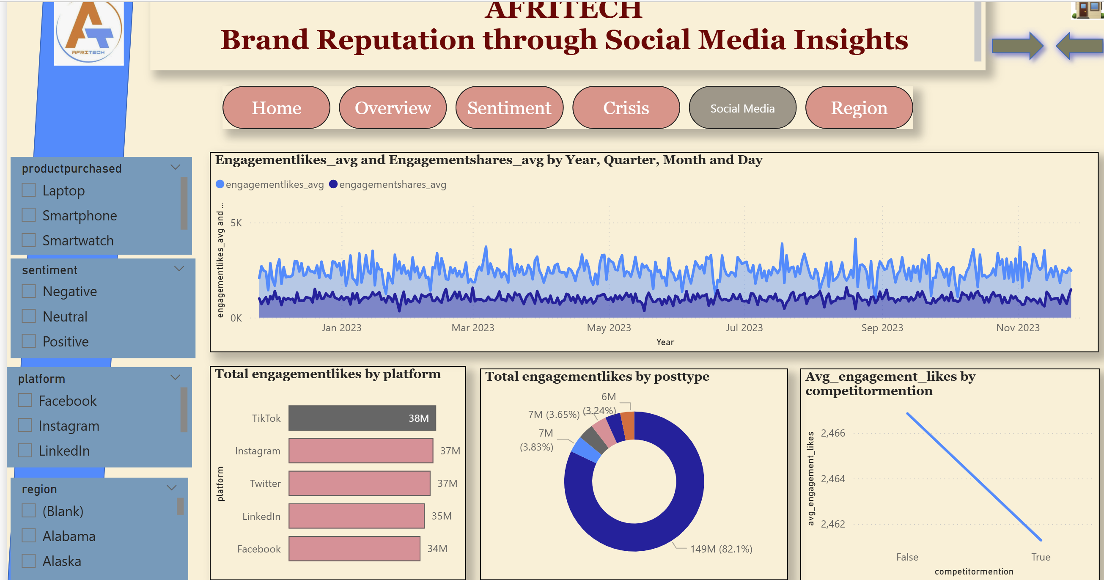

Slide 7
Social Media Challenges and Impact Brand Reputation
Challenges
Slow reaction to rapidly spreading complaints or negative content
Failure to capture brand mentions due to indirect tagging or spelling variations
Difficulty detecting early signs of negative sentiment or reputational risks
Impact on Brand
Negative public reactions may intensify before the brand has a chance to respond
The brand risks losing control of its public image and message
Perceived as out of touch with customer concerns and evolving market sentiment.

Slide 8
Crisis management Challenges and Impact Brand Reputation
Challenge | Consequence
Lack of a structured crisis response plan | Disorganized internal efforts and delayed reaction times
Absence of real-time alert systems | Issues intensify without timely intervention
Ineffective cross-team coordination | Inconsistent messaging that undermines public trust

Slide 9
Sentiment Challenges and Impact Brand Reputation
Risk | Impact
Misreading sarcasm/slang/emojis | False positivity or false alarms
One-size-fits-all language models | Ignoring platform tone (Twitter vs LinkedIn)
No sentiment trend tracking | Missed mood shifts before major issues arise

Slide 10
Recommendations
Deploy AI-based monitoring tools with NLP capabilities
Build a real-time dashboard for mentions, sentiment, and influencer spikes
Create a data-driven crisis response framework
Train ML models on brand-specific tone and language patterns

Slide 11
Summary of Steps-
Data Cleaning
Data Validation
Exploratory Data Analysis
Uploading Data in Database
Data Exploration in SQL
Loading of Data to PowerBI
Data Visualization
Creating DashBoard

Slide 12
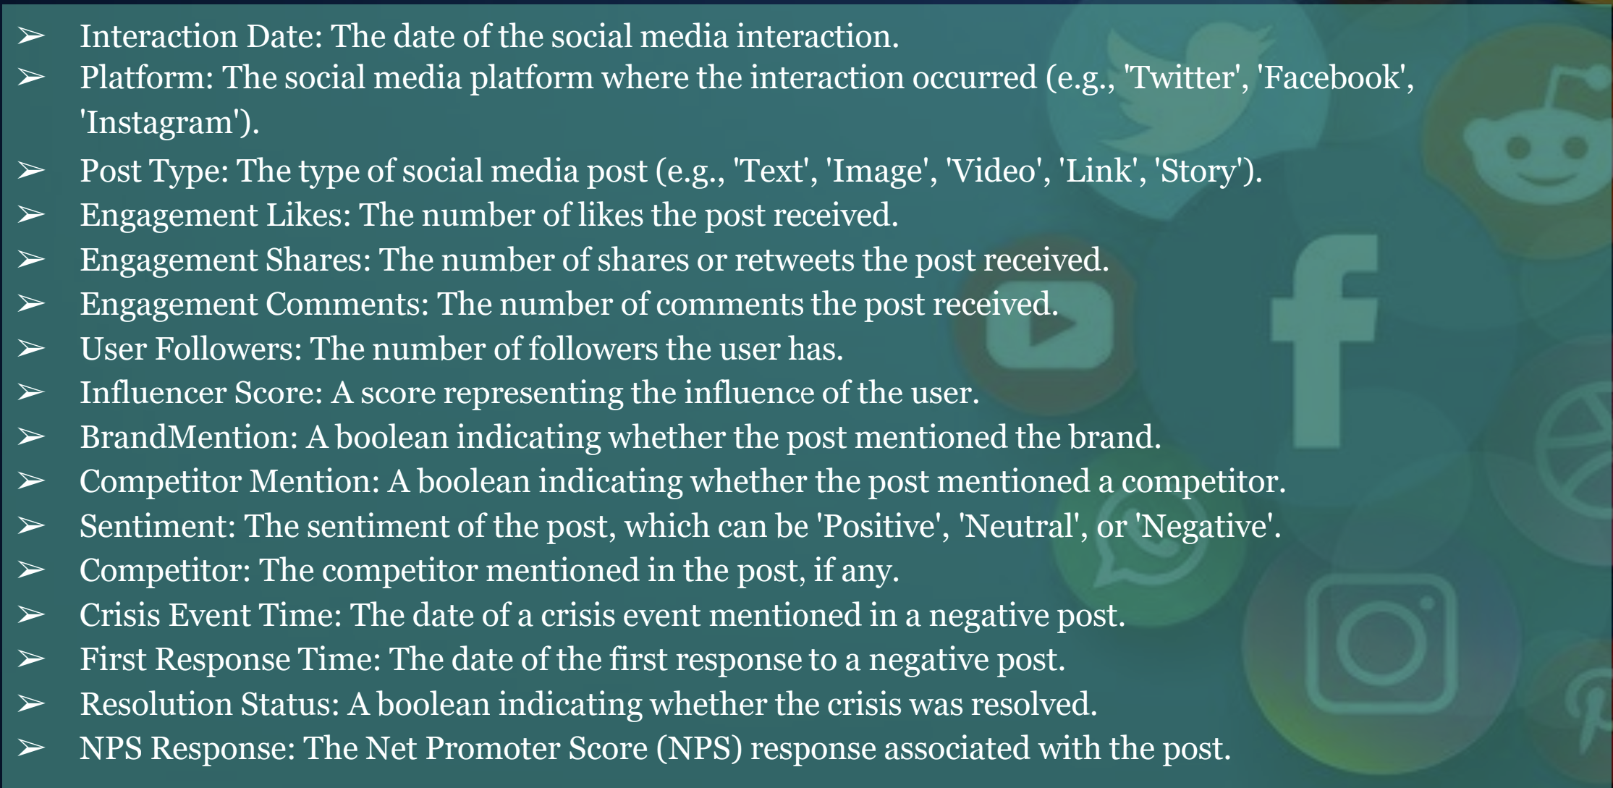
Data Dictionary

Slide 13
Conclusion
In today’s hyper-connected world, a brand’s reputation is largely influenced by online dialogue. Social media monitoring has evolved from a supportive function to a critical necessity. Detecting negative sentiment early, responding swiftly to public concerns, and engaging authentically with audiences empower brands to mitigate risks before they escalate.
Leveraging advanced technologies such as sentiment analysis, real-time monitoring systems, and well-structured crisis response protocols enables organizations to:
Strategically shape public perception
React quickly to emerging issues

Slide 14
Conclusion Contd--
Strengthen customer engagement and loyalty
Preserve brand integrity and trust in a competitive environment
Ultimately, investing in intelligent social media oversight is not merely a defense mechanism—it is a strategic asset for building sustainable brand equity.

Slide 15
Thank you…… By Faith Ejele

